Slide 1
Senior Design room scheduling calendar
a quick overview

Slide 2
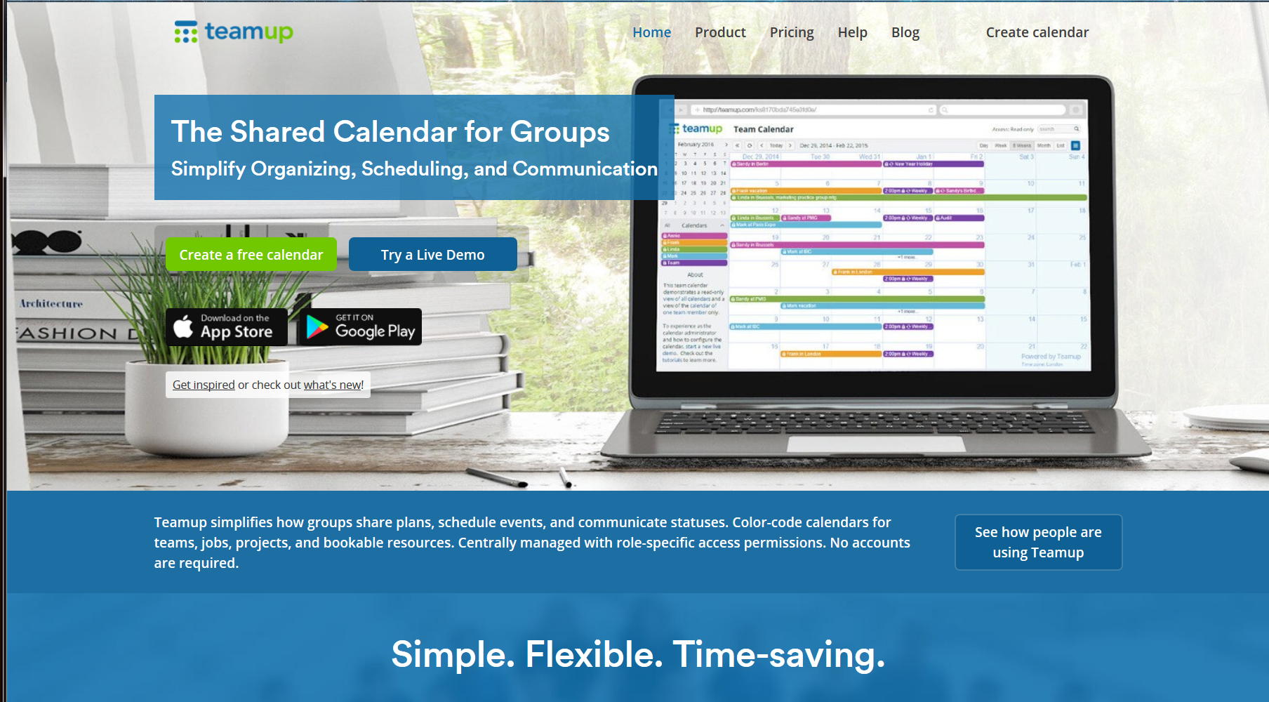
Teamup Shared Calendar https://www.teamup.com/

Slide 3
How to access the calendar
Each Advisor will be emailed a link for themselves and a link to pass along to their project team lead.
Each link is unique and will have the form:
https://teamup.com/ks2yqj8f7g5p32fpam
This is the link for the read-only viewing link. Pass this one on to anyone that needs to be able to check the schedule but not change it.
The Advisor links can only be used to reserve the two large A/V tech conference rooms - B10-B (Far Corner) and B10-C (Glassed-in).
If an advisor needs to change their teams table reservations they will have to use the team lead link.
The team lead links can only be used to reserve any of the tables in the senior design work areas in room ET-B10 (down in the basement) and ET-C245 (the old networking room).
Don't share these links - they identify your accounts on the calendar. Everyone can see who reserved which tables.
The system is set up so that reservations for a resource can not overlap.
Only the account that created a reservation can change it.

Slide 4
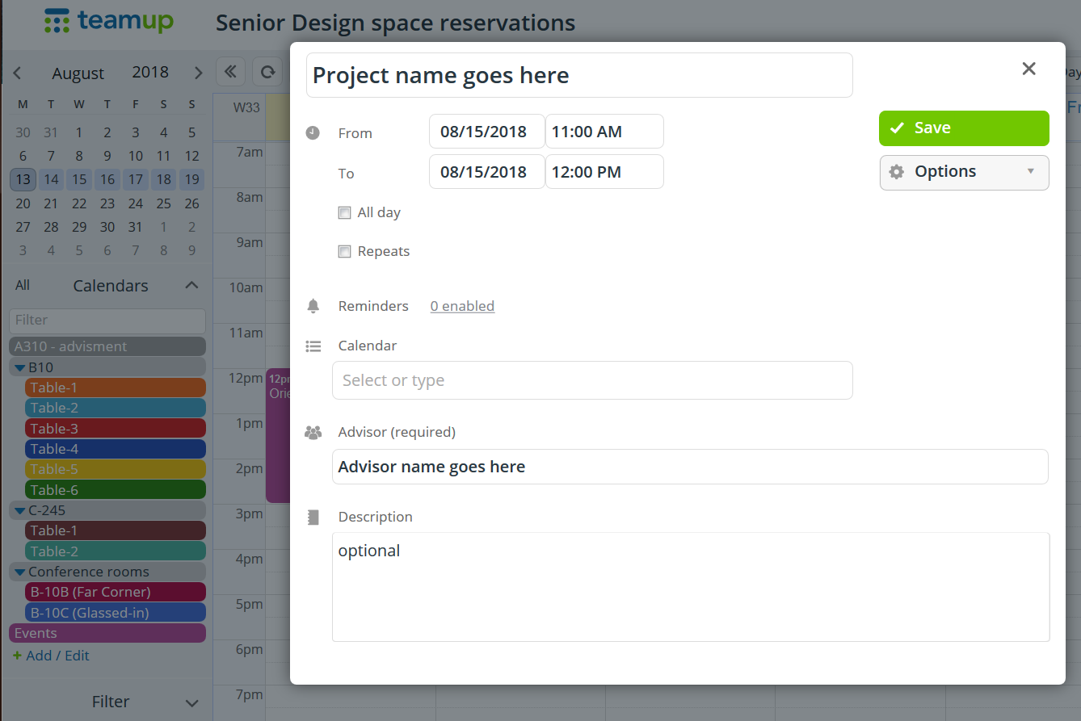
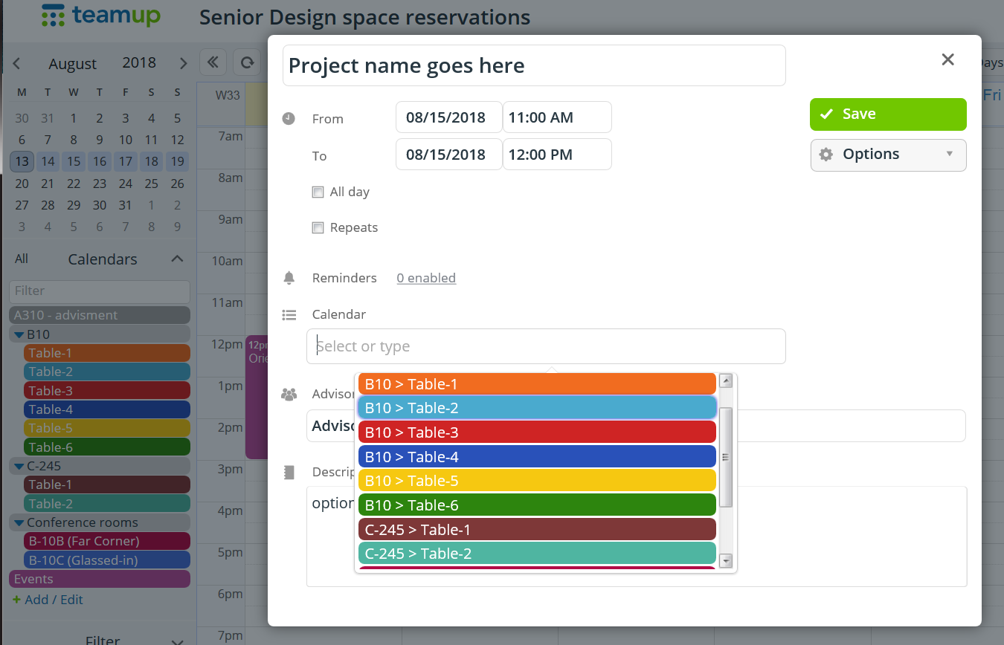
Reserving a table
Must include these two items
Tables and rooms each get their own 'calendar' selected from the drop down list
The process is almost identical to adding an event to Google Calendar.
When setting a reservation as a repeating event have it end by at most Dec 31.

Slide 5
If you are not using the table, change your reservation so that someone else can use it.
Occasionally we will be checking on table use. If you are not there when the table has been reserved for it may reflect on your team work evaluation.
Team work includes teams working together in an organization.
No eating in the B10 work area. When you need a break you can eat in the hallway that leads into B10.
Keep the rooms tidy. Straiten up the chairs when you are done.

Slide 6
and also ...
The conference rooms will be available with first priority for liaison teleconferences and second priority for liaison meetings.
There is also a calendar named 'Events'. This is a general purpose notification calendar. Any of the faculty can modify and overlap any of the Event items, including editing someone else's entries.

