Slide 1
Senior Design
How CS 4961 Works
Chengyu Sun
Department of Computer Science
California State University, Los Angeles

Slide 2
CS 4961
First half of CS 4961/4962 Senior Design sequence
Project Development + Writing Component

Slide 3
Project Development
Work on a real-world, sponsored project as a team
List of projects
For the most part, each team (students, faculty advisor, and sponsors) decides how to conduct their project

Slide 4
General Requirements
3 Lab Units = 9 Hours Per Week
1-2 hours weekly meeting with faculty advisor / project liaisons
Reserved time: 8:00-10:30am on Friday
2-3 hours group activity
4-6 hours individual work
This is NOT an online/hybrid class (i.e., in-person meetings are expected)

Slide 5
Class Meetings
First Class Meeting (8/26/2022) ✓
Kickoff Meeting (9/2/2022)
A special lecture on SRD, SDD, and Ethics (TBD)
Project Presentations (Usually on the Friday of Week 15)

Slide 6
Project Deliverables
Class
Software Requirements Document (SRD)
Preliminary Software Design Document (SDD)
Project Presentation
Project-specific

Slide 7
Writing Component
Why
So CS 4961/4962 meet GE requirements
Written communication is an important skill for your future career
What
See the Writing section on class website

Slide 8
Grading
Grades will be based on a number of factors including contribution to the project, teamwork, and performance in oral and written communication.
Each faculty advisor will decide the grading policy for their groups, and the grading policy will be explained to the students at the first group meeting of the semester.

Slide 9
Online Resources
Class website: https://csns.cysun.org/site/f22/cs4961-1
Project list: https://csns.cysun.org/department/cs/projects?year=2023

Slide 10
Using CSNS
Make sure you can log in
Make sure you have the right email address in CSNS
Profile → Edit to change
Check the class website every Monday for new course materials (announcements, writing assignments etc.)

Slide 11
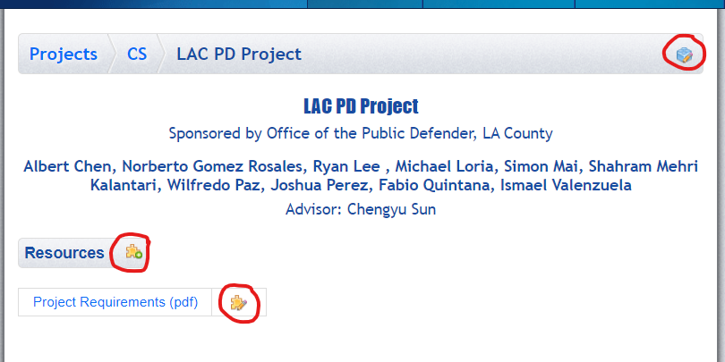
Manager Your Project Page

Slide 12
Meeting Rooms …
Available 8-10:30am Every Friday
Room | Project Advisor
ET A331 | Manveen Kaur
ET A332 | Zilong Ye
ET A309 | Jungsoo Lim
ET A220 | Chengyu Sun
KH LH1 | Huiping Guo

Slide 13
… Meeting Rooms
Available 9-10:30am Every Friday
Room | Project Advisor
ET B108 | John Hurley
ET C154 | Weronika Cwir
ET C255D | Navid Amini
ET C255E | Richard Cross
ET C255G | David Krum
ET C256 | Yuqing Zhu

Slide 14
Additional Meeting Space
ET B10 common area (up to two teams)
ET B10-B conference room
ET B10-C conference room
(Reservation method TBA)

Slide 15
Contacts
Your faculty advisor for project-related questions
Prof. Joshua Adachi (jadachi2@ad.calstatela.edu) for writing-related questions
Dr. Chengyu Sun (csun@calstatela.edu) for class-related questions
Dr. Elaine Kang (eykang@calstatela.edu) for all other questions

