Slide 1
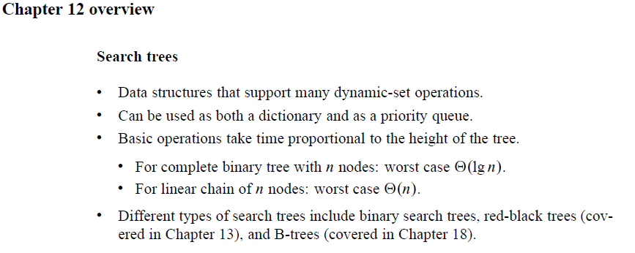
Chapter 12: Binary Search Trees

Slide 2
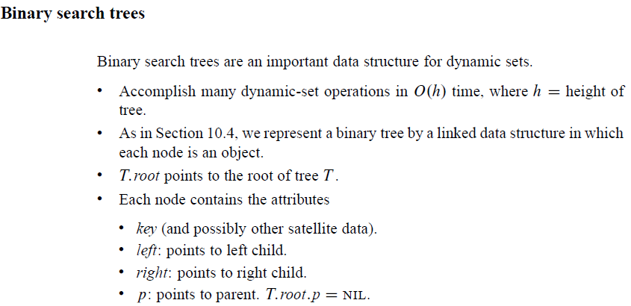
Binary Search Trees

Slide 3
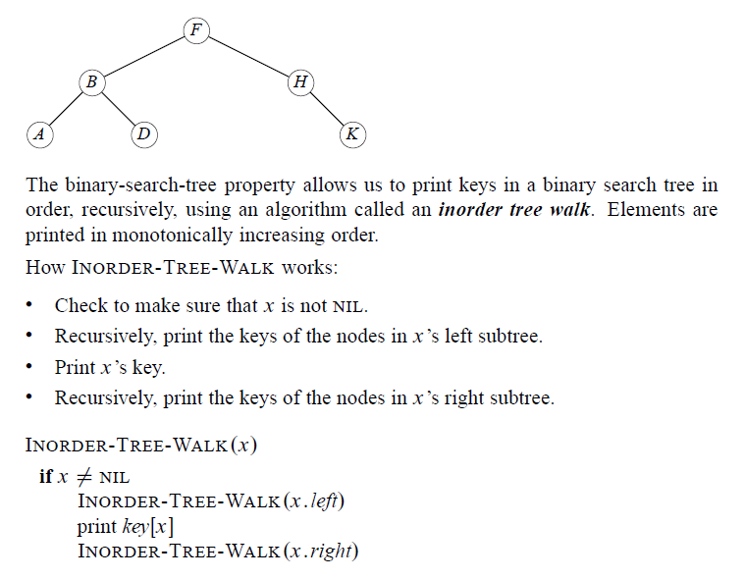
Binary Search Trees

Slide 4
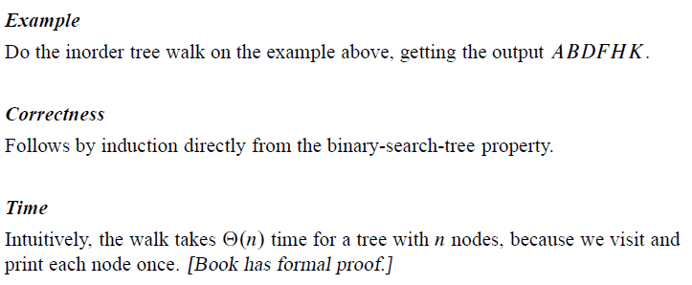
Binary Search Trees

Slide 5
Binary Search Trees

Slide 6
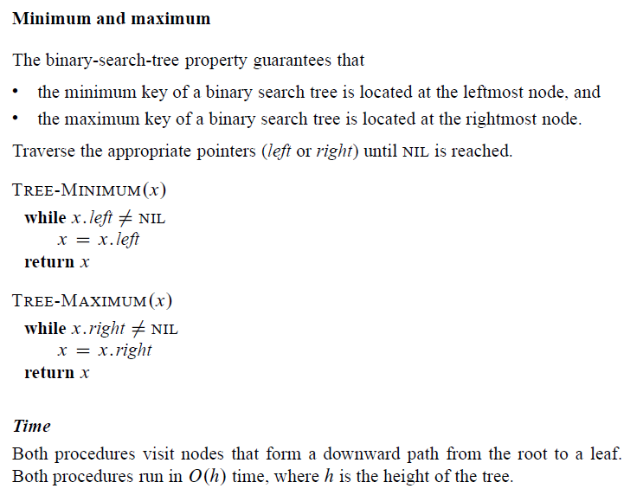
Binary Search Trees

Slide 7
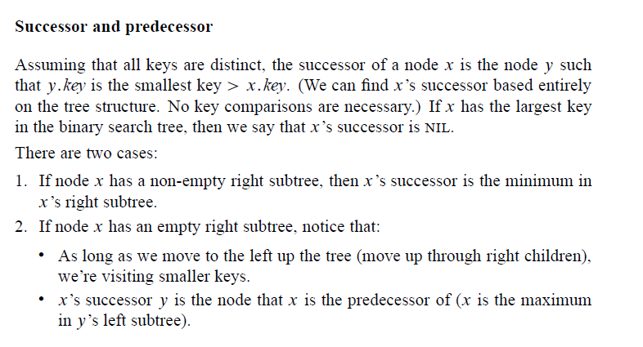
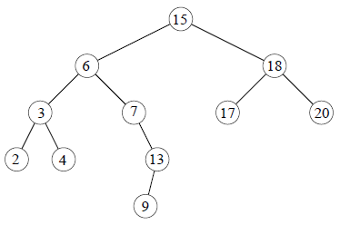
Binary Search Trees

Slide 8
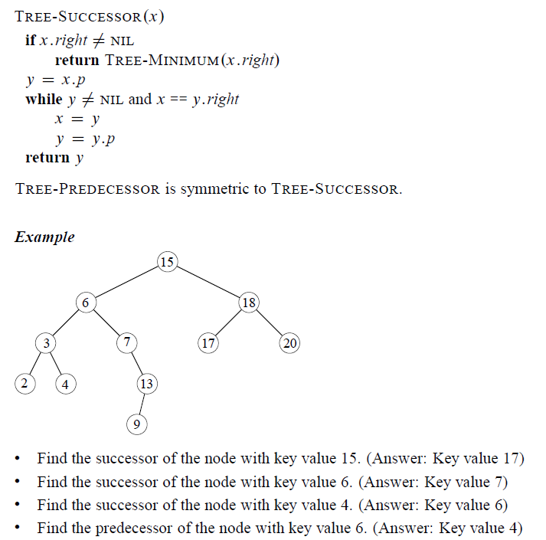
Binary Search Trees

Slide 9
Binary Search Trees

Slide 10
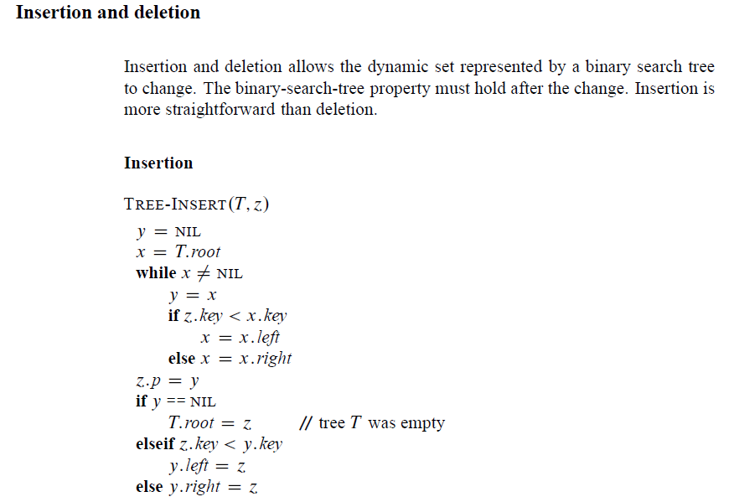
Binary Search Trees

Slide 11
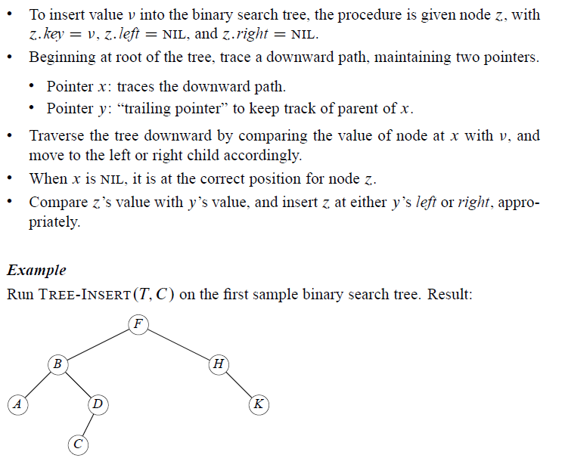
Binary Search Trees

Slide 12
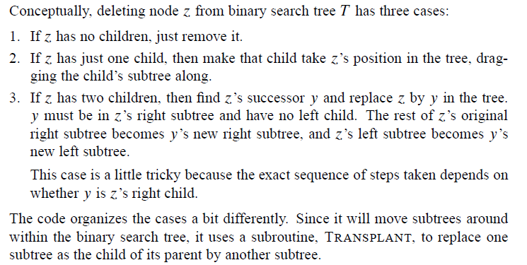
Binary Search Trees

Slide 13
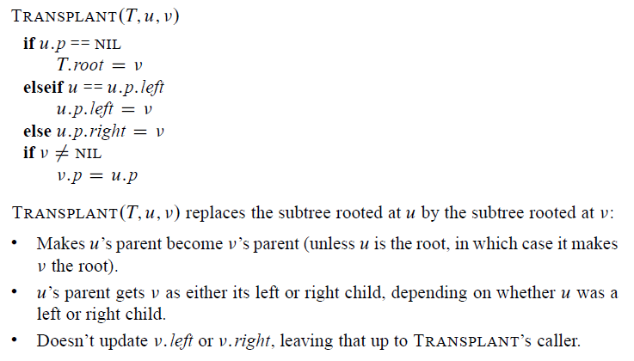
Binary Search Trees

Slide 14
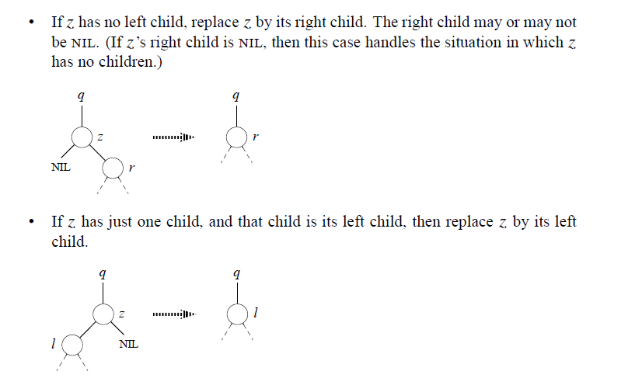
Binary Search Trees

Slide 15
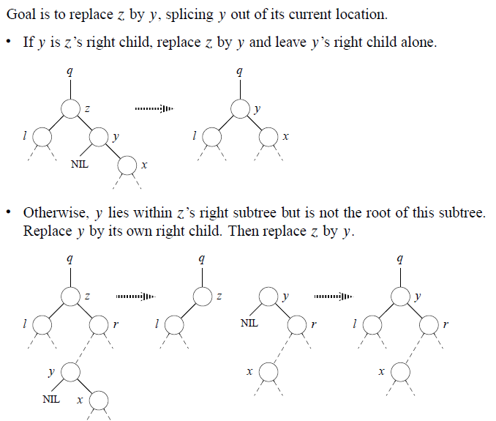
Binary Search Trees
Otherwise z has two children. Find z’s successor y. y must lie in z’s right subtree and have no left child (Exercise 12.2-5).

Slide 16
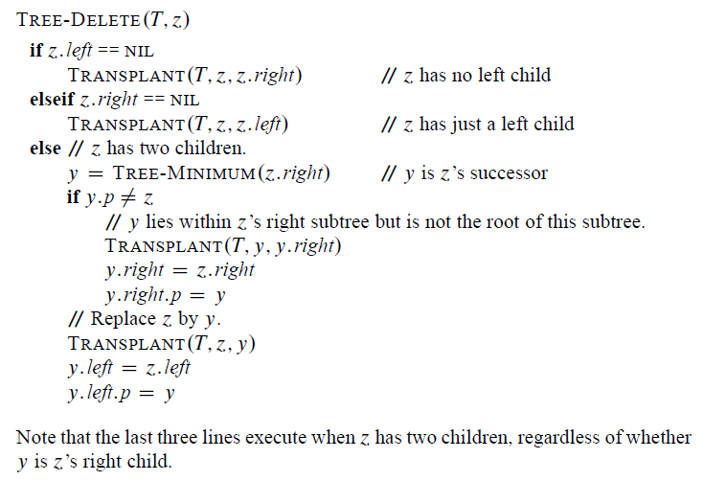
Binary Search Trees

Slide 17
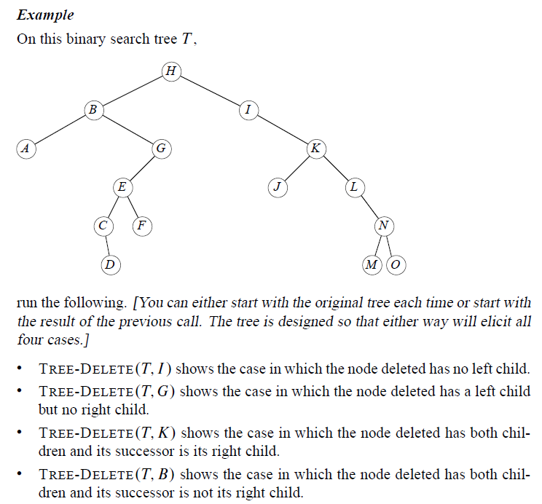
Binary Search Trees

Slide 18
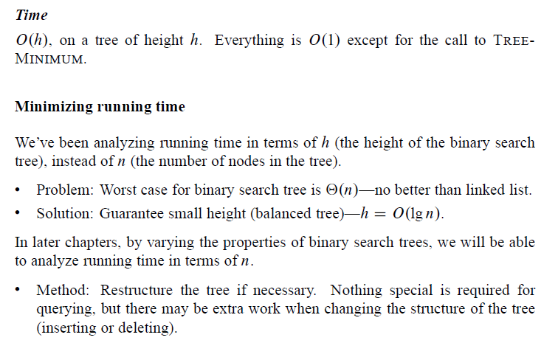
Binary Search Trees

