Slide 1
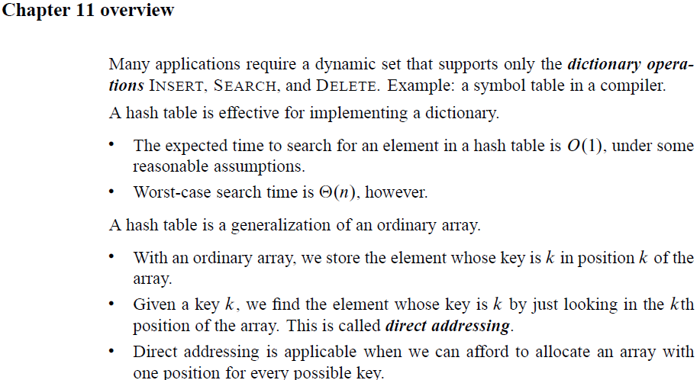
Chapter 11: Hash Tables

Slide 2
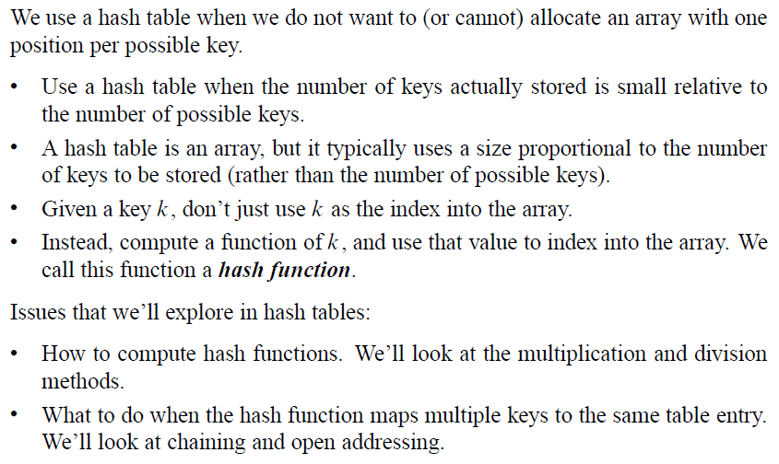
Hash Tables

Slide 3
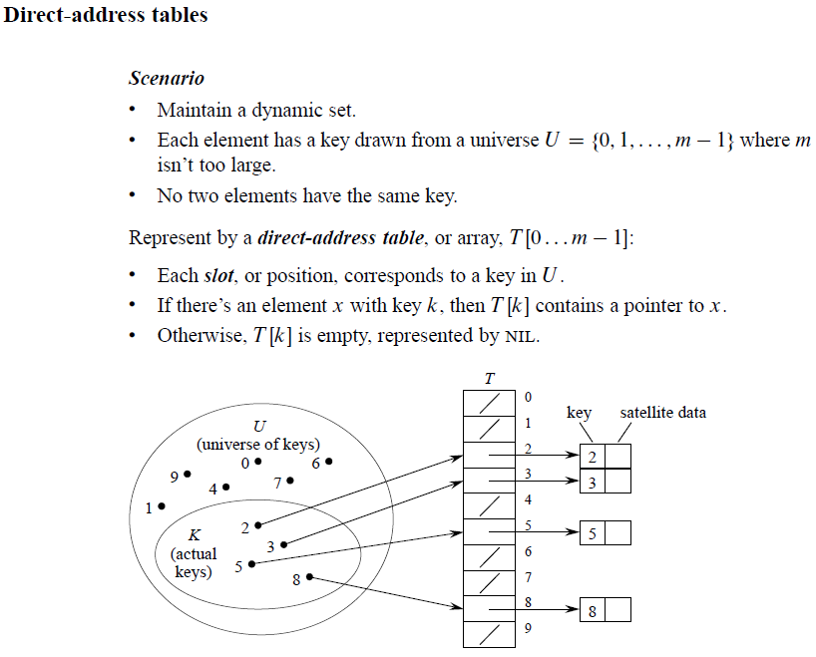
Direct Address Tables

Slide 4
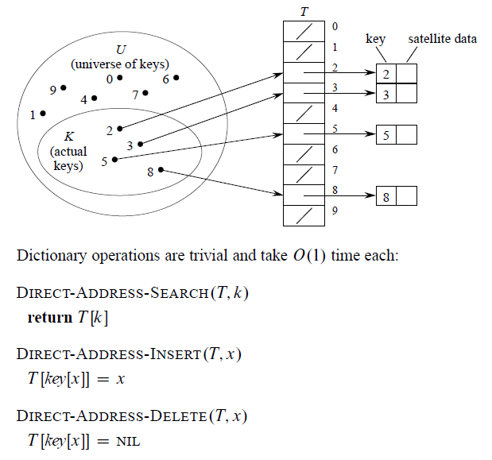
Direct Address Tables

Slide 5
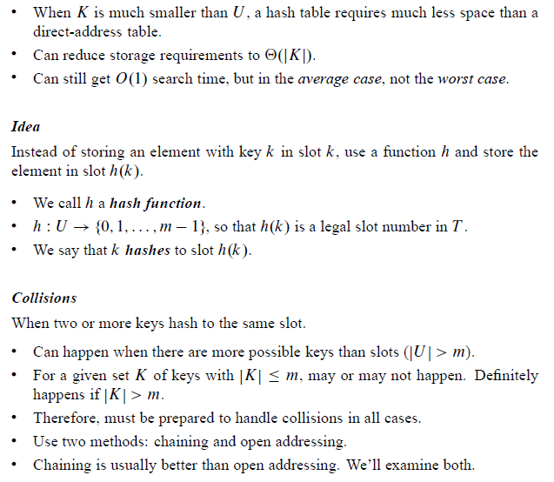
Hash Tables

Slide 6
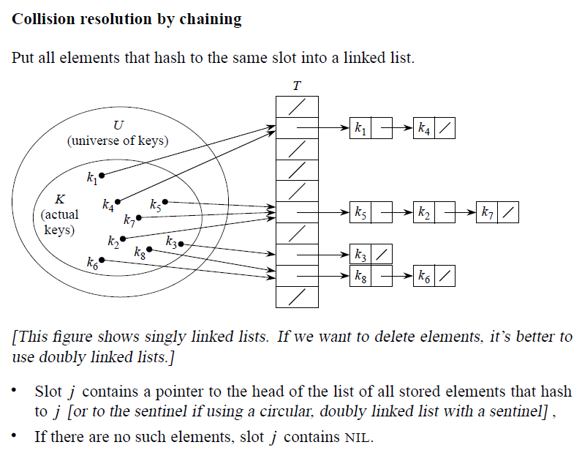
Hashing with Chaining

Slide 7
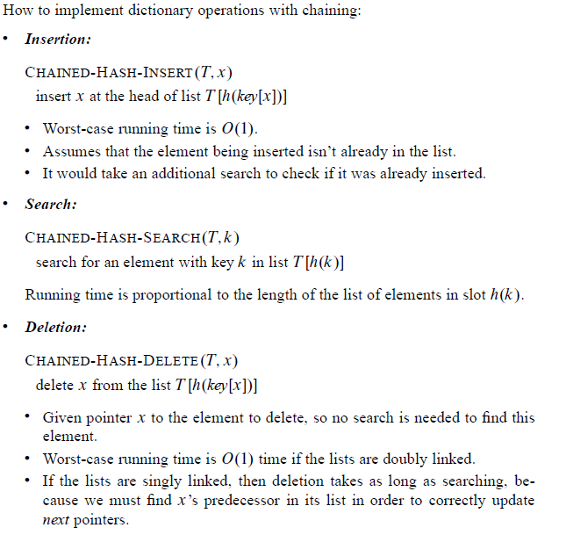
Hashing with Chaining

Slide 8
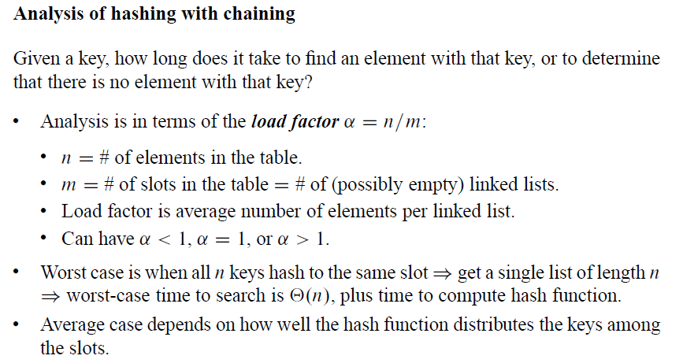
Hashing with Chaining

Slide 9
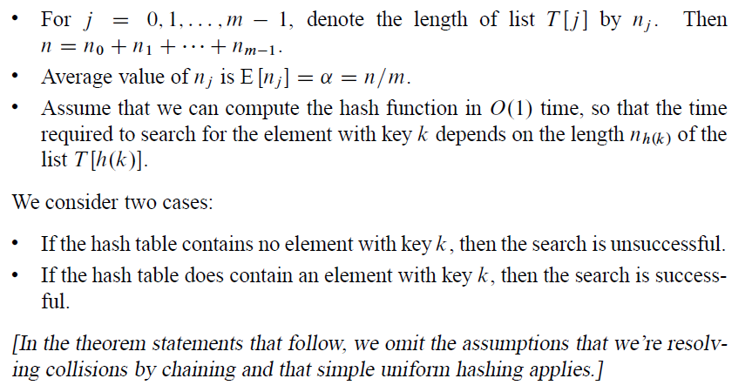
Hashing with Chaining

Slide 10
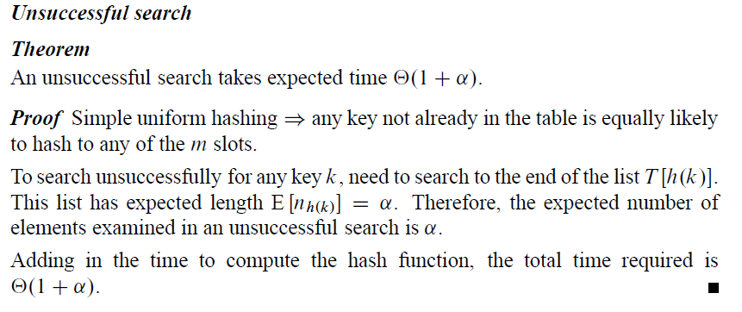
Hashing with Chaining

Slide 11
Hashing with Chaining
Proof is not covered in CS312.

Slide 12
Hash Functions

Slide 13
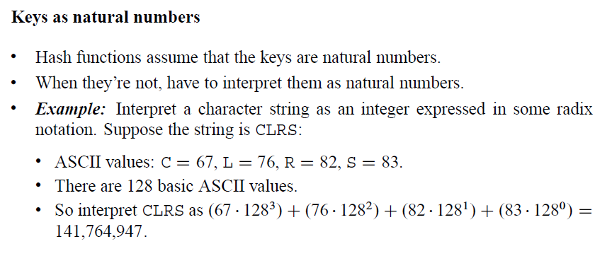
Hash Functions

Slide 14
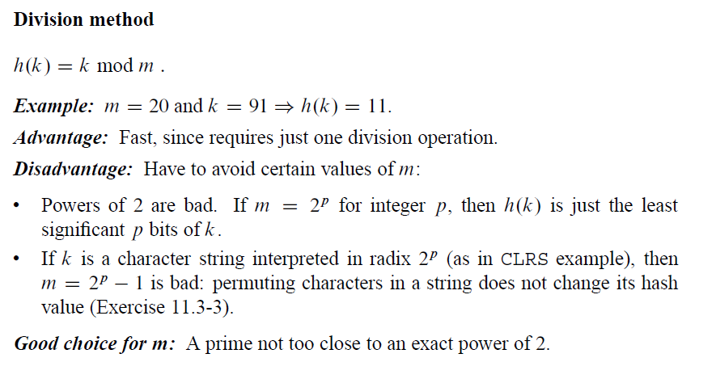
Hash Functions: Division Method

Slide 15
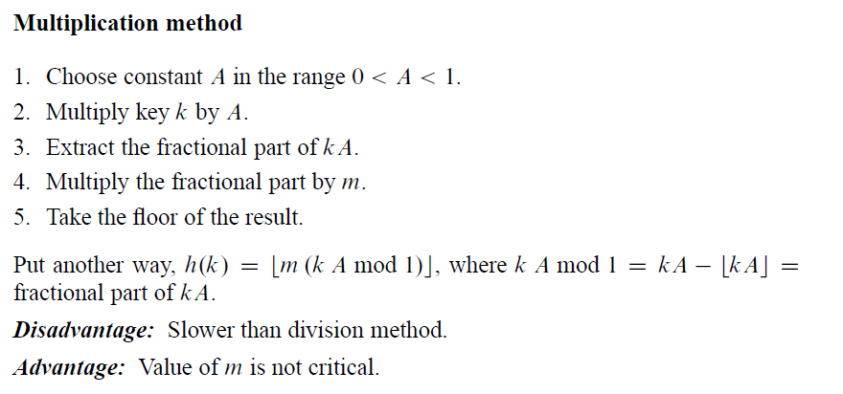
Hash Functions: Multiplication Method

Slide 16
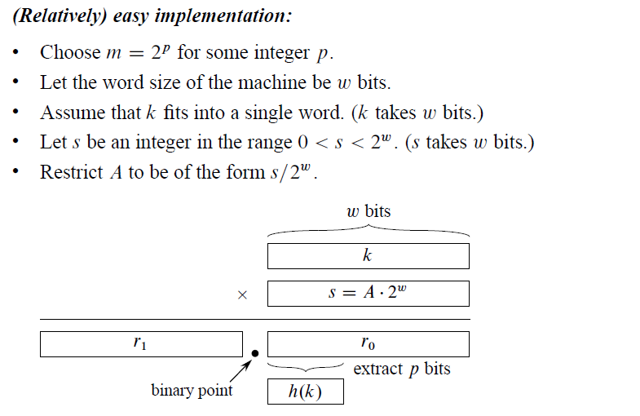
Hash Functions: Multiplication Method

Slide 17
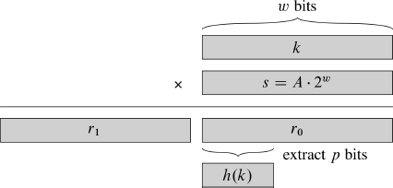
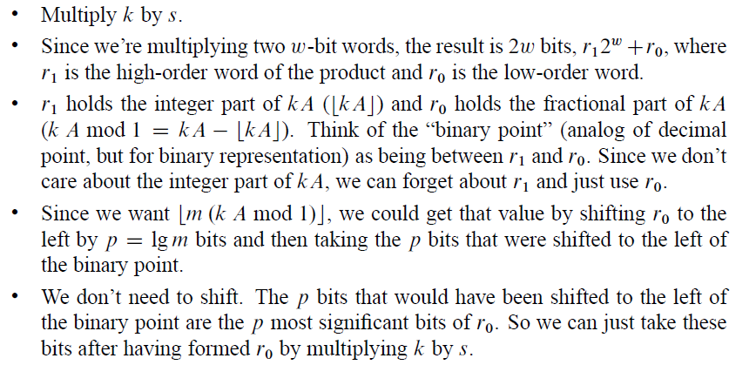
Hash Functions: Multiplication Method
$$m=2^{p}$$
$$0<s<2^{w}$$
$$A=\frac{s}{2^{w}}$$

Slide 18
Hash Functions: Multiplication Method

Slide 19
Hash Tables: Open Addressing

Slide 20
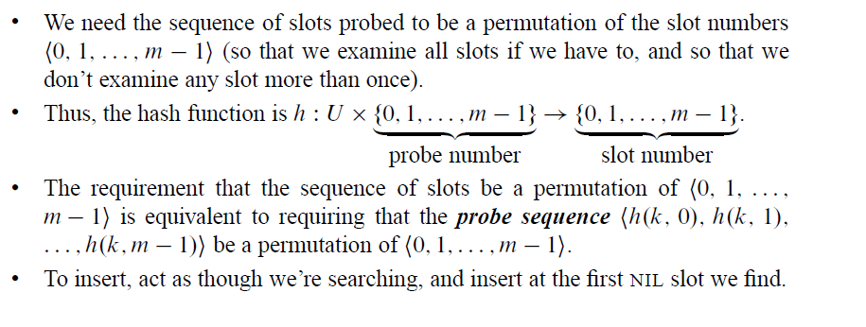
Hash Tables: Open Addressing

Slide 21
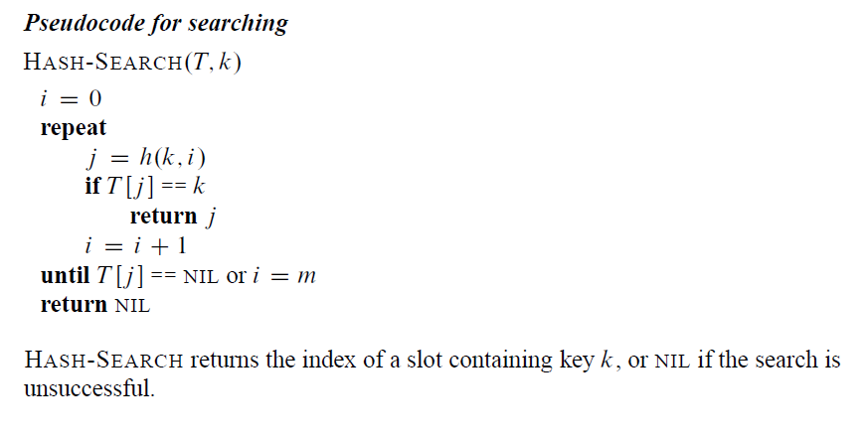
Hash Tables: Open Addressing

Slide 22
Hash Tables: Open Addressing
// It is a number between 0 and m-1

Slide 23
Hash Tables: Open Addressing

Slide 24
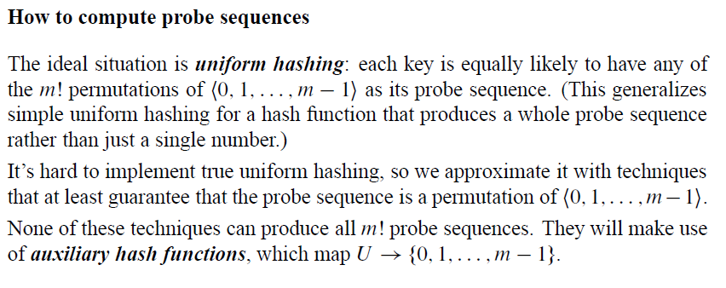
Hash Tables: Open Addressing

Slide 25
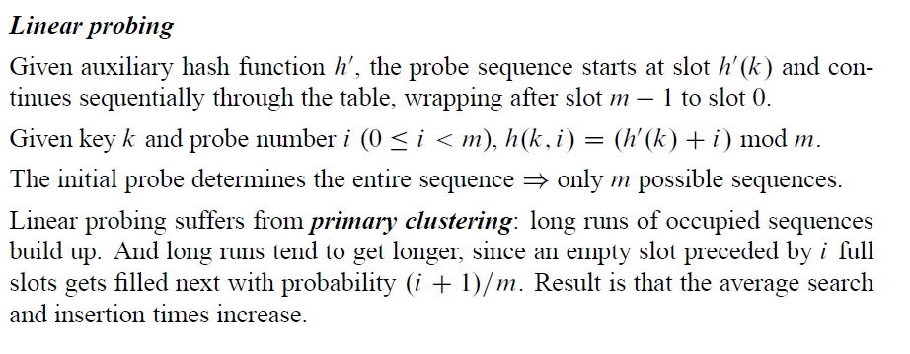
Hash Tables: Open Addressing

Slide 26
Hash Tables: Open Addressing

Slide 27
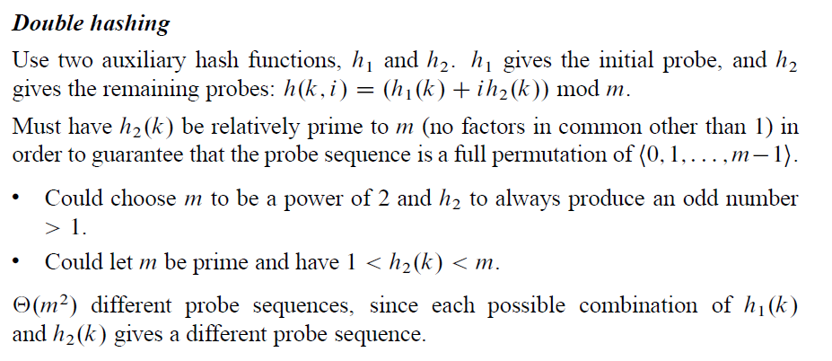
Hash Tables: Open Addressing
Example: Hash table size 13 with h₁(k)= k mod 13 and h₂(k)= 1+(k mod 11)
Consider k = 14. h₁(14) = 1 and h₂(14) =4.
Therefore, we probe 1, 5, 9, …

Slide 28
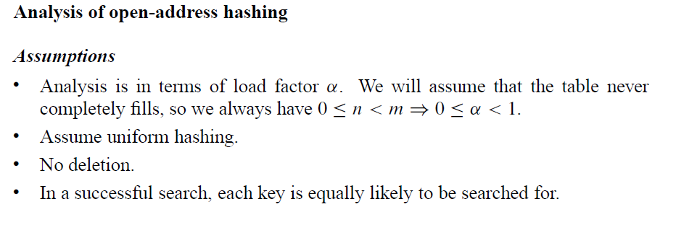
Hash Tables: Open Addressing

Slide 29
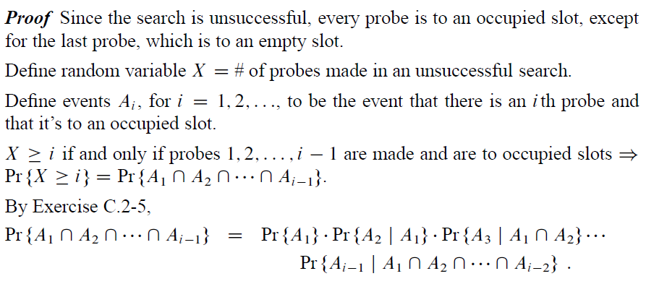
Hash Tables: Open Addressing

Slide 30
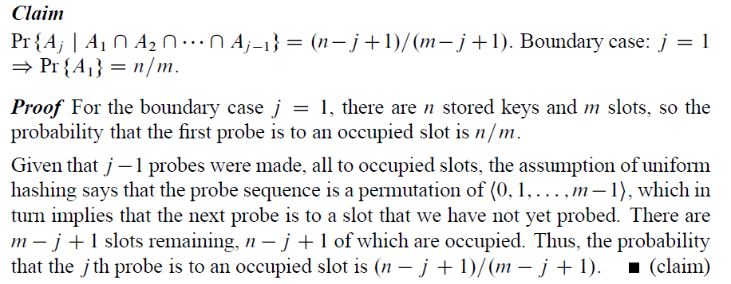
Hash Tables: Open Addressing

Slide 31
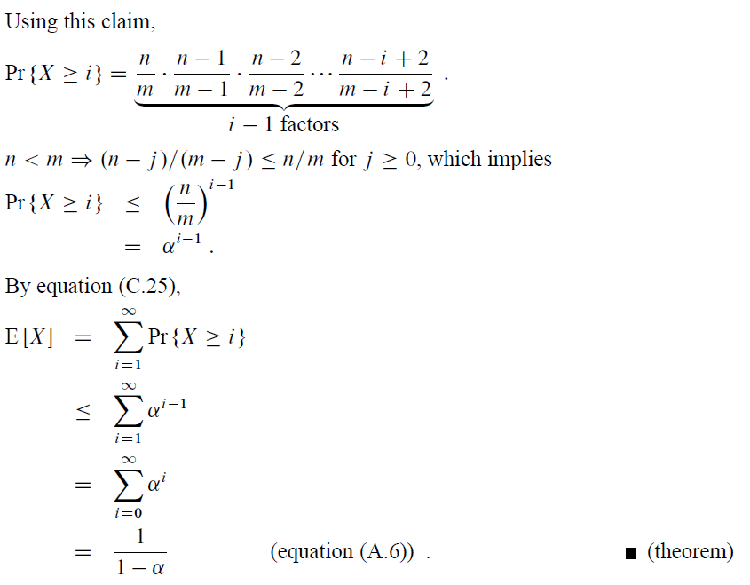
Hash Tables: Open Addressing

Slide 32
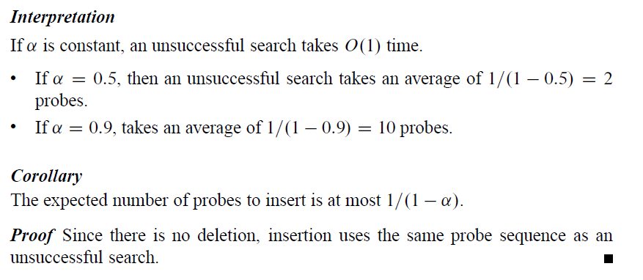
Hash Tables: Open Addressing
Proof: not covered in CS312

Slide 33
