Slide 1
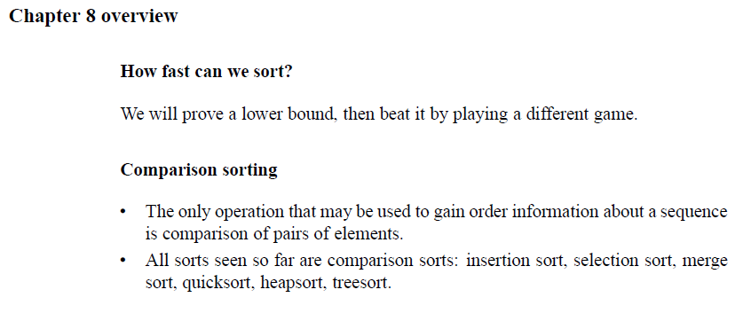
Chapter 8: Sorting in Linear Time

Slide 2
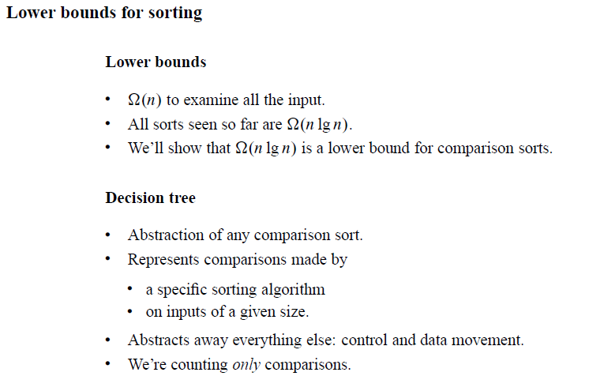
Comparison Sorts

Slide 3
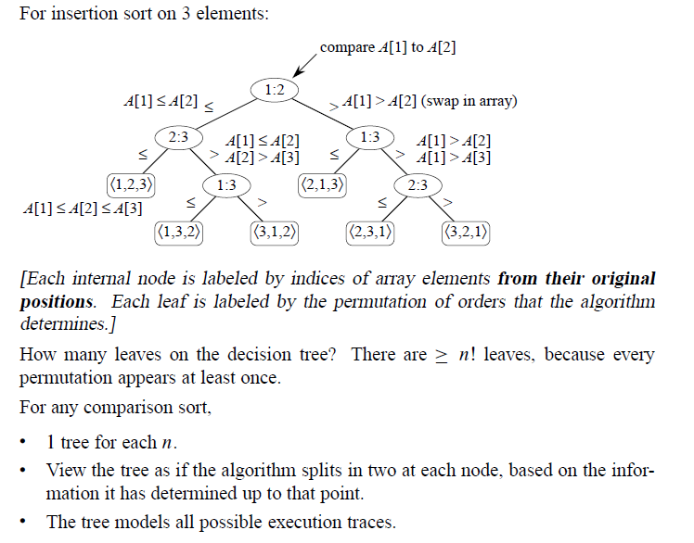
Comparison Sorts

Slide 4
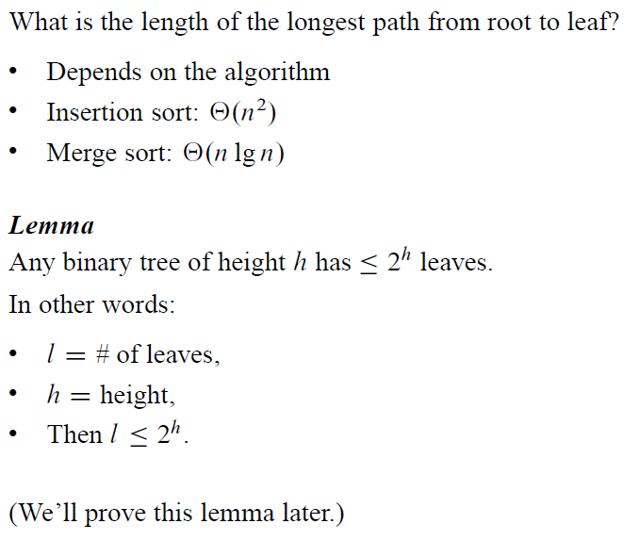
Comparison Sorts

Slide 5
Comparison Sorts
Using equation 3.19: $\lg\left(n!\right)=Θ(nlgn)$ we have
$$h≥\lg\left(n!\right)$$
$$=Θ(nlgn)$$
Therefore,
$$h=Ω(nlgn)$$

Slide 6
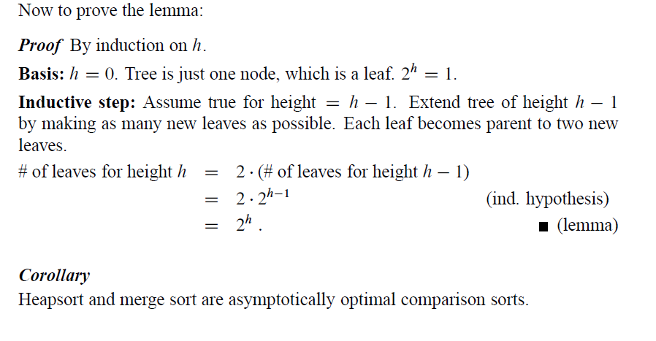
Comparison Sorts

Slide 7
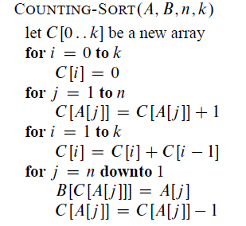
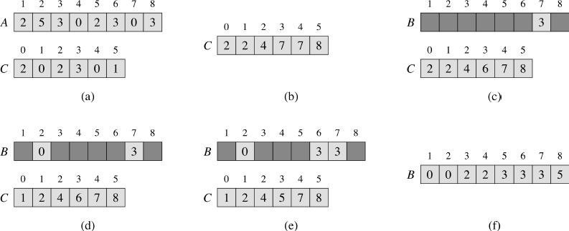
Linear Time sorting: Counting Sort
Note: Counting sort is stable (keys with same value appear in same order in output as
they did in input) because of how the last loop works.

Slide 8
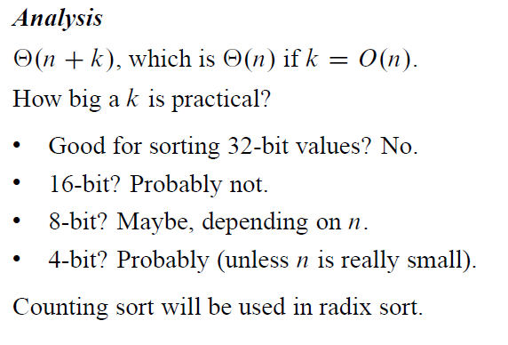
Counting Sort

Slide 9
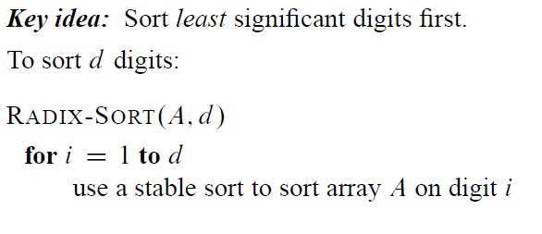
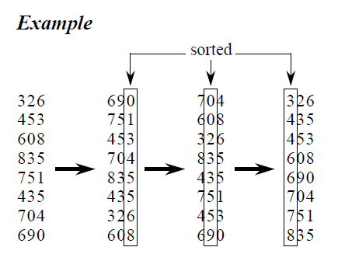
Radix Sort

Slide 10
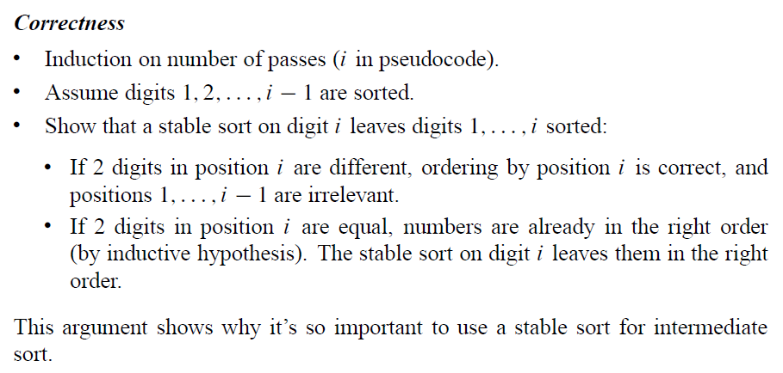
Radix Sort

Slide 11
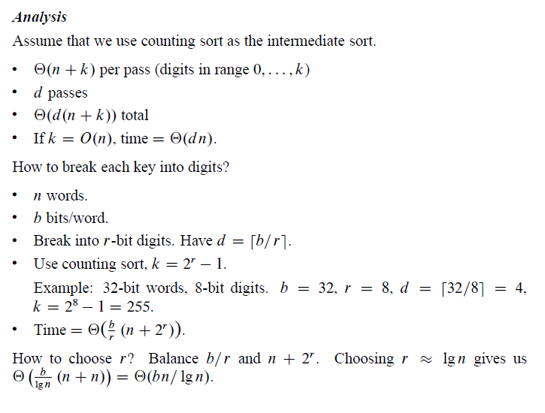
Radix Sort

Slide 12
Radix Sort

Slide 13
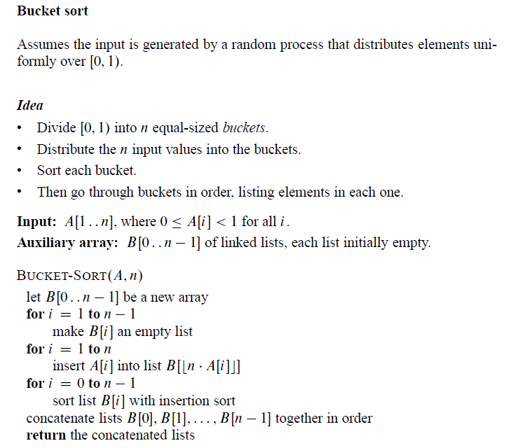
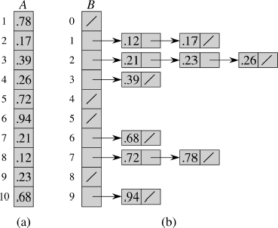
Bucket Sort
Should be i = 0 to n-1

Slide 14
Bucket Sort

Slide 15
Bucket Sort

Slide 16
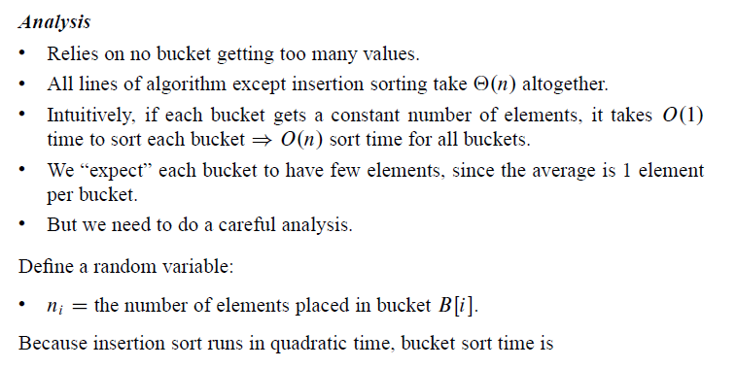
Bucket Sort

Slide 17
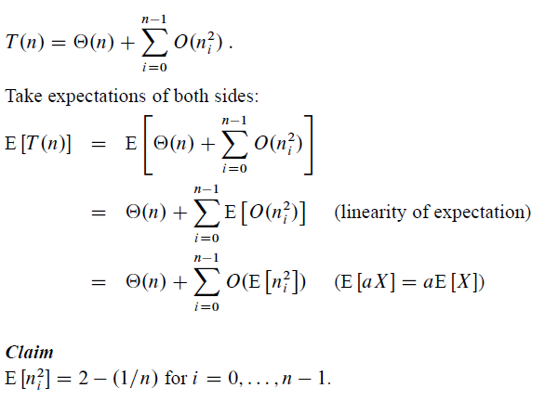
Bucket Sort
Note: We are not covering the formal proof of this claim in CS312

Slide 18
Bucket Sort

