Slide 1
Chapter 7: Quicksort

Slide 2
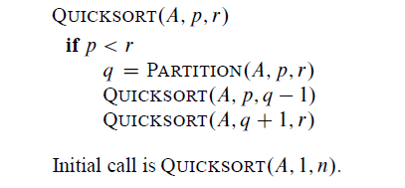
Quicksort

Slide 3
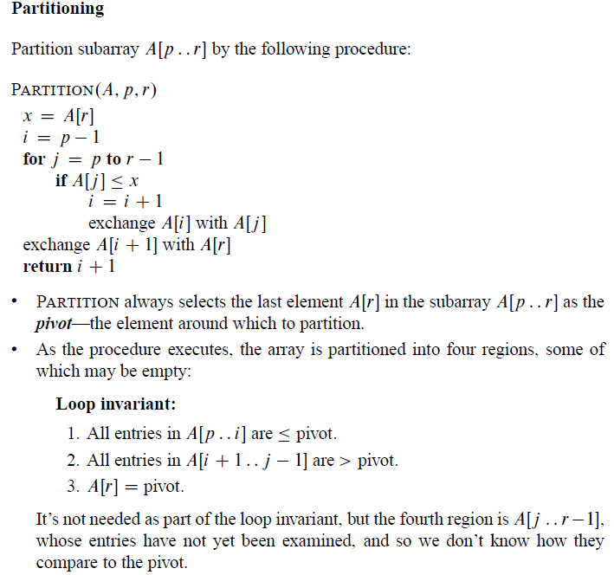
Partitioning

Slide 4
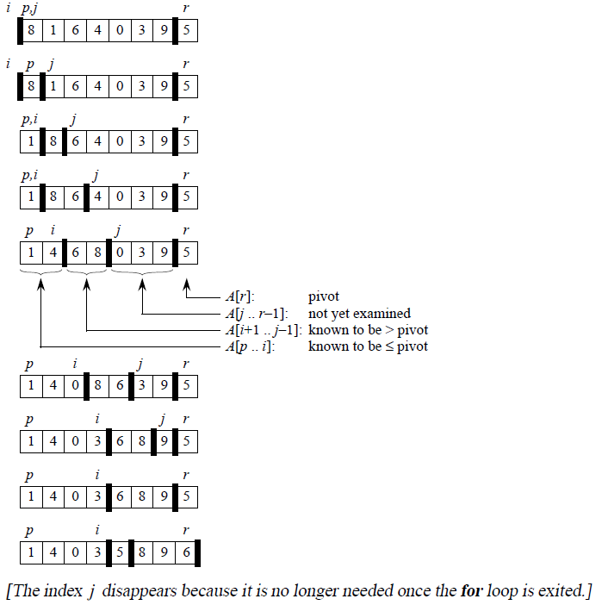
Partitioning Example

Slide 5
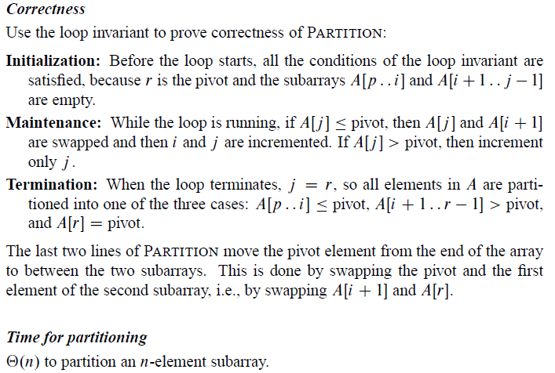
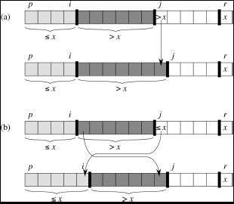
Partitioning

Slide 6
Quicksort

Slide 7
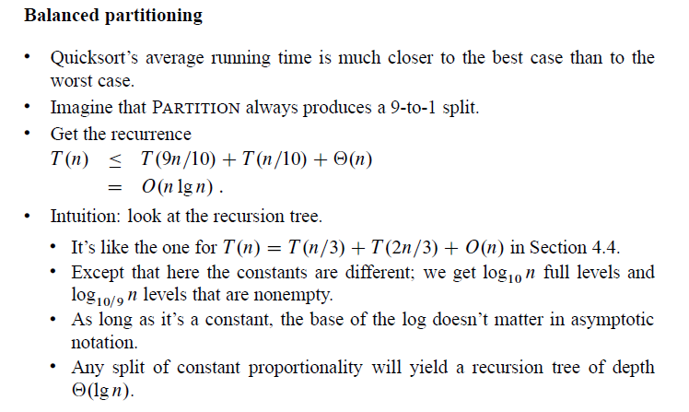
Quicksort

Slide 8
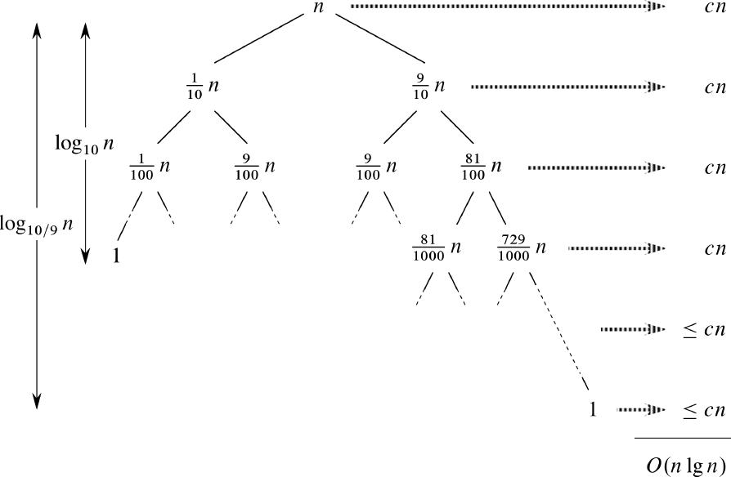
Quicksort

Slide 9
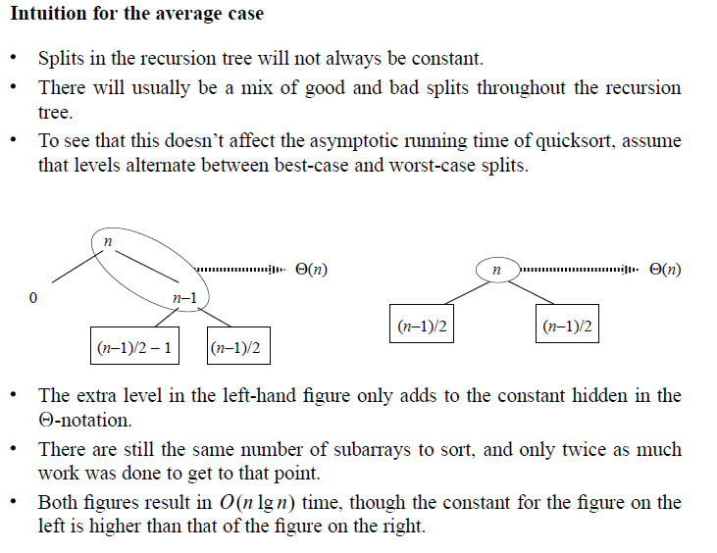
Quicksort

Slide 10
Randomized Quicksort

Slide 11
Randomized Quicksort

Slide 12
