Slide 1
Chapter 6:Heapsort

Slide 2
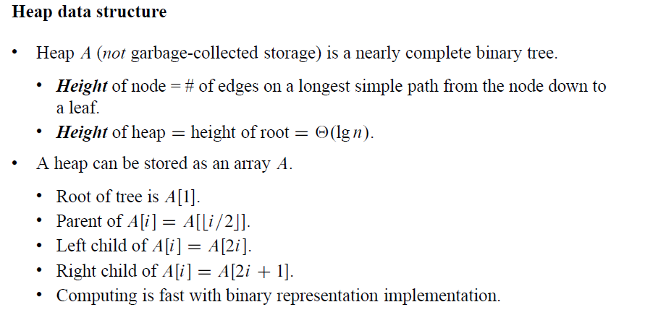
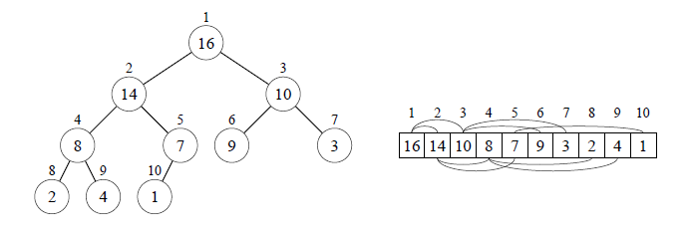
Heapsort

Slide 3
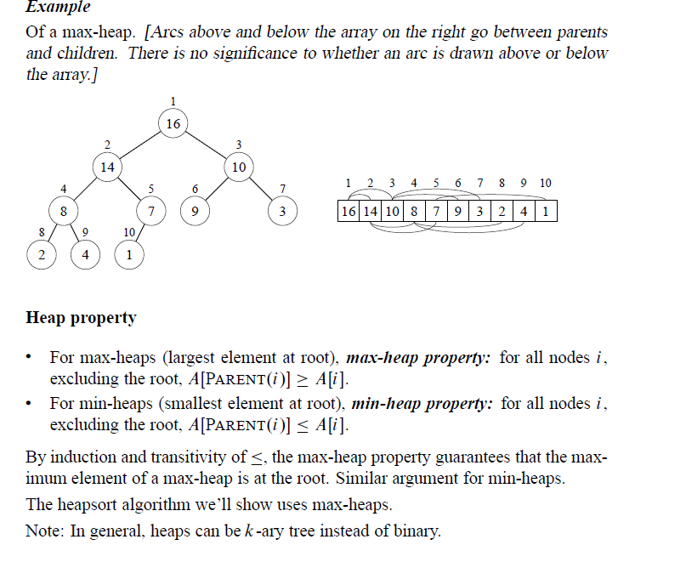
Heapsort

Slide 4
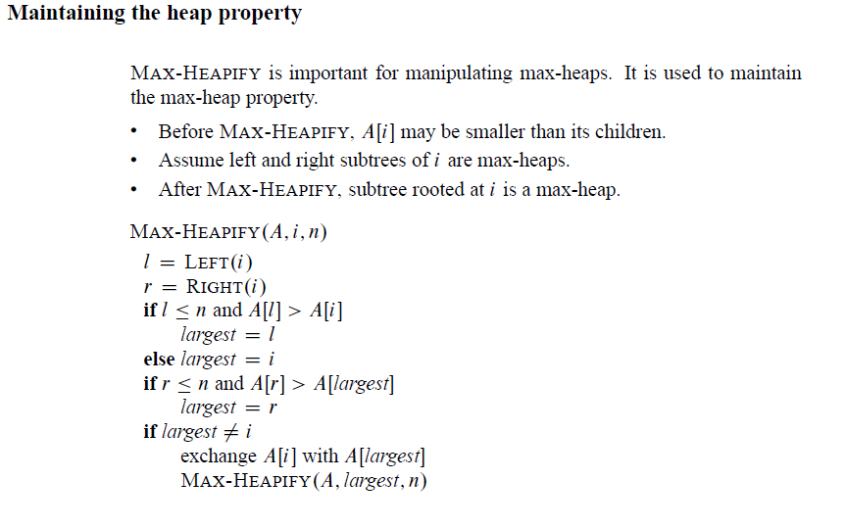
Heapsort

Slide 5
Heapsort

Slide 6
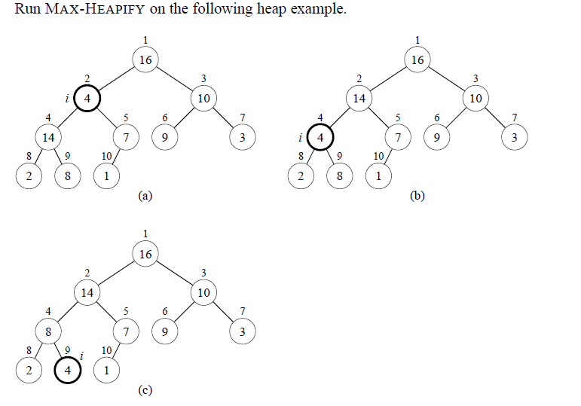
Heapsort

Slide 7
Heapsort
Time
O(lg n)
Intuitive Analysis
Heap is almost-complete binary tree, hence must process O(lg n) levels,
with constant work at each level (comparing 3 items and maybe swapping 2).
For more formal analysis see your book using recurrence and Master method.

Slide 8
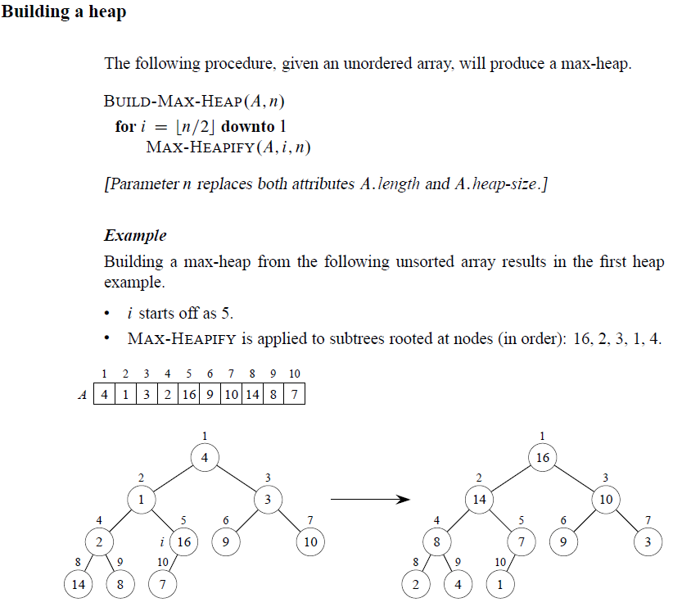
Build-Max-Heap
See next page for detail.

Slide 9
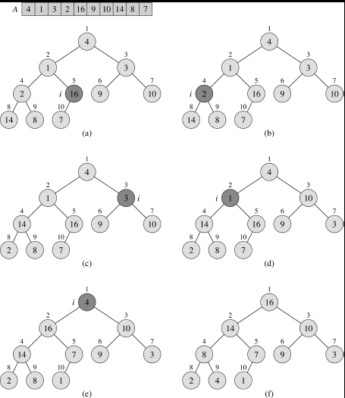
Build-Max-Heap
The Operation of BUILD_MAX_HEAP

Slide 10
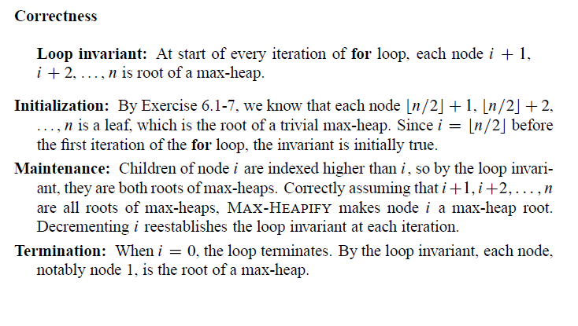
Build-Max-Heap

Slide 11
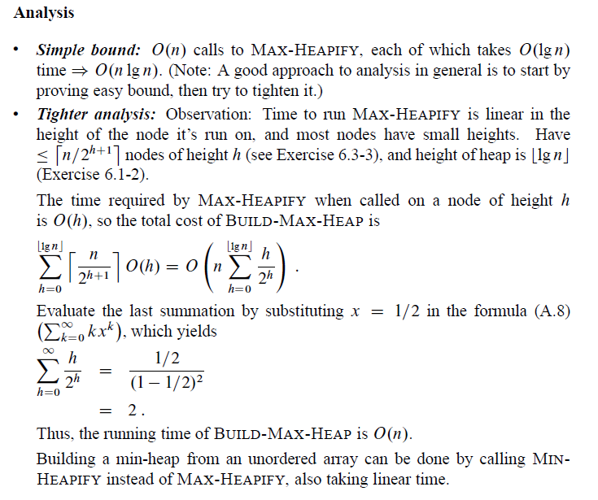
Build-Max-Heap

Slide 12
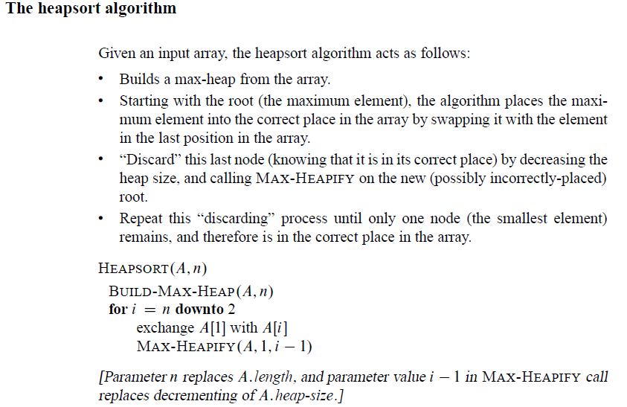
Heapsort

Slide 13
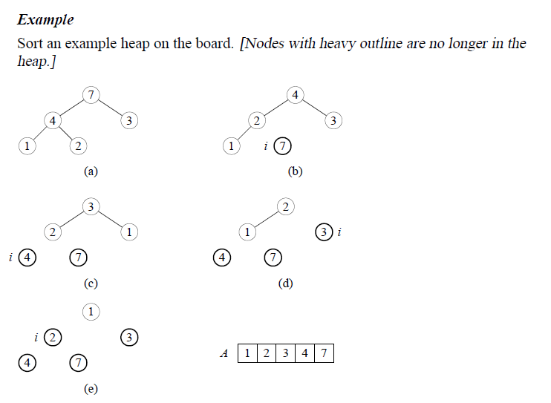
Heapsort

Slide 14
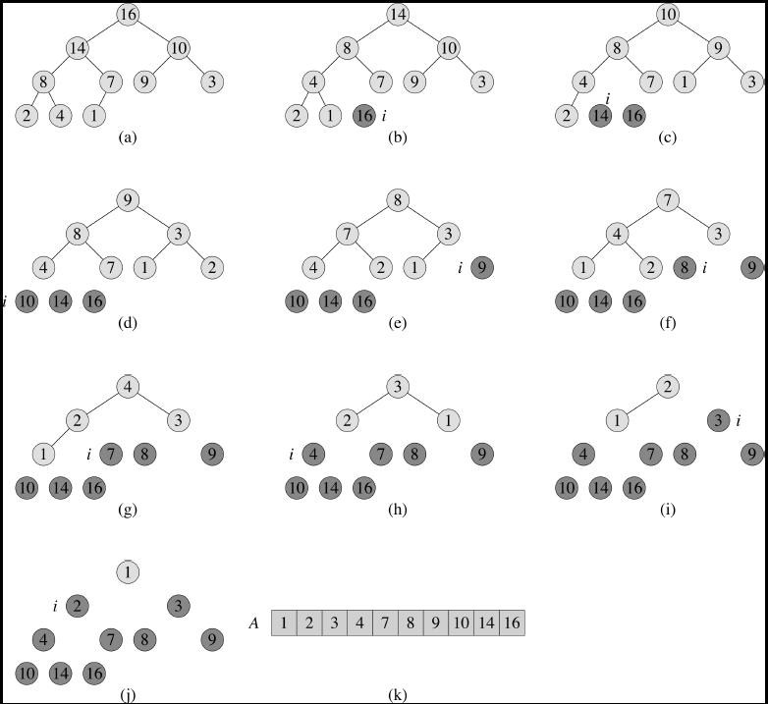
Heapsort Example

Slide 15
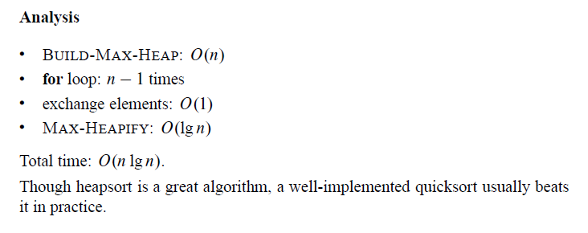
Heapsort

Slide 16
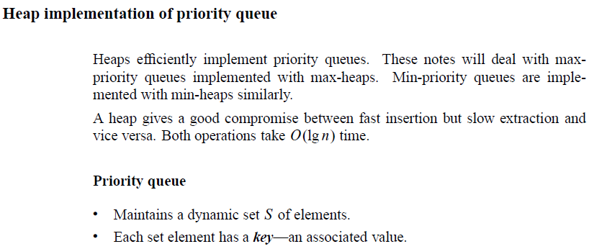
Priority Queues

Slide 17
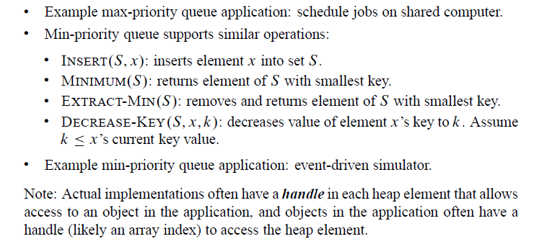
Priority Queues

Slide 18
Priority Queues

Slide 19
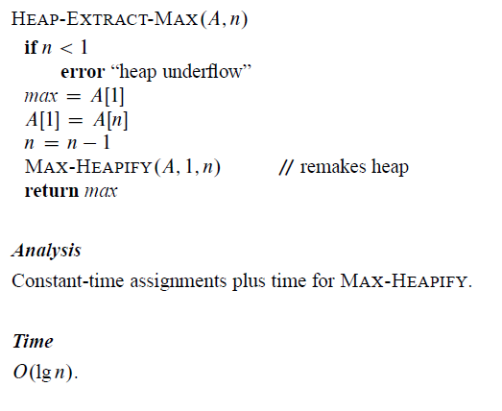
Priority Queues

Slide 20
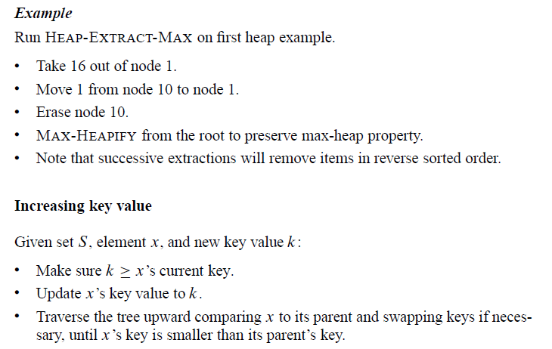
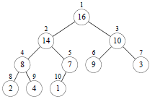
Priority Queues

Slide 21
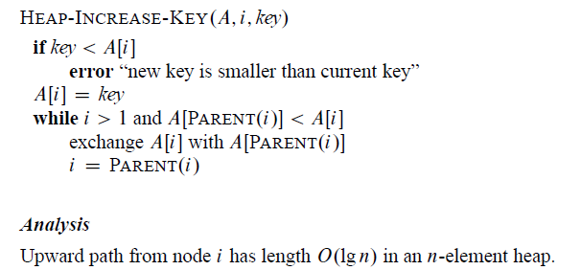
Priority Queues

Slide 22
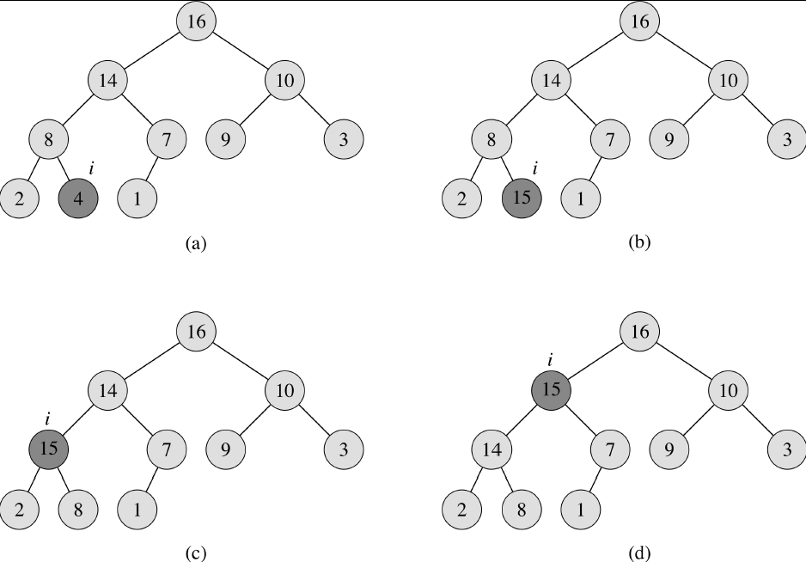
Heap-Increase-key Example

Slide 23
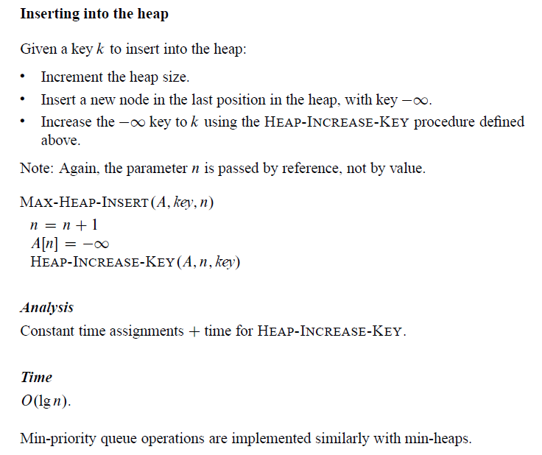
Priority Queues

