Slide 1
Chapter 5: Probabilistic Analysis and Randomized Algorithms
Introduction to probabilistic analysis and randomized algorithms.
Note: It is assumed that the students are familiar with the basic probability material in Appendix C.
The primary goals of this chapter is:

Slide 2
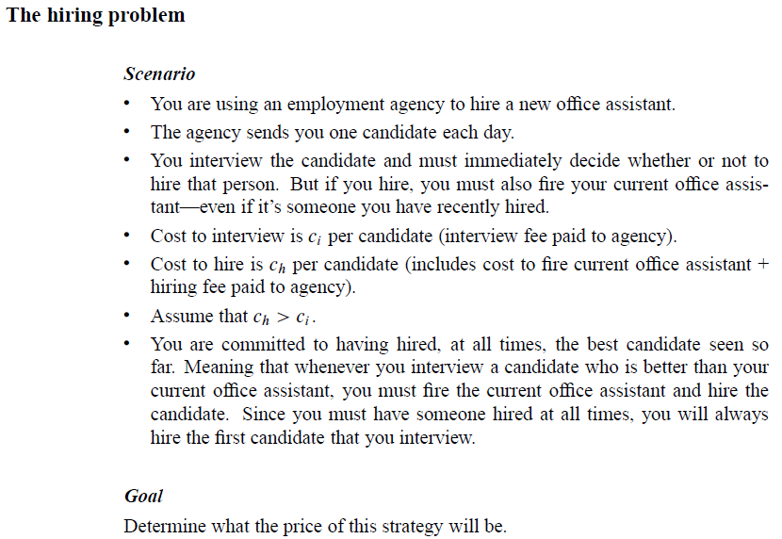
Probabilistic Analysis and Randomized Algorithms

Slide 3
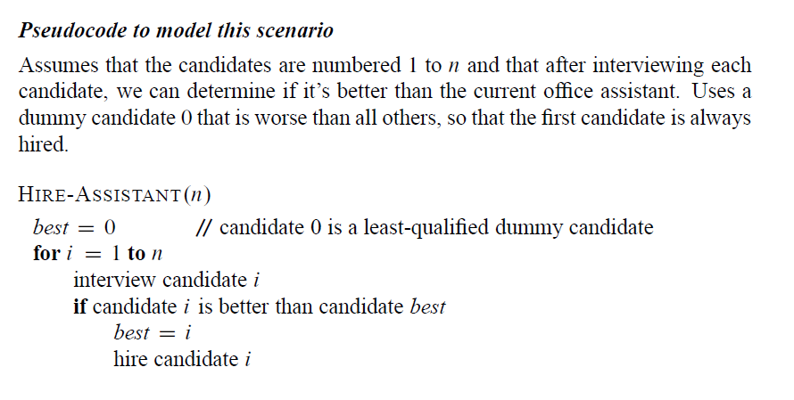
Probabilistic Analysis and Randomized Algorithms

Slide 4
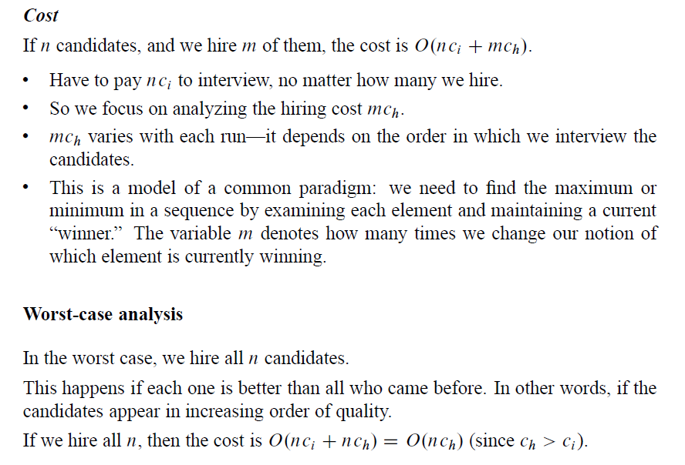
Probabilistic Analysis and Randomized Algorithms

Slide 5
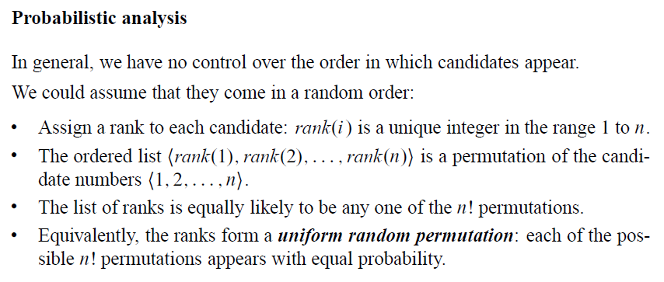
Probabilistic Analysis and Randomized Algorithms

Slide 6
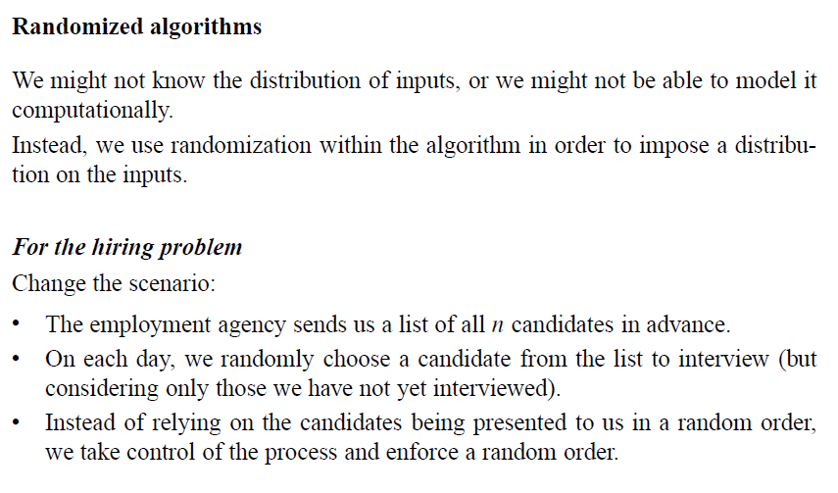
Probabilistic Analysis and Randomized Algorithms

Slide 7
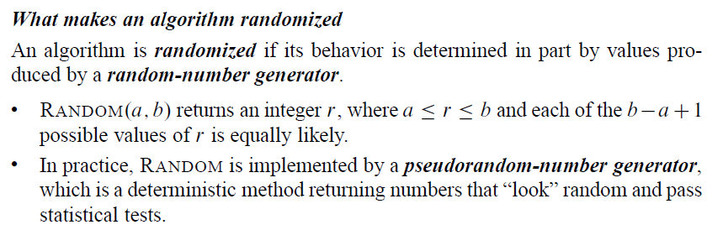
Probabilistic Analysis and Randomized Algorithms

Slide 8
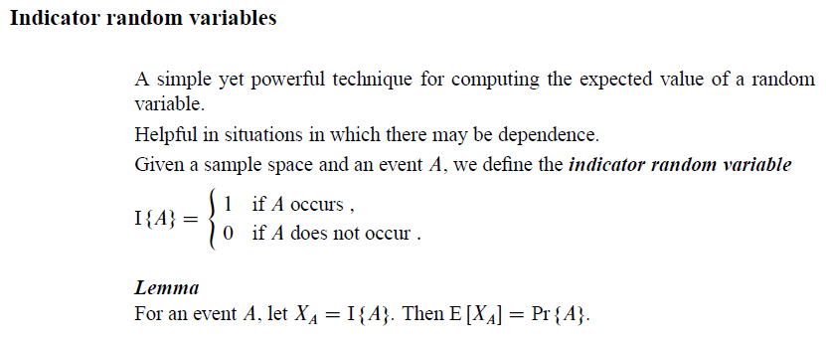
Probabilistic Analysis and Randomized Algorithms

Slide 9
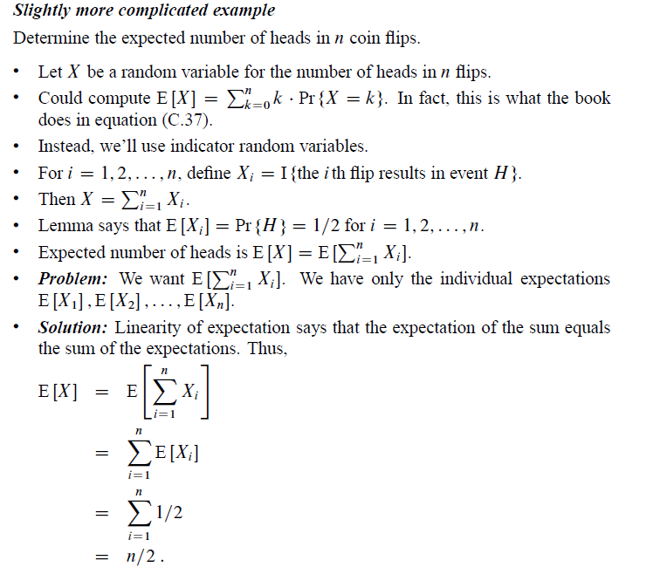
Probabilistic Analysis and Randomized Algorithms

Slide 10
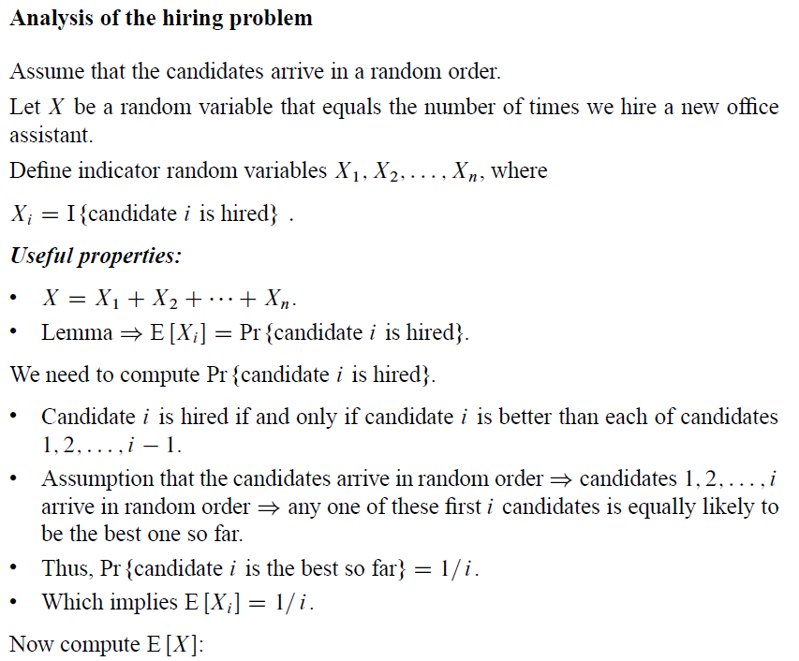
Probabilistic Analysis and Randomized Algorithms

Slide 11
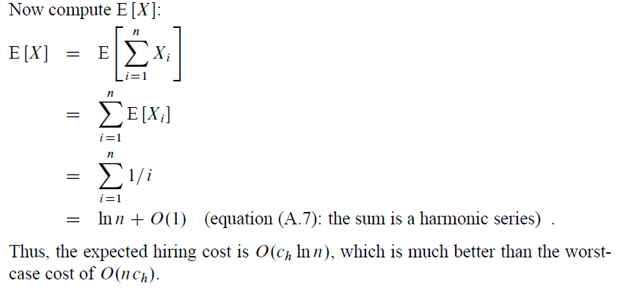
Probabilistic Analysis and Randomized Algorithms

Slide 12
Probabilistic Analysis and Randomized Algorithms

Slide 13
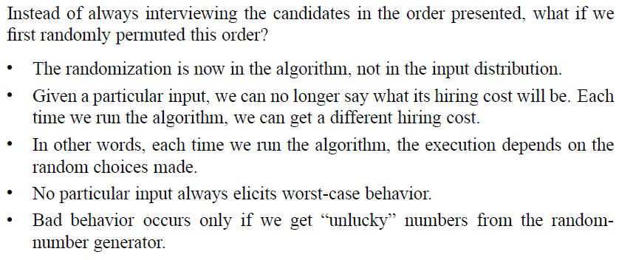
Probabilistic Analysis and Randomized Algorithms

Slide 14
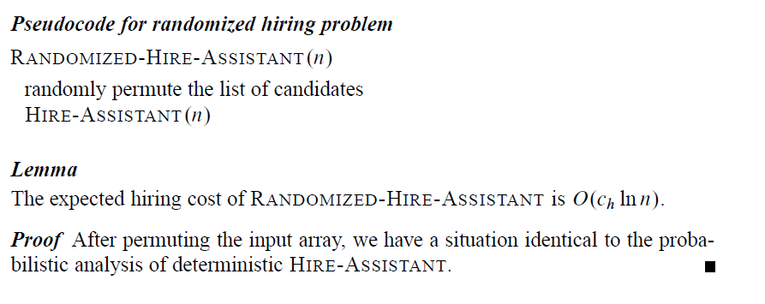
Probabilistic Analysis and Randomized Algorithms

Slide 15
Probabilistic Analysis and Randomized Algorithms
Your book considers two methods of randomly permuting an n-element array. The first method assigns a random priority in the range 1 to n³ to each position and then reorders the array elements into increasing priority order. The second method is better: it works in place, it runs in linear time without requiring sorting, and it needs fewer random bits (n random numbers in the range 1 to n rather than the range 1 to n³ ). Let us consider the second method.
Goal
Produce a uniform random permutation ( each of the n! permutations is equally likely to be produced).

Slide 16
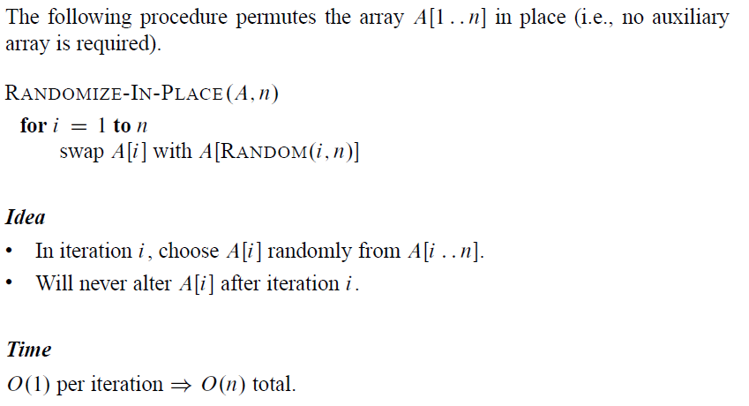
Probabilistic Analysis and Randomized Algorithms

Slide 17
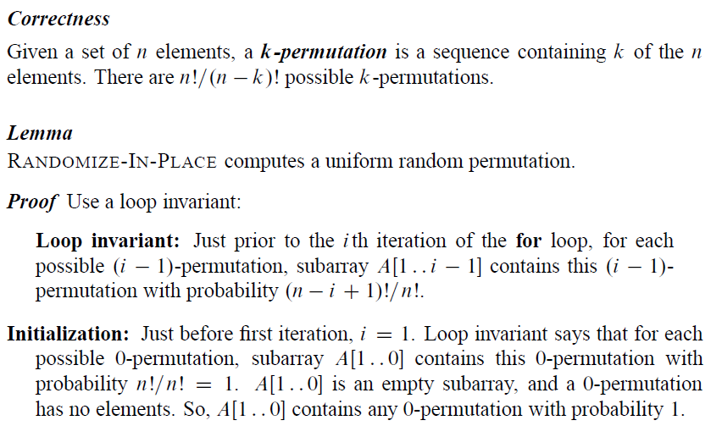
Probabilistic Analysis and Randomized Algorithms

Slide 18
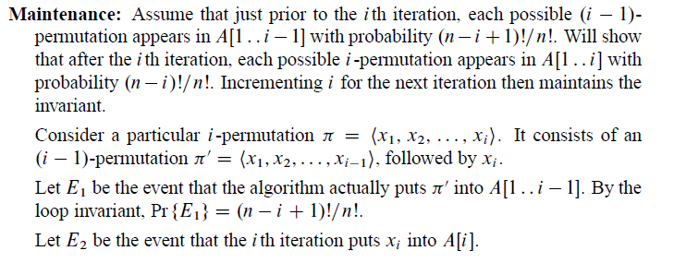
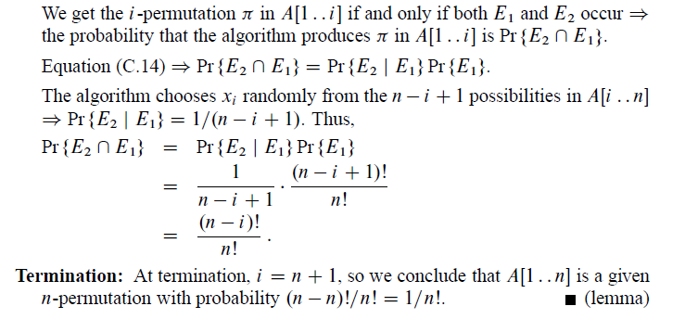
Probabilistic Analysis and Randomized Algorithms

