Slide 1
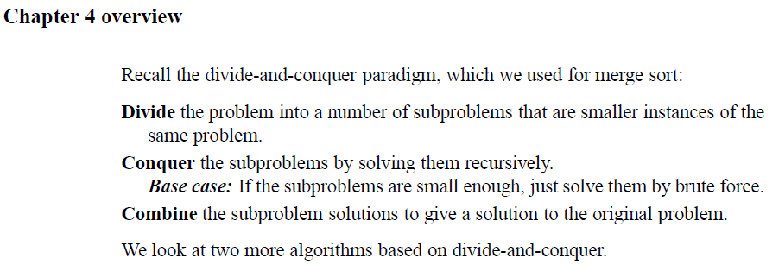
Chapter 4: Divide and Conquer

Slide 2
Divide and Conquer

Slide 3
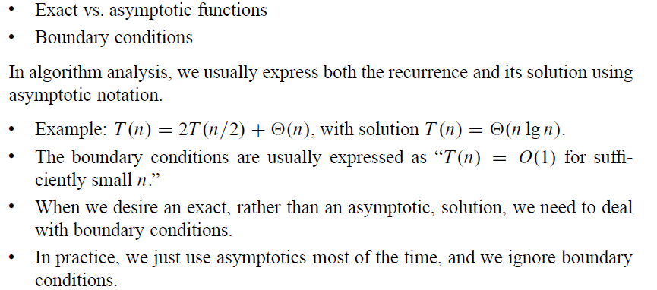
Divide and Conquer
(Normally, they can be ignored.)

Slide 4
Divide and Conquer
Three methods for solving recurrences:
Substitution Method: Guess a bound and use Mathematical induction to prove.
Master Method: Memorize three cases and use them to solve recurrences of the form: T(n) = a T(n/b) + f(n)
Iteration Method: However, it is too easy to make an error in parenthesization, and that recursion trees give a better intuitive idea than iterating the recurrence of how the recurrence progresses.
Note: To help us finding a solution, we may use recursion-tree method that converts the recurrence into a tree whose nodes represent the cost incurred at various level of the recursion. We use techniques for bounding summations to solve the recurrence.

Slide 5
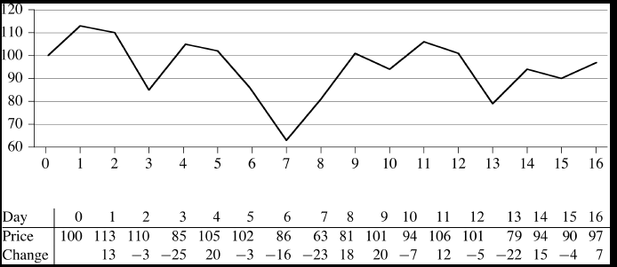
The Maximum-subarray problem
Consider investing in stock market. You can buy one unit of stock only one time and then sell it at a later date, buying and selling after close of the trading day. Suppose you have a “Cristal Ball” to see the price of the stock in the future. What is your strategy?

Slide 6
The Maximum-subarray problem
Should you always buy at the lowest or sell at the highest? Consider:
We need to find the nonempty, contiguous subarray of array A whose values have the largest sum.

Slide 7
The Maximum-subarray problem
Three possibilities for the location of the maximum-subarray with respect to the midpoint (the divide point):

Slide 8
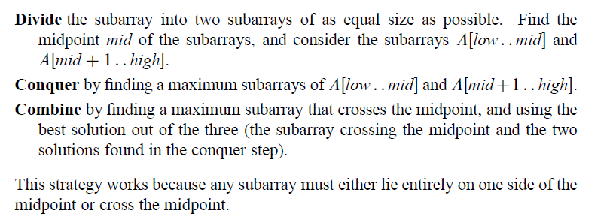
The Maximum-subarray problem

Slide 9
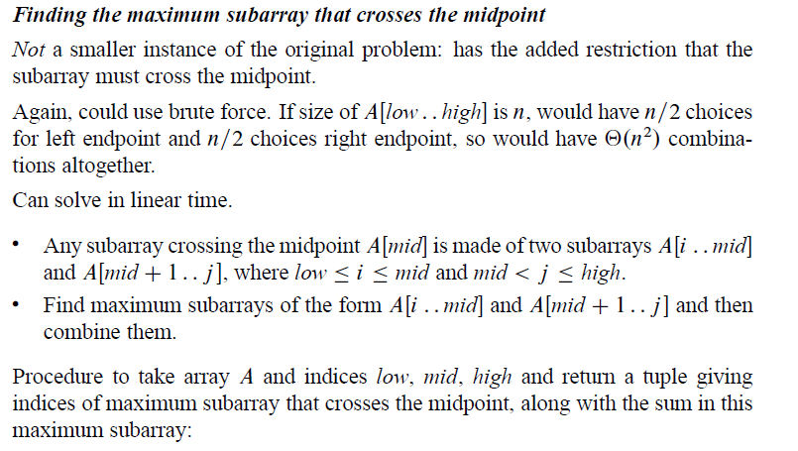
The Maximum-subarray problem

Slide 10
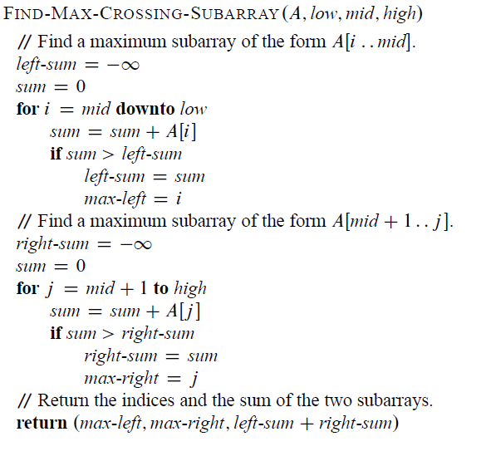
The Maximum-subarray problem

Slide 11
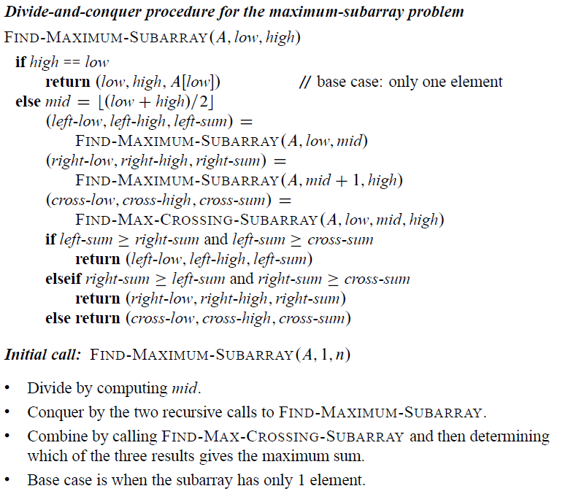
The Maximum-subarray problem

Slide 12
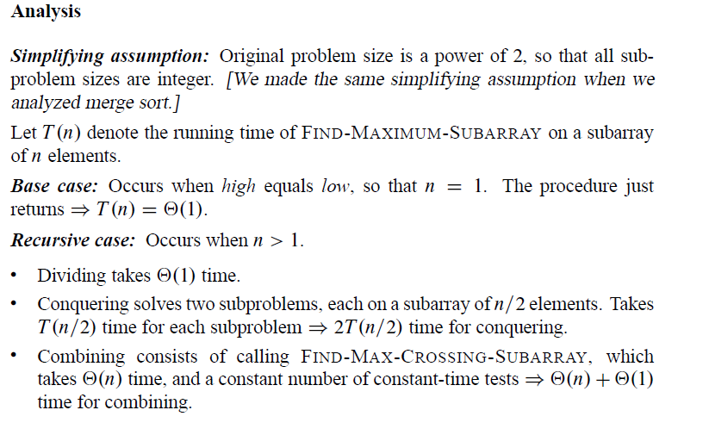
The Maximum-subarray problem

Slide 13
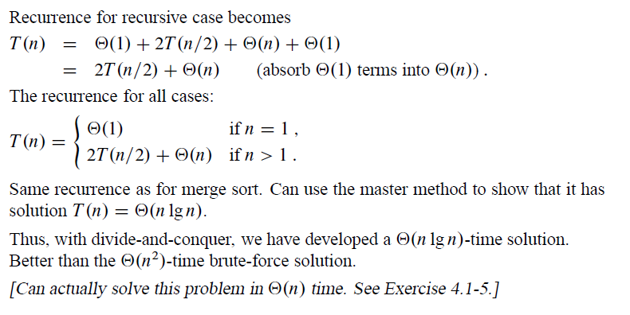
The Maximum-subarray problem

Slide 14
Master Method
Let a, b, and k be integers satisfying a ≥ 1, b ≥ 2, and k ≥ 0
n/b can be either floor or ceiling function.
Floor: T(0) = u is given
Ceiling: T(1) = u is given
Examples: T(n) = 4T(n/2) + n ⇒ T(n) ∈ ?
T(n) = 4T(n/2) + n² ⇒ T(n) ∈ ?
T(n) = 4T(n/2) + n³ ⇒ T(n) ∈ ?

Slide 15
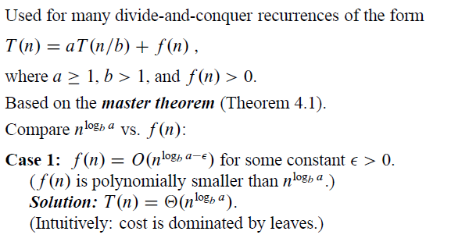
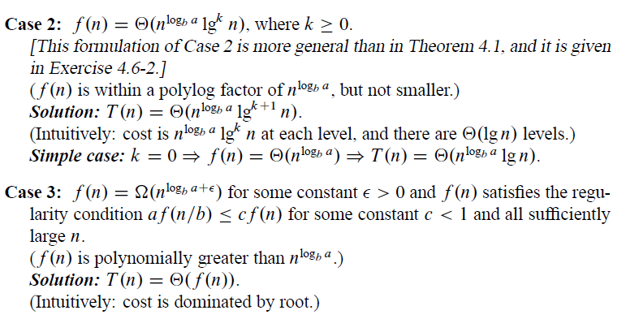
Master Method
F(n) is polynomially smaller than $n^{\log_{b}{a}}$
F(n) is the same size as $n^{\log_{b}{a}}$
F(n) is polynomially larger than $n^{\log_{b}{a}}$ . It should also satisfy the regularity condition

Slide 16
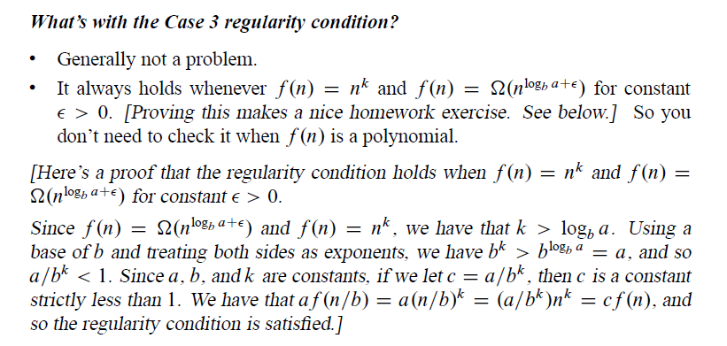
Master Method

Slide 17
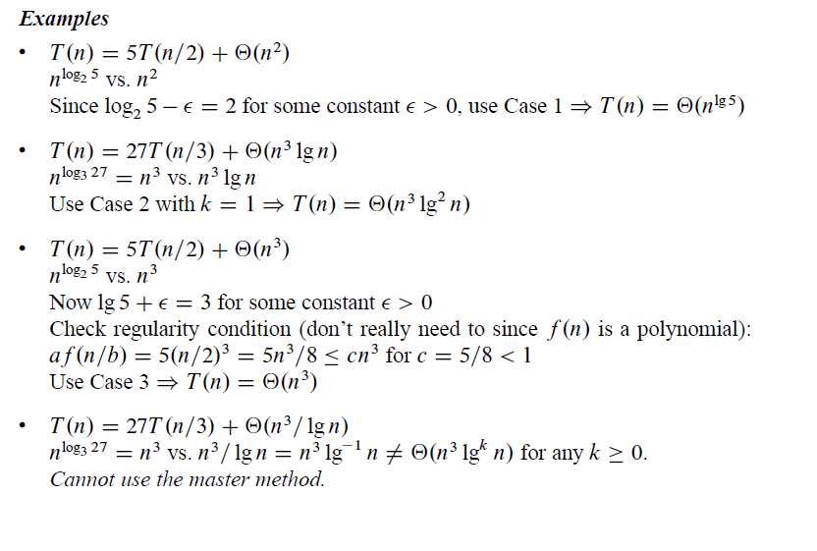
Master Method

