Slide 1
Chapter 3: Growth of Functions

Slide 2
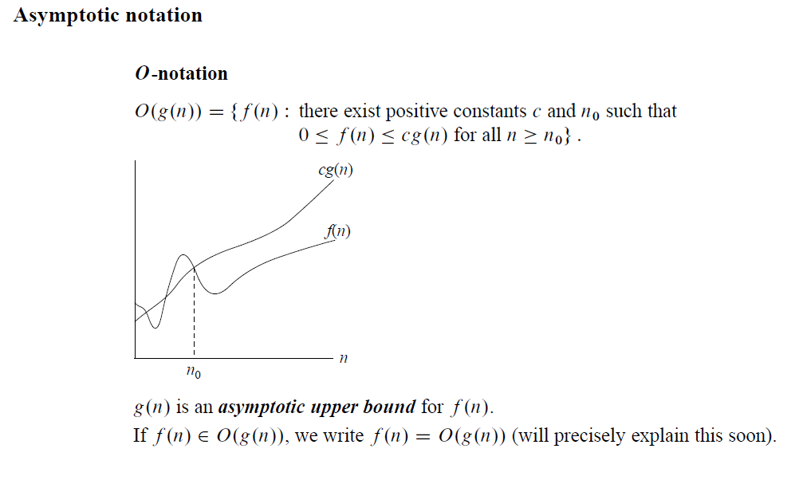
Growth of Functions

Slide 3
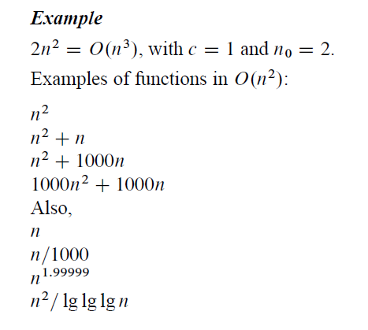
Growth of Functions

Slide 4
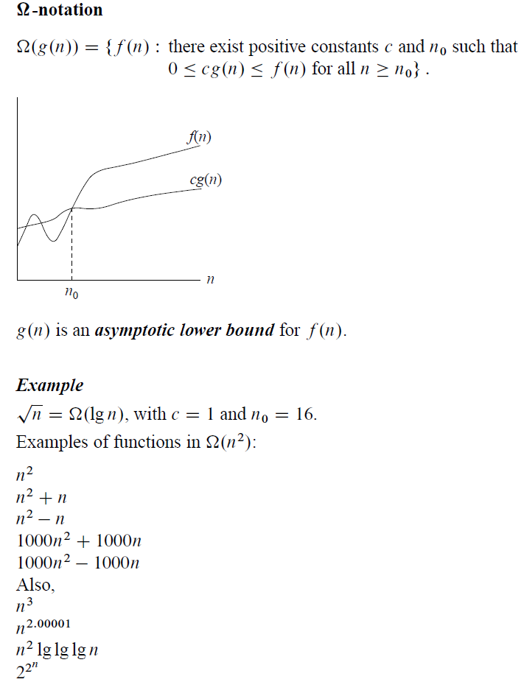
Growth of Functions

Slide 5
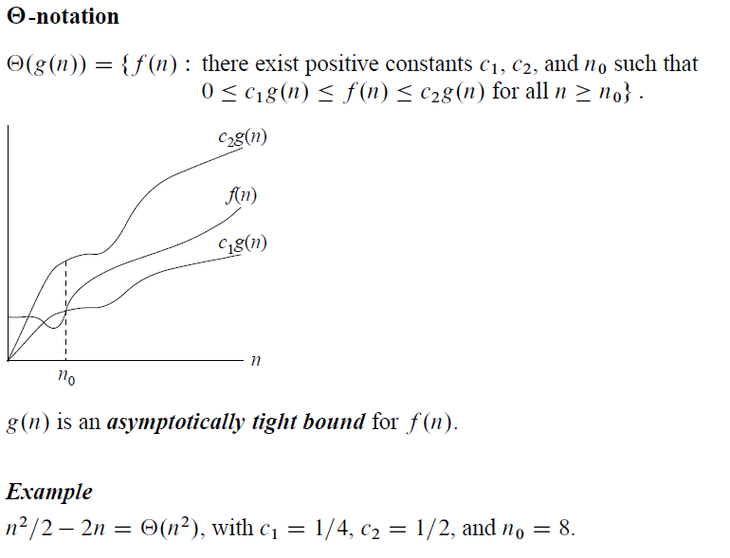
Growth of Functions

Slide 6
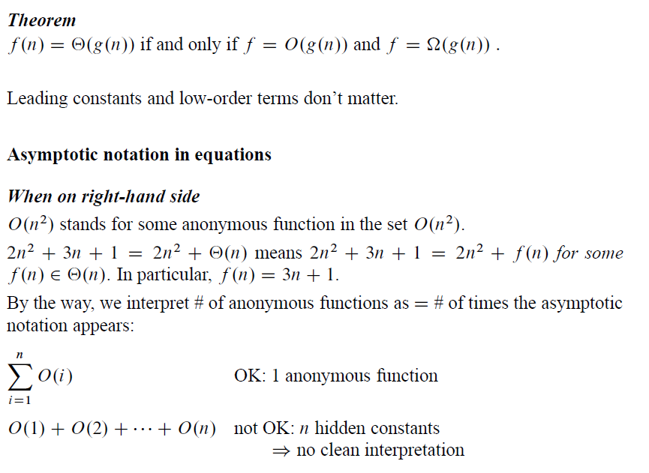
Growth of Functions

Slide 7
Growth of Functions

Slide 8
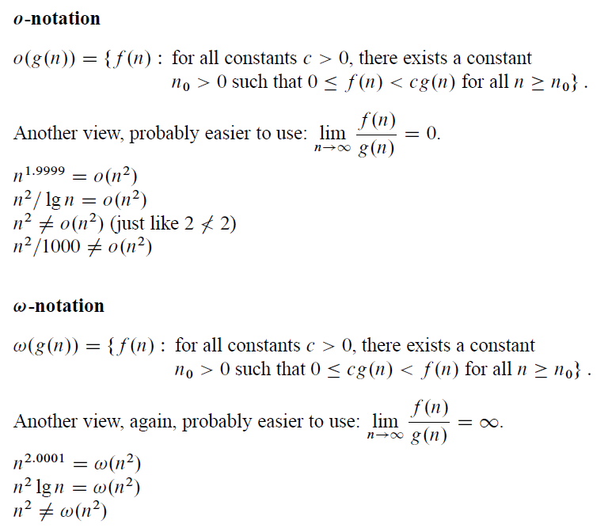
Growth of Functions

Slide 9
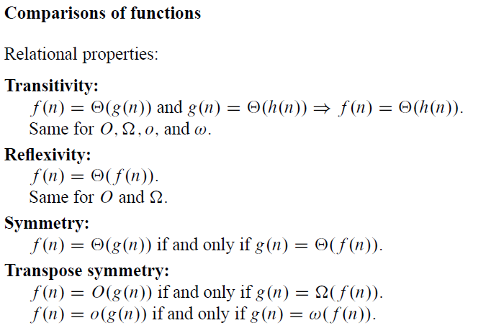
Growth of Functions

Slide 10
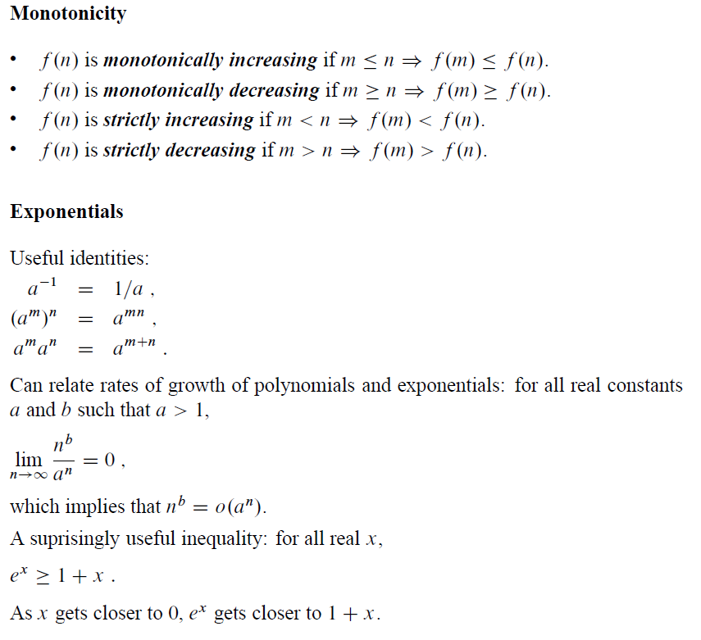
Growth of Functions

Slide 11
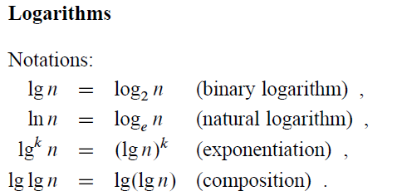
Growth of Functions

Slide 12
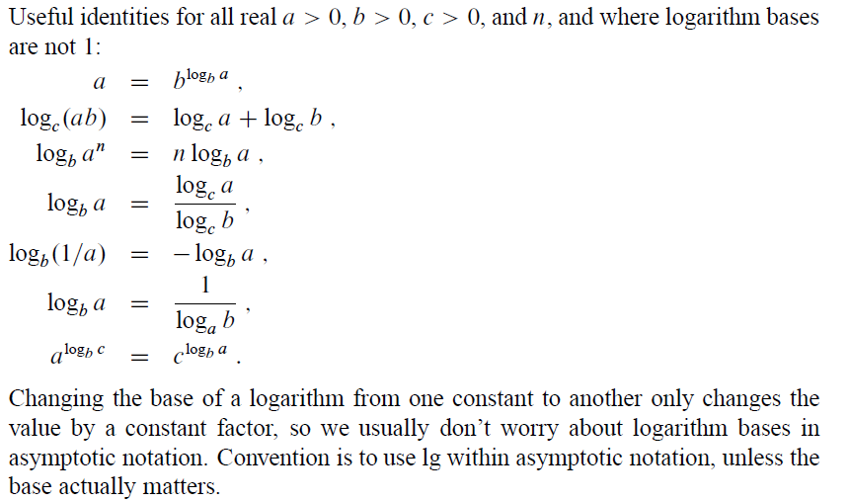
Growth of Functions

Slide 13
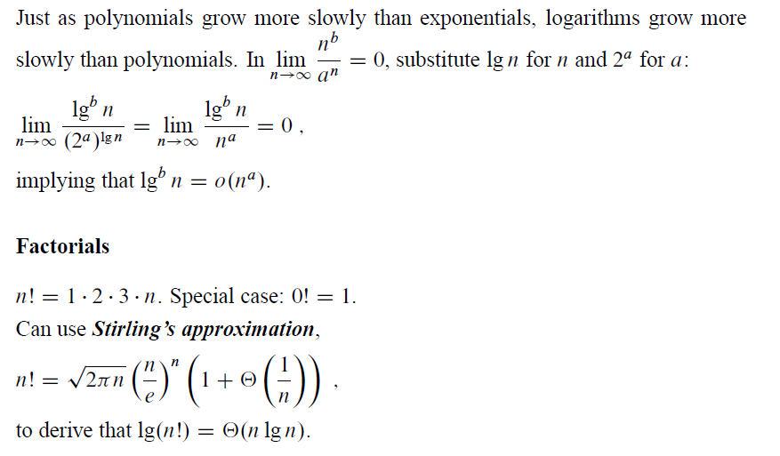
Growth of Functions

