Slide 1
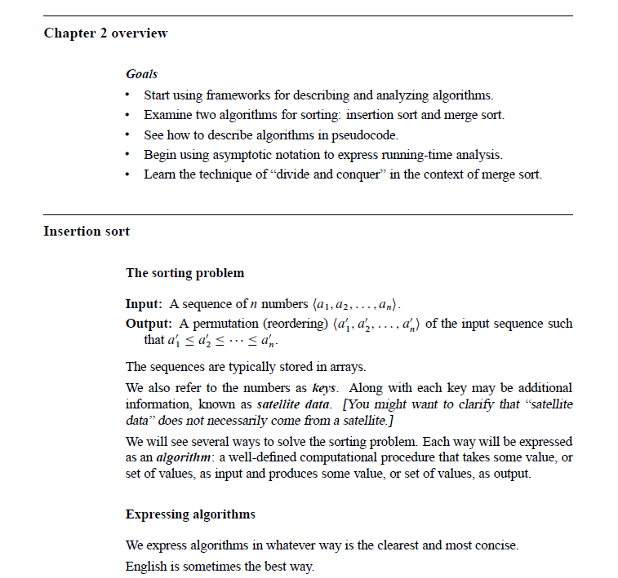
Chapter 2: Getting Started

Slide 2
Chapter 2: Getting Started

Slide 3
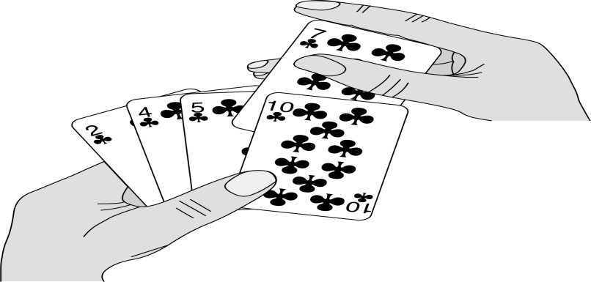
Insertion Sort

Slide 4
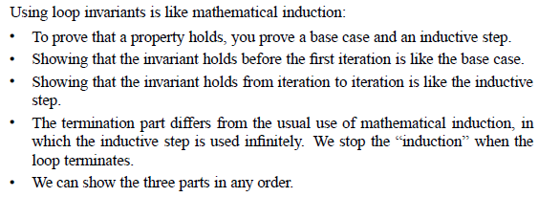
Insertion Sort

Slide 5
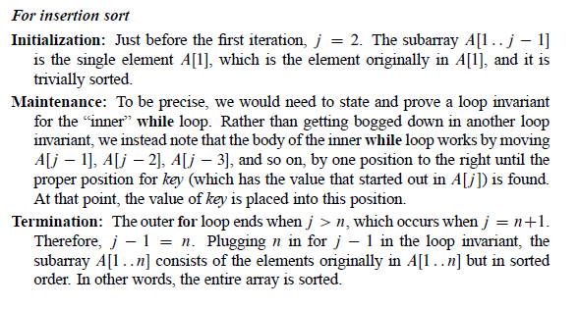
Insertion Sort

Slide 6
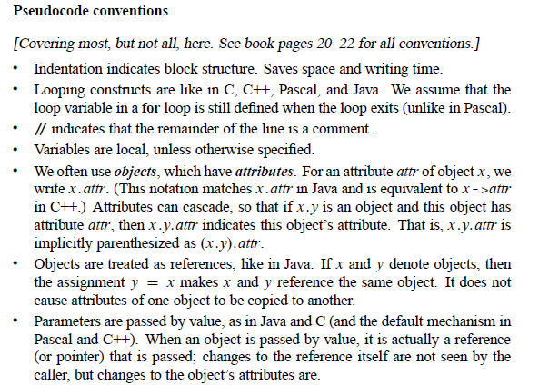
Pseudocode

Slide 7
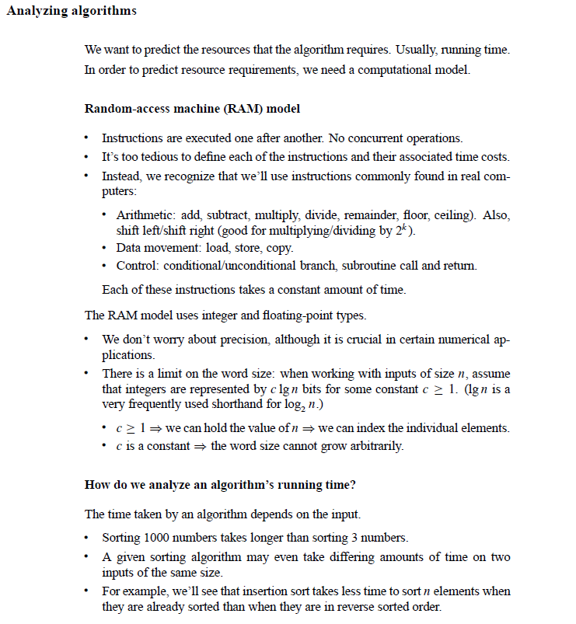
Analysis of Algorithms

Slide 8
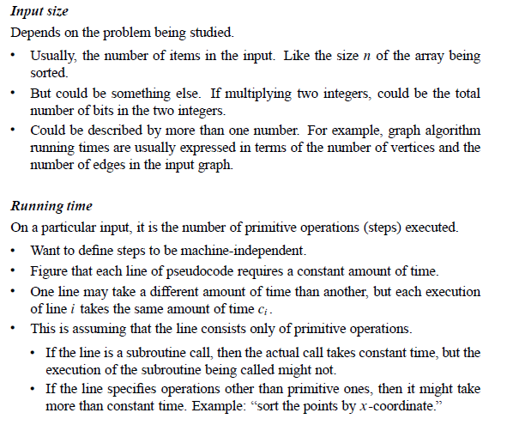
Analysis of Algorithms

Slide 9
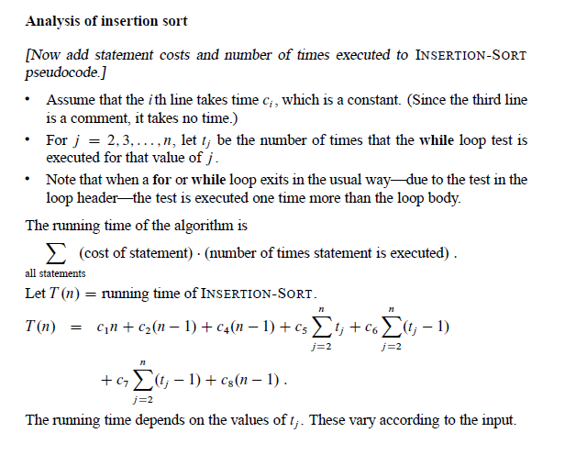
Analysis of Algorithms

Slide 10
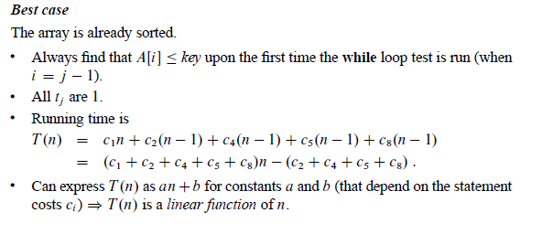
Analysis of Algorithms

Slide 11
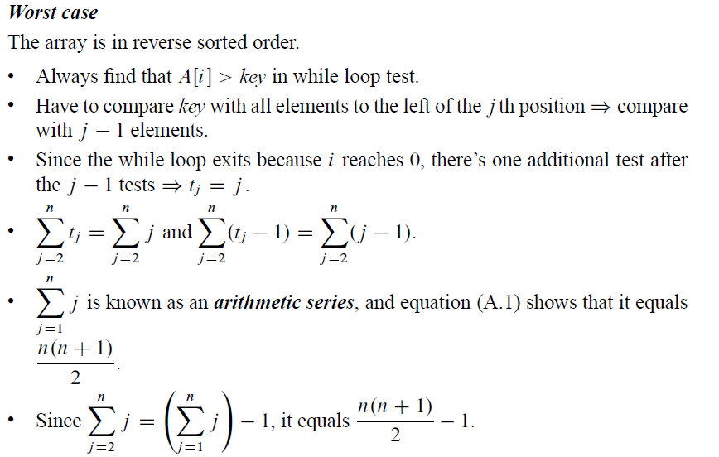
Analysis of Algorithms

Slide 12
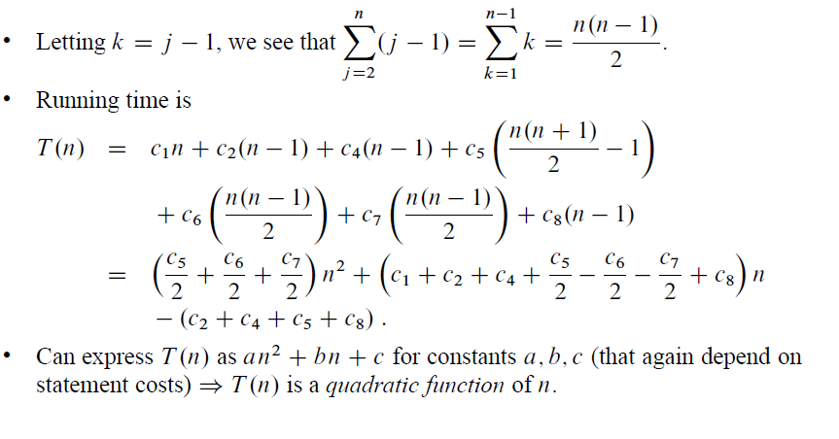
Analysis of Algorithms

Slide 13
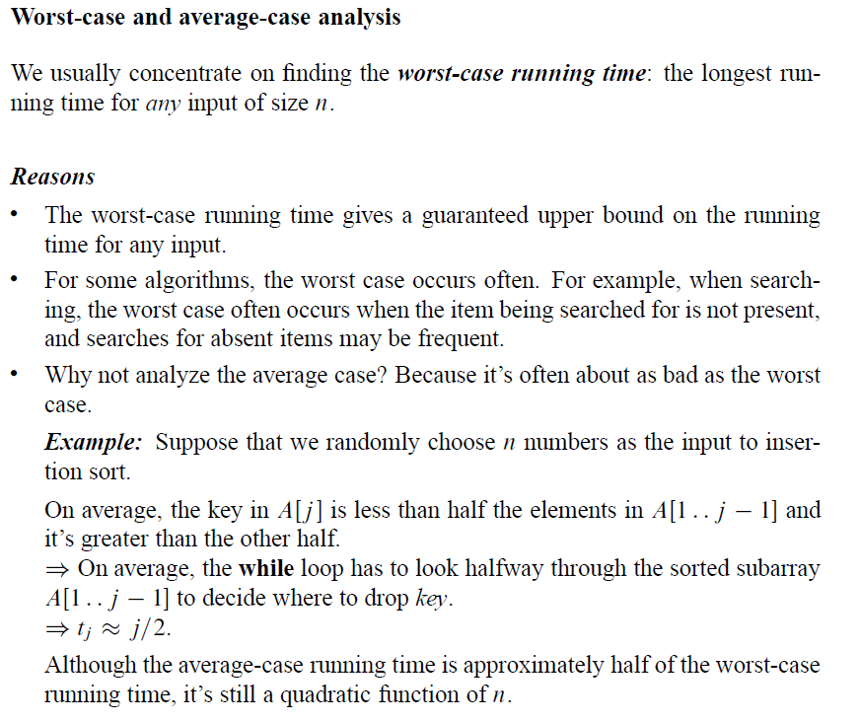
Analysis of Algorithms

Slide 14
Analysis of Algorithms

Slide 15
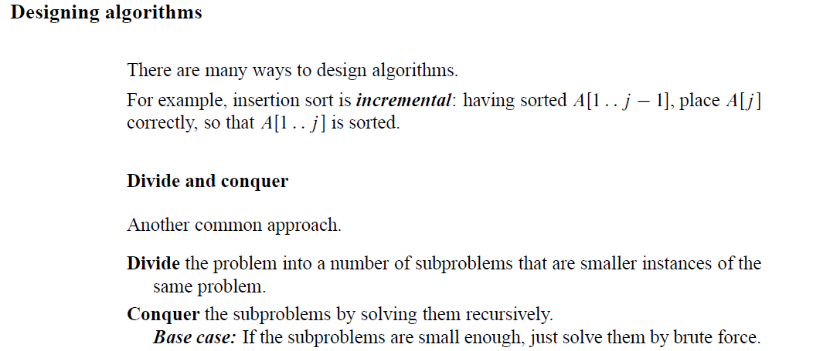
Designing Algorithms

Slide 16
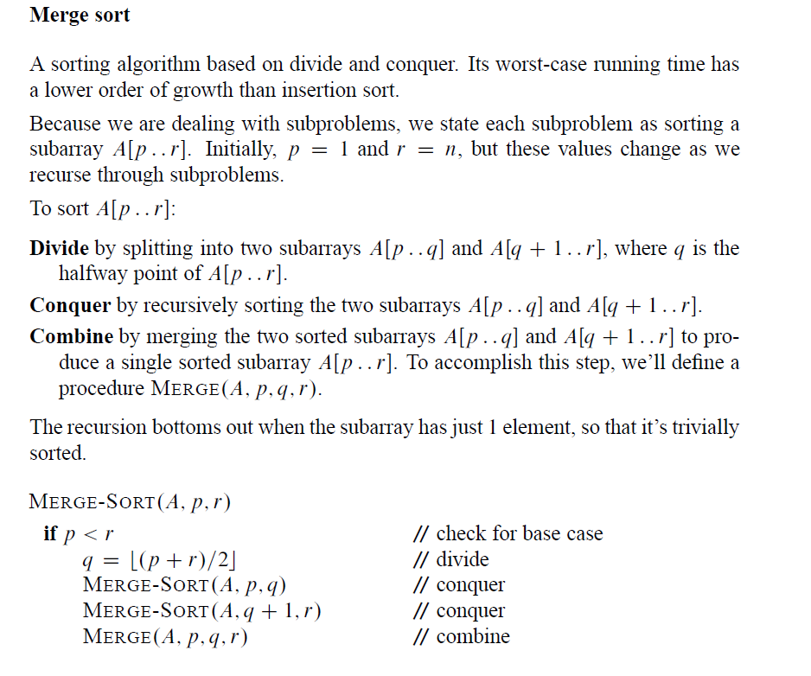
Designing Algorithms

Slide 17
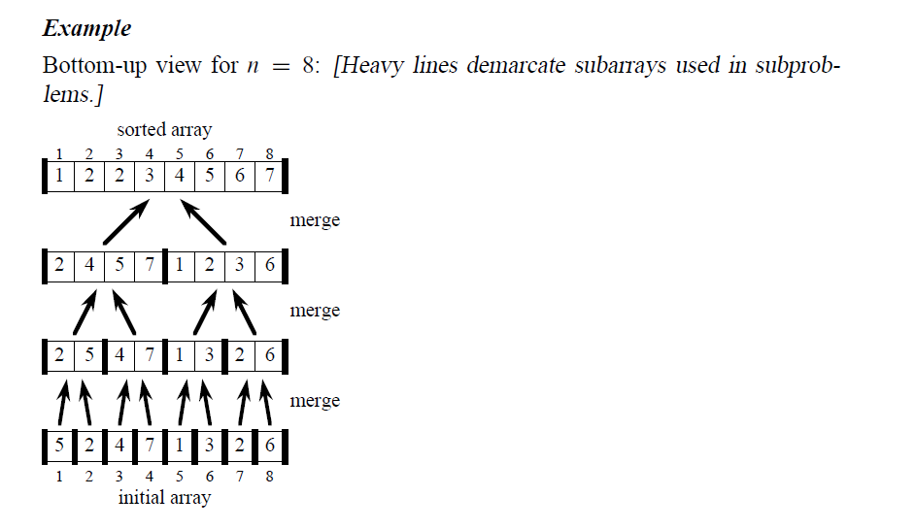
Designing Algorithms

Slide 18
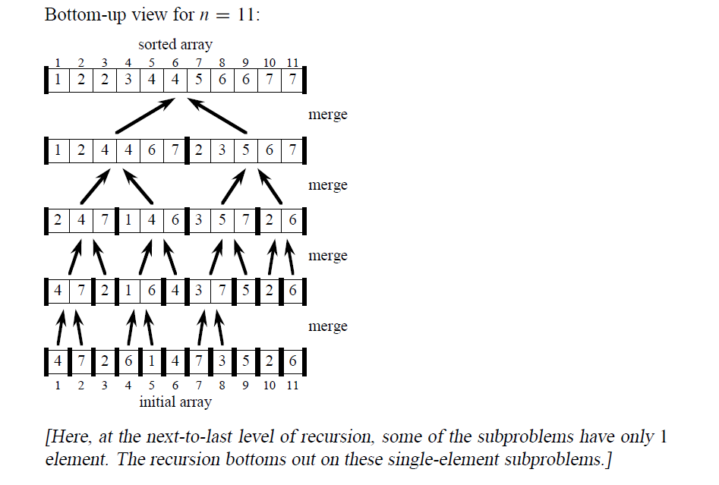
Designing Algorithms

Slide 19
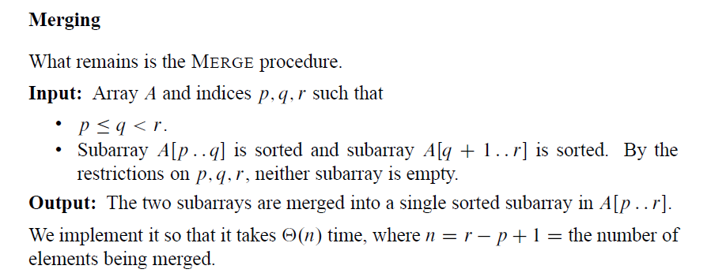
Designing Algorithms

Slide 20
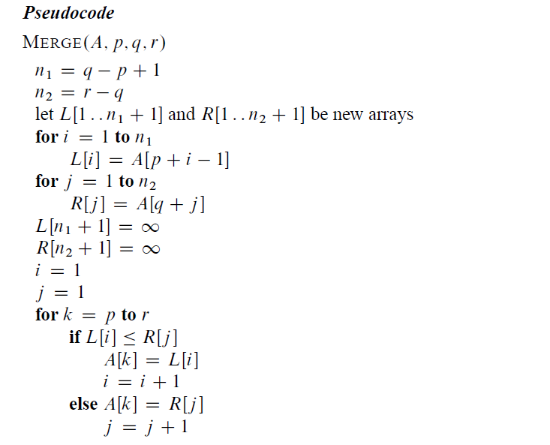
Designing Algorithms

Slide 21
Designing Algorithms
Example:
A call of Merge(A,9,12,16)

Slide 22
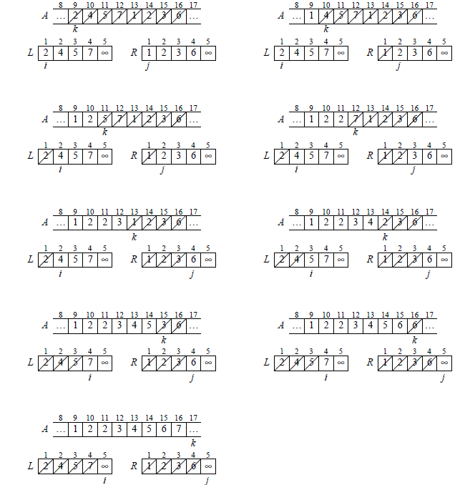

Slide 23
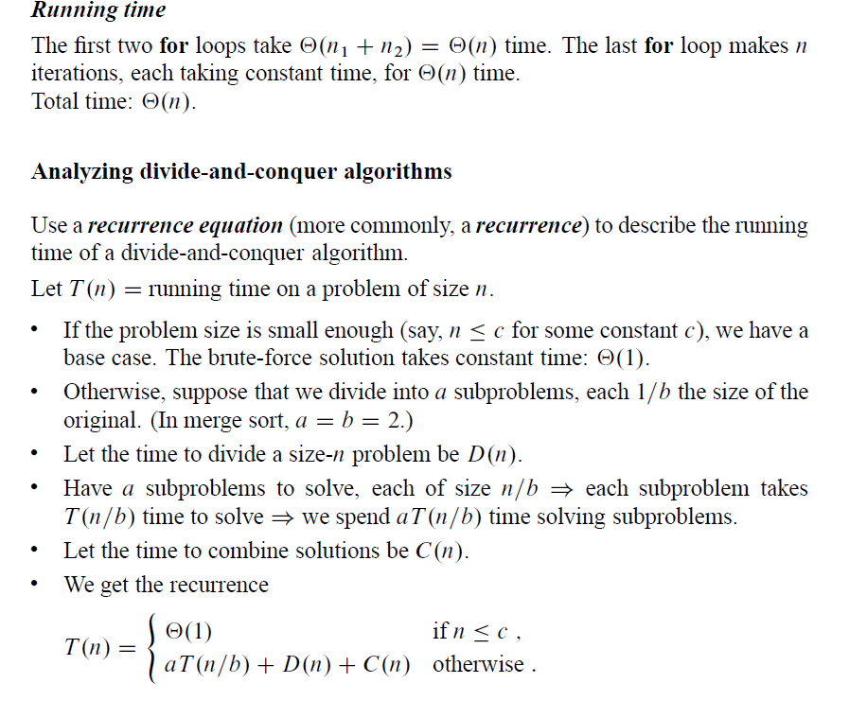
Designing Algorithms

Slide 24
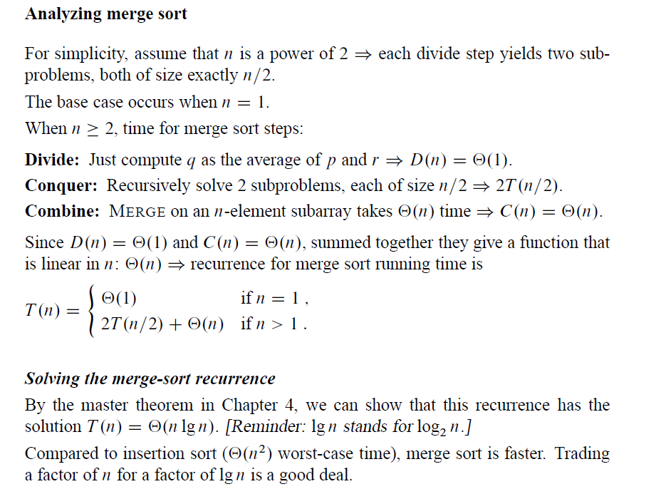
Designing Algorithms

Slide 25
Designing Algorithms

Slide 26
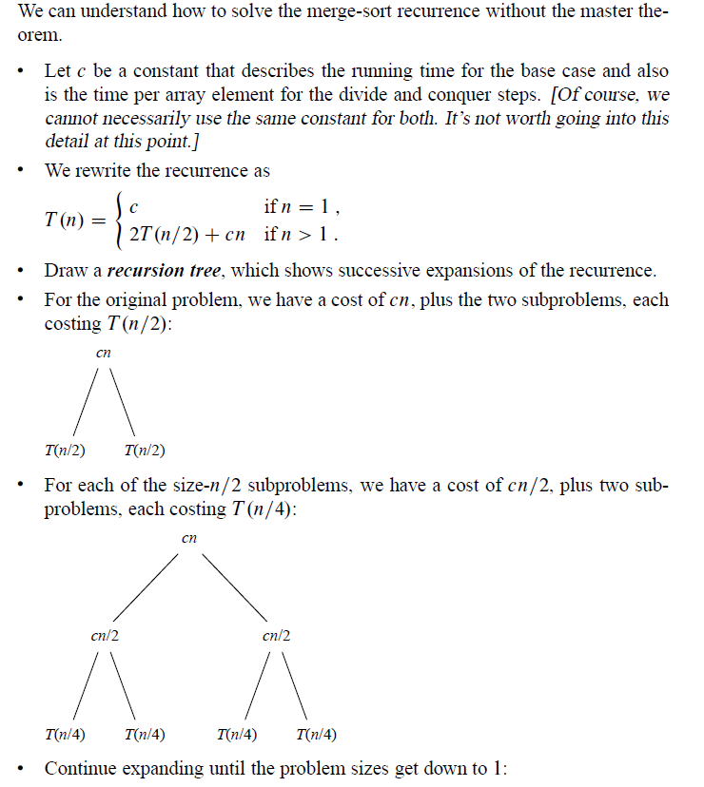
Designing Algorithms

Slide 27
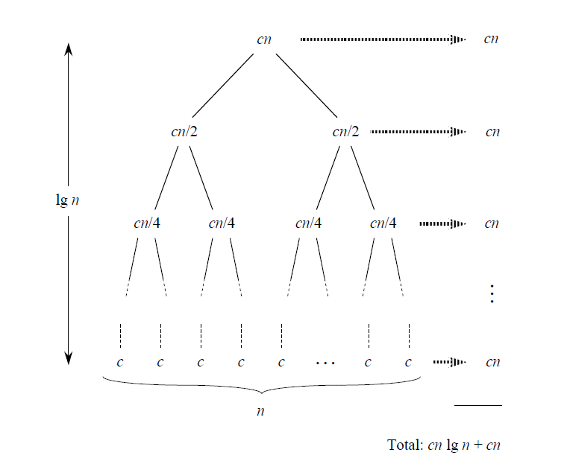
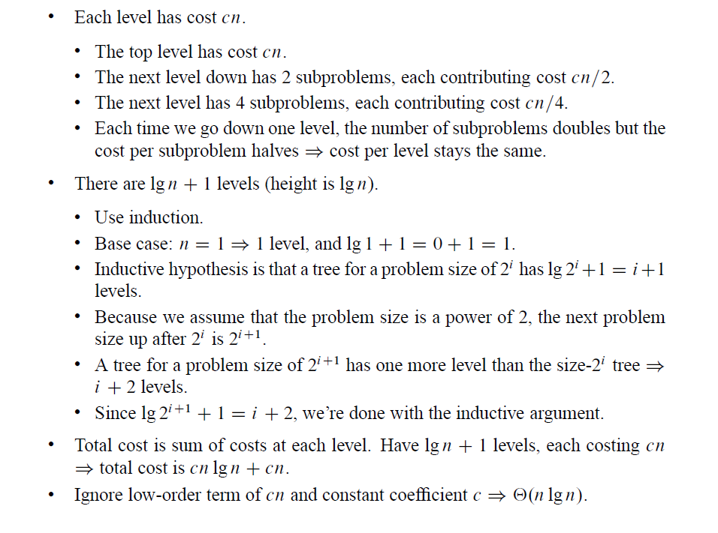
Designing Algorithms
We use induction to show that the number of levels is log n + 1

Slide 28
What we learnt in this lecture?
How to calculate running time.
How to solve recurrences.
Insertion sort and Merge sort.
Divide and conquer
Lecture Notes give you key points in each lecture.
You must read textbook after lectures in order to study well.

