Slide 1
CS3220 Web and Internet Programming Web Application Hosting and Deployment
Chengyu Sun
California State University, Los Angeles

Slide 2
Common Types of Hosting
Shared Hosting
Dedicated Server, including Virtual Private Server (VPS)
Various cloud hosting options (IaaS, PaaS, SaaS …)

Slide 3
About Shared Hosting
Search "shared hosting" on Google
Many websites on the same server
Cheap and easy to use – many do not even require knowledge of HTML/CSS
Limitations on what you can use and what you can do
Suitable for static websites and sites with limited dynamic content

Slide 4
About Dedicated Server and VPS
Full control of the OS, software, and applications on the server
More expensive than shared hosting
Require more knowledge of web development and system administration

Slide 5
Use Dedicated Server/VPC Hosting
Find a server
Configure networking
Install the necessary software
Package and deploy the web application
Additional configuration

Slide 6
Find a Server
Option A: use a home computer
Option B: use a virtual server in the cloud

Slide 7
Using A Home Computer
Cable
Modem
Router
Home
Outside World
Only the router has a "real" IP address
Home computers only have private IP addresses

Slide 8
Configure Network Address Translation (NAT) on Router
Router
Map requests to a port on the router to a port on a home computer
Not all routers support NAT configuration

Slide 9
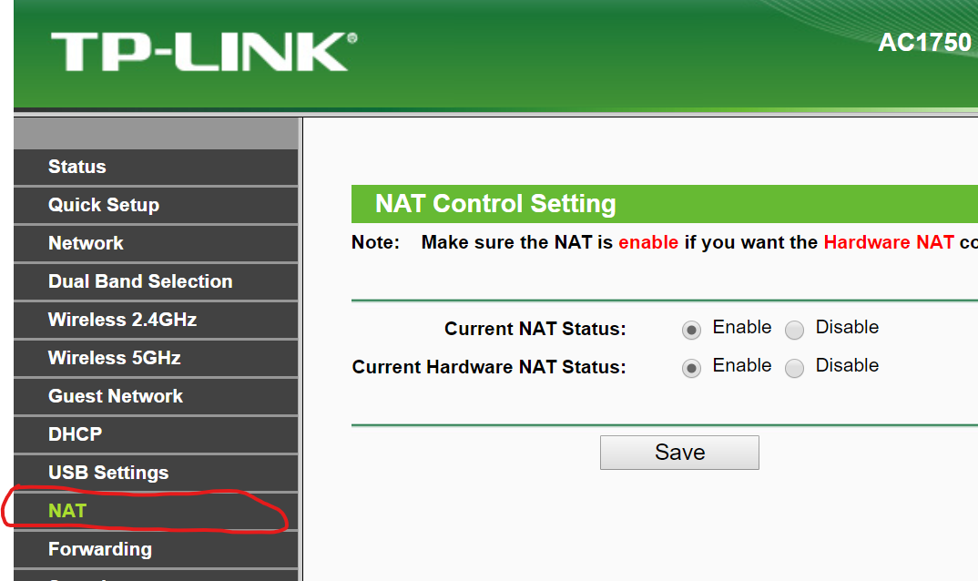
Router Configuration Example …

Slide 10
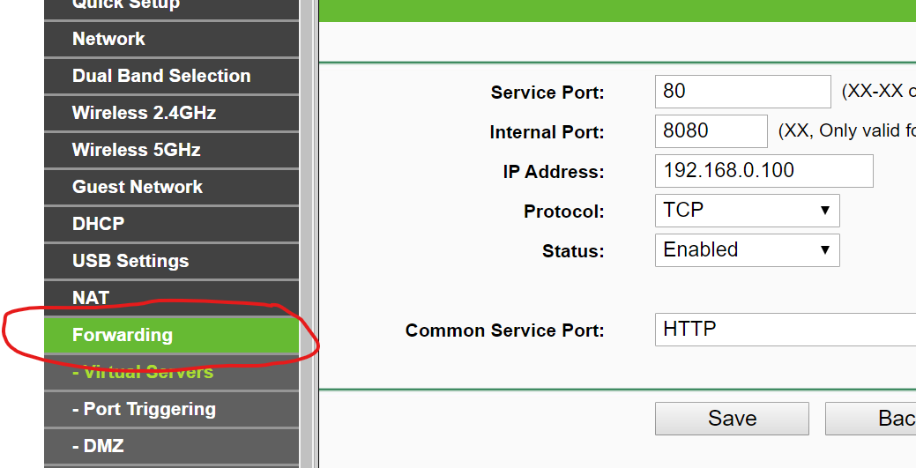
… Router Configuration Example

Slide 11
Configure Dynamic DNS
Domain Name System (DNS) maps host names to IP addresses
The IP address your ISP assigns to your router may change, so you'll need dynamic DNS
Some dynamic DNS services:
Dyn.com
Noip.com

Slide 12
About Using a Home Computer As a Server
Cheap
Easy access and control
Heat and noise
Unreliable (e.g. power outage, hardware failure etc.)

Slide 13
Using a Virtual Server in Cloud
DigitalOcean
Amazon Lightsail
Ligthsail is a simplified offering of Amazon EC2

Slide 14
Using DigitalOcean
See video at https://www.youtube.com/watch?v=filyn4iKkUA

Slide 15
Droplet
A "droplet" is a virtual server, a.k.a. virtual machine (VM)
Operating System: Linux or FreeBSD
Prices from $5 per month
Google "digitalocean promotion" for some free credits (does require a credit card to sign up)

Slide 16
Access Droplet
Use browser-based droplet console – username and password
Use SSH – public/private key authentication

Slide 17
Using Linux and Command Line
Free OS and free software
Easy software management
https://csns.calstatela.edu/wiki/content/cysun/notes/set_up_ubuntu
Efficient for server environments
No unnecessary software
No GUI to take up resources

Slide 18
WAR File
Web application ARchive
A JAR file for packaging, distributing, and deploying Java web applications
Create WAR files
Eclipse Export -> Web -> WAR file
Or use the command line tool jar or the build tool Maven

Slide 19
Deploy WAR Files to a Tomcat Server
Use the Manager App
Need a user with the manager-gui role
Or simply copy the WAR file to the webapps folder
More options at http://tomcat.apache.org/tomcat-8.5-doc/deployer-howto.html

Slide 20
Additional Configuration – Domain Name and DNS
Buy a domain name at Google Domains or other domain registrars
$12 per year for a .org domain
Configure DNS to map the domain and host names to your servers

Slide 21
Addition Configuration – HTTPS
Buy an SSL/TLS certificate or get a free one at Let's Encrypt
Configure the server to use HTTPS
Tomcat 8.5
Nginx – a high-performance, easy-to-use web server

Slide 22
Additional Configuration – Reverse Proxy
WebApp1 on
Tomcat at
Port 8080
http://host/webapp1
http://host/webapp2
Nginx at
Port 80
WebApp2 using
Node.js at
Port 3000
Server
Outside World
https://csns.calstatela.edu/wiki/content/cysun/notes/nginx_config

Slide 23
About Reverse Proxy
Expose only one port to the outside world
Configure HTTPS only once in Nginx
Use Nginx for serving static resources, request logging, and so on

Slide 24
Final Words
The most important thing about running a website is SECURITY
Use long, random password
Reduce attack surface
Expose minimum ports to the outside world
Enable minimum services (e.g. do not use Tomcat Manager)
Pay attention to application security (e.g. SQL injection)
And Have Fun!

