Slide 1
CS2011 Introduction to Programming I Methods (II)
Chengyu Sun
California State University, Los Angeles

Slide 2
A Few More Things About Methods
Variable scope
Pass by value
Method overloading
Top-Down Design

Slide 3
Scope of Variables
The part of the program where a variable can be used
public static void method1() {
… …
for (int i = 1; i < 10; i++) {
… …
int j=0;
… …
}
}
scope of i
scope of j

Slide 4
Local Variable …
A variable defined inside a method is called a local variable
What are non-local variables??
The scope of a local variable starts from its declaration to the end of the block (i.e. {}) containing the variable
Method parameters are actually local variables

Slide 5
… Local Variable
Two local variables with the same name cannot have overlapping scopes
for (int i = 1; i < 10; i++) {
… …
for (int i = 1; i < 10; i++)
… …
}
}
for (int i = 1; i < 10; i++) {
… …
}
… …
for (int i = 1; i < 10; i++) {
… …
}

Slide 6
Example: Swap
public static void swap(int a, int b) {
int temp = a;
a = b;
b = temp;
}
int a = 10, b = 20;
swap( a, b );
System.out.println (a + ", " + b ); // ??

Slide 7
Pass By Value
When a method is invoked with a argument, the value of the argument is passed to the parameter
public static void inc( int n ) {
++n;
}
public static void main( String args[] ) {
int n = 10;
inc(n);
System.out.println(n);
}
(c)
(a)
(b)
(d)

Slide 8
Activation Record and Call Stack
An activation record contains the parameters and local variables of an invoked method
A call stack keeps the activation records of the active methods (i.e. methods that are not finished)

Slide 9
Method Invocation Example
inc()
inc()
n = 10
n = 11
main()
main()
main()
main()
args
n = 10
args
n = 10
args
n = 10
args
n = 10
(a)
(b)
(c)
(d)

Slide 10
Same Method for Different Types
public static int max( int n1, int n2 ) {
return n1 > n2 ? n1 : n2;
}
What if we want to create a similar method for double values?
One possible solution:
int maxInt( int n1, int n2 )
double maxDouble( double n1, double n2)

Slide 11
Method Overloading
Method overloading allows us to create methods with the same name but different parameters
public static int max( int n1, int n2 ) {
return n1 > n2 ? n1 : n2;
}
public static double max( double n1, double n2 ) {
return n1 > n2 ? n1 : n2;
}

Slide 12
How Does Java Compiler Choose Which Method to Use?
Suppose we have three methods:
int max( int n1, int n2 )
double max( double n1, double n2 )
double max( double n1, double n2, double n3 )
max( 10, 20 ); // ??
max( 1.2, 2.3 ); // ??
max( 1, 2, 3 ); // ??
max( 1, 2.3 ); // ??

Slide 13
Ambiguous Invocation
Suppose we have two methods:
double max( int n1, double n2 )
double max( double n1, int n2 )
max( 10, 20 ); // ??
max( 10.5, 20.5); // ??

Slide 14
Example: Print Calendar

Slide 15
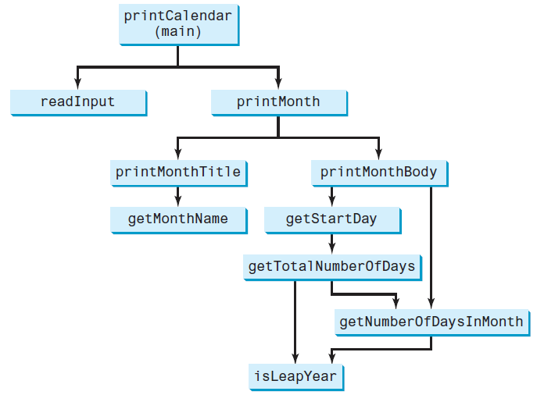
Top-Down Design
Bottom-Up
Implementation

Slide 16
Readings
Chapter 6 of the textbook (there will be a quiz next week)

