Slide 1
CS2011 Introduction to Programming I
Loop Statements (II)
Chengyu Sun
California State University, Los Angeles

Slide 2
Three Keys Things in a Loop
Initial State
Loop Condition
int count = 0;
while ( count < 20 ) {
System.out.println( "Welcome" );
++count;
}
Change of state that affects the loop condition

Slide 3
for Statement
All three things in one place
for( int count = 0 ; count < 20 ; ++count ){
System.out.println( "Welcome" );
}
Suitable when the number of iterations is known in advance, e.g.
  Display "Welcome" 20 times ➔ for
  Convert any binary number to decimal ➔ while

Slide 4
Syntax and Flow
for ( initialization ; termination ; increment ) {
statement(s)
}
initialization
termination
false
true
increment
statement(s)

Slide 5
More on For Loop Syntax
Initialization is usually the declaration and initialization of a single variable
  The variable name is usually i (for iteration or index)
  The scope of the variable is within the loop
Initialization and Increment may consist of multiple statements separated by commas
Initialization, termination, and increment are all optional

Slide 6
For Loop Examples
for ( int i=0 ; i < 10 ; ++i )
for ( int x=3, y=4 ; x+y < 15; x++, y++ )
int n = 0, m = 10;
for ( ; n < 10 || m > 0; ++n, m -= 2)
Does it make any difference to use ++i or i++?

Slide 7
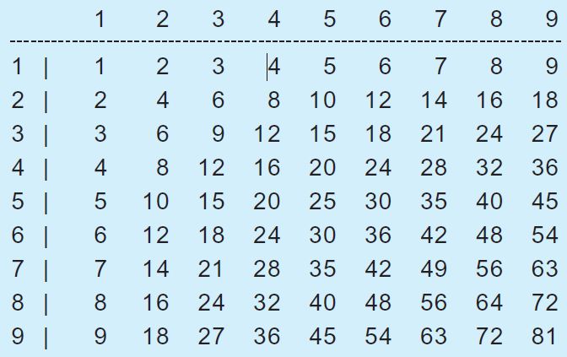
Example: Multiplication Table

Slide 8
Be Careful With Nested Loops
for ( int i = 0 ; i < 1000 ; ++i )
for( int j = 0 ; j < 1000 ; ++j )
for( int k = 0 ; k < 1000 ; ++k ) {
// Perform an action
… …
}
How many times is the action performed??

Slide 9
Example: Find The Greatest Common Divisor
The greatest common divisor of two integers n1 and n2 are the largest number d that meet the condition n1%d==0 && n2%d==0
Strategy (that involves repetition)??

Slide 10
break Statement
Example: check for palindrome
  If we find a mismatch, we don't need to check the rest of the string
break allows us to break out of a loop (or a switch statement as we see before)

Slide 11
continue Statement
continue allows us to skip the rest of the current iteration
Example: calculate
1 + 2 + 3 + … + 9 +
11 + 12 + 13 + … + 19 +
21 + 22 + 13 + … + 29 +
… …
91 + 92 + 93 + … + 99
i.e. skipping 10, 20, 30, …, 100

Slide 12
Readings
Chapter 5 of the textbook (there will be a quiz the week after next)

