Slide 1
CS2011 Introduction to Programming I Multidimensional Arrays
Chengyu Sun
California State University, Los Angeles

Slide 2
The Grades Example …
 | Grades
Student 1 | 95
Student 2 | 80
Student 3 | 90
Student 4 | 75
An array is suitable for storing and processing a list of values

Slide 3
… The Grades Example
 | HW1 | HW2 | HW3
Student 1 | 95 | 90 | 95
Student 2 | 80 | 85 | 85
Student 3 | 90 | 88 | 70
Student 4 | 75 | 82 | 90
A 2-dimensional array is suitable for storing and processing a table of values

Slide 4
It's Mostly Like An Array …
Declare an array variable
Array (or 1-Dimensional Array)
int[] a;
or
int a[];
2-Dimensional Array
int[][] a;
or
int a[][];

Slide 5
… It's Mostly Like An Array …
Create an empty array
Array (or 1-Dimensional Array)
a = new int[10];
2-Dimensional Array
a = new int[10][20];

Slide 6
… It's Mostly Like An Array
Access array elements
Array (or 1-Dimensional Array)
a[0] = 1;
2-Dimensional Array
a[0][0] = 1;

Slide 7
What Else Are The Same
Array variable and array are two different things
Allocated on heap instead of stack
Pass-by-reference to methods

Slide 8
Understand Multidimensional Arrays
A 2-dimensional array is simply an array of arrays
A 3-dimensional array is simply an array of 2-dimensional arrays
… …
A n-dimensional array is simply an array of (n-1)-dimensional arrays

Slide 9
Array Initializer
int[] a = {1, 2, 3, 4};
int[][] b = { {1, 2, 3, 4}, {2, 3, 4, 5}, {3, 4, 5, 6} };
three 1-d arrays
int[][][] c = {
{ {1, 2, 3, 4}, {2, 3, 4, 5}, {3, 4, 5, 6} },
{ {4, 5, 6, 7}, {5, 6, 7, 8}, {6, 7, 8, 9} }
};
two 2-d
arrays
three 1-d arrays

Slide 10
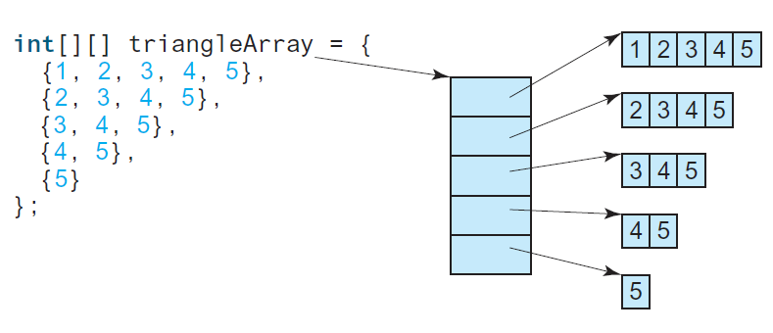
Ragged Arrays

Slide 11
Array Sizes
int[] a = {1, 2, 3, 4};
int[4]
int[][] b = { {1, 2, 3, 4}, {2, 3, 4, 5}, {3, 4, 5, 6} };
int[??][??]
int[][][] c = {
{ {1, 2, 3, 4}, {2, 3, 4, 5}, {3, 4, 5, 6} },
{ {4, 5, 6, 7}, {5, 6, 7, 8}, {6, 7, 8, 9} }
};
int[??][??][??]

Slide 12
Array Lengths
a.length
4
b.length ??
b[0].length ??
b[1].length ??
c.length ??
c[0].length ??
c[1].length ??
c[0][1].length ??
c[1][2].length ??

Slide 13
Rows and Columns
1 | 2
3 | 4
5 | 6
7 | 8
row
column
int[][] a = { {1,2}, {3,4}, {5,6}, {7,8} }; // int[4][2]
int[][] b = { {1,3,5,7}, {2,4,6,8} }; // int[2][4]
column
row
Row-first (or row-major order) is usually the more
natural choice.

Slide 14
Example: Print2DArray
Using for loop
Using for-each loop

Slide 15
More Array Examples
Find the row with the largest sum
Using a sumRow() method
Find the column with the largest sum
Using a sumCol() method

Slide 16
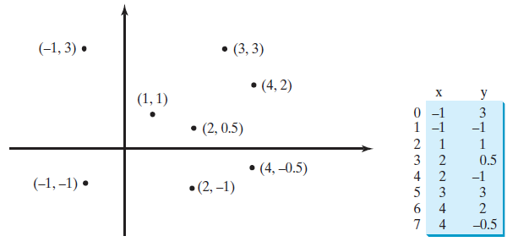
Exercise: Closest Points
Find the closest pair of points
Distance formula
How to get the distance of every pair?

Slide 17
Readings
Chapter 8 of the textbook (no quiz next week)

