Slide 1
CS2011 Introduction to Programming I Math Functions and Characters
Chengyu Sun
California State University, Los Angeles

Slide 2
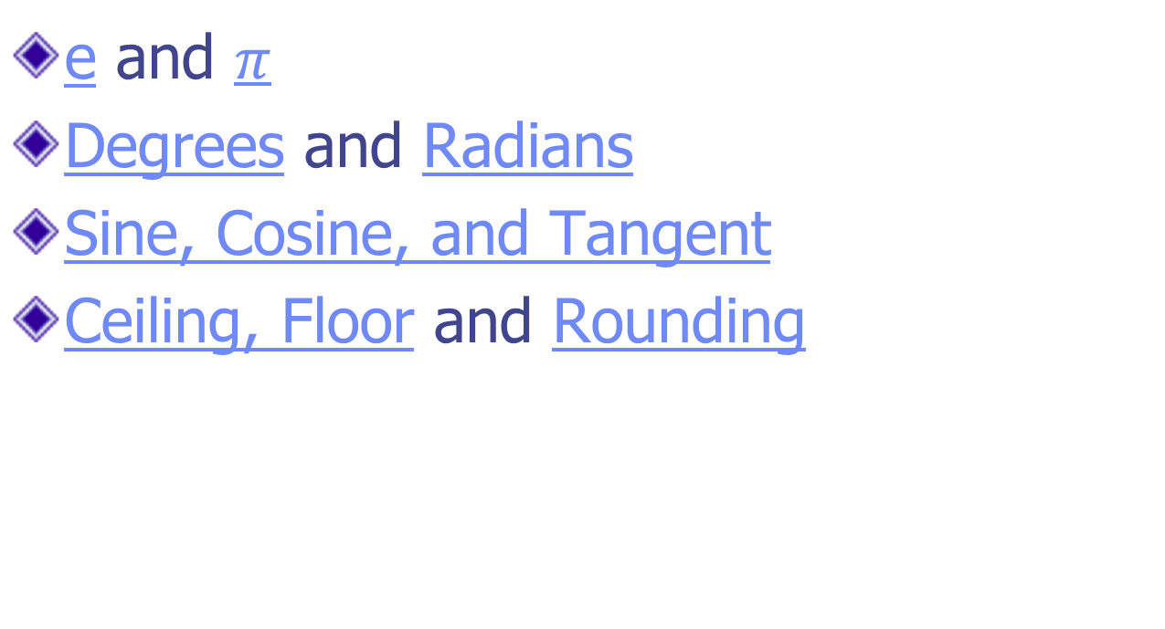
Math Is Fun
e and $π$
Degrees and Radians
Sine, Cosine, and Tangent
Ceiling, Floor and Rounding

Slide 3
Constants
Math.E
Math.PI

Slide 4
Trigonometric Methods
Method | Description
sin(radians) | Returns the trigonometric sine of an angle in radians.
cos(radians) | Returns the trigonometric cosine of an angle in radians.
tan(radians) | Returns the trigonometric tangent of an angle in radians.
asin(a) | Returns the angle in radians for the inverse of sine.
acos(a) | Returns the angle in radians for the inverse of cosine.
atan(a) | Returns the angle in radians for the inverse of tangent.
toRadians(degree) | Returns the angle in radians for the angle in degrees.
toDegrees(radians) | Returns the angle in degrees for the angle in radians.

Slide 5
Exponent Methods
Method | Description
exp(x) | Returns e raised to power of x
log(x) | Returns the natural logarithm of x
log10(x) | Returns the base 10 logarithm of x
pow(a, b) | Returns a raised to the power of b
sqrt(x) | Returns the square root of x

Slide 6
Rounding Methods
Method | Description
double ceil(x) | x is rounded up to its nearest integer value
double floor(x) | x is rounded down to its nearest integer value
double rint(x) | x is rounded to its nearest integer value
long round(double x) int round(float x) | x is rounded to its nearest integer value
Round to two digits after the decimal point??

Slide 7
Other Methods
Math.min( x, y )
Math.max( x, y )
Math.abs( x )
Math.random()

Slide 8
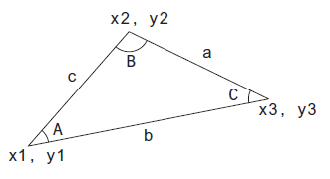
Example: Compute Angles
A = acos((a*a – b*b – c*c) / (-2*b*c))
B?? C??

Slide 9
The char Data Type
Represent a single character
char literals: 'A', '4'
Vs. String??

Slide 10
Operations on char
char can often be treated like an integer type. For example:
a = 'A';
++a;
b = 'A' * 2;
c = 'A' + 'B';
d = 'B' > 'A';
e = (char) 65.12;
But why? (and why you should be careful treating char as a number)

Slide 11
Encoding
Remember that computers use binary numbers internally
A character is stored as a sequence of 0s and 1s
There are different ways to map characters to binary sequences, known as encoding schemes

Slide 12
ASCII
Originally people thought they only needed to encode English letters, digits, and some symbols (e.g. +, -, &, |, etc.)
And it only takes 7 bit (or 1 byte with 1 bit to spare)
Character | Binary Encoding | Value
Space | 00100000 | 32
A | 01000001 | 65
B | 01000010 | 66

Slide 13
Unicode
Unicode is a character set (not an encoding!) that tries to include all the characters used by all the languages I the world
Currently (i.e. Unicode Version 11) includes 137,374 characters
Allow up to 1,112,064 characters

Slide 14
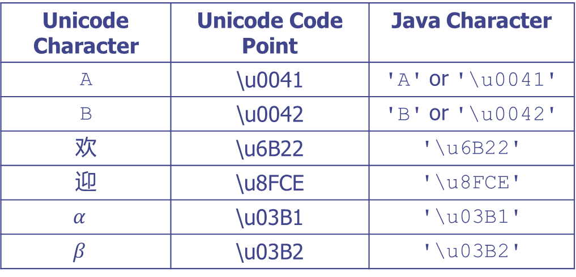
Unicode Characters and Code Points
Unicode Character | Unicode Code Point | Java Character
A | \u0041 | 'A' or '\u0041'
B | \u0042 | 'B' or '\u0042'
欢 | \u6B22 | '\u6B22'
迎 | \u8FCE | '\u8FCE'
$$α$$ | \u03B1 | '\u03B1'
$$β$$ | \u03B2 | '\u03B2'
Unicode code point uses hexadecimal (i.e. base 16) numbers
E.g. 0041 → 65, 0042 → 66

Slide 15
Unicode Encoding
There are multiple way to encode Unicode characters
The most commonly used Unicode encoding these days is UTF-8
Java internally use UTF-16
Most characters take two bytes (i.e. 16 bits)
Some characters (the so-called supplementary characters) take more than two bytes

Slide 16
Additional Reading on Character Set and Encoding
The Absolute Minimum Every Software Developer Absolutely, Positively Must Know About Unicode and Character Sets (No Excuses!) by Joel Spolsky

Slide 17
Escape Sequences for Special Characters
Tab??
New line??
Double Quote??
Back slash??

Slide 18
Some Methods in the Character class
isDigit( ch )
isLetter( ch )
isLetterOrDigit( ch )
isLowerCase( ch )
IsUpperCase( ch )
toLowerCase( ch )
toUpperCase( ch )

