Slide 1
CS2011 Introduction to Programming I About Computers and Programming Languages
Chengyu Sun
California State University, Los Angeles

Slide 2
Computers Are Everywhere
Desktops and laptops
Servers
Mobile devices
Inside machines, vehicles, "smart" appliances …

Slide 3
Computers Are Everywhere
Desktops and laptops
Servers
Mobile devices
Inside machines, vehicles, "smart" appliances …
Job opportunities for people who know computers

Slide 4
Hardware
Components, e.g. CPU, Memory, Hard drive
Peripheral devices
Input, e.g. mouse and keyboard
Output , e.g. monitor and printer
Communication devices, e.g. network card

Slide 5
Software
Instructions that tell computer what to do
A.K.A. Program, Application
Examples of software
Desktop/laptop ??
Mobile ??
Web ??
Embedded ??

Slide 6
Programming Language
A language used to write software (i.e. those instructions to computers)
Human Languages (computers don't understand, yet)
Programming Languages
Easy for humans to learn and use
Easy to translate into machine language
Machine Language (instructions in binary numbers)

Slide 7
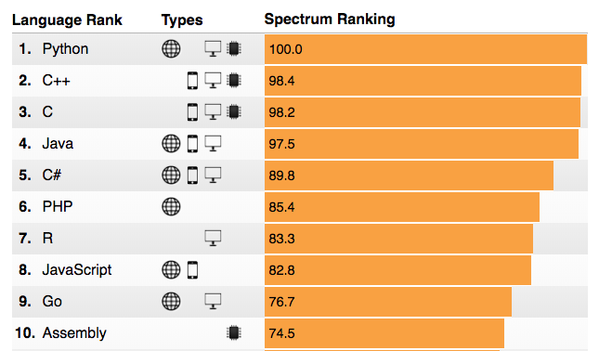
"Top" Programming Languages in 2018
According to IEEE Spectrum

Slide 8
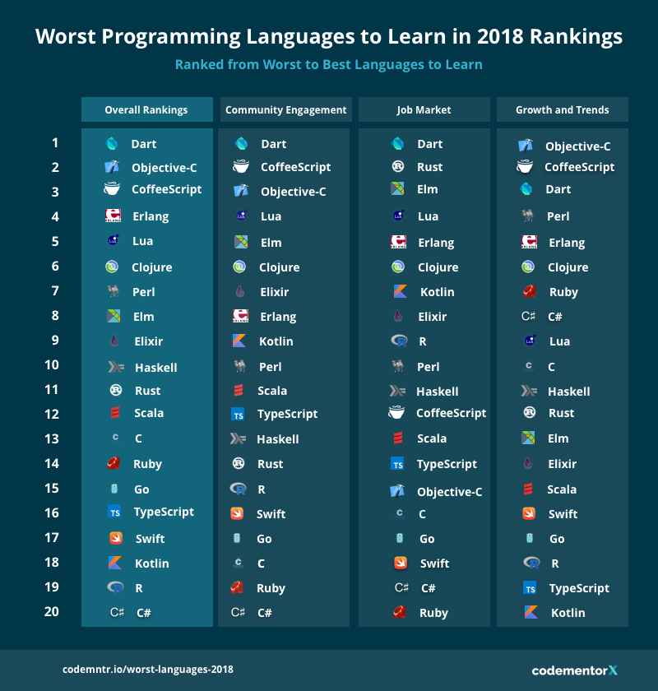
"Worst" Programming Languages 2018
According to CodeMentor

Slide 9
Q: How useful it is to learn one
programming language when
there seems to be hundreds
of them??
Ans: It's very useful

Slide 10
A Popular PL Is Used in Many Places
Java, for example, is used to build software that runs on desktop/laptop computers, web servers, database servers, smart phones, and embedded systems

Slide 11
PLs Are Similar to Each Other
Imperative
Languages
Functional
Languages
Logical
Languages
… so learning a 2nd, 3rd programming language is much easier than the 1st one

Slide 12
Q: Are there any tips for learning
the 1st programming language?
Ans: there are many, but let's
start with two.

Slide 13
A Story about Language
We have it indeed on the authority of
African explorers that many Hottentot
tribes do not have in their vocabulary
the names for numbers larger than three.
Ask a native down there how many sons he
has or how many enemies he has slain,
and if the number is more than three he
will answer "many."
From One Two Three … Infinity by George Gamow

Slide 14
A Trade of Pigs and Goats …
Suppose one pig is worth two goats, how do two Hottentot tribe members trade 4 pigs and 8 goats with each other??

Slide 15
… A Trade of Pigs and Goats
Icons made by Freepik from www.flaticon.com is licensed by CC 3.0 BY

Slide 16
Tip #1
Language determines how we
solve problems
Learning a new language is learning a new way of thinking
It is not just about the syntax and grammar, but more importantly, it's about how the language is used in different situations

Slide 17
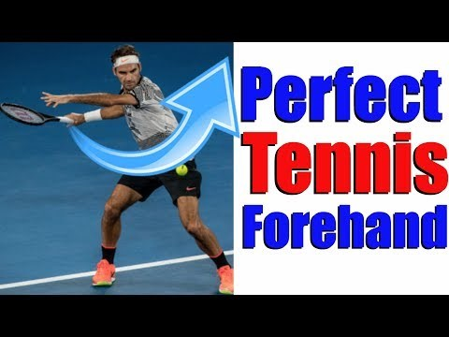
The Perfect Forehand in Tennis …
YouTube Video
How To Hit The Perfect Tennis Forehand In 5 Simple Steps

Slide 18
… The Perfect Forehand in Tennis
YouTube Video
How To Hit The Perfect Tennis Forehand In 5 Simple Steps
Do you think a person who never played
tennis before can hit a perfect forehand
after watching 15 minutes of YouTube
video?

Slide 19
Tip #2
Just like tennis, programming is a
skill that takes lots of practice
It takes very little time to learn the rules, but lots of time to become good at it
It doesn't take much talent, but does take much effort

