Slide 1
Department Meeting
Friday, Februarys 5th, 2021

Slide 2
Agenda
New BSCS and MSCS curricula
Fall 2021 Schedule and Planning
Q&As

Slide 3
New BSCS Program (Effective Fall 2021)
Changes
Phys2200, Math Elective, EE 3445 are no longer requirements.
CS 2445 and CS 2470 are new required courses.
1 unit increase for each of these classes: CS 2011, CS 2012, CS 2013, CS 2148, CS 3220
Starting from Fall 2021, we offer multiple sections of CS 2445 and CS 2470 every semester.
If you are interested in teaching these courses, indicate it in your teaching preference response.
Time module change for CS 2011, CS 2012, CS 2013, CS 2148, CS 3220.

Slide 4
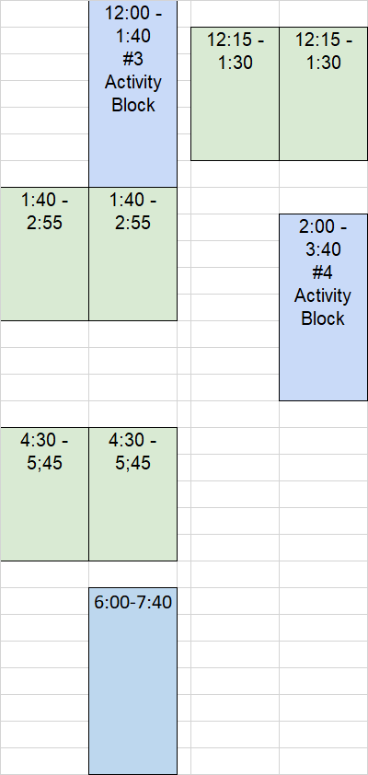
Time Module Change - 1
Additional time modules possibly from Spring 2022
CS 2011, CS 2012, CS 2013, CS 3220
3-unit Lecture (150 mins)
1-unit Activity (100 mins)
Fall 2021

Slide 5
Time Module Change - 2
CS 2148: 4-unit lecture (200 mins)
67 minutes classes on MWF
100 minutes evening classes on MW or TR
CS 3112, CS 3337, CS 3801: 3-unit lecture

Slide 6
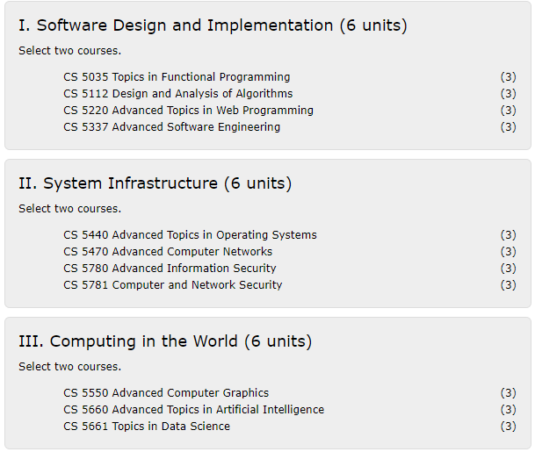
MS CS Curriculum (New) Effective Fall 2021 semester term
Three Thematic Areas:
Required Core (18 units)
Two courses from each of the three areas
Thesis Option (12 units)
2 additional electives (CS4000/CS5000)
CS 5990 Thesis (3 units) - 6 units over 2 semesters
Comp. Exam Option (12 units)
Take 4 additional electives (CS4000/CS5000)
Take CS5960 Comp Exam (0 units)

Slide 7
Offer Patterns
Each semester, offer at least one course per area.
III. Computing in the World
We offer CS 5661 for Spring.
Any course for Fall??

Slide 8
Fall 2021 Planning (online, hybrid, in-person)
Goal: Identify any class that requires in-person meetings and plan how to reduce capacity per meeting.
Guidelines
Classroom capacity – allow 40% occupancy of the room capacity (e.g. 12 for 30 capacity room)
Schedule block A – any in-person class should be scheduled for the block A.
Many things are uncertain at this point. So treat this discussion as an early planning that will go through several revisions.

Slide 9
Fall 2021 Planning (online, hybrid, in-person)
Suggested classes or course components :
Senior design projects (4 projects? – BOE, JPL, RoboSub, AR)
Lower division programming activity (lectures are online)
Upper division courses
Robotics (only two groups per week?)
One or two grad courses (hybrid lectures)
Comp Exam
Other exams – CS 4963 (MFT exams) in multiple class rooms?

Slide 10
Fall 2021 Planning (online, hybrid, in-person)
Required info by Fall 2021 in-person planning template
Specific room (e.g., computer lab or senior design room)
Proposed weekly meeting pattern
Proposed section length pattern
Proposed reduced capacity
Total proposed in-person class hrs for the semester

