Slide 1
Department Meeting
Friday, September 3rd, 2021

Slide 2
Agenda
Announcements
Important Dates
Phone # for ITC support
Protocol to handle positive case
Fall 2021 enrollment data
RTP
Department assistant and tutor
Discussion
Classroom experience sharing

Slide 3
Important Dates
Sep 6 (M) | Labor Day (University closed)
Sep 7 (Tu) | No record drop deadline (use GET to drop) Add deadline (includes applications for WPE (UNIV 4000), and CR/NC and ABC-/NC grading)
Sep 8 (W) | Withdrawal (W) period begins (requires instructor and department chair signatures on the Petition to Withdraw form; submit form to ADM 409)

Slide 4
ITC Support
For immediate IT support, call the ECST IT helpdesk phone number
1-669-900-6833 with meeting ID 3233434500.
Save this on your phones.
Emails inquiry and IT tickets are for non-urgent IT support.

Slide 5
Positive Case
Health Watch
https://www.calstatela.edu/healthwatch
Report Channel
Students to Health Center
Faculty/Staff to HR
Current understanding is that if a student tests positive and has attended class, faculty will be notified as part of process to determine whether the action for faculty and other students is testing only, or modified or full quarantine.
Current Covid sick leave policy good until December 31.
https://www.calstatela.edu/hrm

Slide 6
COVID-related Information
Find more details about campus COVID-19 protocols and answers to frequently asked questions on Health Watch. Policies and requirements regarding COVID-19 may change based on campus, local, state and/or federal guidelines; the Health Watch page is the best resource for current Cal State LA information.
https://www.calstatela.edu/healthwatch
COVID-19 Self-Certification by September 30

Slide 7
Your course info
Office hours - https://csns.cysun.org/wiki/content/department/cs/office-hours
Syllabus
Send your syllabus (in PDF) to Valentina

Slide 8
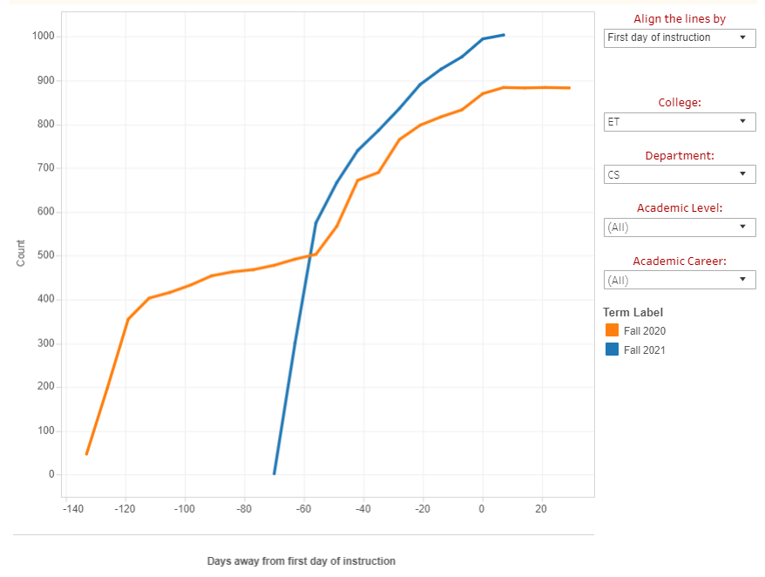
Fall 2021 – as of Aug 30
Department | CS
Freshman | 257
Sophomore | 154
Junior | 233
Senior | 274
Postbac | 1
Graduate | 85
Grand Total | 1,004

Slide 9
RTP 2021-2022
Probationary faculty in 2nd Year: File Closure by 9/20/2021
N. Forouzesh, D. Krum, J. Lim
Performance review: File closure by 10/11/2021
N. Amini
Range Elevation: File closure by 10/11/2021
G. Edmund
Post-tenure Review: File closure by 2/7/22
B. Parviz, J. Guo
Review of lecturers: Class visitation in Fall 2021
For renew (1 / 3 year renew)
For rehire for Spring 2022

Slide 10
Department Student Assistant and Tutor
Student Assistant
Juya Ahmadi (Grad)
20 hours / week
Mac support
Office support to Valentina
CS 2012-2013 tutoring (virtual)
Jackson Bently (Junior)
10 hours / week
CS 2011 (virtual)
CAS (Center for Academic Success)
3 tutors are available.

Slide 11
Your Experience for 2 weeks of Fall Semester
Canvas (default LMS)
Exception: CS 4961
Have a contingency plan: recommend to add a backup faculty to your Canvas shell
Syllabus
Post in-person meeting schedule
Post mask requirement and student support

