Slide 1
Computer Science

Slide 2
Agenda
Transfer Student Advisement (20 minutes)
Transfer Roadmap
Transfer Articulation Credits
Introduction to Undergraduate Study (20 minutes)
Why choose Computer Science
Project Showcase
Q & A (10 minutes)

Slide 3
Cal State LA: One of “America’s great working-class colleges”
“The colleges where the American dream is still alive”
https://www.youtube.com/watch?v=QhN4wBfQ9yI
3
Notes:
Congratulations on getting into Cal State LA.
The New York Times called Cal State LA one of “America’s great working-class colleges”.
We’re not famous and there isn’t much press coverage of what we do. But we do good work.
What we do is educate students. We help you build skills, find opportunity, and embark on good careers.
Cal State LA is the best place to go if you want upward mobility. We help students move up the economic ladder better than any other American college.
Vox is a news website, and they created a video that highlights Cal State LA as one of the colleges where the American dream is still alive. I encourage you to take the time to view it.

Slide 4
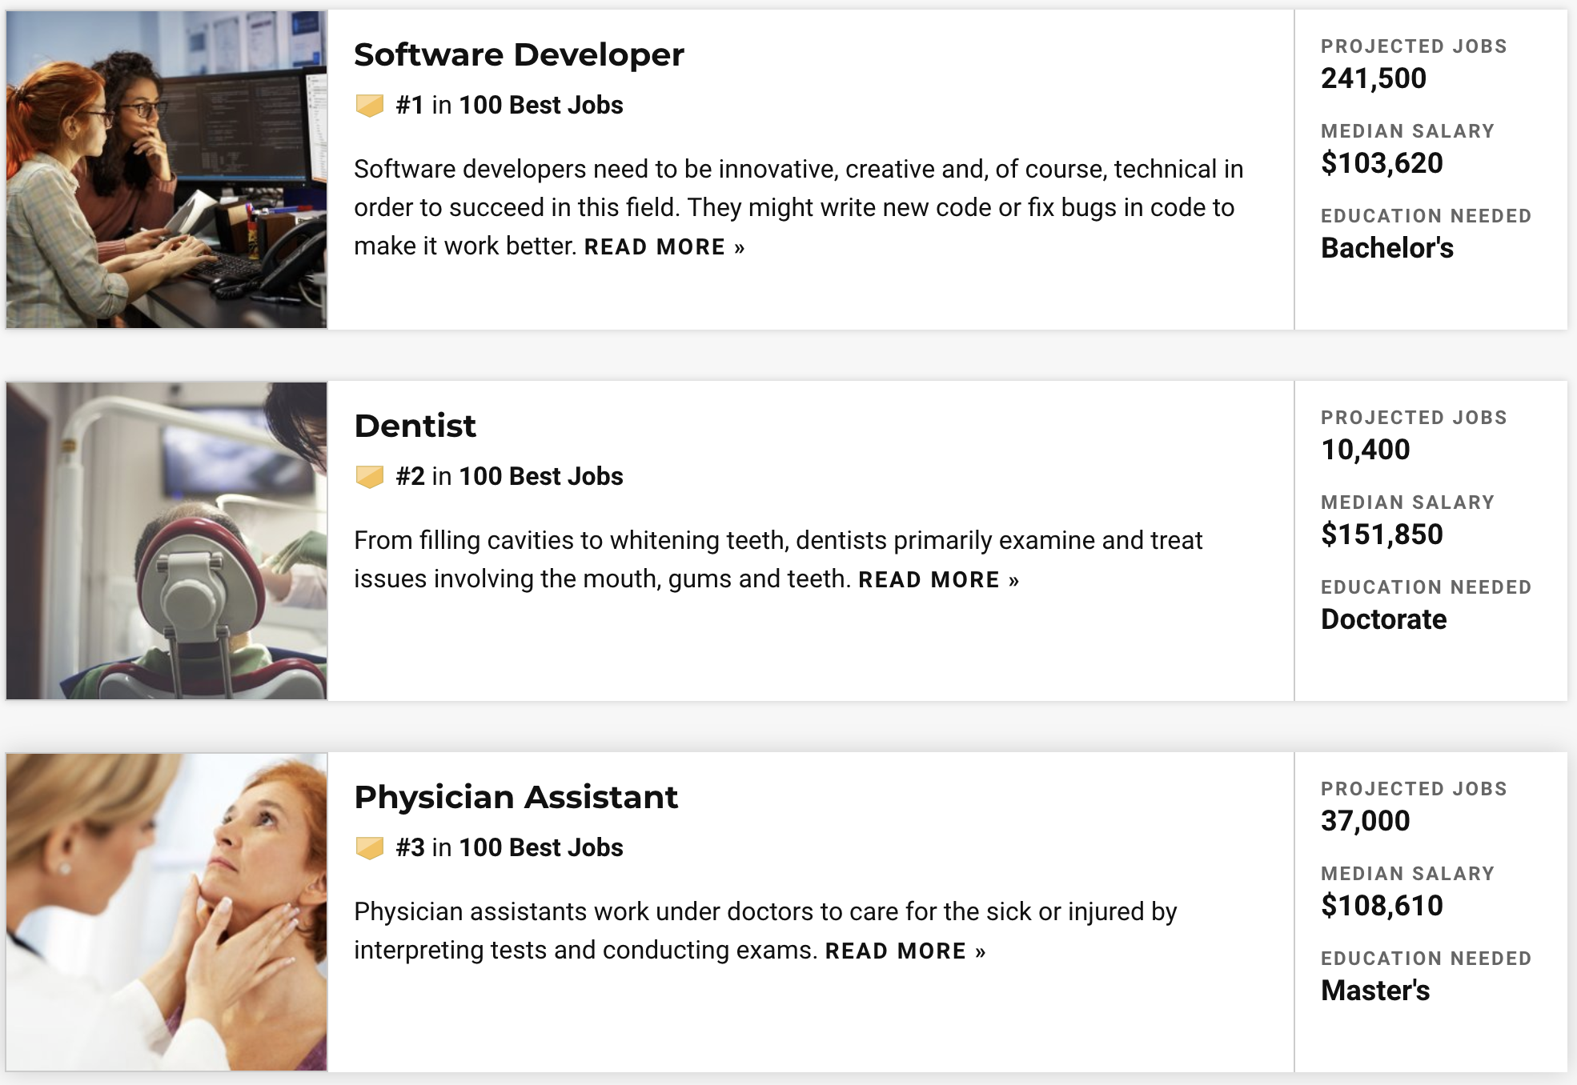
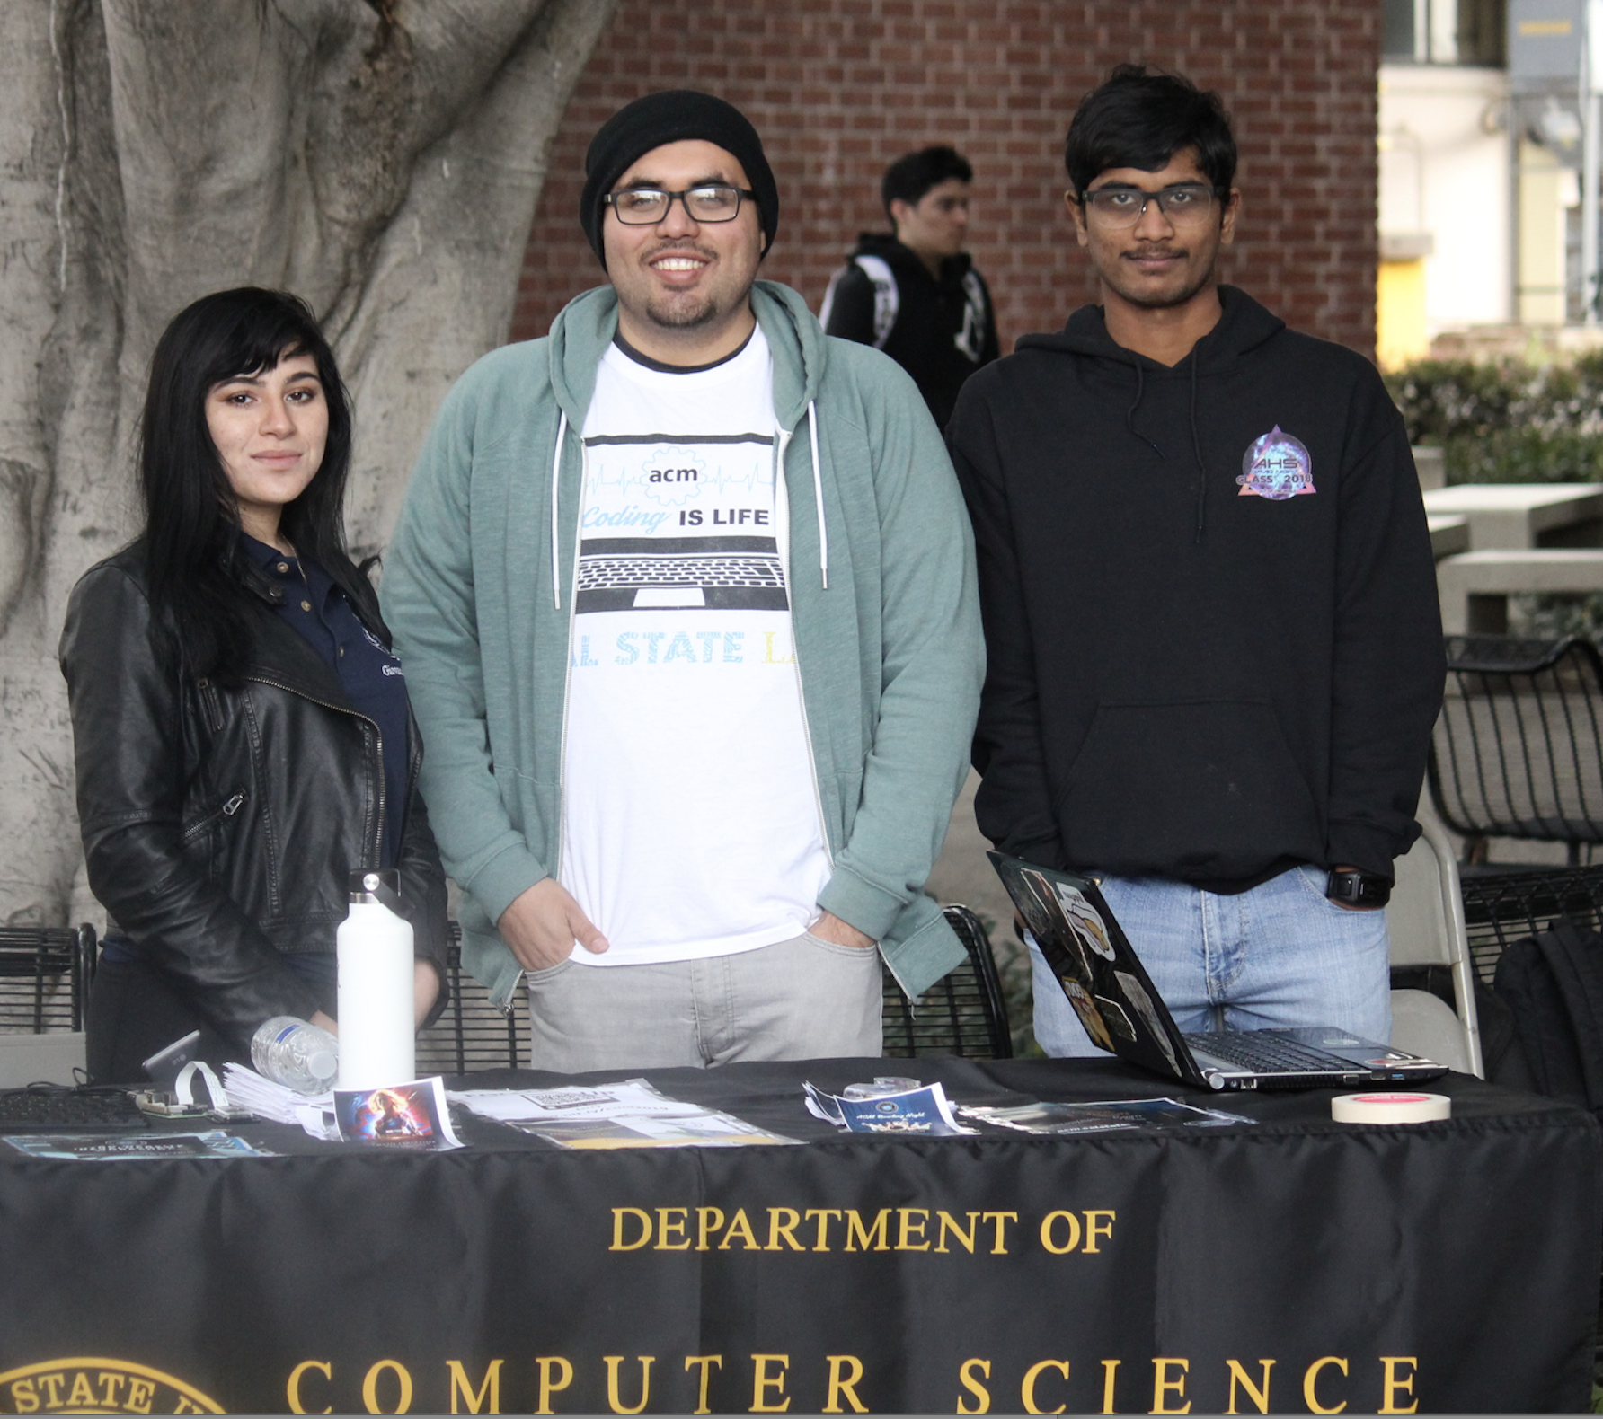
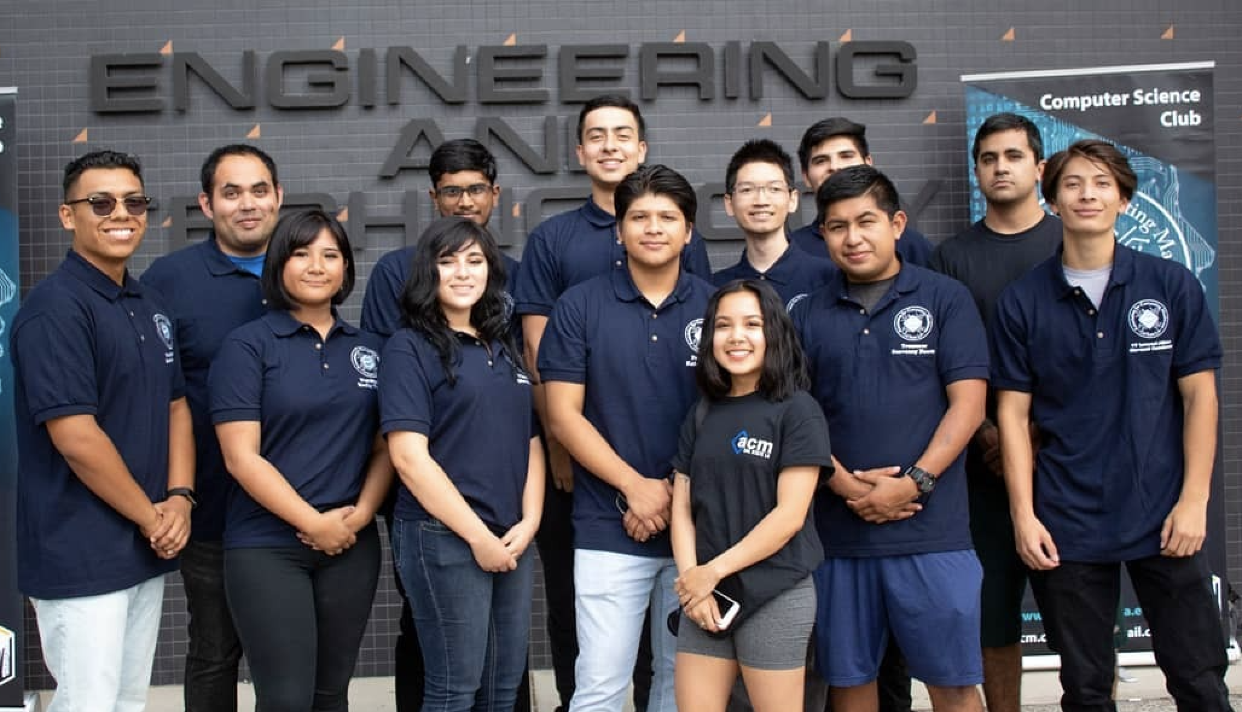
Best Jobs 2020 (Based on Prospects and Satisfaction)
#1 Software Developer
4
Notes:
These rankings are based on job prospects and job satisfaction. On the job satisfaction scale, being a software developer usually comes with above average flexibility. Overall, there will be job opportunities in the computing profession, the jobs earn good wages, and people enjoy their jobs.

Slide 5
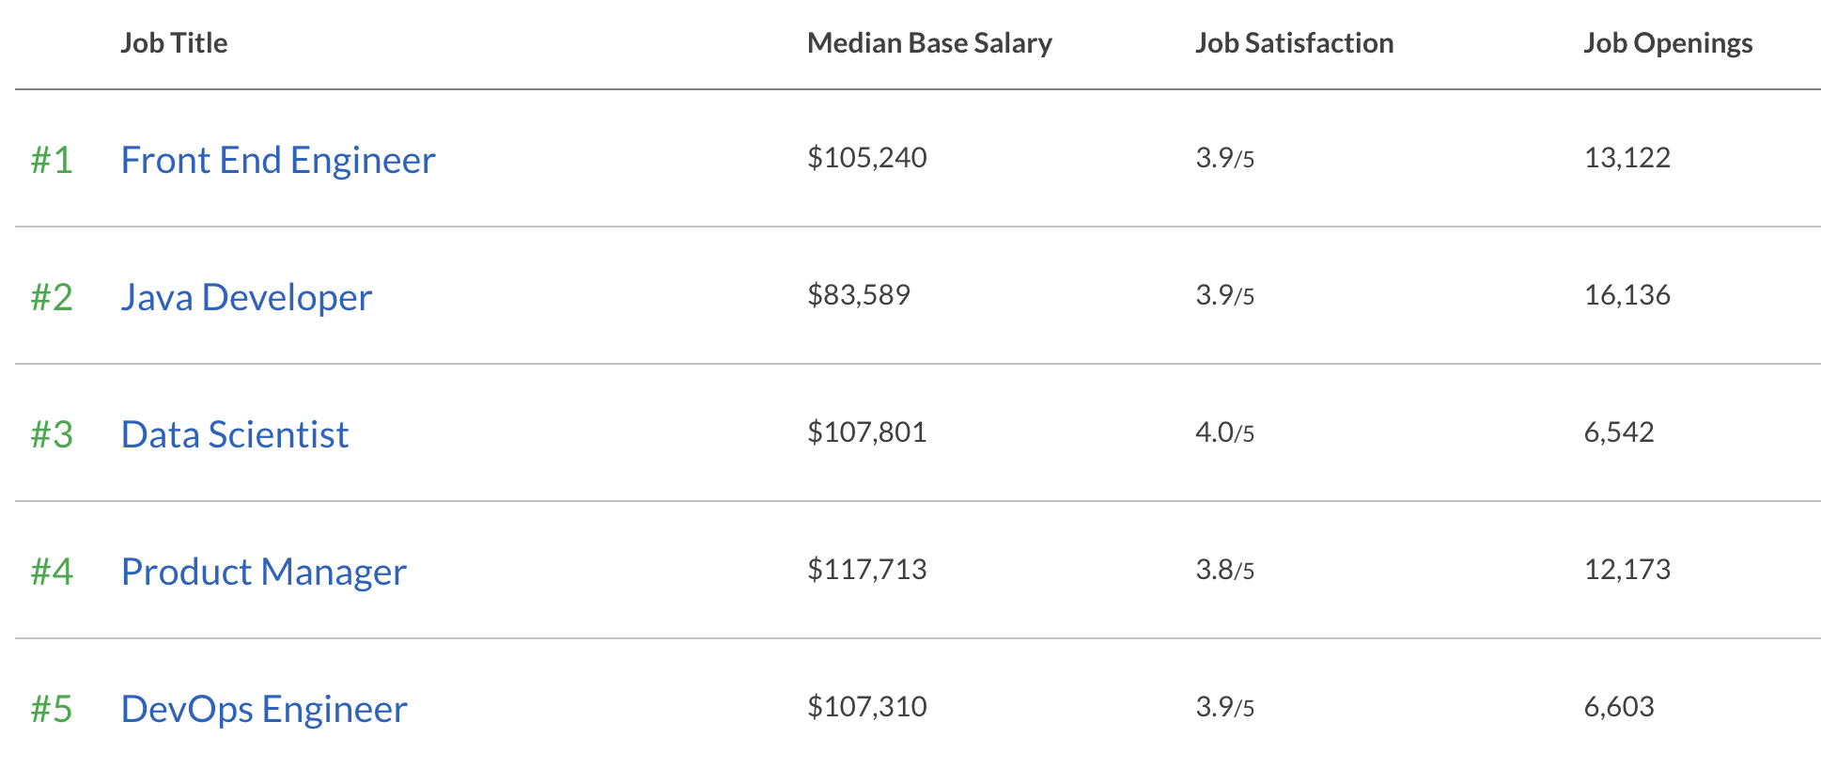
Best Jobs 2020 (Based on Salary and Satisfaction)
#1 Software Developer
5
Notes:
The front-end developer focuses on the look and feel of the site, along with its functionality.
DevOps (development and operations) is an enterprise software development phrase used to mean a type of agile relationship between development and IT operations. The goal of DevOps is to change and improve the relationship by advocating better communication and collaboration between these two business units.

Slide 6
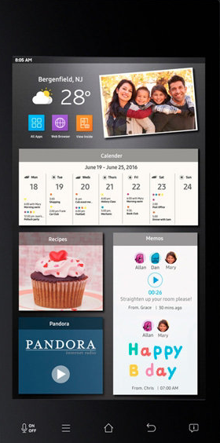
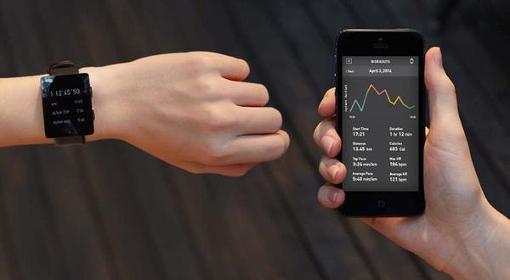
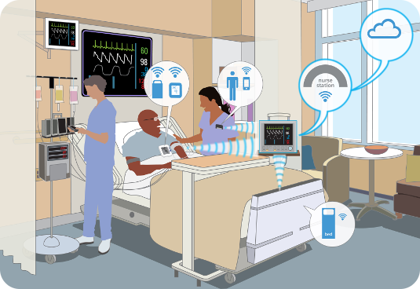
Computers Are Everywhere
Smart Appliances
Wearable Tech
Entertainment
Google Glass Enterprise
Healthcare
Automotive and Transportation
6
Notes:
They affect all aspects of our life.

Slide 7
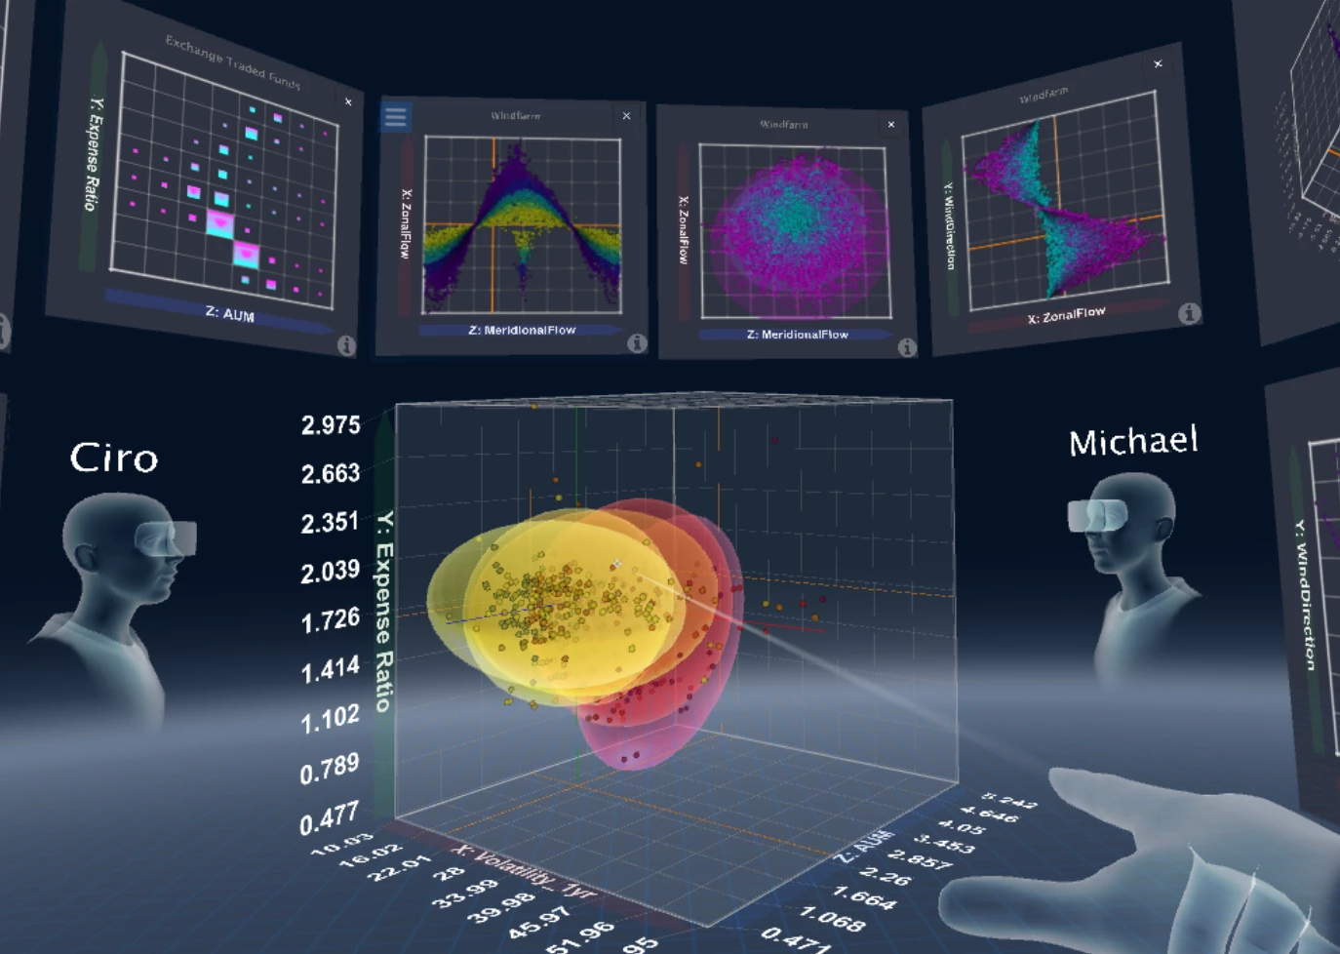
Solving Complex Problems to Make a Positive Difference
Computer Scientists build the tools that make the future possible
Discovering new drugs
Optimizing logistics and the supply chain
Organizing the world’s information
Supporting worldwide communication and collaboration
Exploring other planets
And more...

Slide 8
Job Satisfaction of our Alumni
8

Slide 9
Alumni Profiles
Phu Kieu (Class of 2012)
Senior Software Engineer
Google
Vignesh Saravanan (Class of 2018)
Software Engineer
Comcast
Mark Sargent (Class of 2015)
Software Engineer
Google
Mohammed Al Rawi (Class of 2018)
Chief Information Officer
LA County Public Defender
Sweta Shinde (Class of 2010)
Lead Engineer (Mobile App Dev.)
AutoGravity
Stacey O'Malley (Class of 2008)
Lead Engineer
Honeywell
9
Notes:
Job satisfaction. Giving back to the department and college.

Slide 10
Senior Design Capstone Project
Projects sponsored by
Businesses: large and small, local and global
Government: city, county, state, federal (e.g., Govt. printing office, DoD)
The university: other departments, colleges, etc.
Public-service organizations: Engagement, Service, and the Public good (e.g., hospitals, libraries)
Year long group projects: typically five students and one or two faculty advisors
https://csns.calstatela.edu/department/cs/projects
10

Slide 11
Senior Design Capstone Project
Provide students with a capstone experience in which they apply their theoretical knowledge to real-world applications.
Get to know potential employees over an extended period—like a hassle-free year-long internship
Improve students’ resumes and job prospects
11

Slide 12
Sample Project: Modernizing PD Legacy Repositories
Office of the Public Defender, LA County
Advisor: Chengyu Sun
Liaison: Mohammed Al Rawi

Slide 13
Sample Project: Collaborative Visualization for Solar System Treks
Advisor: David Krum
Liaison: Emily Law
https://trek.nasa.gov

Slide 14
Student panel
Discussions

Slide 15
Thank you

