Slide 1
Department Meeting
Friday, January 21st, 2022

Slide 2
Agenda
Welcome
Spring 2022
Enrollment data
Reminders
CS 4962
Fall 2022 and beyond
Q&A

Slide 3
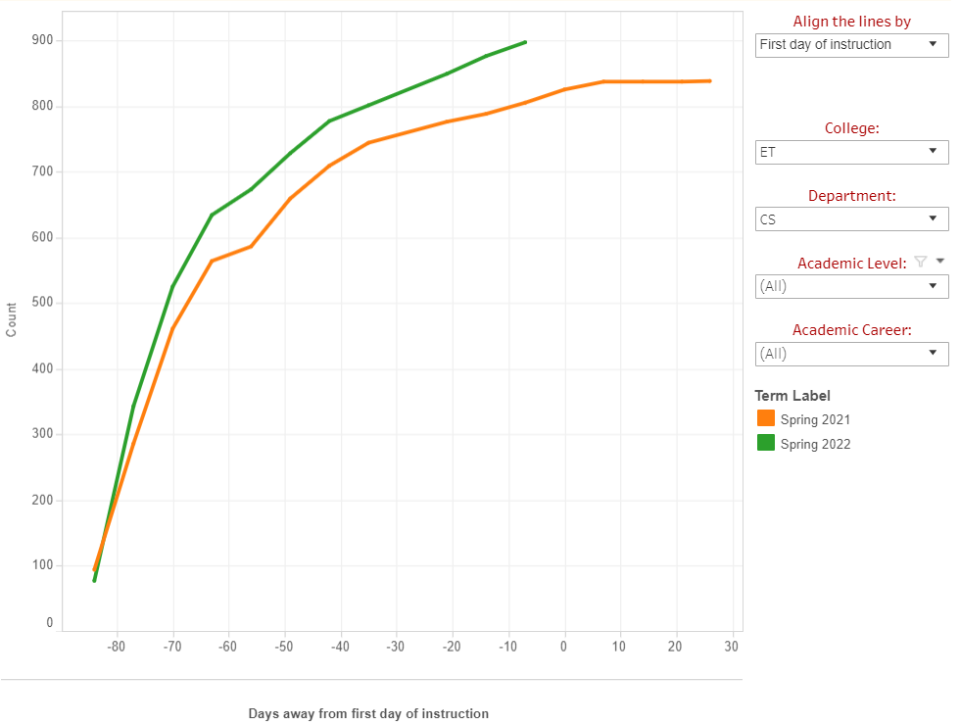
Spring 2022 – Enrollment Data
as of Monday, Jan 17

Slide 4
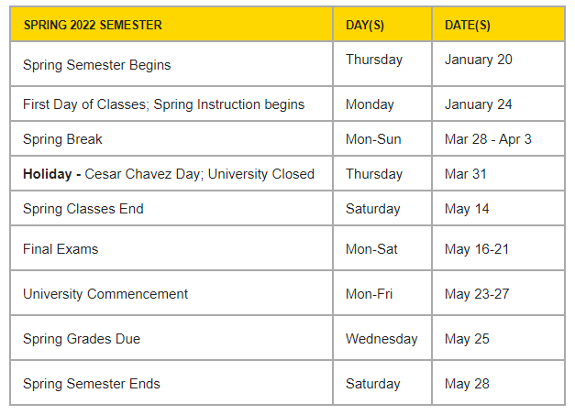
Spring 2022 – Academic Calendar and Instruction
Jan 24 – First Day of Classes
The first 3 weeks – remote for all courses (no exception)
You are allowed to use your office to teach remotely.
In-person meeting: required to wear a surgical mask at minimum or a N95 mask.
EPITA students (20-22 students) – CS 1222, CS 2013, CS 2148, CS 3220

Slide 5
Spring 2022 – Academic Calendar and Instruction
Are you ready to start your class?
Syllabus approval – invite me to your canvas for 10 days
Materials on Canvas?
Zoom meeting setup?
Office hours?
Need a headset? Pick one at the dept office.
Need a webcam? Request one.
Need a mic and a portable speaker for in-person meeting? Send me email.
Anything?

Slide 6
Spring 2022 – Student Hires
TAs/GAs/Graders
Contact your TAs/GAs/Graders and coordinate the work.
Give access to canvas shell
Set a regular meeting time
Introduce your TA to the class
2 Tutors for CS 2011-2013: tutoring on zoom, 12 hours/week
Hugo Gomez (hgomez32@calstatela.edu):
MW: 1pm - 2pm
TTH : 8am -12pm and 3pm - 4pm
Jack Bentley (jbentle6@calstatela.edu):
MW: 9am - 12pm and 4:30pm - 5:30pm Friday: 12pm - 4pm
Student Assistants
Avani Dungarwal
Juya Ahmadi

Slide 7
Spring 2022 – Meetings
ECST Welcome Week (Jan 24-Jan 28):
CS dept presentation (1/27, 3-3:30)
Need a volunteer(s) – Soo & David
Department Meetings
On every 2nd and 4th Fridays of the month
Feb 11, Feb 25, Mar 11, Mar 25, April 8, April 22, May 13
11AM – 12:30PM

Slide 8
Spring 2022 – Department Retreat
Feb 25, 9AM-1PM
Discussion items
Strategic planning
Discussion on online/hybrid courses (not one-time exception)
Approved courses : CS 3186, CS 4661, CS 4662
Review PEOs, eval data
Department resources (identify, justify, and request)
Scale Up for Fall 2022 and beyond
Lecturer pool
CS electives
Grad courses (CS 5035 and more)
Senior design
Anything else?

Slide 9
Spring 2022 – Faculty Search
Successful hiring
2-3 new junior faculty
Plan
Semi-finalist interviews in Feb
Finalist interviews in early Mar

Slide 10
Online/Hybrid Course Proposals
Term offering online/hybrid courses | Course Proposals | Approved Courses
Spring 2022 | One-time exception approval required | CS 2445, CS 3186*, CS 3220, CS 3801, CS 4440, CS 4662*
Fall 2022 | One-time exception approval required | CS 3186*, CS 4661* CS 1222, CS 2012, CS 2148, CS 2445 (not yet), CS 3220, CS 3801 (not yet), CS 4440, CS 4550, CS 4780
Spring 2023 | One-time exception approval required
Fall 2023 and beyond | Regular course mod approval required (submit course mod proposals in Spring 2022) Course mod template AY 2023-2024 is available on curriculog. | CS 3186* CS 4661* CS 4662* TBD during the department retreat

Slide 11
Department Committee
CS Department
Committee/Taskforce Name | 2021-2022
 | Committee Member (Chair*) | Alternate
RTP Committee (elected) | H. Guo, Z. Ye, Y. Zhu* | B. Parviz
Post-tenure eval (elected) | E. Kang*, C. Sun, H. Guo
Faculty Search (elected) | N. Amini, B. Parviz, H. Guo*
Lecturer Review (elected) | M. Pourhomayoun, C. Sun*, Z. Ye | Y. Zhu
Lecturer Eval Taskforce (class visitations) | Amini, Krum*, Forouzesh, Lim
IAC (syllabi, course proposals, course redesign, program mods, certificate programs, textbook selection) | Pourhomayoun*, C. Sun, R. Pamula, N. Amini, J. Lim
SAC (orientations, scholarship, advisement, events) | Amini, Forouzesh*, Jrum
Senior Design | J. Lim, C. Sun*
Graduate Program (orientations, admission, Comp. Exam, Thesis scheduling, academic standing) | B. Parviz*, R. Pamula
IAB ((IAB meetings, internships, professional development) | Krum*, Pourhomayoun, Forouzesh, J. Guo, N. Amini
Research (program promotion, grants, …) | Pourhomayoun*, J. Guo, Y. Zhu
Assessment | C. Sun*, R. Pamula

Slide 12
CS 4962

Slide 13
Have a great Weekend!

