Slide 1
Computer Science
M.S. Program Information Session & Orientation
Department Chair: Dr. Eun-Young (Elaine) Kang
Faculty Advisors: Dr. Raj S. Pamula & Dr. Behzad Parviz
Graduate Coordinator: Lupe Martinez
Department Coordinator: Valentina Ovasapyan
Notes:
Welcome and introduce ourselves

Slide 2
MS CS Program
http://www.calstatela.edu/ecst/cs

Slide 3
Agenda
Admission to CS MS
Standing
Curriculum CS MS
Requirements
Roadmap
Fall 2021 Registration Help
Identify your courses
Receive permits
Q&A
Notes:
The agenda for this information session will be as follows:

Slide 4
CS MS Admission & Graduate Standing
Conditional Admission (G1 standing)
Admission with a few prerequisite courses such as Programming (CS 3035), Algorithms (CS 3112), Web (CS 3220), and Software Engineering (CS 3337).
Must complete prerequisite courses by the end of the first semester
Classified Admission (G2 standing)
CS4000/5000 courses
Advanced to Candidacy (G3 standing)
Electives, Thesis, Comprehensive Exam
4

Slide 5
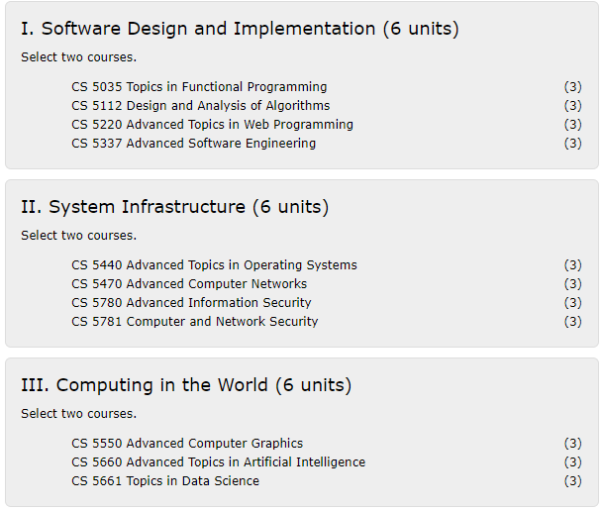
MS CS Curriculum
Three Thematic Areas:
Required Core (18 units)
Two courses from each of the three areas
Thesis Option (12 units)
2 additional electives (CS4000/CS5000)
CS 5990 Thesis (3 units) - 6 units over 2 semesters
Comp. Exam Option (12 units)
Take 4 additional electives (CS4000/CS5000)
Take CS5960 Comp Exam (0 units)

Slide 6
List of Graduate Courses
Students completing CS 5960 Comprehensive Exam select 12 units and students completing CS 5990 Thesis select 6 units to satisfy the degree requirement.
CS 4075 - Concurrent and Distributed Programming (3)
CS 4112 - Competitive Programming (3)
CS 4188 - Compilers (3)
CS 4220 - Current Trends in Web Design and Development (3)
CS 4222 - Principles of Data Base Systems (3)
CS 4470 - Computer Networking Protocols (3)
CS 4471 - Computer Networks Configuration and Management (3)
CS 4540 - Topics in Advanced Computer Science (1-3)
CS 4550 - Computer Graphics (3)
CS 4551 - Multimedia Software Systems (3)
CS 4555 - Introduction to 3D Computer Game Programming (3)
CS 4556 - Multiplayer Online Game Design and Development (3)
CS 4635 - Modeling and Simulation (3)
CS 4660 - Artificial Intelligence (3)
CS 4661 - Introduction to Data Science (3)
CS 4662 - Advanced Machine Learning and Deep Learning (3)
CS 4663 - Deep Learning (3)
CS 4780 - Cryptography and Information Security (3)
CS 5035 - Topics in Functional Programming (3)
CS 5112 - Design and Analysis of Algorithms (3)
CS 5188 - Languages and Translators (3)
CS 5220 - Advanced Topics in Web Programming (3)
CS 5337 - Advanced Software Engineering (3)
CS 5390 - Advanced Software Architecture (3)
CS 5440 - Advanced Topics in Operating Systems (3)
CS 5470 - Advanced Computer Networks (3)
CS 5540 - Graduate Topics in Computer Science (3)
CS 5550 - Advanced Computer Graphics (3)
CS 5660 - Advanced Topics in Artificial Intelligence (3)
CS 5661 - Topics in Data Science (3)
CS 5780 - Advanced Information Security (3)
CS 5781 - Computer and Network Security (3)
CS 5980 - Graduate Directed Study (1-3)

Slide 7
Roadmap: Classified Admission (G2)
Thesis Option | Fall 2022 | Spring 2023 | Summer 2023 | Fall 2023 | Spring 2024 | Summer 2024
 | CS Core 1 | CS Core 3 |  | CS Core 5
 | CS Core 2 | CS Core 4 |  | CS Core 6
 | CS Elective 1 | CS Elective 2 |  | CS 5990 | CS 5990
Comp Exam Option | Fall 2022 | Spring 2023 | Summer 2023 | Fall 2023 | Spring 2024 | Summer 2024
 | CS Core 1 | CS Core 3 |  | CS Core 5 | CS Elective 4
 | CS Core 2 | CS Core 4 |  | CS Core 6
 | CS Elective 1 | CS Elective 2 |  | CS Elective 3 | CS 5960

Slide 8
Roadmap: Provisional Admission (G1)
Thesis Option | Fall 2022 | Spring 2023 | Summer 2023 | Fall 2023 | Spring 2024 | Summer 2024
 | Prerequisite 1 | CS Core 1 | CS Elective 1 | CS Core 4 | CS Elective 2
 | Prerequisite 2 | CS Core 2 |  | CS Core 5 | CS Core 6
 | Prerequisite 3 | CS Core 3 |  | CS 5990 | CS 5990
Comp Exam Option | Fall 2022 | Spring 2023 | Summer 2023 | Fall 2023 | Spring 2024 | Summer 2024
 | Prerequisite 1 | CS Core 1 | CS Elective 1 | CS Core 4 | CS Elective 3
 | Prerequisite 2 | CS Core 2 | CS Elective 2 | CS Core 5 | CS Elective 4
 | Prerequisite 3 | CS Core 3 |  | CS Core 6 | CS 5960

Slide 9
Fall 2022 Registration
Available courses for Fall 2022
CS 3112
CS 3220
CS 3035
CS 3337
CS 4075
CS 4222
CS 4470
CS 4780
CS 5220
CS 5337
CS 5390
CS 5781
I’m admitted. What’s next?
Registration:
Check Schedule of Classes at
https://www.calstatela.edu/registrar/schedule-classes
Course descriptions (University Catalog > Course Descriptions)

Slide 10
How to register on GET
Available courses for Fall 2022
CS 3112
CS 3220
CS 3035
CS 3337
CS 4075
CS 4222
CS 4470
CS 4780
CS 5220
CS 5337
CS 5390
CS 5781
Learn about GET - https://www.calstatela.edu/registrar/get
Enroll/Register for Classes (https://www.calstatela.edu/registrar/registration-enrollment)
Steps:
Resolve Holds
Plan your Class Schedule with Schedule Planner
Pay tuition and fees
Online payment: https://commerce.cashnet.com/cashneti/static/epayment/csulapay/login
Obtain permits if needed
G1 students : need permits for any courses
G2 students : need permits for 4000-level courses and some 5000-level courses
Enroll
Permits valid until 7/8

Slide 11
Course Registration
Available courses for Fall 2022
CS 3112
CS 3220
CS 3035
CS 3337
CS 4075
CS 4222
CS 4470
CS 4780
CS 5220
CS 5337
CS 5390
CS 5781
Things to remember:
CS 3112 Algorithms is a prerequisite to all the CS 4000 level courses.
CS 4440 Operating Systems is not an elective course for MSCS students.
CS 5000 levels for G2 students. Some CS 5000 level courses have CS 4000-level prerequisites.
Suggested plan for Fall 2022
G1: Prerequisite courses + 4000-level courses (need permits for any courses)
G2: CS 4000/5000-level courses (need permits for some classes)
Permits valid until 7/8

Slide 12
G1 Students
Upon completion of your admission condition, Change from Conditional Classified to Classified Status by submitting a GS-8 form. https://www.calstatela.edu/sites/default/files/users/u50136/gs_8_re._8.21.19.pdf
Submission instruction at https://www.calstatela.edu/ecst/cs/forms.

Slide 13
Resources
Office of Graduate Studies:
https://www.calstatela.edu/graduatestudies/funding-opportunities
E-meet a faculty advisor
https://www.calstatela.edu/ecst/cs/cs-faculty-advising-and-office-hours
One-stop Financial Services
https://www.calstatela.edu/finance-onestop
Online payment
https://commerce.cashnet.com/cashneti/static/epayment/csulapay/login

Slide 14
Questions?

Slide 15
Tuition Fee Calculation
International Students' Orientation

Slide 16
CASHNET PORTAL - International Student Fee
01
PICK SEM
03
NON-RES
05
Choose the semester for fee payment
Add the non- residential fee
LOGIN PAGE
02
ADD TUITION
04
PAY
Login with your CIN & Date of Birth
Choose the number of credits and add fee
Credit card, International Flywire

Slide 17
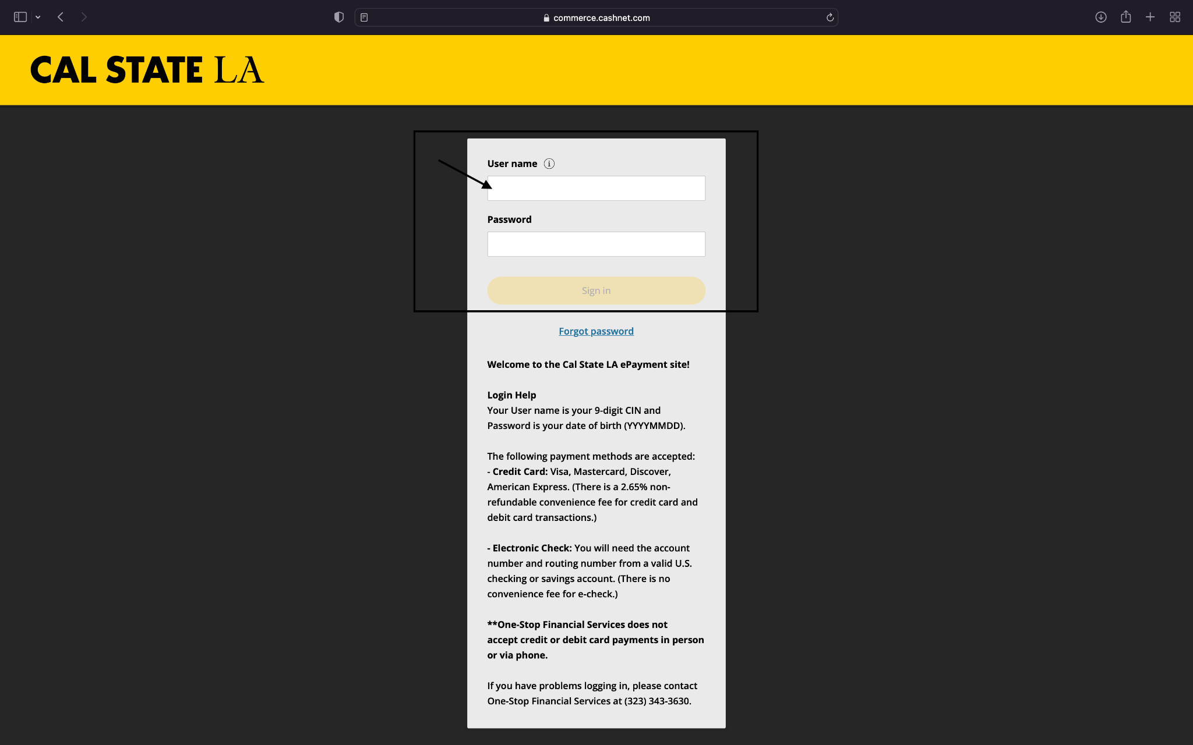

Slide 18
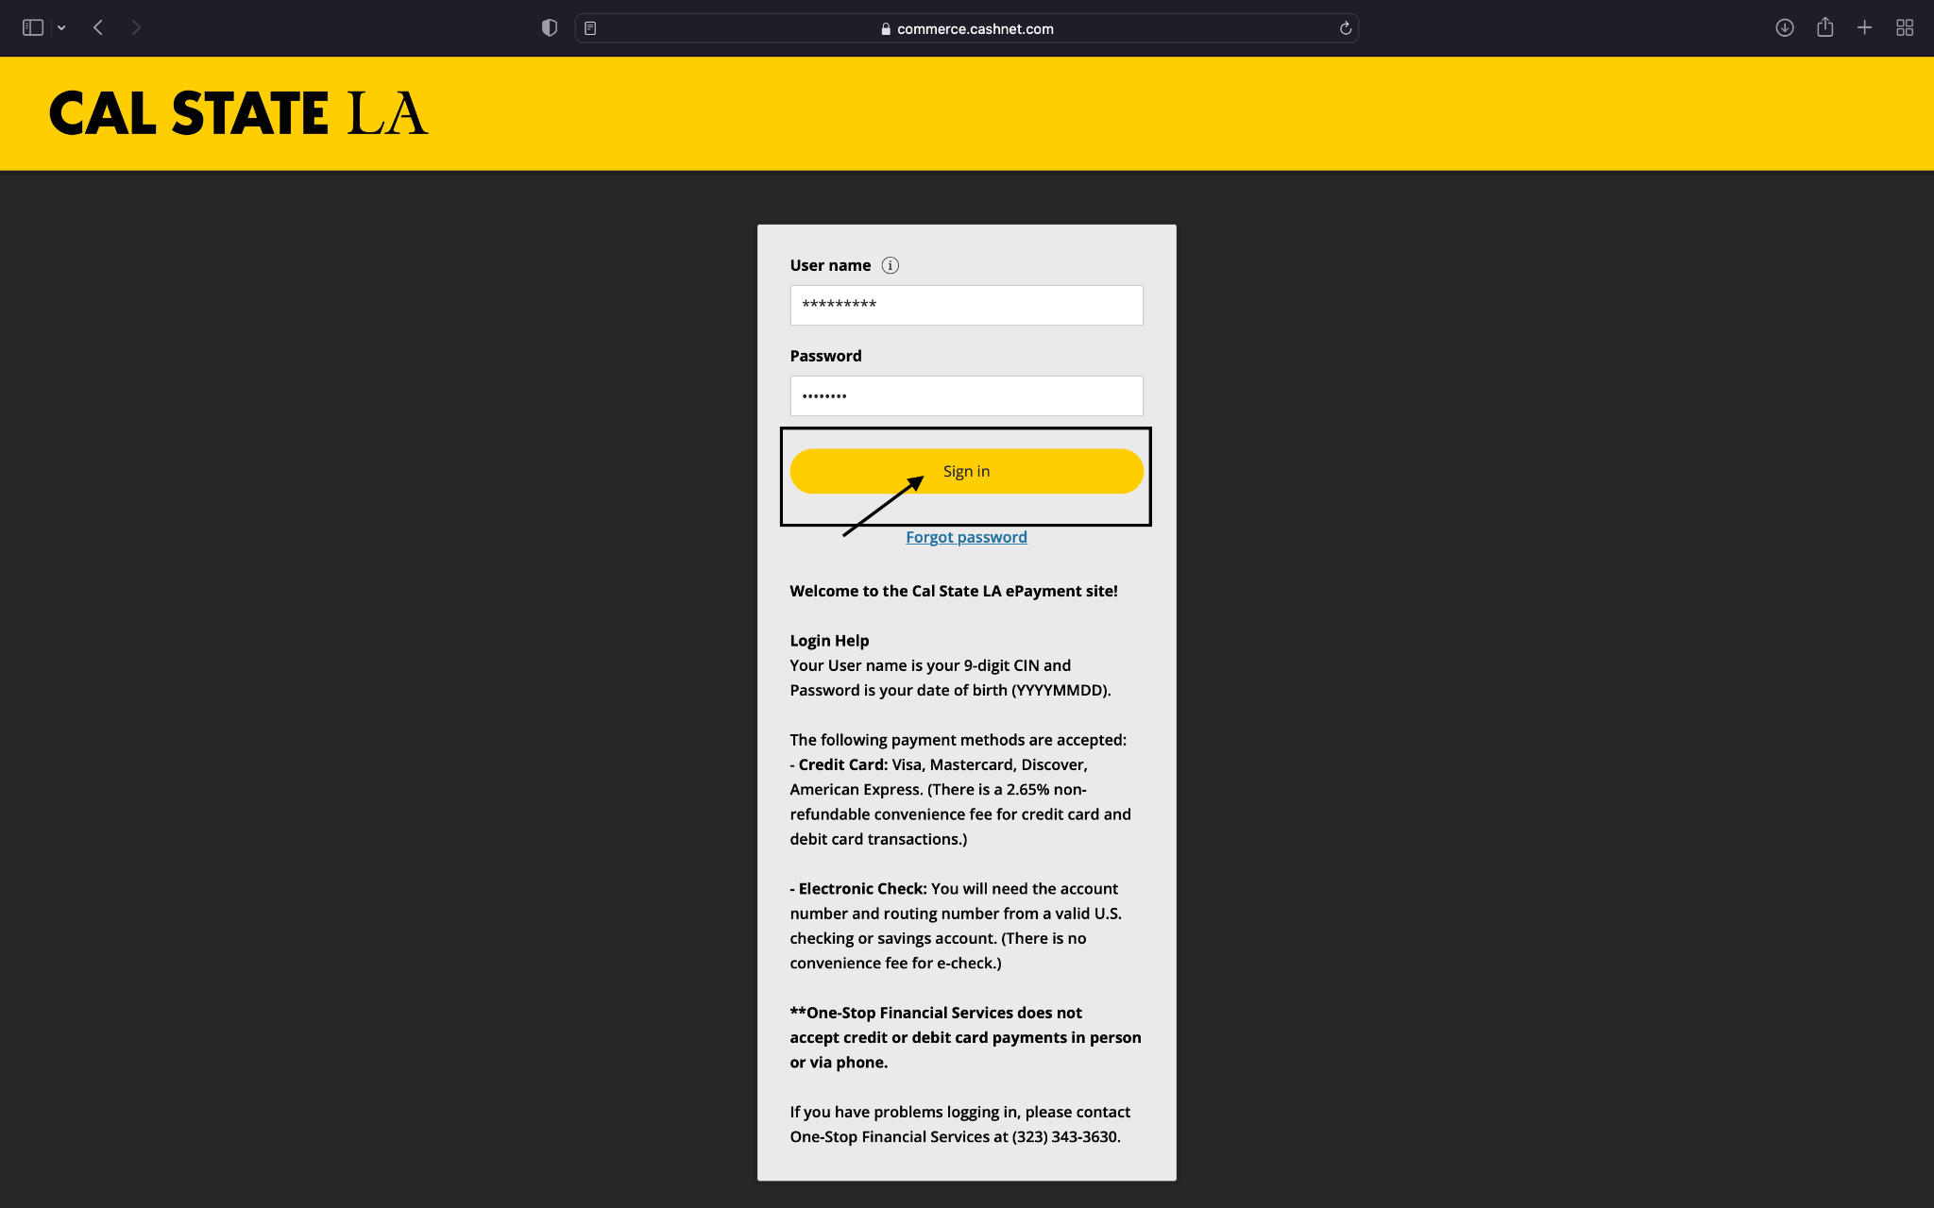

Slide 19
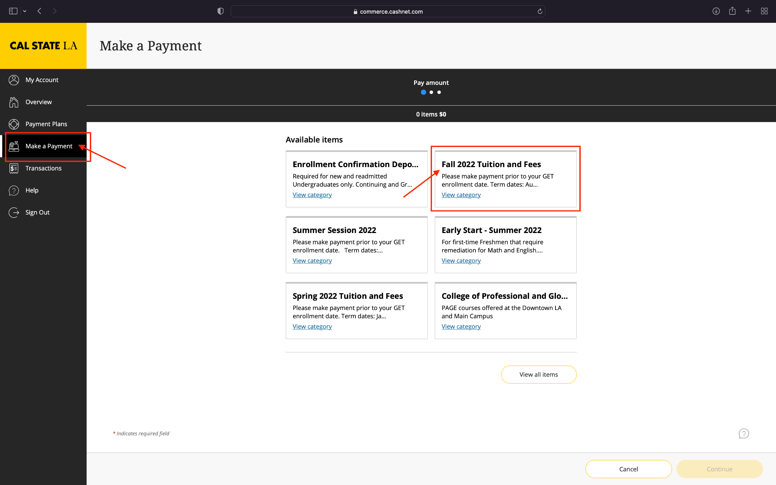

Slide 20
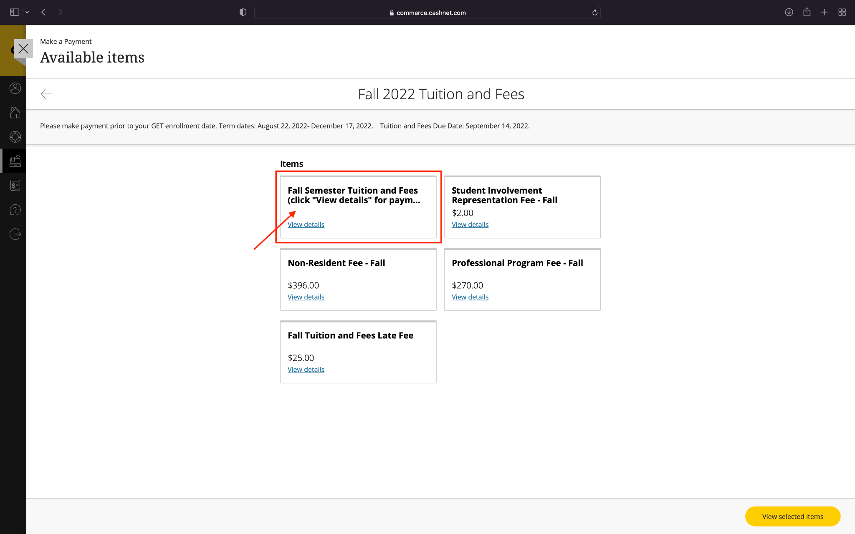

Slide 21
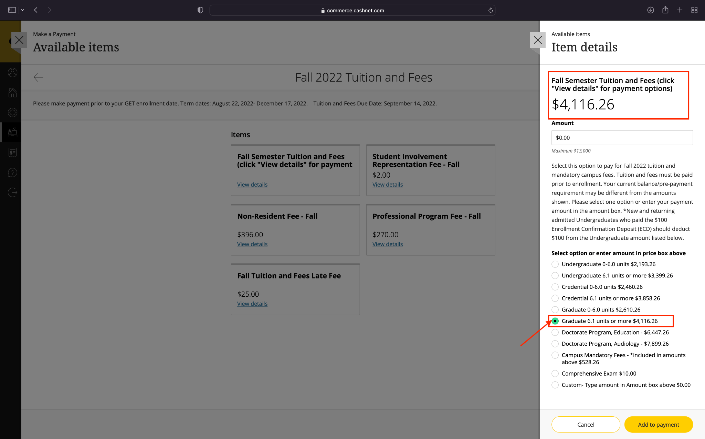

Slide 22
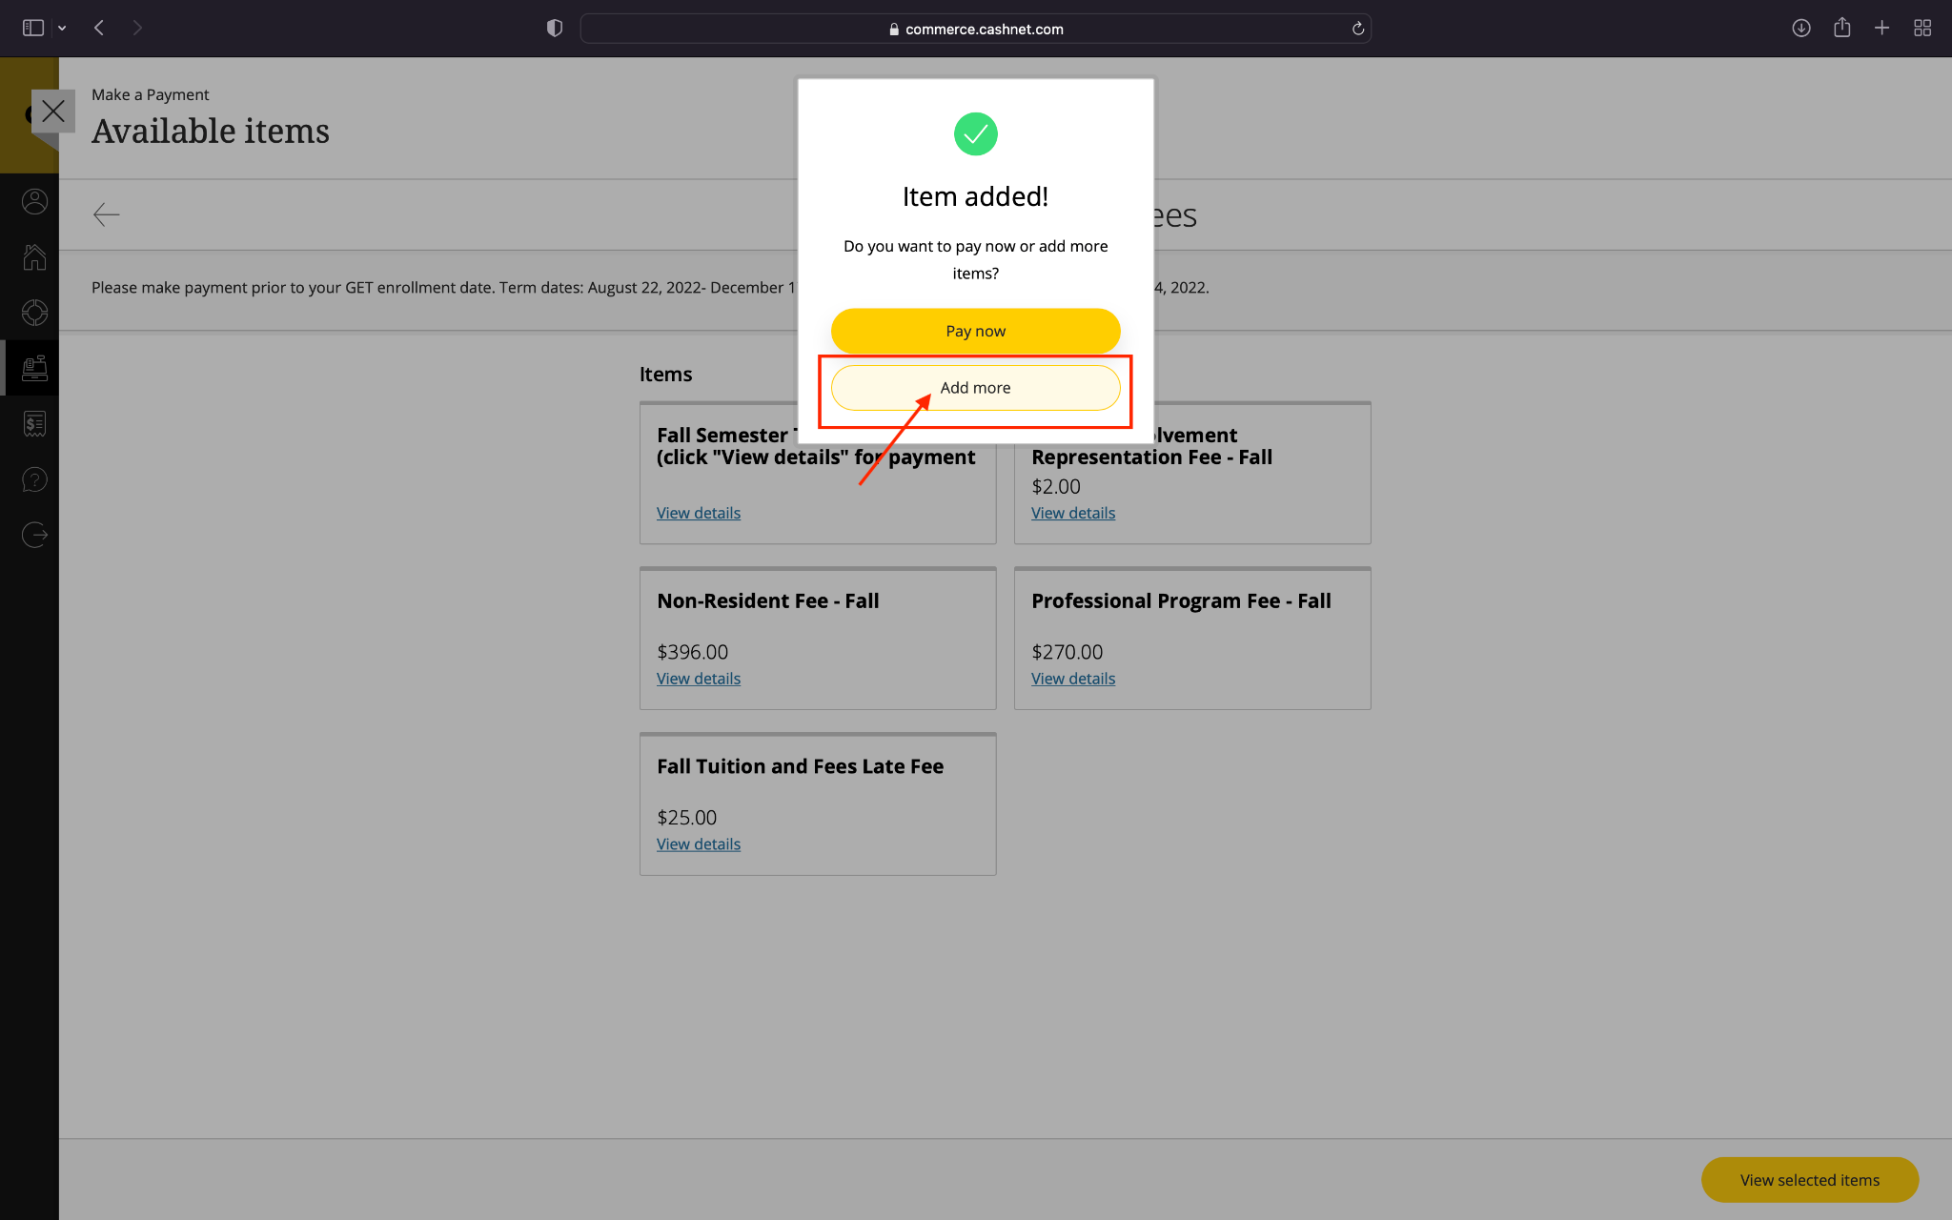

Slide 23
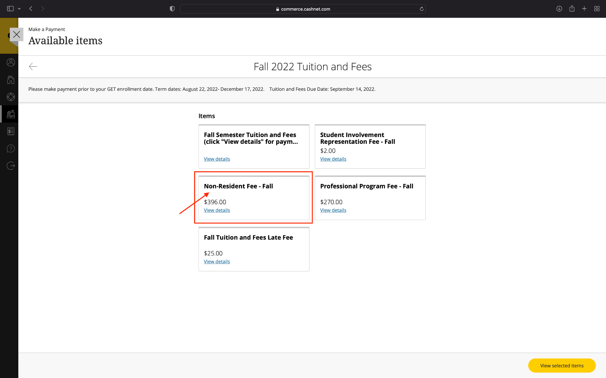

Slide 24
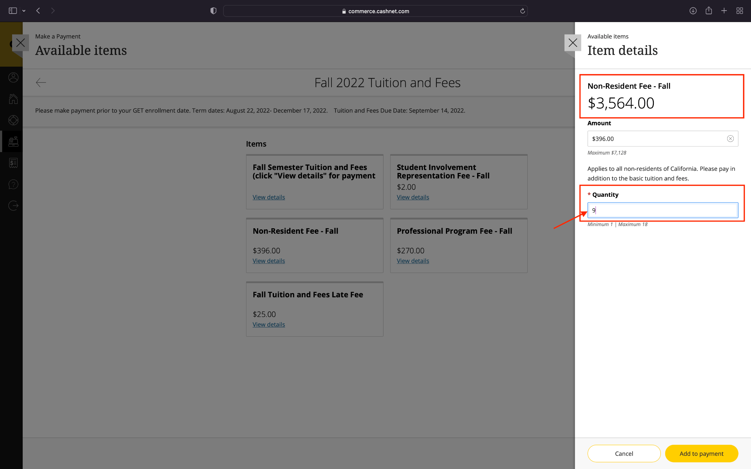

Slide 25
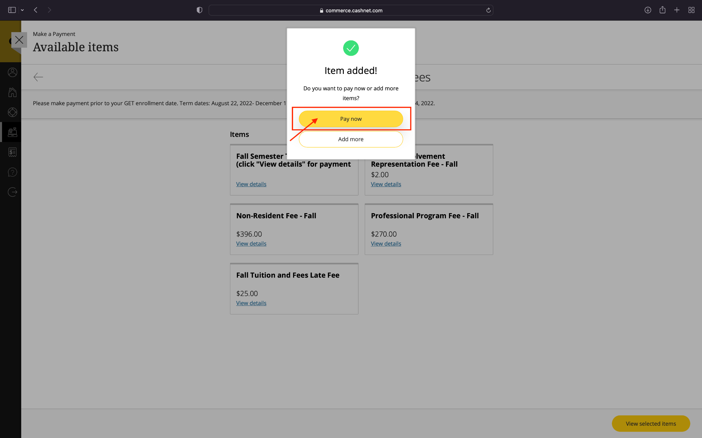

Slide 26
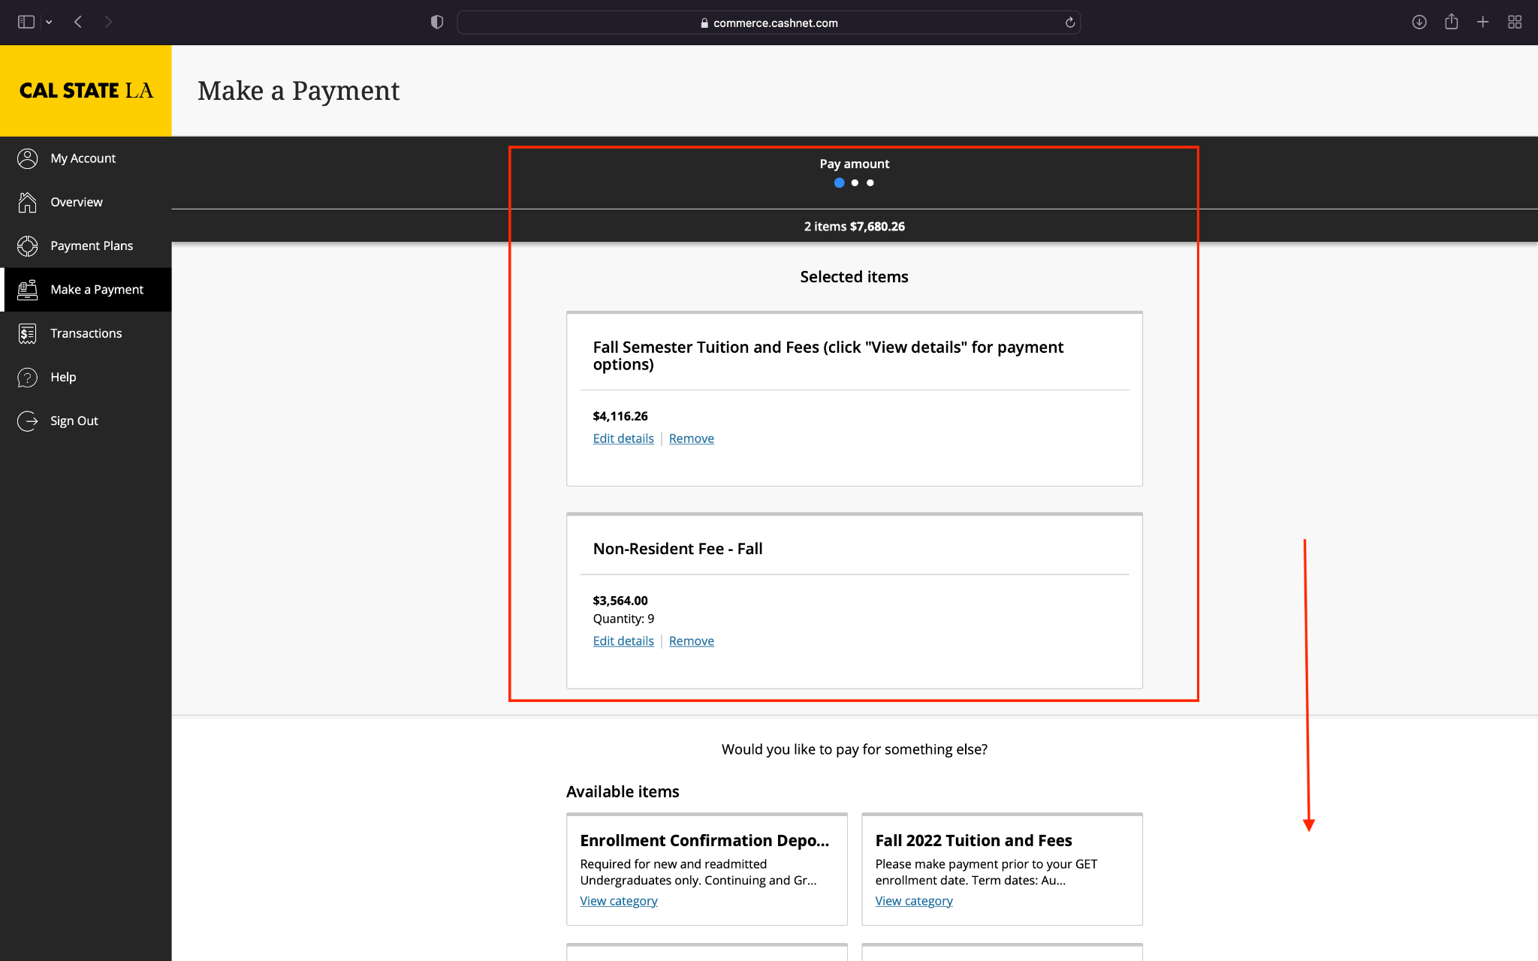

Slide 27
