Slide 1
Computer Science Groups Advisement for CS Juniors
Department Chair: Dr. Eun-Young (Elaine) Kang
Faculty Advisors: Dr. Raj S. Pamula & Dr. Zilong Ye
ECST Academic Advisor: Evelyn Crosby
Department Coordinator: Valentina Ovasapyan
Notes:
1

Slide 2
Year 2020- Life lessons
Physical Well-being
Eat, Sleep, Exercise
Virtually Connect with Family and Friends
Maintain a healthy life style with a good routine
Emotional Well-being
Reduce Stress and Anxiety
Increase Faith and Patience
Mind Matters Resources (https://www.calstatela.edu/mindmatters)
Social Well-being
Stronger together in diversity
Take action against injustices and Inequalities in our daily lives
Positive influence on social media

Slide 3
New BS Curriculum (effective Fall 2021) – Major Requirements (93 units)
Lower Division Required Courses (44 units)
CS 1222 - Introduction to Relational Databases
CS 2011 - Introduction to Programming I (4)
CS 2012 - Introduction to Programming II (4)
CS 2013 - Programming with Data Structures (4)
CS 2148 - Discrete Structures (4)
CS 2445 – Intro to Computer Systems
CS 2470 – Network Systems and Cybersecurity
ENGL 2030 - Introduction to Technical Writing
MATH 2110 - Calculus I
MATH 2120 - Calculus II
MATH 2550 - Introduction to Linear Algebra
PHYS 2100 - General Physics I: Mechanics
PHYS 2200 - General Physics II: Electromagnetism and Circuits
Upper Division Required Courses (31 units)
CS 3035 - Programming Language Paradigms
CS 3112 - Analysis of Algorithms
CS 3186 - Introduction to Automata Theory
CS 3220 - Web and Internet Programming (4)
CS 3337 - Software Engineering
CS 3801 - Societal and Ethical Issues in Computing
CS 4440 - Introduction to Operating Systems
CS 4961 - Software Design Laboratory I
CS 4962 - Software Design Laboratory II
CS 4963 - Computer Science Recapitulation
EE 3445 - Computer Organization
--------------------------------------------------------------------------
CS Electives (18 units)
Math Elective (3 units)
Notes:
3

Slide 4
Summary of Changes
Changes
Phys2200, Math Elective, EE 3445 are no longer requirements.
CS 2470, CS 2445 are new required courses.
1 unit increase for each of these classes: CS 2011, CS 2012, CS 2013, CS 2148, CS 3220
4

Slide 5
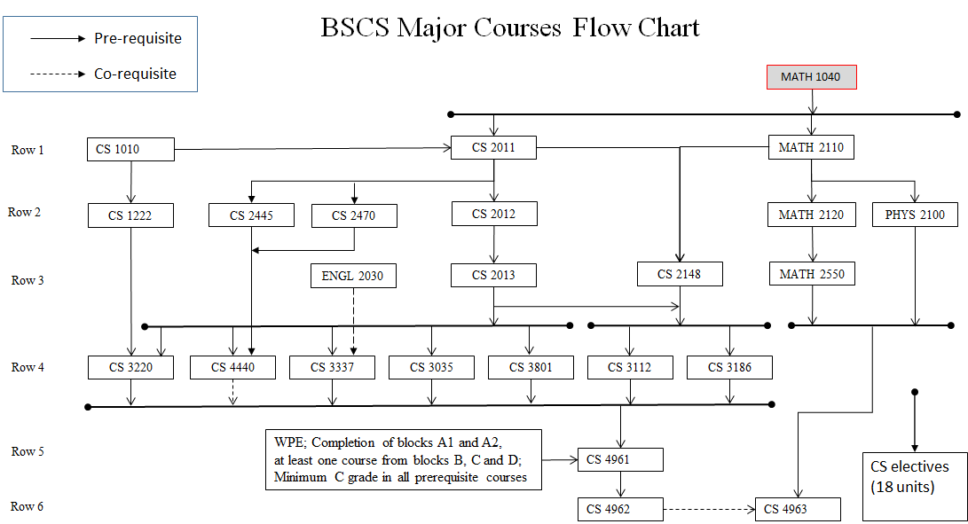

Slide 6
Ideal Planner for Juniors
Ideal planner for Juniors
GET Degree Planner
Populate courses (including electives) as per your plan
Can modify later if needed
Planned Advising Report
Verify the report for all the requirements (GE and major)
Green (completed), Yellow (registered), Blue (planned), Red (missing) indicators
Any red indicators?
summer | fall | spring
? | CS 3035 | CS 3186
 | CS 3112 | CS 3801
 | CS 3220 | CS 4440
 | CS 3337 | CS Elective
 | EE 3445 | GE ?
summer | fall | spring
? | CS 4961 | CS 4962
 | CS Elective | CS 4963
 | CS Elective | CS Elective
 | CS Elective | CS Elective
Notes:
6

Slide 7
Academic Requirement on GET
Login to GET
Go to `academic requirement`
Green color (complete)
Yellow color (currently enrolled)
Blue color (planned)
Red color (missing)
How to fix these red blocks?
Petition or ARS for the transfer credit
Degree planner
Check `advising report planned` to make sure there is no red block

Slide 8
Transfer Credit, Petition Forms and Office Hours
Transfer credit
Login to MyCSULA portal
Go to GET
Check your transfer credit report
Meet an advisor to submit ARS request
Forms
CS department homepage -> advising resources -> student resources -> computer science department forms https://www.calstatela.edu/ecst/cs/forms
Office hours:
https://www.calstatela.edu/ecst/cs/cs-faculty-advising-and-office-hours

Slide 9
Course Planning and Time Management
Full time student = Full time job
15 units (5 courses) = 40 hours (or more)/week
Minimum course commitment = 40/5 = 8 hours/week
Each course scheduled time:
Lecture only – Scheduled for 3 hours/week
Lecture/Lab – Scheduled for 5 hours/week
Each course extra study time
5 hours/week

Slide 10
Q&A
www.calstatela.edu/cs
10
Notes:
10

