Slide 1
Department Meeting
Friday, December 10th, 2021

Slide 2
Agenda
Announcements and Reminders
Spring 2022
Fall 2022 and beyond
MSCS curriculum and comp exam discussion
Q&A

Slide 3
Announcements and Reminders
Fall 2021
Dec 11 : last day of instruction
Dec 13 – 18: Final exam (do not move your final exam dates)
Dec 22 : Final grades due by 9AM
Senior design evaluations by 12/17
Rubric/survey reminders
Senior design evaluations
Thesis evaluations
Others?
Winter vacation plan?
Other announcements?

Slide 4
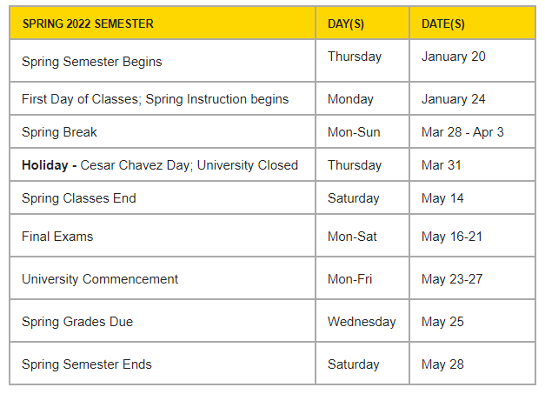
Spring 2022 – Important Meetings
Department Meetings
Bi-weekly
Mix of in-person and online meetings
Friday 11-12:15?
1st Meeting: Jan 21st
In Feb : Department Retreat
Strategic planning
Discussion on online/hybrid courses (not one-time exception)
Approved courses : CS 3186, CS 4661, CS 4662
Review PEOs, eval data

Slide 5
Spring 2022 - Reminders
Instruction
If you need accommodation (remote teaching), contact the HR.
Inform/remind the department of your RT/Sabbatical/Assigned Times
No additional hybrid courses
EPITA students (25 students) – CS 1222, CS 2013, CS 2148, CS 3220
Successful hiring
2-3 new junior faculty
Very competitive market
Recommend your colleagues

Slide 6
Scale Up for Fall 2022 and beyond
CS Electives
More seats for 4000-level elective courses (~600 seats) per semester
30 enrollment cap (20 elective courses)
In reality, we offer 7-9 elective courses
Need more instructors (e.g., CS 5035)
Convert your special topics to regular courses: Data Visualization, HCC, Cyber Security
Senior Design
160 students or more

Slide 7
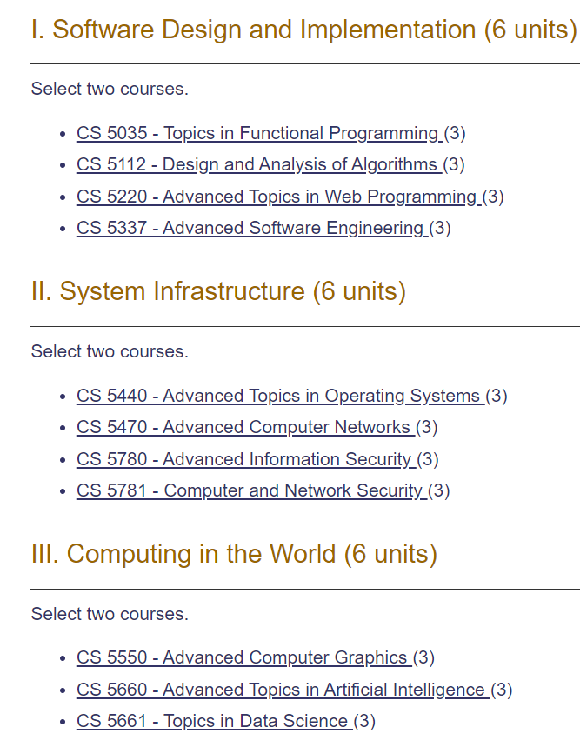
Graduate Program (Fall 2021)
Core courses and offer pattern
Need to add courses to Area 3 : CS 5875 – Advanced Human Issues in Computing & New courses (IoT, AR/VR)
Comp Exam Topics
Students are required to choose one topic per area and take three oral tests to meet the comp exam requirement.

Slide 8
Comprehensive Exam Format & Grading
Pre-Pandemic: Online exams (multiple choice) on campus
During the pandemic
Online on Zoom (Spring 2020-Summer2021)
Oral exam (Fall 2021)
Grading
From Spring 2022:
Oral exam
CR – 66% or above
NC – below 66% (no-makeup & repeat)

Slide 9
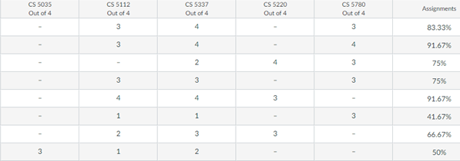
Comp Exam Results (Fall 2021)
CR – 66% or above
NC – below 66% (no-makeup & repeat)

Slide 10
Have a great break!

