Slide 1
EagleFest
November 5th, 2022
Department of Computer Science

Slide 2
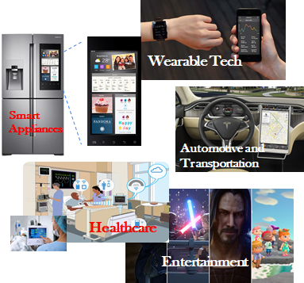
Department Overview
Department of Computer Science
Computers are Everywhere
The Department of Computer Science bachelor's degree program provides you with an excellent foundation in all areas of computer science by stressing both theory and practice.
We offer on-demand industry courses such as Web Programming, Artificial Intelligence, Data Science, Cybersecurity, Virtual Reality, Game Programming, and many more.
To learn more: https://www.calstatela.edu/ecst/cs/undergraduate

Slide 3
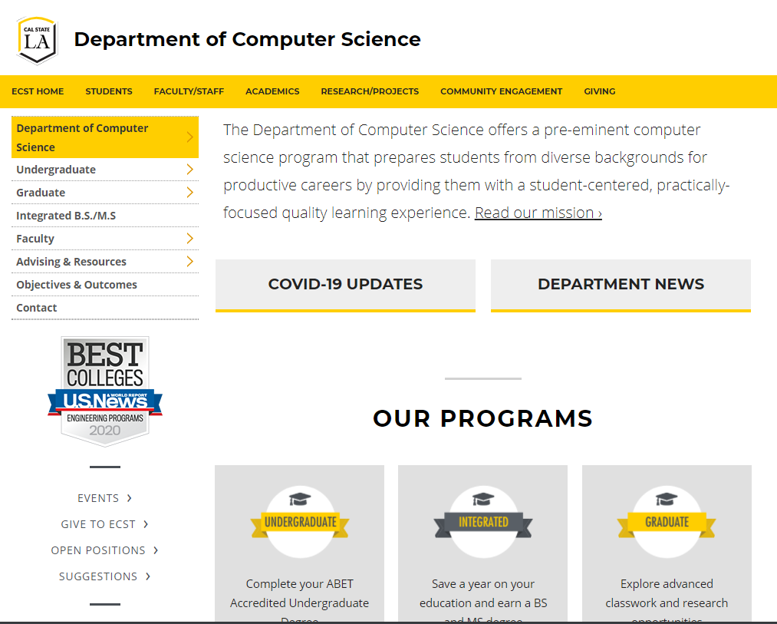
Computer Science Department
Department website: https://www.calstatela.edu/ecst/cs
Check undergraduate curriculum requirement https://www.calstatela.edu/ecst/cs/curriculum-requirements
Check research opportunities
Check faculty webpages

Slide 4
Computer Science Requirements
General Education
Lower Division – Reduced number for CS
Upper Division – Met by CS courses
Math/Physics
Lower Division
Computer Science
Lower Division
Upper Division
All Lower Division Courses are Transferable

Slide 5
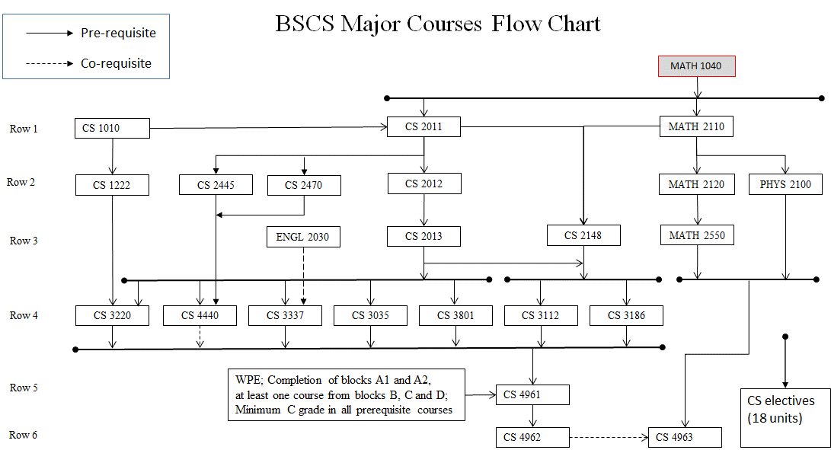
BS CS Curriculum
Notes:
Elaine

Slide 6
CS Electives - Wide range of courses
CS 3034 - Widely-used Programming Languages
CS 3660 - Complex Social and Economic Systems
CS 4075 - Concurrent and Distributed Programming
CS 4112 - Competitive Programming
CS 4188 - Compilers
CS 4220 - Current Trends in Web Design and Development
CS 4222 - Principles of Data Base Systems
CS 4470 - Computer Networking Protocols
CS 4471 - Computer Networks Configuration and Management
CS 4540 - Topics in Advanced Computer Science (Data Visualization, Mobile Computing, Cybersecurity, Robotics, Human Centered Computing, VR)
CS 4550 - Computer Graphics
CS 4551 - Multimedia Software Systems
CS 4555 - Introduction to 3D Computer Game Programming
CS 4556 - Multiplayer Online Game Design and Development
CS 4635 - Modeling and Simulation
CS 4660 - Artificial Intelligence
CS 4661 - Introduction to Data Science
CS 4662 - Advanced Machine Learning
CS 4780 - Cryptography and Information Security
Notes:
Elaine

Slide 7
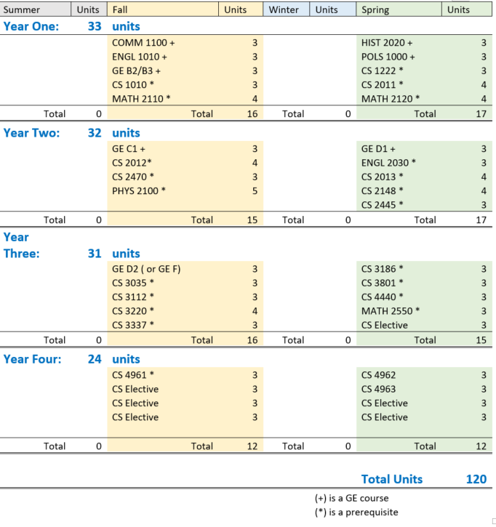
4-Year Roadmap
7

Slide 8
Transfer Roadmap (2-Year Roadmap)
If all lower division requirements are completed, ideal 2 year planner for Juniors
summer | fall | spring
 | CS 3035 | CS 3186
 | CS 3112 | CS 3801
 | CS 3220 | CS 4440
 | CS 3337 | CS Elective
summer | fall | spring
? | CS 4961 | CS 4962
 | CS Elective | CS 4963
 | CS Elective | CS Elective
 | CS Elective | CS Elective

Slide 9
Cal State LA: One of “America’s great working-class colleges”
“The colleges where the American dream is still alive”
https://www.youtube.com/watch?v=QhN4wBfQ9yI
9
Notes:
Congratulations on your acceptance to Cal State LA!
The New York Times called Cal State LA one of “America’s great working-class colleges”.
We’re not as famous as some other schools. But we work hard to provide a great experience for students.
Our focus is on educating students. We help you build skills, find opportunities, and embark on great careers.
Cal State LA is the best place to go if you want upward mobility. We help students move up the economic ladder better than any other American college.
Here is a YouTube link to a video created by Vox. Vox is a news website, and this video highlights Cal State LA as one of the colleges where the American dream is still alive. I encourage you to take the time to view it. I’ll paste it into the chat. Bookmark it for later.
https://www.youtube.com/watch?v=QhN4wBfQ9yI

Slide 10
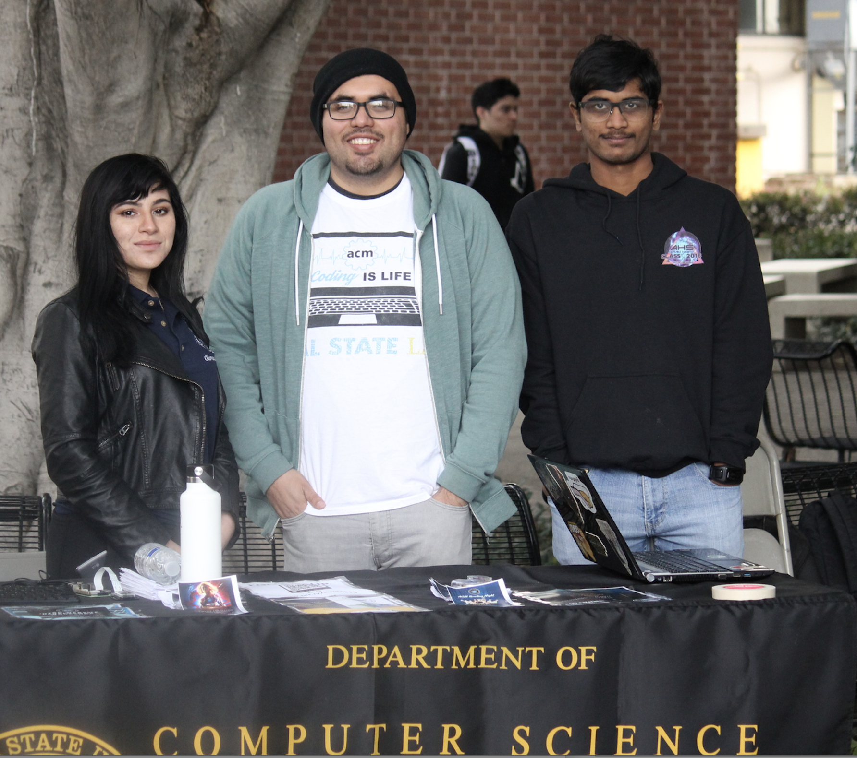
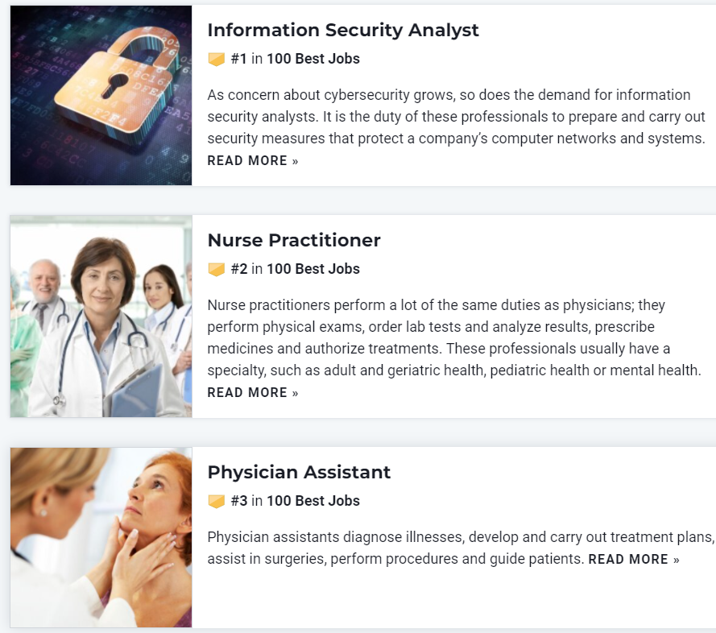
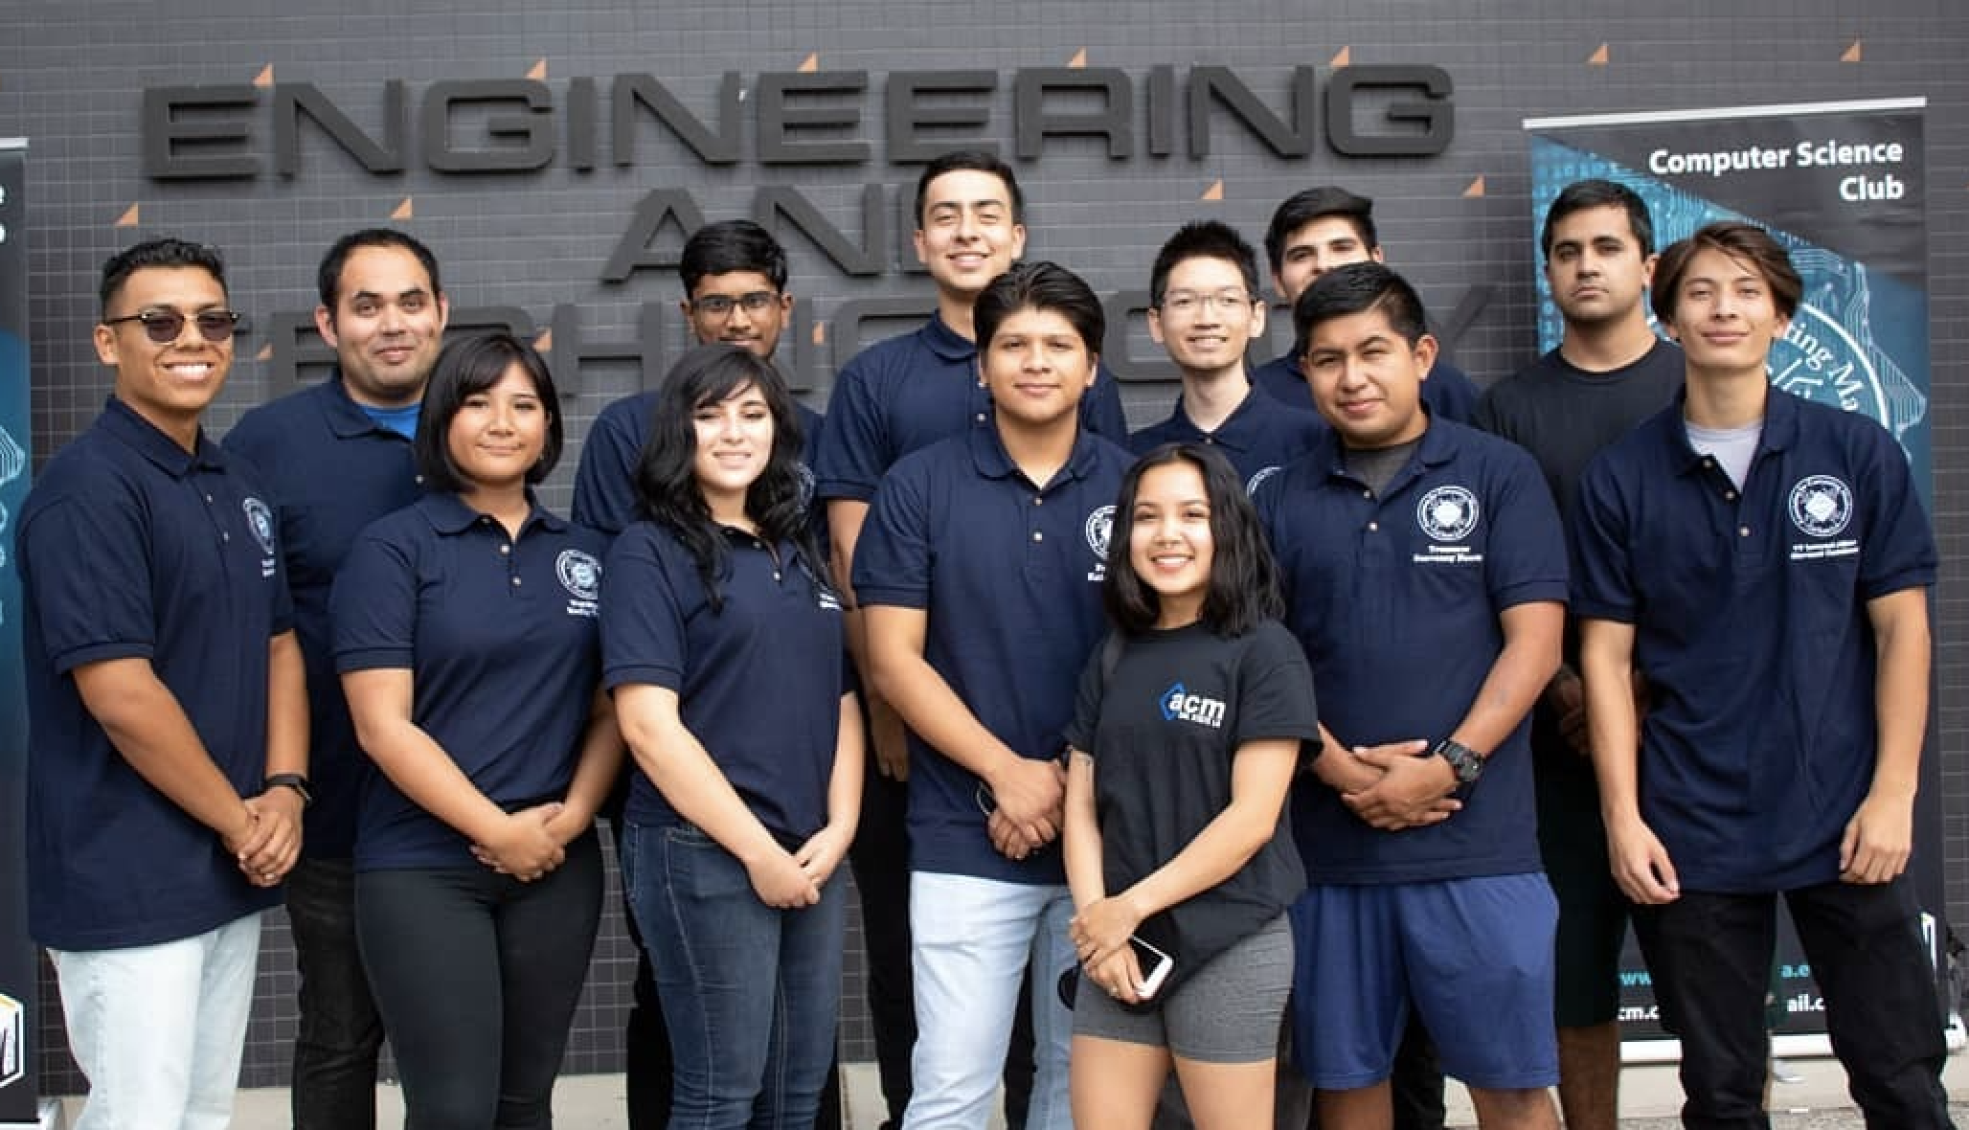
Best Jobs 2022 (Based on Prospects and Satisfaction)
#1 Information Security Analyst
10
Notes:
A career in computer science is one of the best careers out there, according to US News and World Report.
These rankings are based on job prospects and job satisfaction. On the job satisfaction scale, being an information security analyst usually provides above average flexibility. Overall, there are many job opportunities in the computing profession, the jobs earn good wages, and people enjoy their jobs.

Slide 11
Best Jobs 2022 (Based on Salary and Satisfaction)
11
Notes:
Glassdoor also rates computer science jobs at the top of the best jobs list.
The enterprise architect is responsible for overseeing, improving and upgrading enterprise services, software and hardware.
Full stack engineer works on both the back-end and front-end of systems.
A data scientist analyzes data and helps companies make decisions. They are part mathematician and part computer scientist.
DevOps (development and operations) is an enterprise software development phrase used to mean a type of agile relationship between development and IT operations. The goal of DevOps is to change and improve the relationship by advocating better communication and collaboration between these two business units.
A strategy manager could be in any field, but there are many in computer and technology companies. They manage the development of new product features and often need a strong background in computer science.
Number 6 is machine learning Engineer. (Work with data scientists)
Number 7 is data Engineer.
Number 8 is software engineer. (general title for someone who develops software.)

Slide 12
Job Satisfaction of our Alumni
12

Slide 13
Alumni Profiles
Phu Kieu (Class of 2012)
Senior Software Engineer
Google
Vignesh Saravanan (Class of 2018)
Software Engineer
Comcast
Mark Sargent (Class of 2015)
Software Engineer
Google
Mohammed Al Rawi (Class of 2018)
Chief Information Officer
LA County Public Defender
Sweta Shinde (Class of 2010)
Lead Engineer (Mobile App Dev.)
AutoGravity
Stacey O'Malley (Class of 2008)
Lead Engineer
Honeywell
13
Notes:
Here are some of our alumni and some of the different organizations they have joined. Some are tech companies that you have heard of, like Google and Comcast. Honeywell is a large industrial conglomerate. But you can see that we also have an alum working as a CIO in the LA County Public Defender’s office and another working for on mobile app development for a startup that is a few years old.
Job satisfaction. Giving back to the department and college.
Many of our alumni give back to the department and college by providing gifts or financial support, recruiting our students as interns or new employees, and also by sponsoring senior projects.

Slide 14
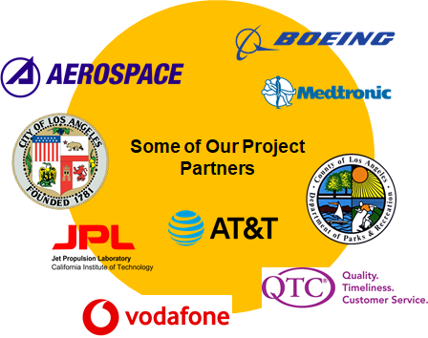
Senior Design Capstone Project
Projects sponsored by
Businesses: large and small, local and global
Government: city, county, state, federal (e.g., Govt. printing office, DoD)
The university: other departments, colleges, etc.
Public-service organizations: Engagement, Service, and the Public good (e.g., hospitals, libraries)
Year long group projects
Provide students with a capstone experience in which they apply their theoretical knowledge to real-world applications.
Improve students’ resumes and job prospects
https://csns.calstatela.edu/department/cs/projects
14

Slide 15
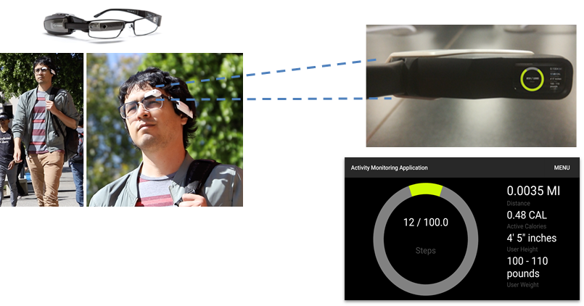
Sample Projects: Activity Monitoring with Smart Glasses
15
45

Slide 16
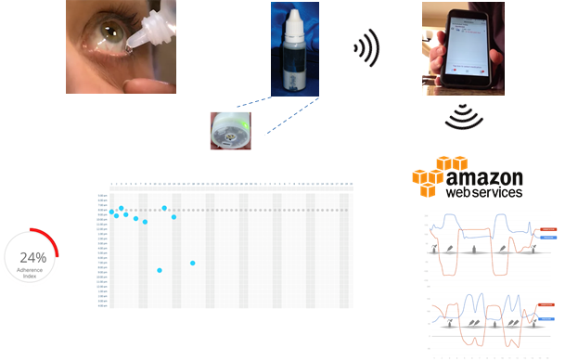
Sample Projects: Smart EyeDrops
16
45

Slide 17
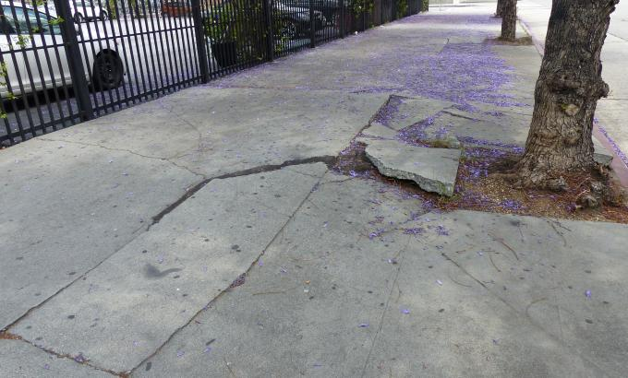
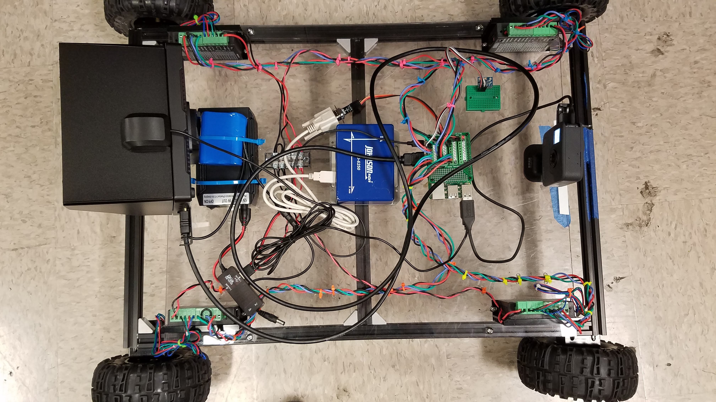
Sample Projects: Robots for Sidewalk Slope Measuring
Internet of Things (IoT) -based Solution
Screen Cover
Accelerometer
Raspberry Pi 3
Camera
24”
Motor Controller
26”
GPS Module
Battery
RS232-UART converter
Digital leveler
45

Slide 18
Sample Projects: LA County Fleet Management System
IoT-based Solution

Slide 19
Thank you

