Slide 1
What is Computer Science?
Department of Computer Science
Computers are Everywhere
The study of computer science involves programming, problems solving, and methodical processes (such as algorithms).
Skills to become software engineer, application developer, cyber security analyst, game developer, web developer, data analyst, information system manager, and etc.
To learn more: https://www.calstatela.edu/ecst/cs/undergraduate

Slide 2
Computer Science Program
Department of Computer Science
The Department of Computer Science bachelor's degree program provides you with an excellent foundation in all areas of computer science by stressing both theory and practice.
We offer on-demand industry courses such as Web Programming, Artificial Intelligence, Data Science, Cybersecurity, Virtual Reality, Game Programming, and many more.
To learn more: https://www.calstatela.edu/ecst/cs/undergraduate

Slide 3
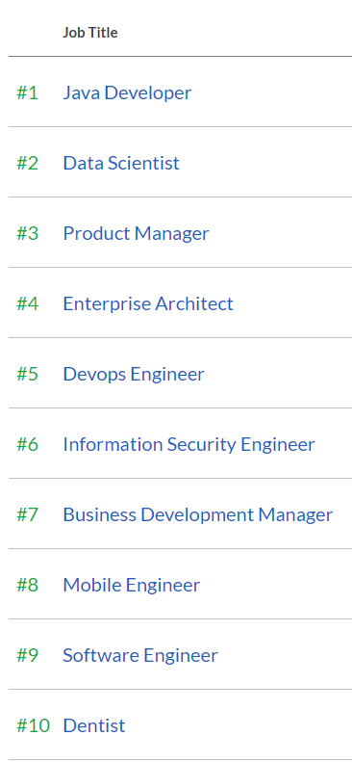
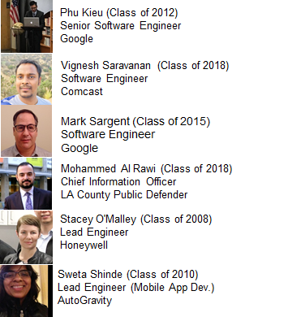
Job Prospects
Department of Computer Science
Our Alumni
Best Jobs 2021 (Based on Salary and Satisfaction) by glassdoor
To learn more: https://www.calstatela.edu/ecst/cs/undergraduate

