Slide 1
CS Program Assessment
November 4, 2022

Slide 2
ABET Accreditation
ABET accredits programs in applied and natural science, computing, engineering and engineering technology
BS CS program received full ABET accreditation (6-year) in 2006, 2012, and 2018
Next ABET visit in Oct 2024

Slide 3
Assessment in AY 2021-2022
Finalized new assessment methods under the new ABET guidelines
Adopted a new Program Educational Objective (i.e. PEO #4)
Conducted assessment and completed 2021-2022 Annual Assessment Reports (AAR)

Slide 4
Program Educational Objectives …
Broad statements that describe what graduates are
expected to attain within a few years of graduation.
PEO #1. Students who had entered the workforce will have established themselves as effective professionals by having solved real problems through the use of their computer science knowledge and their communication, critical thinking, and problem solving skills.

Slide 5
… Program Educational Objectives
PEO #2. Students who had continued in academia will have been successful in pursuing advanced degrees and in demonstrating their ability to master advanced areas of computer science.
PEO #3. Students will have demonstrated their ability to adapt to a rapidly changing environment by having learned and applied new skills and new technologies.
PEO #4. Students will have demonstrated their ability to recognize and apply legal and ethical principles in academic, professional, social, and/or personal contexts.

Slide 6
2021-2022 Assessment Results
Full reports are online
2021-2022 BS CS AAR
2021-2022 MS CS AAR
Results from most measures are satisfactory
Some concerns in Major Field Test (MFT), CS 4963, and MS Comprehensive Exam results

Slide 7
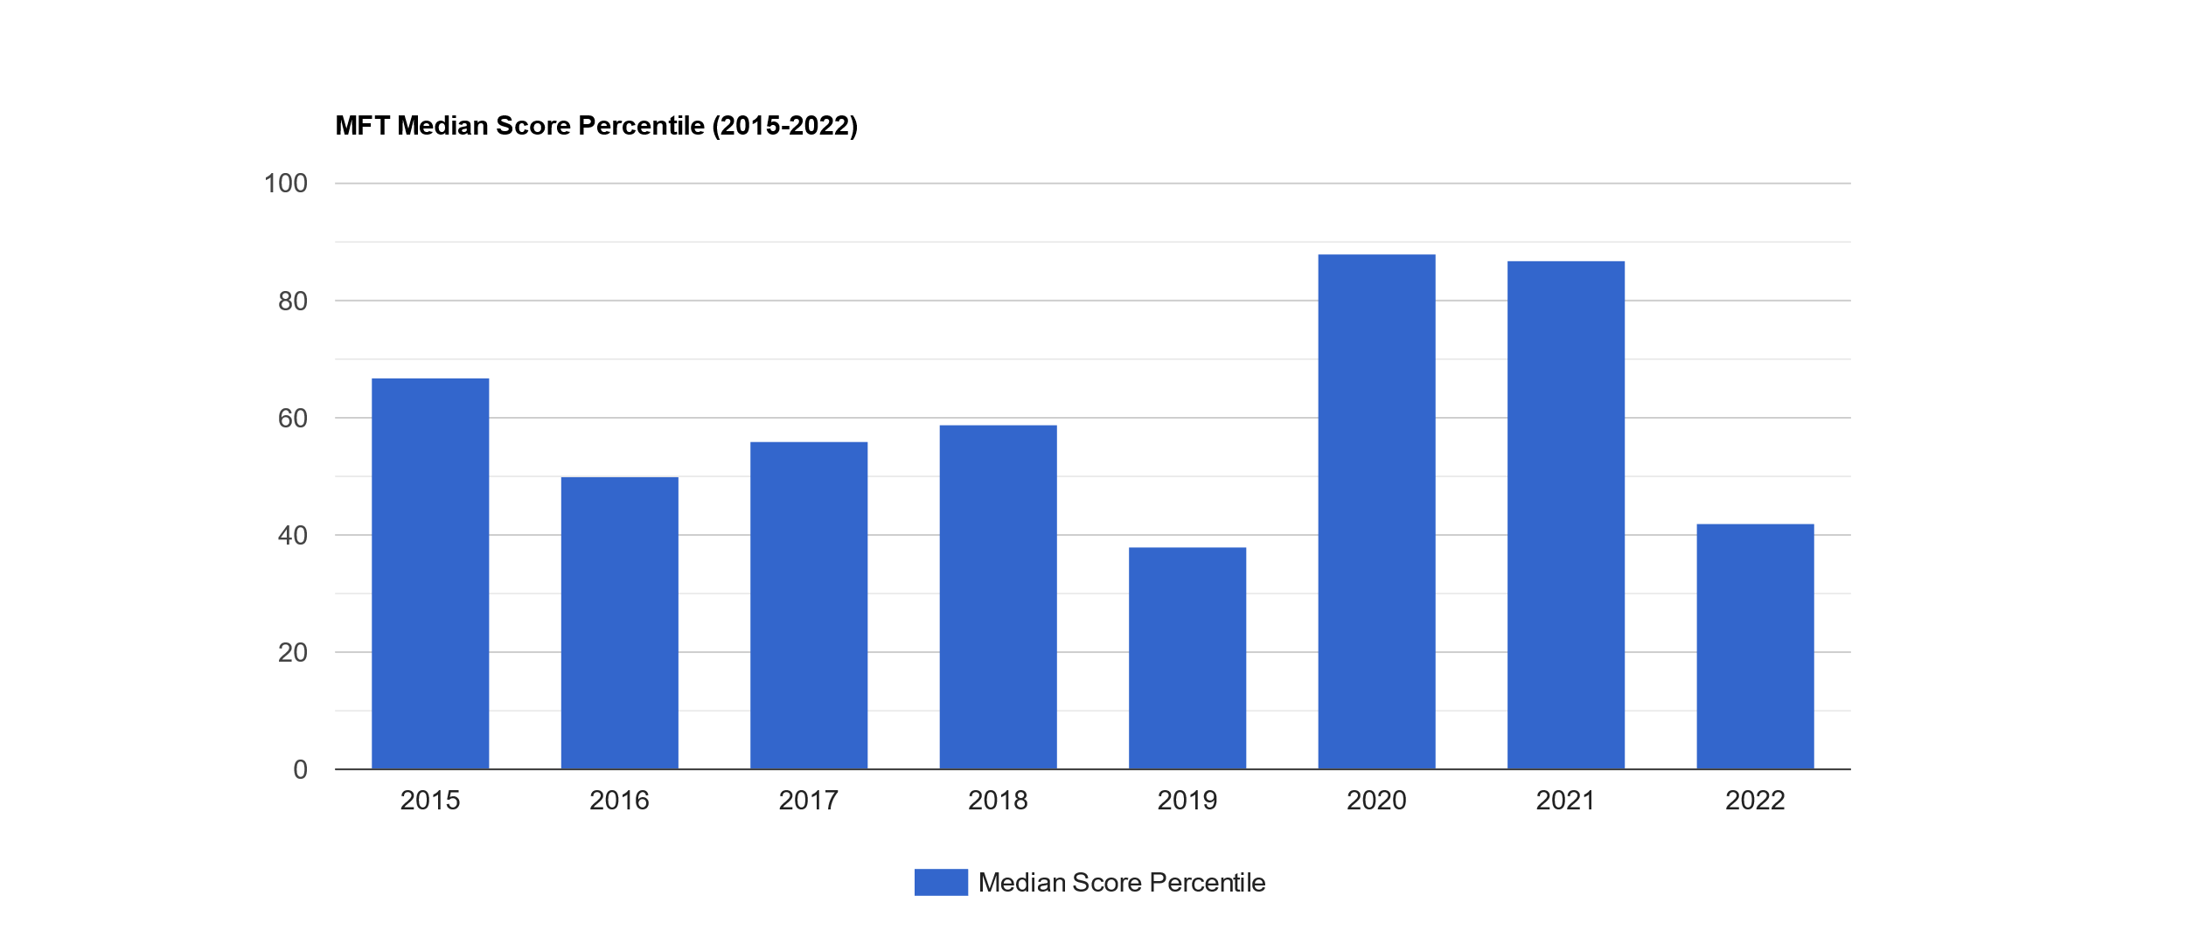
MFT Median Score Percentile

Slide 8
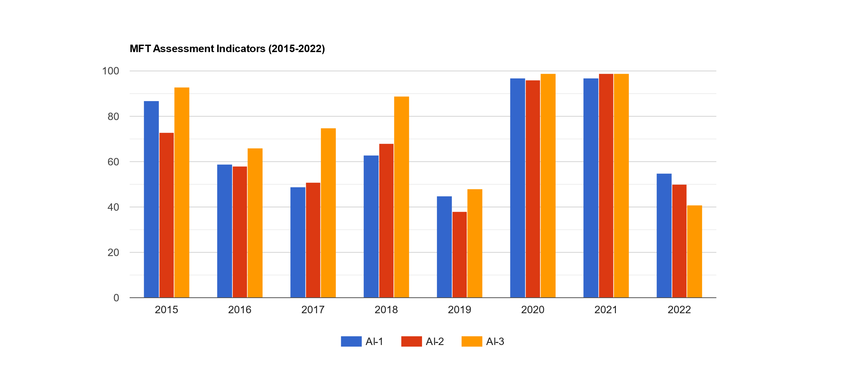
MFT Assessment Indicators (Percentile)
AI-1: Programming and Software Engineering
AI-2: Discrete Structures and Algorithms
AI-3: Systems: Architecture/Operating Systems/Networking/Database

Slide 9
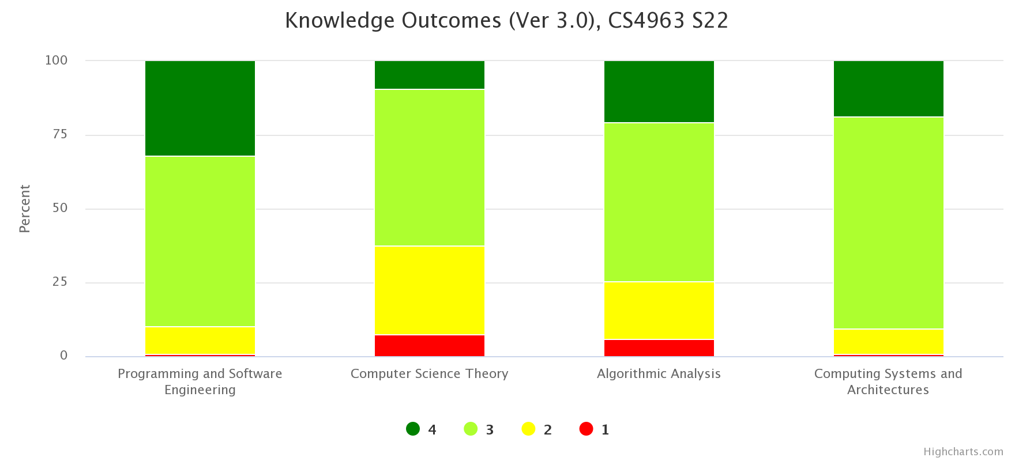
CS 4963 Knowledge Outcome Tests

Slide 10
MS Comprehensive Exam
 | Unsatisfactory | Needs Improvement | Meets Expectations | Exceeds Expectations
PI 1.1 | 2 | 3 | 5 | 5
PI 3.1 | 0 | 3 | 6 | 7
Performance Indicator 1.1 - Analyze the computational
complexity of sophisticated algorithms.
Performance Indicator 3.1 - Demonstrate advanced
knowledge and skills in software development, system
infrastructure, and/or application of computing theory
and practice in interdisciplinary areas.

Slide 11
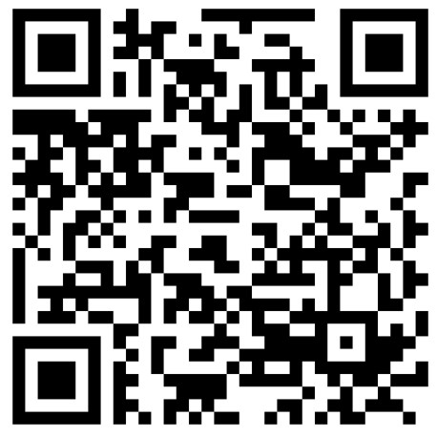
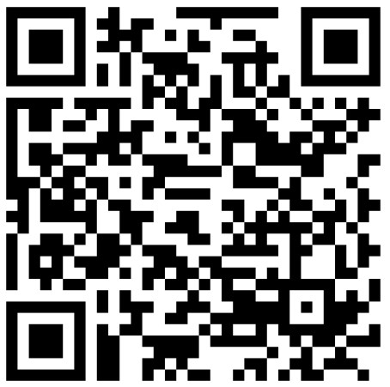
Outcome Surveys
Undergraduate - https://ascent.cysun.org/survey/response/edit?surveyId=2
Graduate - https://ascent.cysun.org/survey/response/edit?surveyId=3

