Slide 1
Computer Science Senior Design Expo
May 5th, 2022

Slide 2
Agenda
09:00 a.m. – 09:40 a.m. Opening
09:00 Welcome message by the Department Chair
09:05 Project Introduction
09:20 Special Recognition
09:30 Dean’s Welcome
09:45 a.m. – 10:00 a.m. Presentation Room Set-Up
10:00 a.m – 12:00 p.m. Project Presentation/Demo Sessions
4 parallel sessions (LA A, LA B, LA C, Alhambra)
12:00 p.m – 12:30 p.m. Group Photos
12:30 p.m – 01:30 p.m. Lunch, Networking, & Posters (ECST Courtyard)

Slide 3
2021-2022 Projects

Slide 4
150 Students
16 Projects
14 Sponsors

Slide 6
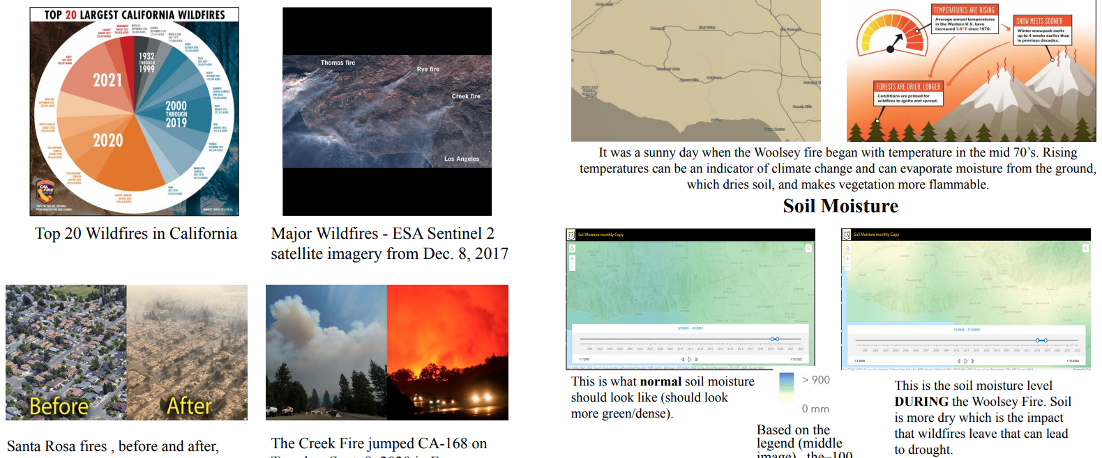

Slide 12
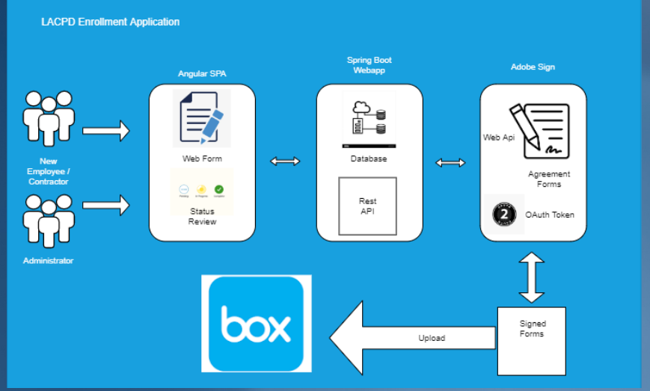
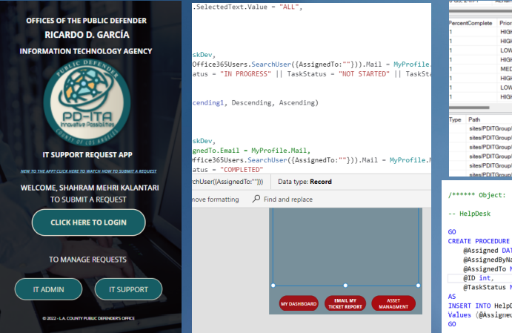

Slide 16
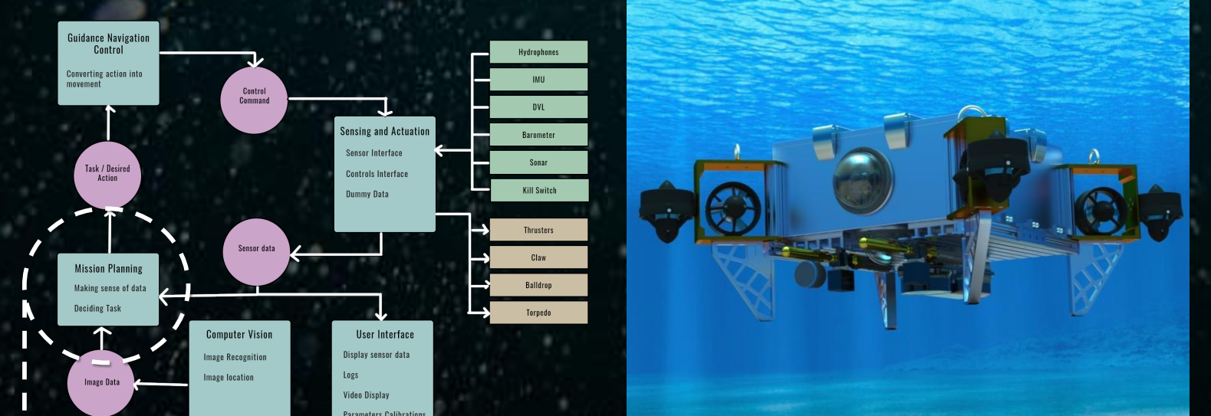

Slide 18
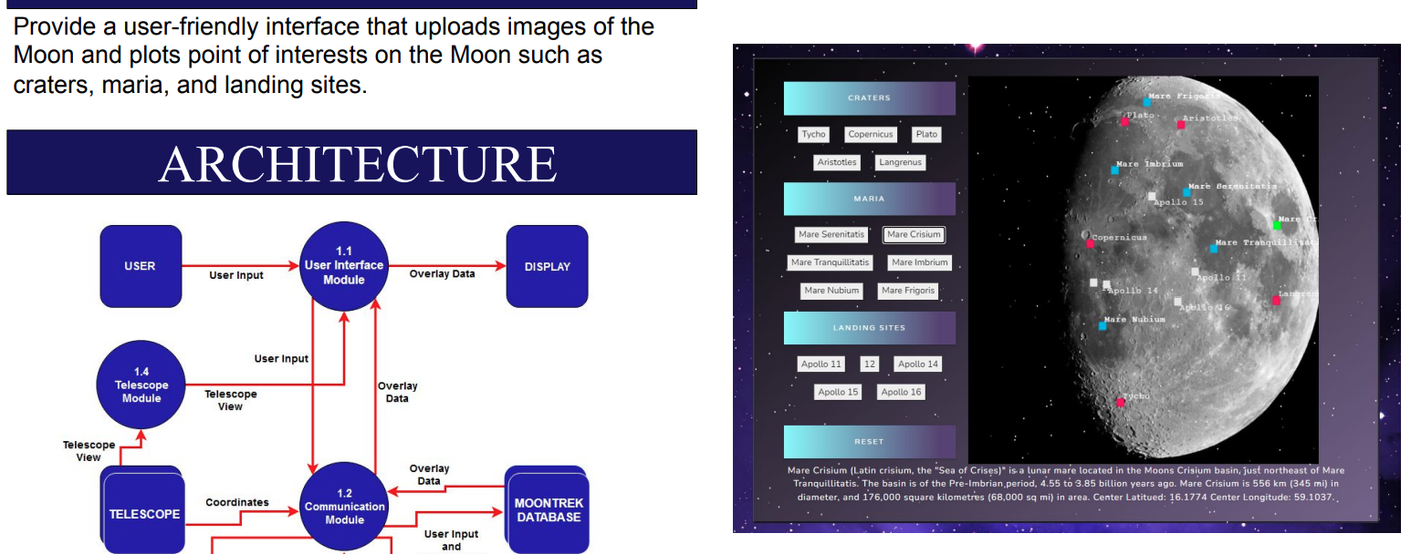

Slide 19
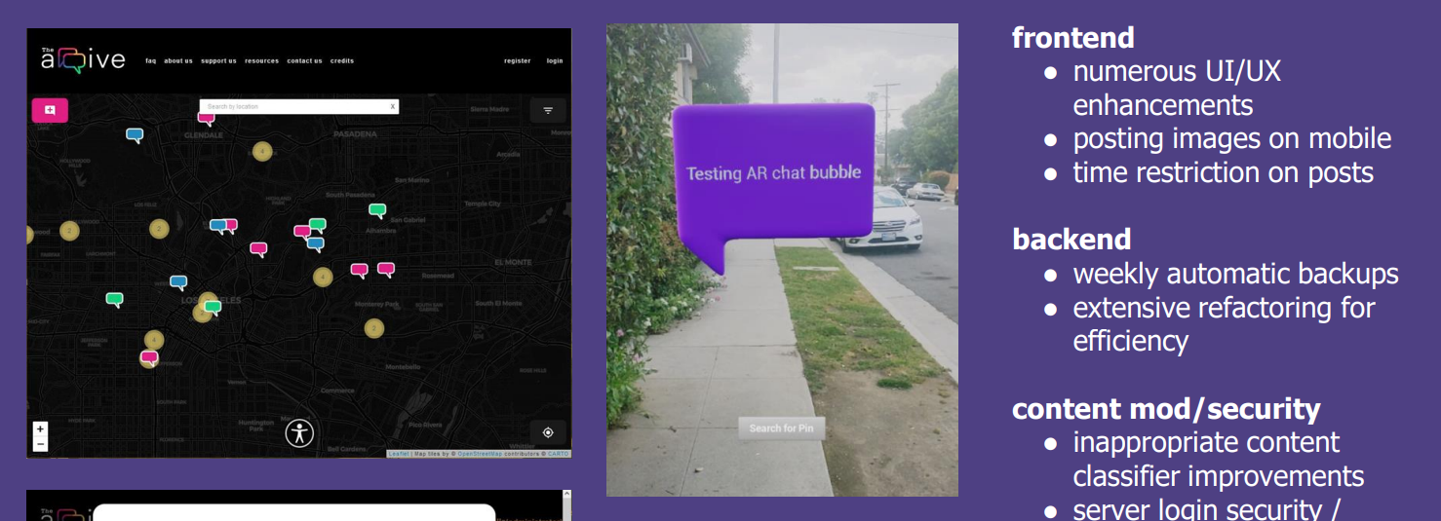

Slide 21
Also, Special Thanks to
CS IAB members
Future sponsors
Alumni
Industry guests
Students, families and friends

Slide 22
Special Recognition
Outstanding Graduating Students (Class of 2022)
Undergraduate Student(s)

Slide 23
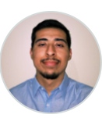
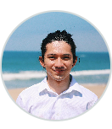
Outstanding Undergraduate Students
Daniel Gonzalez
Ralph Christian Belleca

Slide 24
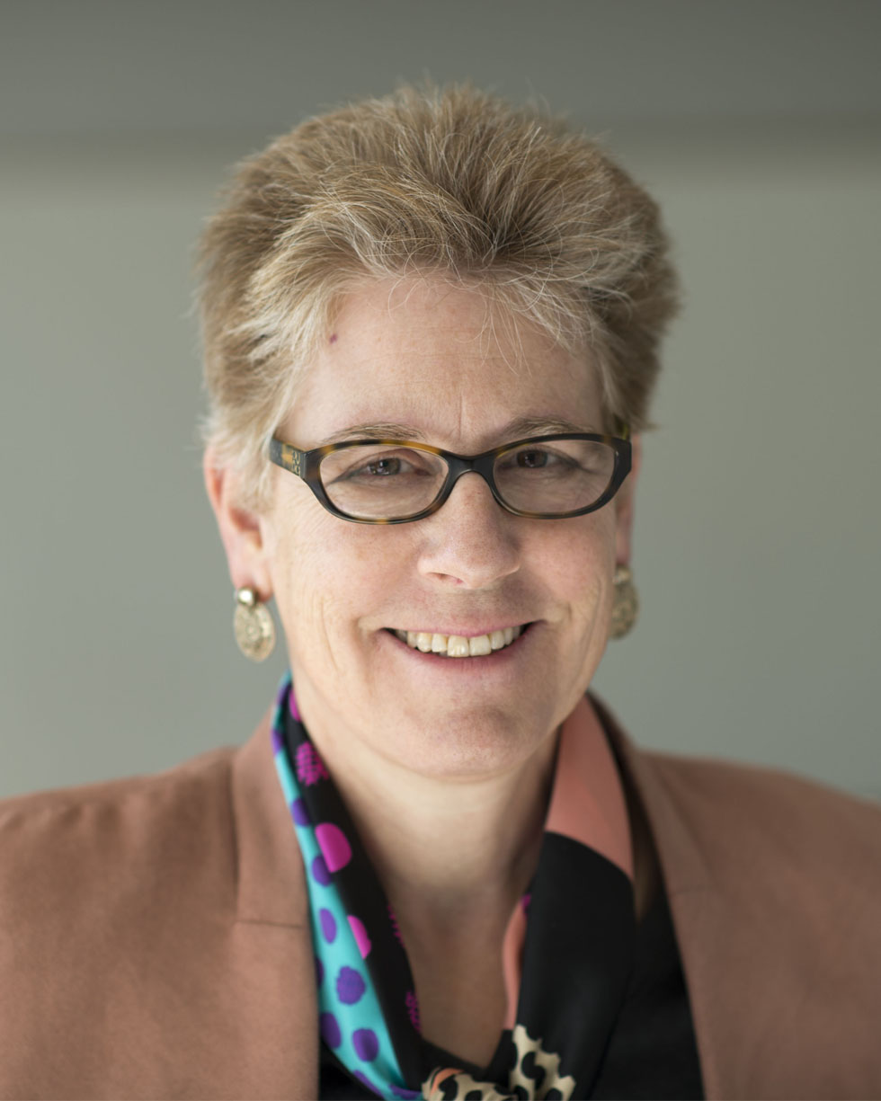
Welcome Message
Emily Allen, PhD
Dean, College of Engineering, Computer Science, and Technology

Slide 26
CS Presentation Sessions: 10:00AM-12:00 PM
 | Session 1 (LA A) | Session 2 (LA B) | Session 3 (LA C) | Session 4 (Alhambra)
10:00-10:25 AM | Artificial Intelligence and Data Science for Air Pollution Prediction and Visualization | Document Tag Parser & Box.com/eDefender Integration | Immersive Storytelling with Engaging Physical Actions | Satellite Anomaly Injection & Detection (SAID) Testbed
10:30-10:55 AM | Artificial Intelligence and Data Science for Climate Change Management with Focus on Drought and Wildfire in California | Power BI Data Analytics Dashboard | Operationalize Networked Collaboration Features for Moon Trek | Telescope AR
11:00-11:25 AM | Comorbidity and its Impact on Patients with COVID-19 | BOE Sidewalk Monitoring System | Exam File Manager | The ArQive: LGBTQ Storytelilng App - Expanding Mobile and Gamification
11:30-11:55 AM | Pelvic Image Analysis and Geometry Reconstruction | Azure Cloud Database Migration & LACPD New Hire Enrollment Process Web Application | RoboSub | Want 2 Remember

Slide 27
Afternoon Schedule (after Presentation Sessions)
12:00 p.m – 12:30 p.m. Group Photos
Take project group photos with your colleagues, sponsors, and faculty advisors
12:30 p.m – 01:30 p.m. Lunch, Networking, & Posters (ECST Courtyard)
Pick up lunch outside your presentation room
Walk to the ECST building. Tables are set in the ECST Courtyard.
Posters: Pick up your team’s poster in ET C159 and display in the ECST Courtyard

Slide 28
Next Year Sponsorship
~170 Students
E. Kang eykang@calstatela.edu
C. Sun csun@calstatela.edu
J. Lim jlim34@calstatela.edu
17-18 Projects

Slide 29
Thank you and enjoy presentations

