Slide 1
Computer Science
M.S. Program Information Session & Orientation
Department Chair: Dr. Eun-Young (Elaine) Kang
Faculty Advisors: Dr. Raj S. Pamula & Dr. Behzad Parviz
Graduate Coordinator: Lupe Martinez
Department Coordinator: Valentina Ovasapyan
Notes:
Welcome and introduce ourselves

Slide 2
MS CS Program
http://www.calstatela.edu/ecst/cs

Slide 3
Agenda
Admission to CS MS
Standing
Curriculum CS MS
Requirements
Roadmap
Fall 2021 Registration Information
Q&A
Notes:
The agenda for this information session will be as follows:

Slide 4
Faculty Expertise
http://www.calstatela.edu/ecst/cs/faculty
Research labs:
http://www.calstatela.edu/ecst/research
Artificial Intelligence and Data Science Research Lab ‒ Dr. Mohammad Pourhomayoun, CS
The Experience Lab ‒ Dr. David Krum, CS
Network Research Lab ‒ Dr. Huping Guo, Dr. Jiang Guo, Dr. Zilong Ye, Dr. Yuquing Zhu, CS
Visual Media Lab ‒ Dr. Eun-Young Elaine Kang, CS
Machine Learning and Sensing Lab ‒ Dr. Navid Amini, CS
4
Notes:
Faculty cover all the areas of Computer Science.

Slide 5
CS MS Admission & Graduate Standing
Conditional Admission (G1 standing)
(Admission with a few prerequisite conditions)
Programming (CS 3035)
Algorithms (CS 3112)
Web (CS 3220)
Must complete these prerequisites in the first semester
Classified Admission (G2 standing)
CS4000/5000 courses
Advanced to Candidacy (G3 standing)
Electives, Thesis, Comprehensive Exam
5

Slide 6
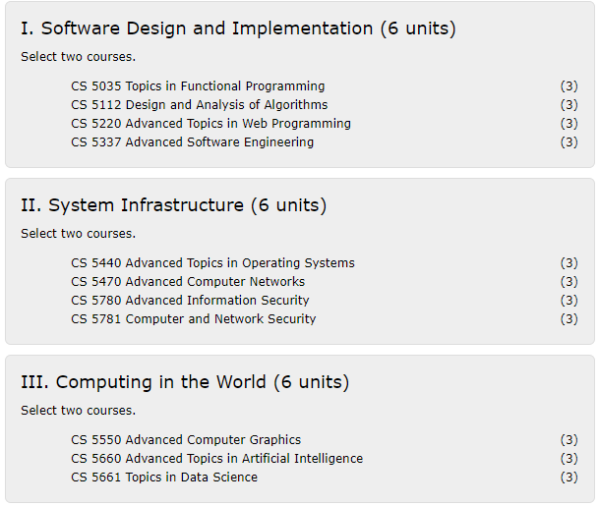
MS CS Curriculum Effective Fall 2021 semester term
Three Thematic Areas (Fall 2021):
Required Core (18 units)
Two courses from each of the three areas
Thesis Option (12 units)
2 additional electives (CS4000/CS5000)
CS 5990 Thesis (3 units) - 6 units over 2 semesters
Comp. Exam Option (12 units)
Take 4 additional electives (CS4000/CS5000)
Take CS5960 Comp Exam (0 units)

Slide 7
List of Graduate Courses
Students completing CS 5960 Comprehensive Exam select 12 units and students completing CS 5990 Thesis select 6 units to satisfy the degree requirement.
CS 4075 - Concurrent and Distributed Programming (3)
CS 4112 - Competitive Programming (3)
CS 4188 - Compilers (3)
CS 4220 - Current Trends in Web Design and Development (3)
CS 4222 - Principles of Data Base Systems (3)
CS 4470 - Computer Networking Protocols (3)
CS 4471 - Computer Networks Configuration and Management (3)
CS 4540 - Topics in Advanced Computer Science (1-3)
CS 4550 - Computer Graphics (3)
CS 4551 - Multimedia Software Systems (3)
CS 4555 - Introduction to 3D Computer Game Programming (3)
CS 4556 - Multiplayer Online Game Design and Development (3)
CS 4635 - Modeling and Simulation (3)
CS 4660 - Artificial Intelligence (3)
CS 4661 - Introduction to Data Science (3)
CS 4662 - Advanced Machine Learning and Deep Learning (3)
CS 4663 - Deep Learning (3)
CS 4780 - Cryptography and Information Security (3)
CS 5035 - Topics in Functional Programming (3)
CS 5112 - Design and Analysis of Algorithms (3)
CS 5188 - Languages and Translators (3)
CS 5220 - Advanced Topics in Web Programming (3)
CS 5337 - Advanced Software Engineering (3)
CS 5390 - Advanced Software Architecture (3)
CS 5440 - Advanced Topics in Operating Systems (3)
CS 5470 - Advanced Computer Networks (3)
CS 5540 - Graduate Topics in Computer Science (3)
CS 5550 - Advanced Computer Graphics (3)
CS 5660 - Advanced Topics in Artificial Intelligence (3)
CS 5661 - Topics in Data Science (3)
CS 5780 - Advanced Information Security (3)
CS 5781 - Computer and Network Security (3)
CS 5980 - Graduate Directed Study (1-3)

Slide 8
Roadmap: Classified Admission
Thesis Option | Fall 2021 | Spring 2022 | Summer 2022 | Fall 2022 | Spring 2023 | Summer 2023
 | CS Core 1 | CS Core 3 |  | CS Core 5
 | CS Core 2 | CS Core 4 |  | CS Core 6
 | CS Elective 1 | CS Elective 2 |  | CS 5990 | CS 5990
Comp Exam Option | Fall 2021 | Spring 2022 | Summer 2022 | Fall 2022 | Spring 2023 | Summer 2023
 | CS Core 1 | CS Core 3 |  | CS Core 5 | CS Elective 4
 | CS Core 2 | CS Core 4 |  | CS Core 6
 | CS Elective 1 | CS Elective 2 |  | CS Elective 3 | CS 5960

Slide 9
Roadmap: Provisional Admission
Thesis Option | Fall 2021 | Spring 2022 | Summer 2022 | Fall 2022 | Spring 2023 | Summer 2023
 | Prerequisite 1 | CS Core 1 | CS Elective 1 | CS Core 4 | CS Elective 2
 | Prerequisite 2 | CS Core 2 |  | CS Core 5 | CS Core 6
 | Prerequisite 3 | CS Core 3 |  | CS 5990 | CS 5990
Comp Exam Option | Fall 2021 | Spring 2022 | Summer 2022 | Fall 2022 | Spring 2023 | Summer 2023
 | Prerequisite 1 | CS Core 1 | CS Elective 1 | CS Core 4 | CS Elective 3
 | Prerequisite 2 | CS Core 2 | CS Elective 2 | CS Core 5 | CS Elective 4
 | Prerequisite 3 | CS Core 3 |  | CS Core 6 | CS 5960

Slide 10
Research Opportunities
Faculty research projects
Many faculty have external or internal grants. Many faculty are supervising graduate (individual) thesis.
More than 60 thesis completions in the last five years.
All students under the thesis option register for a two semesters course sequence (CS5990). Students usually start working on their thesis (prior to registering for CS5990) early in their graduate program.
Many faculty are involved in student capstone projects (senior design team projects). This often involve grad students as mentors.

Slide 11
Fall 2021 Registration
In addition, see
Please check Fall 2021 Information > Schedule of Classes at
https://www.calstatela.edu/registrar/university-scheduling-office
Course descriptions: Undergrad courses ; Grad courses
Things to remember
CS 3112 is a prerequisite to all the CS 4000 level courses.
CS 5000 levels for G2 students.

Slide 12
How to register on GET
https://www.calstatela.edu/registrar/get
Learn about GET
Enroll/Register for Classes
Steps:
Resolve Holds
Plan your Class Schedule with Schedule Planner
Pay tuition and fees
https://www.calstatela.edu/sfinserv/cashiers-office
Obtain permits if needed
G1 students : need permits for any courses
G2 students : need permits for 4000-level courses and some 5000-level courses
Enroll

Slide 13
Graduation Writing Assessment Requirement (GWAR)
(Graduate Students) How can a graduate student satisfy the GWAR?
https://www.calstatela.edu/wpe/faq
International graduate students who graduate from universities where English is NOT the primary language of instruction and do not meet some other exemption criteria must pass the Writing Proficiency Exam (WPE), UNIV 4000, or a writing course, UNIV 4010, within their first 12 units.
Students who do not satisfy the Graduate Writing Requirement within their first 12 units may be subject to a registration hold.
Students must satisfy this Graduate Writing Requirement to Advance to Candidacy.

Slide 14
Some Forms and Requirements
Change from Conditional Classified to Classified Status (GS-8)
https://www.calstatela.edu/sites/default/files/users/u50136/gs_8_re._8.21.19.pdf
Advance to Candidacy Form (GS-10)
https://www.calstatela.edu/sites/default/files/users/u50136/gs-10_application_for_advancement_to_candidacy_-06-2020.pdf
Graduate Application Form
https://www.calstatela.edu/sites/default/files/groups/Graduation/Docs/grad_app_grad.pdf

Slide 15
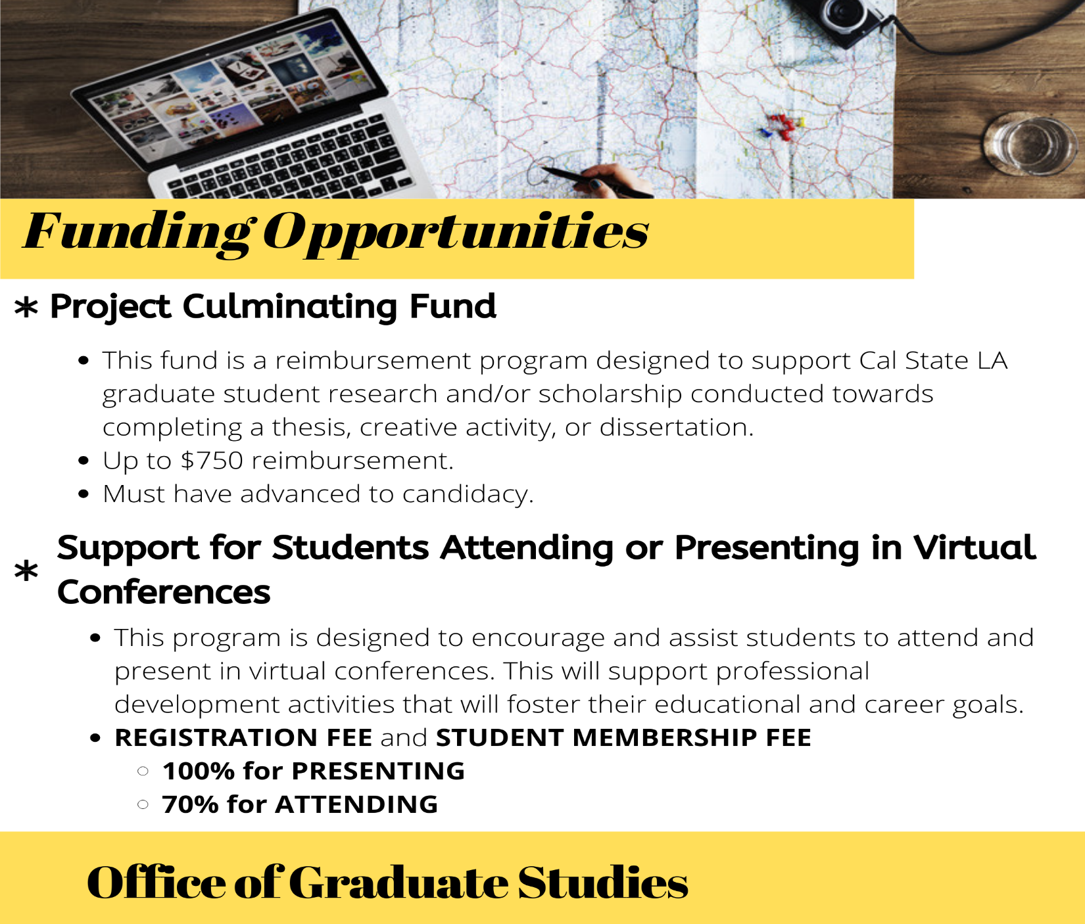
Funding Opportunity

Slide 16
Questions?

