Slide 1
Computer Science Senior Design Expo
May 7th, 2021

Slide 2
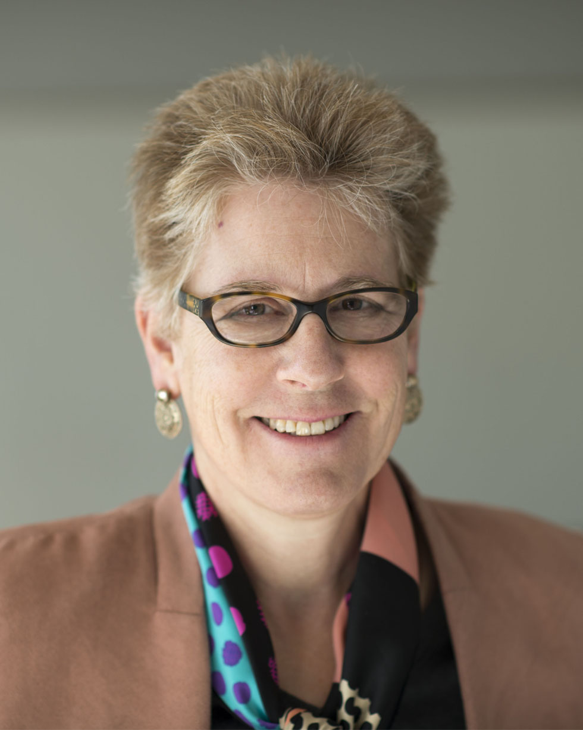
Welcome Message
Emily Allen, PhD
Dean, College of Engineering, Computer Science, and Technology

Slide 4
Special Thanks to
AT&T
Civil Engineering and Mechanical Engineering, Cal State LA
Commonwealth Casualty Company
Civil Engineering, Cal State LA
Department of Public Works and Bureau of Engineering, LA City
The Institute for Interactive Arts, Research, and Technology (INART) at Cal State LA
JPL
NASA and LA City
Office of the Public Defender, LA County
QTC
The Aerospace Corporation
The ArQive at Cal State LA
TOYOTA and LA City
Vodafone Group
We2Link
Chengyu Sun
David Krum
Jiang Guo
John Hurley
Jungsoo (Soo) Lim
Keenan Knaur
Mohammad Pourhomayoun
Navid Amini
Negin Forouzesh
Richard Cross
Russ Abbott
Weronika Cwir
Zilong Ye
Faculty Advisors
Industry Sponsors

Slide 5
Agenda
09:00 a.m. – 10:00 a.m. General Session
10:00 a.m – 11:00 a.m. Project Demo Sessions (4 parallel sessions)
11:10 a.m – 11:55 a.m. Networking Sessions (3 parallel sessions)
12:00 p.m – 12:30 p.m. Closing

Slide 6
General Session : 9:00-10:00 AM
3-min live exec summary
Artificial Intelligence and Data Science for Air Pollution Prediction and Visualization
AWS Project
Collaborative Visualization for Solar System Treks
COVID-19 Data Analysis and Visualization
Digitization of PD Onboarding & Approval Process
INART VR Project
Online Application for Street and Highway Pavements Design
Open Source Real-Time Video Player
PDF Web Viewer / Filter
RoboSub
Satellite Anomaly Injection & Detection Testbed
Sidewalk Slope Monitoring System
Telescope Moon Trek
The ArQive Mobile App
Want2Remember App

Slide 7
CS Project Demo Breakout Sessions: 10:00-11:00 AM
May 7th, 2021 | Session 1 | Session 2 | Session 3 | Session 4
10:00-10:15 AM | Modernizing PD Legacy Repositories (C. Sun) | AI Air Pollution (M. Pourhomayoun) | Collaborative Visualization for Solar System Treks (D. Krum) | Sidewalk (S. Lim)
10:15-10:30 AM | AWS (J. Guo) | Break | INART VR Project (D. Krum) | Robosub (R. Cross)
10:30-10:45 AM | The ArQive Mobile App (J. Hurley) | Online Application for Street Highway Pavements Design (N. Forouzesh) | Satellite Anomaly Injection & Detection Testbed (R. Abbott) | COVID-19 Data Analysis and Visualization (N. Amini)
10:45-11:00 AM | PDF Web Viewer / Filter (K. Knaur) | Open Source Real-Time Video Player (N. Forouzesh) | Want2Remeber (Z. Ye) | Telescope Moon Trek (W. Cwir)

Slide 8
Project Demo: 10:00-10:15 AM
Session 1 | Session 2 | Session 3 | Session 4
Modernizing PD Legacy Repositories (C. Sun) | AI Air Pollution (M. Pourhomayoun) | Collaborative Visualization for Solar System Treks (D. Krum) | Sidewalk (S. Lim)

Slide 9
Project Demo: 10:15-10:30 AM
Session 1 | Session 2 | Session 3 | Session 4
AWS (J. Guo) | Break | INART VR Project (D. Krum) | Robosub (R. Cross)

Slide 10
Project Demo: 10:30-10:45 AM
Session 1 | Session 2 | Session 3 | Session 4
The ArQive Mobile App (J. Hurley) | Online Application for Street Highway Pavements Design (N. Forouzesh) | Satellite Anomaly Injection & Detection Testbed (R. Abbott) | COVID-19 Data Analysis and Visualization (N. Amini)

Slide 11
Project Demo: 10:45-11:00 AM
Session 1 | Session 2 | Session 3 | Session 4
PDF Web Viewer / Filter (K. Knaur) | Open Source Real-Time Video Player (N. Forouzesh) | Want2Remeber (Z. Ye) | Telescope Moon Trek (W. Cwir)

Slide 12
Break: 11:00-11:10AM
During this break time, students shall log-in CSNS and complete “Quiz : Senior Design Expo” under CS 4962.
Complete only three-project questions (2 questions per project) that you attended.
Those who participated in the quiz will be automatically entered in a random draw to win prizes.
Winners will be announced during the closing session.

Slide 13
Networking Sessions: 11:10-11:55 AM
Session 1 Facilitators: Prof. David Krum and Prof. Jungsoo Lim | Session 2 Facilitators: Prof. Mohammad Pourhomayoun and Prof. Negin Forouzesh | Session 3 Facilitators: Prof. Navid Amini and Prof. Zilong Ye
Participating industry sponsors and friends: JPL INART (VR project) Disney Department of Public Works and Bureau of Engineering, LA City Civil/Mechanical Engineering, Cal State LA (Robosub) and more | Participating industry sponsors and friends: LA City Commonwealth Casualty Company Civil Engineering, Cal State LA (Street and Highway Pavements Design) AT & T INART (ArQive Project) and more | Participating industry sponsors and friends: The Aerospace Corporation Vodafone Group Office of the Public Defender, LA County QTC We2Link and more

Slide 14
Closing : 12 – 12:30 PM
Awards: Outstanding Graduating Students (led by Dr. Pamula)
Announcement of the Winners (led by Dr. Sun)
Closing remarks

Slide 15
Thank you

