Slide 1
Department Meeting
Friday, April 23rd, 2021

Slide 2
Agenda
Announcements
Commencement
Hybrid/online course proposal process
Fall 2021 schedule
New Incomplete Grade Agreement (GET Faculty Center Grade Roster)
Robotics ENGR 3810 (https://calstatela.curriculog.com/proposal:6524/form)
Spring 2021 assessment
Reminder: Upcoming Events
Senior Design Expo planning
Outstanding students (GPA, MFT, and faculty recommendations)
Q&A

Slide 3
Announcements
Commencement
Two in-person Commencement ceremonies
On Saturday, May 29, 2021
At the Rose Bowl Stadium in Pasadena.
Commencement will honor the Class of 2021 and the Class of 2020
Tentatively students and platform party only
Live broadcast
Each college – online recognition
Hybrid/online course proposals (for Fall 2023)
The department must identify which courses should be online.
Faculty who propose : DOC certified or Quality Matters training
Faculty who teach an approved hybrid/online course: DOC certified or Quality Matters training

Slide 4
Announcements
Fall 2021 – F2F Planning
Sections with in-person meetings: 15 sections by 10 faculty
Plexiglass:
Installed in reception areas only
not installed in chair offices and any classroom
Facility
Library – 70% open
Vaccine required

Slide 5
ENGR 3810
ENGR 3810 Artificial Intelligence for Robotic Systems
https://calstatela.curriculog.com/proposal:6524/form
An interdisciplinary course for EE, ME and CS.
CS2013 is a prerequisite for CS students.
No overlap with CS 4540 Robotics.
Useful for several senior design projects.
Elective for CS students via exception
EE plans to cross-list.
What about CS?

Slide 6
Reminder: Spring 2021 Assessment
Rubrics on CSNS
CS 3337 (Every Fall)
CS 3801 (Every Spring)
CS 4962 (team work rubric by students)
CS 4963
CS 5337
CS 5960
CS 5990

Slide 7
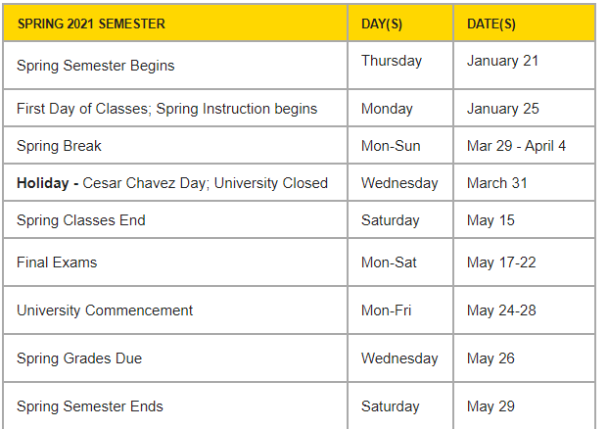
Upcoming Events
Senior Design Expo : Friday, May 7th
Comprehensive exam : Thursday, May 13th
Thesis Presentations : Friday, May 14th
Commencement: Saturday, May 29th
Faculty Retreat: Summer 2021

Slide 8
Senior Design Expo (May 7th)
https://www.calstatela.edu/ecst/seniordesign/ecst-expo-2021 (RSVP)
https://csns.cysun.org/site/s21/cs4962-1
M
Main Zoom (Host: Kang, Co-hosts: Faculty advisors)
Opening + CS General Session
Closing
Project Demo: 4 Breakout Sessions
Networking: 4 Breakout Sessions

Slide 9
Project Demo Breakout Session
May 7th, 2021 | Session 1 | Session 2 | Session 3 | Session 4
10:00-10:15 AM | Modernizing PD Legacy Repositories (C. Sun) | AI Air Pollution (M. Pourhomayoun) | Collaborative Visualization for Solar System Treks (D. Krum) | Sidewalk (S. Lim)
10:15-10:30 AM | AWS (J. Guo) | AI Smart Cities (M. Pourhomayoun) | INART VR Project (D. Krum) | Robosub (R. Cross)
10:30-10:45 AM | The ArQive Mobile App (J. Hurley) | Online Application for Street (N. Forouzesh) | Satellite Anomaly Injection & Detection Testbed (R. Abbott) | COVID-19 Data Analysis and Visualization (N. Amini)
10:45-11:00 AM | PDF Web Viewer / Filter (K. Knaur) | Highway Pavements Design , Open Source Real-Time Video Player (N. Forouzesh) | Want2Remeber (Z. Ye) | Telescope Moon Trek (W. Cwir)

Slide 10
Project Demo Breakout Session
Each session is 15-min long.
The project faculty advisor will serve as a facilitator.
What each team can do
Demonstration
Share their experiences with the audience (faculty, industry liaisons and other teams)
Q&A
Students
Students must be attend their own team’s demo session.
Students must visit at least three other demos.
Visiting evidence will be collected.
At the end of the project demo session, participants will be provided with an online quiz asking simple facts about the projects.

