Slide 1
Department Meeting
Friday, October 9th, 2020

Slide 2
Agenda
Announcements
Modified MSCS program
Planning Grad Program Reviewer visit
Q&A

Slide 3
Resources
Cal Employee CONNECT - secure web-based application allows you to access your last three years of earnings statements and your last four years of W-2s
https://connect.sco.ca.gov/
CS department webpage
https://www.calstatela.edu/cs
Faculty advisor office hours
(Navigation: Advising & Resources > Department Advisement)

Slide 4
Important Dates
Department Meetings
On every 2nd and 4th Fridays of the month
Fall - 9/11, 9/25, 10/9, 10/23 (IAB), 11/13, 12/4 (Provost visit)
IAB meeting – on 10/23, 9-10:30
Provost, José Luis Alvarado, visit – 12/4, 11-12
Thesis presentations – 12/11 Friday, 9:30-11:45
RTP file closure dates – 10/12/2020 (performance review and range elevation)

Slide 5
CS 4961 Senior Design Presentations
15-16 teams of 8~9 students
Presentation time: each team 25-30 minutes
Oral presentation evaluations by the faculty advisors (using the rubric)
Date: 12/4, 8-10:30AM (one day event)
Format: 4 parallel virtual sessions on 12/4
Participants: faculty advisors + sponsors (optional) + all the CS 1010 students (optional)

Slide 6
Updates on Curriculum Changes
MS CS
Non-thesis courses are approved at all levels. Waiting for implementation
CS 5990 course is approve at the GS committee level. Final EPC approval.
MS CS program – under review by the GS Dean
BS CS and CS Minor (approved by the college IAC and the associate dean)
Certificate programs – CSSA (approved by the PaGE)

Slide 7
MS CS Modification - Summary
Current (30/33 units)
New (30 units)
Breadth (9 units) – select three from CS 5112, CS 5780, CS 5220, CS 5035, CS 5337
Thesis option - choose 18 units of 4000/5000 level courses with a minimum of 9 units from 5000 level courses + CS 5990 (3 units)
Comp Exam Option – choose 24 units of 4000/5000 level courses with a minimum of 12 units from 5000 level courses + CS 5960 (0 unit)
Core (18 units) - select two courses from each of the three areas
Thesis option – 6 units of electives + CS 5990 (6 units)
Comp - 12 units of electives + CS 5960 (0 unit)

Slide 8
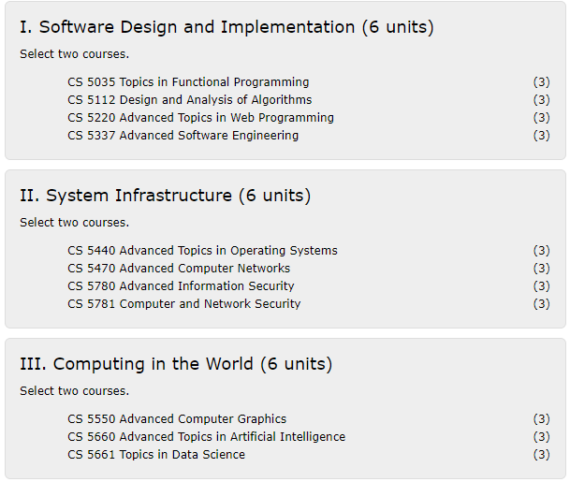
MS CS : Comp Exam
Three Areas (Fall 2021):
Current:
select three courses from CS 5112, CS 5780, CS 5220, CS 5035, CS 5337
New (Fall 2021):
Select one course from each of the three areas

Slide 9
MS CS Program Review in Fall 2020
Two external evaluators confirmed
Christopher Ryu (Chair and Professor, Department of Computer Science, California State University, Fullerton)
Christopher H. Brooks (Professor, Computer Science and Engineering, University of San Francisco)
External evaluator virtual visit itinerary (Nov. 2 – Nov. 20)
2-day event
1-hour meeting with tenured & tenure-track faculty: Raj, Chengyu, Behzad, Mo, Navid
1-hour meeting with lecturers: Richard, Weronika, Keenan
1-hour meeting with students: Grad students, BXG students, Undergrad students ?

