Slide 1
Computer Science Meet and Greet
Fall 2020
Introduction of CS Principal Faculty Advisors
Introduction to the CS Department
How is Advising conducted in the CS Dept.?
CS website and Resources: https://www.calstatela.edu/ecst/cs
What now?

Slide 2
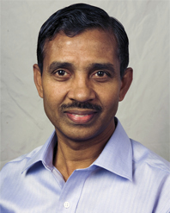
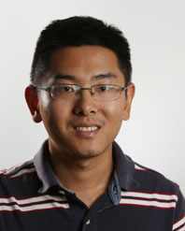
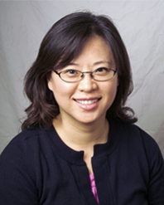
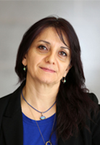
Meet CS Undergraduate Faculty Advisors
Raj S. Pamula
Undergraduate Advisor
rpamula@calstatela.edu
Zilong Ye
Undergraduate Advisor
zye5@calstatela.edu
Elaine Kang
Chair
eykang@calstatela.edu
Valentina Ovasapyan
Administrative Coordinator
vovasapyan@calstatela.edu

Slide 3
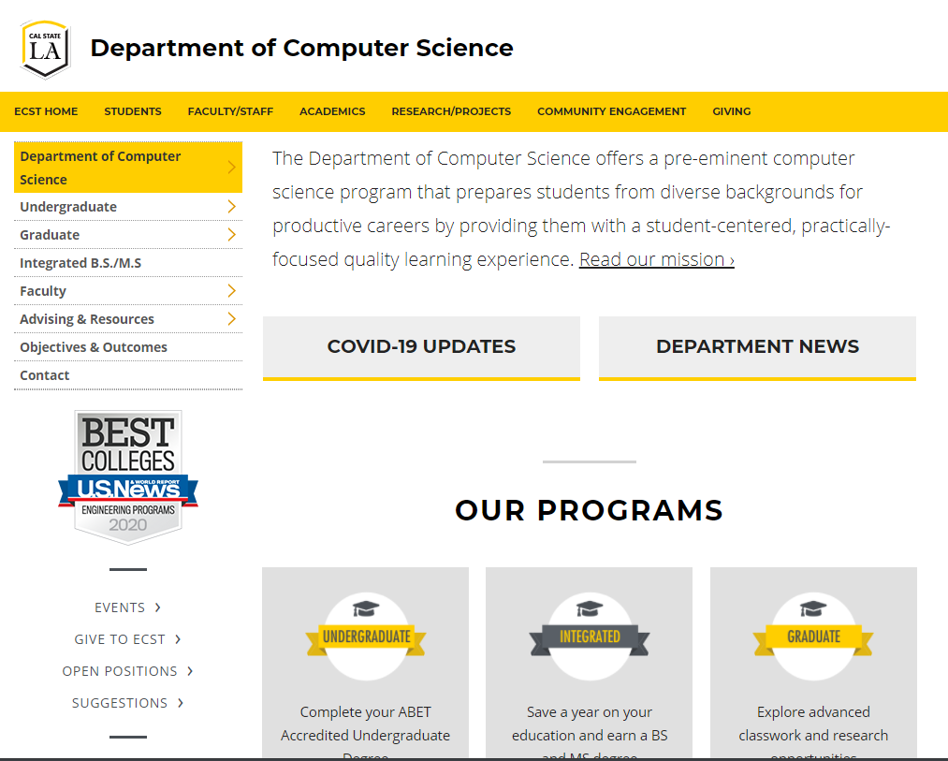
Computer Science Department
Department website: https://www.calstatela.edu/ecst/cs
Check undergraduate curriculum requirement https://www.calstatela.edu/ecst/cs/curriculum-requirements
Check research opportunities
Check faculty webpages

Slide 4
Computer Science Department Advisement
Department website: https://www.calstatela.edu/ecst/cs
Advisement information - https://www.calstatela.edu/ecst/cs/advisement-resources
Check group advisement sessions
Check faculty advisor office hours and zoom links - https://www.calstatela.edu/ecst/cs/cs-faculty-advising-and-office-hours
Check forms - https://www.calstatela.edu/ecst/cs/forms
Check other resources - https://www.calstatela.edu/ecst/cs/resources

Slide 5
BS CS Curriculum
General Education
CS (Core and Electives)
120 units
(39+9) + 72 = 120 units (Univ.)
(24+0) + 96 = 120 units (CS)
Notes:
Elaine

Slide 6
BS Curriculum (current)
Lower Division Required Courses
CS 1222 - Introduction to Relational Databases
CS 2011 - Introduction to Programming I
CS 2012 - Introduction to Programming II
CS 2013 - Programming with Data Structures
CS 2148 - Discrete Structures
ENGL 2030 - Introduction to Technical Writing
MATH 2110 - Calculus I
MATH 2120 - Calculus II
MATH 2550 - Introduction to Linear Algebra
PHYS 2100 - General Physics I: Mechanics
PHYS 2200 - General Physics II: Electromagnetism and Circuits
Upper Division Required Courses
CS 3035 - Programming Language Paradigms
CS 3112 - Analysis of Algorithms
CS 3186 - Introduction to Automata Theory
CS 3220 - Web and Internet Programming
CS 3337 - Software Engineering
CS 3801 - Societal and Ethical Issues in Computing
CS 4440 - Introduction to Operating Systems
CS 4961 - Software Design Laboratory I
CS 4962 - Software Design Laboratory II
CS 4963 - Computer Science Recapitulation
EE 3445 - Computer Organization
CS Electives (18 units)
Math Elective (3 units)
Notes:
Elaine

Slide 7
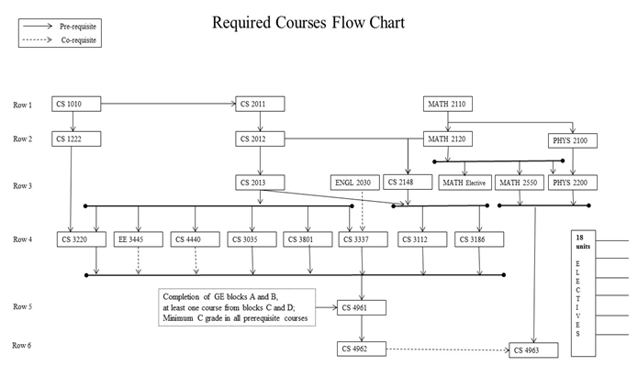
BS CS Curriculum (current)
Notes:
Elaine

Slide 8
CS Electives - Wide range of courses
CS 3034 - Widely-used Programming Languages
CS 3660 - Complex Social and Economic Systems
CS 4075 - Concurrent and Distributed Programming
CS 4112 - Competitive Programming
CS 4188 - Compilers
CS 4220 - Current Trends in Web Design and Development
CS 4222 - Principles of Data Base Systems
CS 4470 - Computer Networking Protocols
CS 4471 - Computer Networks Configuration and Management
CS 4540 - Topics in Advanced Computer Science (Data Visualization, Mobile Computing, Cybersecurity, Robotics, Human Centered Computing)
CS 4550 - Computer Graphics
CS 4551 - Multimedia Software Systems
CS 4555 - Introduction to 3D Computer Game Programming
CS 4556 - Multiplayer Online Game Design and Development
CS 4635 - Modeling and Simulation
CS 4660 - Artificial Intelligence
CS 4661 - Introduction to Data Science
CS 4662 - Advanced Machine Learning
CS 4780 - Cryptography and Information Security
Notes:
Elaine

Slide 9
Critical Course Sequences
CS2011-CS2012-CS2013
Come up with a logic to solve a problem
Programming – step by step logical instructions (code) in a language.
This is the foundation of everything CS
Bread and Butter
CS 3XXX
Intermediate level courses to develop your CS skills
CS4961-CS4962 (Fall-Spring)
Big projects
Icing on the Cake

Slide 10
Degree Planner (Spring 21 and beyond)
By Spring 2022, plan to complete all the prerequisite courses to CS 4961 so that you can take CS 4961 in Fall 2022.
Recommended courses to complete by Spring 2022:
GE
CS LD requirements
CS 3035 - Programming Language Paradigms
CS 3112 - Analysis of Algorithms
CS 3186 - Introduction to Automata Theory
CS 3220 - Web and Internet Programming
CS 3337 - Software Engineering
CS 3801 - Societal and Ethical Issues in Computing
CS 4440 - Introduction to Operating Systems
EE 3445 - Computer Organization
year 2020-2021 | Summer 2020 | fall 2020 | spring 2021
year 2021-2022 | Summer 2020 | fall 2021 | spring 2022
10

Slide 11
Course Planning and Time Management
Full time student = Full time job
15 units (5 courses) = 40 hours (or more)/week
Minimum course commitment = 40/5 = 8 hours/week
Each course scheduled time:
Lecture only – Scheduled for 3 hours/week
Lecture/Lab – Scheduled for 5 hours/week
Each course extra study time
5 hours/week
Spring 2021 Registration
Check enrollment date on GET
Any issues? Contact a faculty advisor.

Slide 12
Q&A
www.calstatela.edu/cs

