Slide 1
Industry Advisory Board Meetings College Overview
College of Engineering, Computer Science, and Technology California State University, Los Angeles
October 20, 2017

Slide 2
Let us get together to:
Engage in dialogue and learn what is new about college, departments, and programs
Discuss industry trends, curricular changes
Ensure our program educational objectives are appropriate and aspirational
Build partnership and enhance ECST community

Slide 3
Cal State LA is “doing the work”
https://www.youtube.com/watch?v=QhN4wBfQ9yI

Slide 4
What we learn from our alumni?
University baccalaureate alumni survey 2016
No. of responses: ECST - 182

Slide 5
Employment status
“What is your primary activity at this time?”

Slide 6
Salary status
Percent of alumni in different income range

Slide 7
Is your current position related to your undergraduate major?

Slide 8
Job Satisfaction of ECST Alumni

Slide 9
Satisfaction with CSLA experience
ECST Alumni’s response to their student experience at CSLA:

Slide 10
Satisfaction with CSLA experience
Quality of Instruction: 77.6% satisfied or very satisfied
Academic Advising: 66.5% satisfied or very satisfied
Opportunity to work with faculty on research/design projects: 50.9% satisfied or very satisfied
Labs and facilities: 54.2% satisfied or very satisfied
Technology resources and access: 70.3% satisfied or very satisfied
Career preparation: 67.6% satisfied or very satisfied

Slide 11
What three words would you use to describe your experience as a student at Cal State LA?

Slide 12
College Updates

Slide 13
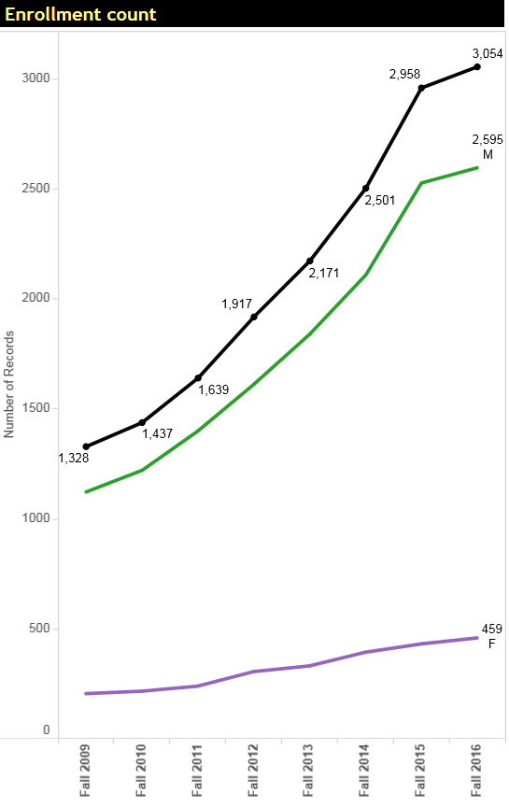
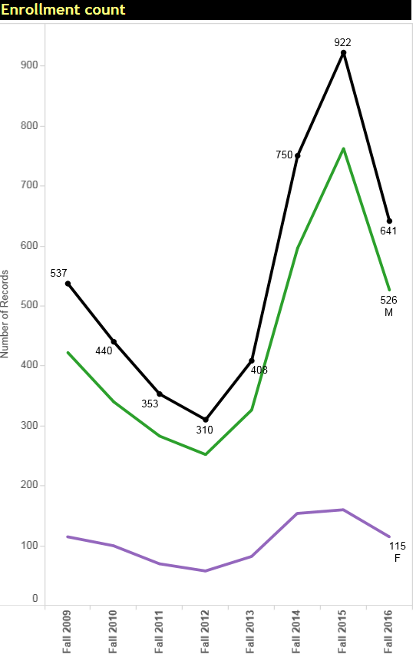
College Enrollment Trend
Undergraduates in ECST
Graduate Students in ECST

Slide 14
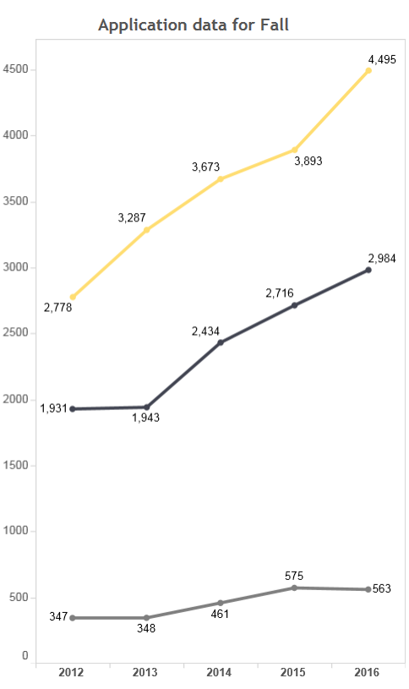
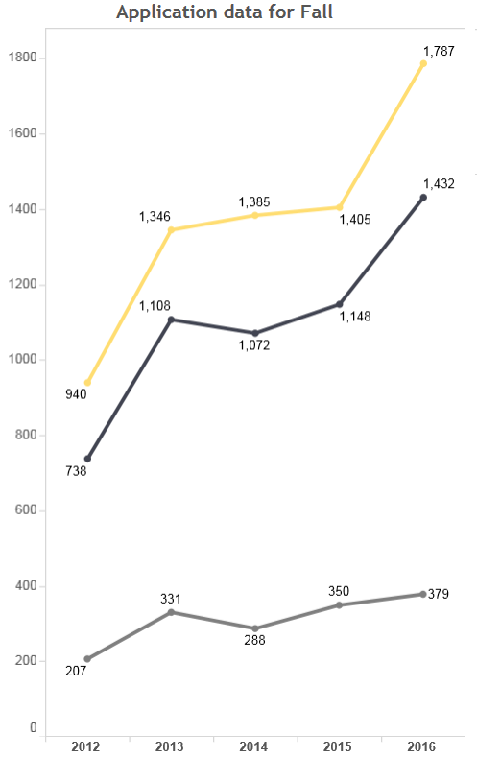
College Application, Admission, and Enrollment
First-time freshman
First-time transfer

Slide 15
A Growing College
Adjunct Professors increased from 93 (2015) to 113 (2017)
Strengthen:
+ IT Support
+ Graduate Admission and Recruitment
+ Transfer Advising
+ Career Service and Placement

Slide 16
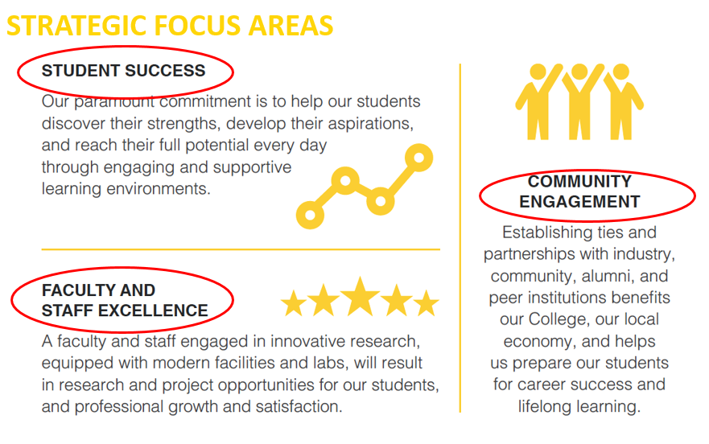
ECST beyond Q2S
Sustainable Solution
We are serving more than 200% students than 5 years ago

Slide 17
Work-in-Progress: Student Success
Major-specific admission
Better prepared students
First-year acceleration
Build a foundation for student success
Advising & mentoring
Progress to Degree
Bottleneck Reduction
Course availability
Enhanced curriculum
Effective Instruction
Pathway to student success

Slide 18
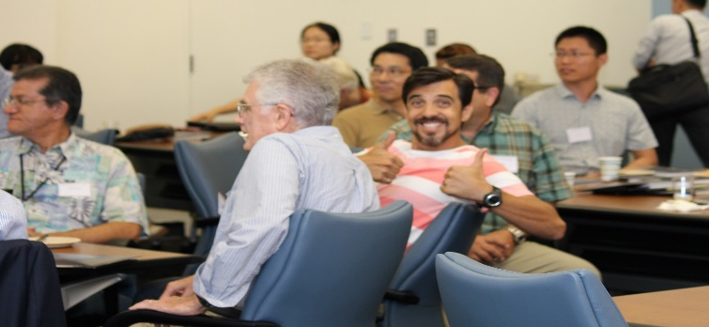
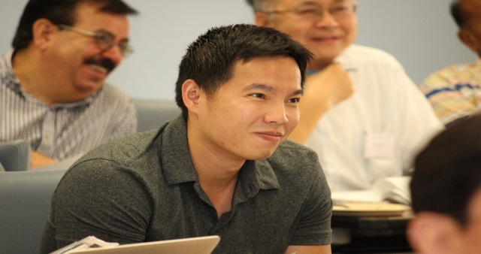
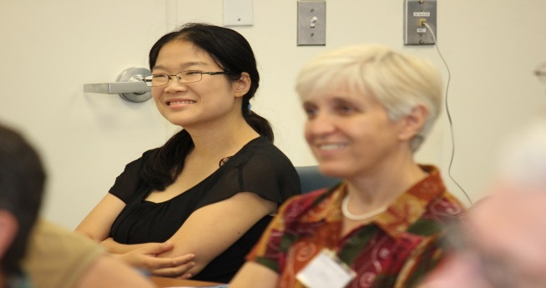
Work-in-Progress: Build a Supportive Community
Teaching & Learning Academy:
→ A community of teacher-scholars to learn & support each other
ECST Research Seminar:
→ Start to cultivate a culture of research
College Parties
Taco BBQ Party
Talent Show
End-of-year celebration
T&L Academy: lots of fun…

Slide 19
Work-in-Progress: Engaging Our Alumni Unsolicited ECST Donations
# of donors
$$ amount

Slide 20
Accreditation update

Slide 21
A Year of Accreditation
BS in Industrial Technology, ATMAE, Spring 18
BS in Computer Science ABET CAC, Fall 18
BS in Civil Engineering, ABET EAC, Fall 18
BS in Electrical Engineering, ABET EAC, Fall 18
BS in Mechanical Engineering, ABET EAC, Fall 18

Slide 22
ABET – A valued credential
Important for our students:
Verifies that the degree meets the global standard for technical education in the profession.
Enhances employment opportunities —multinational corporations require graduation from an accredited program.
Many professional licensure, registration, and certification require graduation from an ABET-accredited program as a minimum qualification.
Paves the way for you to work globally, because ABET accreditation is recognized worldwide through international agreements

Slide 23
ABET – A valued credential
Critical for our programs:
Has received international recognition of its quality.
Promotes “best practices” in education.
Directly involves faculty and staff in self-assessment and continuous quality improvement processes.
Ensure the educational objectives aligned with the emerging workforce needs.
Demonstrated that our graduates attain essential learning outcomes to enter the profession.

Slide 24
Core of ABET Accreditation
Continuous
improvement
Define PEO and outcomes
DESIGN AND CONDUCT ASSESSMENTS
EVALUATE ASSESSMENT FINDINGS
USE RESULTS FOR DECISION MAKING

Slide 25
Accreditation Process: a comprehensive evaluation of the degree programs
General Criteria
1 Students
2 Program Educational Objectives
3 Student Outcomes
4 Continuous Improvement
5 Curriculum
6 Faculty
7 Facilities
8 Institutional Support
Program Criteria
Program-specific requirements (curriculum, faculty qualifications, etc.)
Program Assessment and Evaluation
Key: Systematically use assessment findings to achieve continuous improvement

Slide 26
Accreditation Process: a comprehensive evaluation of the degree programs
Admission;
Advising (Academic & Career);
Graduation process (degree integrity)
General Criteria
1 Students
2 Program Educational Objectives
3 Student Outcomes
4 Continuous Improvement
5 Curriculum
6 Faculty
7 Facilities
8 Institutional Support
Program Criteria
Program-specific requirements (curriculum, faculty qualifications, etc.)
ABET requirements on math, science, major units
Curriculum support PEO / student outcomes

Slide 27
Accreditation Process: a comprehensive evaluation of the degree programs
General Criteria
1 Students
2 Program Educational Objectives
3 Student Outcomes
4 Continuous Improvement
5 Curriculum
6 Faculty
7 Facilities
8 Institutional Support
Program Criteria
Program-specific requirements (curriculum, faculty qualifications, etc.)
Adequate number + expertise to cover all curricular areas, student-faculty interaction and achieve Educational Objectives

Slide 28
Accreditation Process: a comprehensive evaluation of the degree programs
General Criteria
1 Students
2 Program Educational Objectives
3 Student Outcomes
4 Continuous Improvement
5 Curriculum
6 Faculty
7 Facilities
8 Institutional Support
Program Criteria
Program-specific requirements (curriculum, faculty qualifications, etc.)
Tools, equipment, computing resources, labs to support student outcomes

Slide 29
Accreditation Process: a comprehensive evaluation of the degree programs
General Criteria
1 Students
2 Program Educational Objectives
3 Student Outcomes
4 Continuous Improvement
5 Curriculum
6 Faculty
7 Facilities
8 Institutional Support
Program Criteria
Program-specific requirements (curriculum, outcomes, etc.)
Institutional commitment
adequate budget, staff (technical & non-technical) to meet the program needs.

Slide 30
Accreditation Steps
Pre-visit review
Self-study report
Transcripts
Site visit
Review course files, assessment files, tour labs
Interview administrators, faculty, students, and other selected units
Post-site visit
7-day response
Draft statement to Dean
Supporting documents
Lunch with IAB members
30-day response
Final statement after commission meeting in Summer 19
Usually Sunday to Tuesday

Slide 31
Potential Decisions
Deficiency: A Criterion/Policy/Procedure is not Satisfied
→Show Cause (SC): first step to non-accreditation
→ Revisit in two years
Weakness: Lacks Strength of Compliance to a criterion
→ Interim Action Required (IR or IV)
Concern: Currently Satisfies Criterion, but may potentially change in the future
→NGR, but may need to address it in next visit
Observation: comments or suggestions but not affecting accreditation

Slide 32
Key to successful accreditation visit
Preparation:
ABET suggest at least 18 months preparation.
Awareness:
Know up-to-date ABET criteria, policy and procedure
Involvement:
All stake holders are involved (faculty, students, IAB, Alumni)
Organization:
Provide a well-organized visit experience for PEV and make their job easy!

Slide 33
Get Ready for ABET!
Accreditation Taskforce established in Winter 2016 (2 and a half year ahead of ABET visit)
Focus on program assessment and accreditation preparation
College Accreditation Taskforce:
Track changes in ABET criteria, policy and procedure
Establish process and guidelines for program assessment
At Department
Work with faculty to design assessment tools and collect data
Use the assessment results to inform curriculum/program changes
Report & documentation
Assessment coordinators + Chairs

Slide 34
Get Ready for ABET: Our Strength
Well-established assessment and evaluation process
Continuous Improvement is the core of our operation!
Review and update Educational Objectives
Implement Program improvement
Identify areas of improvement
Analyze Assessment Data
Collect Assessment data
Constituency input
2-loop process for program assessment and evaluation (since EC2000)

Slide 35
Get Ready for ABET: Our Strength
Solid Programs
Broad involvement of faculty, IAB, and alumni in assessment and accreditation preparation
Many instructors are supporting course-embedded assessment
Course coordinators and instructors are collecting course files
Faculty are preparing CV
IAB members and alumni always help in assessment, ensure PEO meet the needs of industry, and provide feedback to improve the program

Slide 36
Get Ready for ABET: Positive Changes
Increased # of faculty, with more faculty search on the way
Enhanced advising structure
New tools (e.g. EAB) to monitor students’ progress

Slide 37
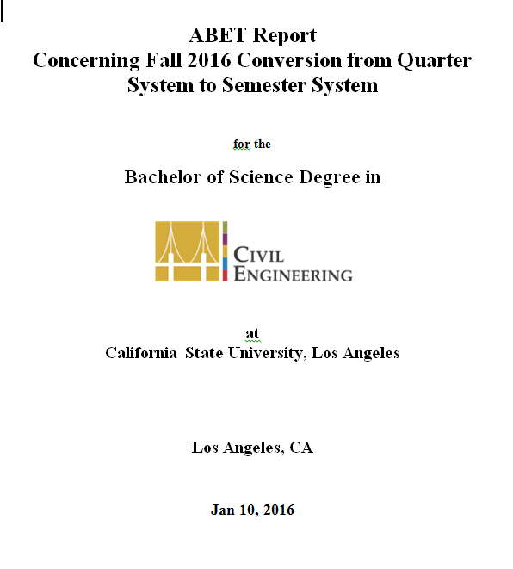
Get Ready for ABET: Potential Challenge
Quarter to Semester Conversion
Semester curriculum in compliance with ABET
Process in place to ensure students meet graduation requirement in Q2S
Documented Advising process to help students in transition process
Our Q2S ABET report was approved by ABET
“It was determined that the conversion does not impact compliance with the accreditation criteria! “

Slide 38
Get Ready for ABET: Potential Challenge
Still, potential challenges related to Q2S:
#1 Transcript analysis will be more difficult
#2 Get ready to answer questions about how we advised and demo they meet degree requirements in Q2S process
#3 Demonstrate continuous improvement in Q2S process
Think-ahead &
Work harder to get Prepared

Slide 39
Get Ready for ABET: our progress
Our Accreditation Taskforce rocks!
Enhanced assessment process, implemented new tools
Completed Data analysis (16-17) in Summer
Working on Self-study report assessment portions
Quarter
Semester
Data collection focused in senior design
Measure student knowledge, skill, attitude at outcome level
Data collected in senior design + core courses
Performance indicators w. rubrics for more consistent assessment
More meaningful data to inform decision of program improvement
Kudos for all assessment coordinators and faculty who worked to support data collection in their courses!

Slide 40
ABET Preparation Timeline
Preparation Timeline
By end of Fall 17: first complete draft of self-study report (including ABET syllabus and faculty CV)
Winter 18: review course files collected.
Spring 18: revise and enhance self-study report with new assessment data
Spring 18: continue to collect course files and prepare for assessment binders
May, 2018: self-study report completed and submitted to college
Mid-June: self-study report shipped to ABET
Critical Timeline
Jan 2018: Submit Request for Evaluation (RFE)
April- May 2018: Review Team will be formed
June 2018: Submit all Self-study reports + supporting documents to ABET
Summer-Fall 18: Transcript Analysis
Fall 2018: On-site visit

Slide 41
Fun Fact Check: your involvement in ABET preparation
#of tasks involved
:
Collect Course File
Write ABET Syllabus
Prepare CV for ABET
Conduct ABET assessment in your class
Assess student performance in Senior Design Expo
Participate in meetings to discuss assessment results and curriculum change
Review the program educational objectives
Write assessment report
Write self-study report
1-3: Great Helper Award
3-7: Major Contributor
8-9: ABET Coordinator

Slide 42
Breakout Sessions
CS IAB meeting – LIB B137
CE IAB meeting – E&T A226
EE IAB meeting – BIO S159
ME IAB meeting – E&T A631

