Slide 1
Computer Science BS CS Curriculum Requirement (Fall 2021)
CS website and Resources:
https://www.calstatela.edu/ecst/cs

Slide 2
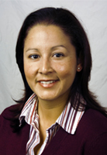
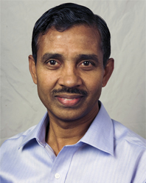
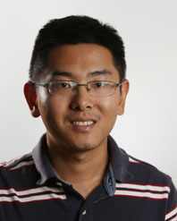
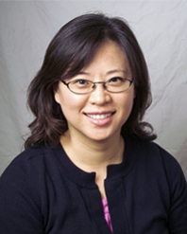
Meet CS Undergraduate Advisors
Evelyn Crosby
Lead Advisor, ECST Advising Center
ecrosby@calstatela.edu
Raj S. Pamula
Undergraduate Advisor
rpamula@calstatela.edu
Zilong Ye
Undergraduate Advisor
zye5@calstatela.edu
Elaine Kang
Chair
eykang@calstatela.edu

Slide 3
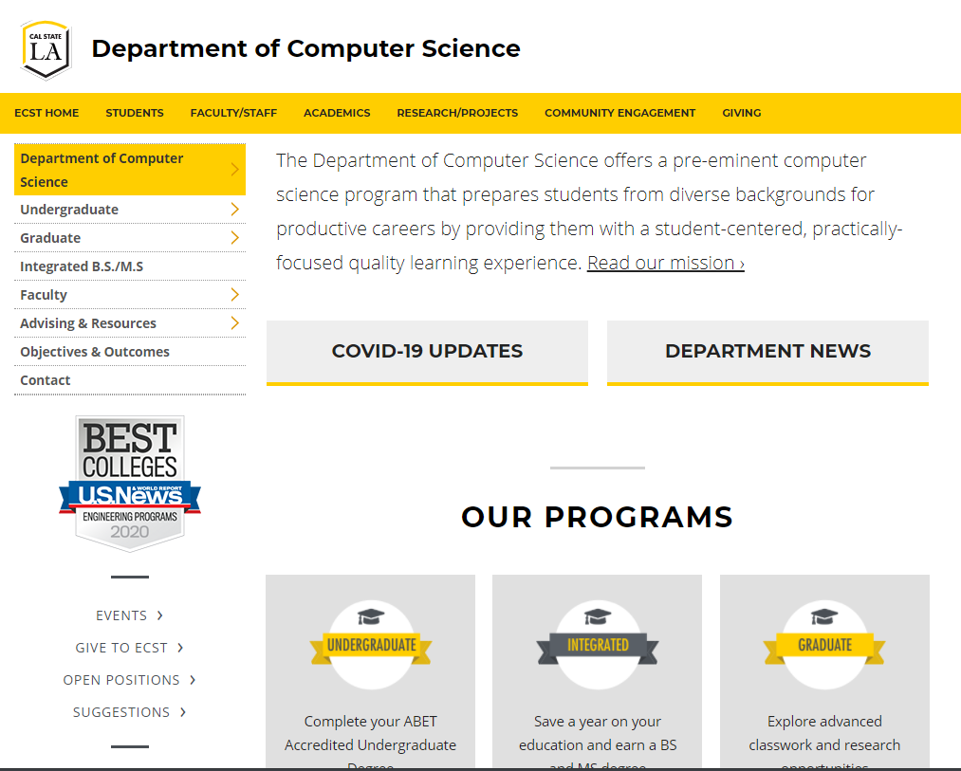
Computer Science Department
Department website: https://www.calstatela.edu/ecst/cs
Check undergraduate curriculum requirement https://www.calstatela.edu/ecst/cs/curriculum-requirements

Slide 4
Computer Science Department Advisement
Department website: https://www.calstatela.edu/ecst/cs
Advisement information - https://www.calstatela.edu/ecst/cs/advisement-resources
Check group advisement sessions
Check faculty advisor office hours and zoom links - https://www.calstatela.edu/ecst/cs/cs-faculty-advising-and-office-hours
Check forms - https://www.calstatela.edu/ecst/cs/forms
Check other resources - https://www.calstatela.edu/ecst/cs/resources

Slide 5
BS Curriculum (current) – Major Requirements (93 units)
Lower Division Required Courses (39 units)
CS 1222 - Introduction to Relational Databases
CS 2011 - Introduction to Programming I
CS 2012 - Introduction to Programming II
CS 2013 - Programming with Data Structures
CS 2148 - Discrete Structures
ENGL 2030 - Introduction to Technical Writing
MATH 2110 - Calculus I
MATH 2120 - Calculus II
MATH 2550 - Introduction to Linear Algebra
PHYS 2100 - General Physics I: Mechanics
PHYS 2200 - General Physics II: Electromagnetism and Circuits
Upper Division Required Courses (33 units)
CS 3035 - Programming Language Paradigms
CS 3112 - Analysis of Algorithms
CS 3186 - Introduction to Automata Theory
CS 3220 - Web and Internet Programming
CS 3337 - Software Engineering
CS 3801 - Societal and Ethical Issues in Computing
CS 4440 - Introduction to Operating Systems
CS 4961 - Software Design Laboratory I
CS 4962 - Software Design Laboratory II
CS 4963 - Computer Science Recapitulation
EE 3445 - Computer Organization
--------------------------------------------------------------------------
CS Electives (18 units)
Math Elective (3 units)
Notes:
Elaine

Slide 6
New BS Curriculum (effective Fall 2021) – Major Requirements (93 units)
Lower Division Required Courses (44 units)
CS 1222 - Introduction to Relational Databases
CS 2011 - Introduction to Programming I (4)
CS 2012 - Introduction to Programming II (4)
CS 2013 - Programming with Data Structures (4)
CS 2148 - Discrete Structures (4)
CS 2445 – Intro to Computer Systems
CS 2470 – Network Systems and Cybersecurity
ENGL 2030 - Introduction to Technical Writing
MATH 2110 - Calculus I
MATH 2120 - Calculus II
MATH 2550 - Introduction to Linear Algebra
PHYS 2100 - General Physics I: Mechanics
PHYS 2200 - General Physics II: Electromagnetism and Circuits
Upper Division Required Courses (31 units)
CS 3035 - Programming Language Paradigms
CS 3112 - Analysis of Algorithms
CS 3186 - Introduction to Automata Theory
CS 3220 - Web and Internet Programming (4)
CS 3337 - Software Engineering
CS 3801 - Societal and Ethical Issues in Computing
CS 4440 - Introduction to Operating Systems
CS 4961 - Software Design Laboratory I
CS 4962 - Software Design Laboratory II
CS 4963 - Computer Science Recapitulation
EE 3445 - Computer Organization
--------------------------------------------------------------------------
CS Electives (18 units)
Math Elective (3 units)

Slide 7
Summary of Changes
Changes
Phys2200, Math Elective, EE 3445 are no longer requirements.
CS 2470, CS 2445 are new required courses.
1 unit increase for each of these classes: CS 2011, CS 2012, CS 2013, CS 2148, CS 3220

Slide 8
Should I change to the new BS CS requirement?
Check what are your major remaining requirements under the current or new requirements.
If PHYS 2200 and Math elective are remaining, we recommend to change.
Check if you would have enough units under the new requirements.
If you have already completed several of CS 2012, CS 2013, CS 2148, CS 3220, you may be short units to graduate under the new requirement. You might need to take another elective.
Decision or Questions?
Update your spring 2021 schedule and your degree planner
Request to change your requirement explicitly in Fall 2021
Contact an advisor
This a general guideline.

Slide 9
Q&A
www.calstatela.edu/cs

