Slide 1
Computer Science
https://www.calstatela.edu/cs

Slide 2
Agenda
Introduction to Computer Science
Why choose Cal State LA Computer Science
Project Showcase
Q & A

Slide 3
Cal State LA: One of “America’s great working-class colleges”
“The colleges where the American dream is still alive”
https://www.youtube.com/watch?v=QhN4wBfQ9yI
3
Notes:
Congratulations on your acceptance to Cal State LA!
The New York Times called Cal State LA one of “America’s great working-class colleges”.
We’re not as famous as some other schools. But we work hard to provide a great experience for students.
Our focus is on educating students. We help you build skills, find opportunities, and embark on great careers.
Cal State LA is the best place to go if you want upward mobility. We help students move up the economic ladder better than any other American college.
Here is a youtube link to a video created by Vox. Vox is a news website, and this video highlights Cal State LA as one of the colleges where the American dream is still alive. I encourage you to take the time to view it. I’ll paste it into the chat. Bookmark it for later.
https://www.youtube.com/watch?v=QhN4wBfQ9yI

Slide 4
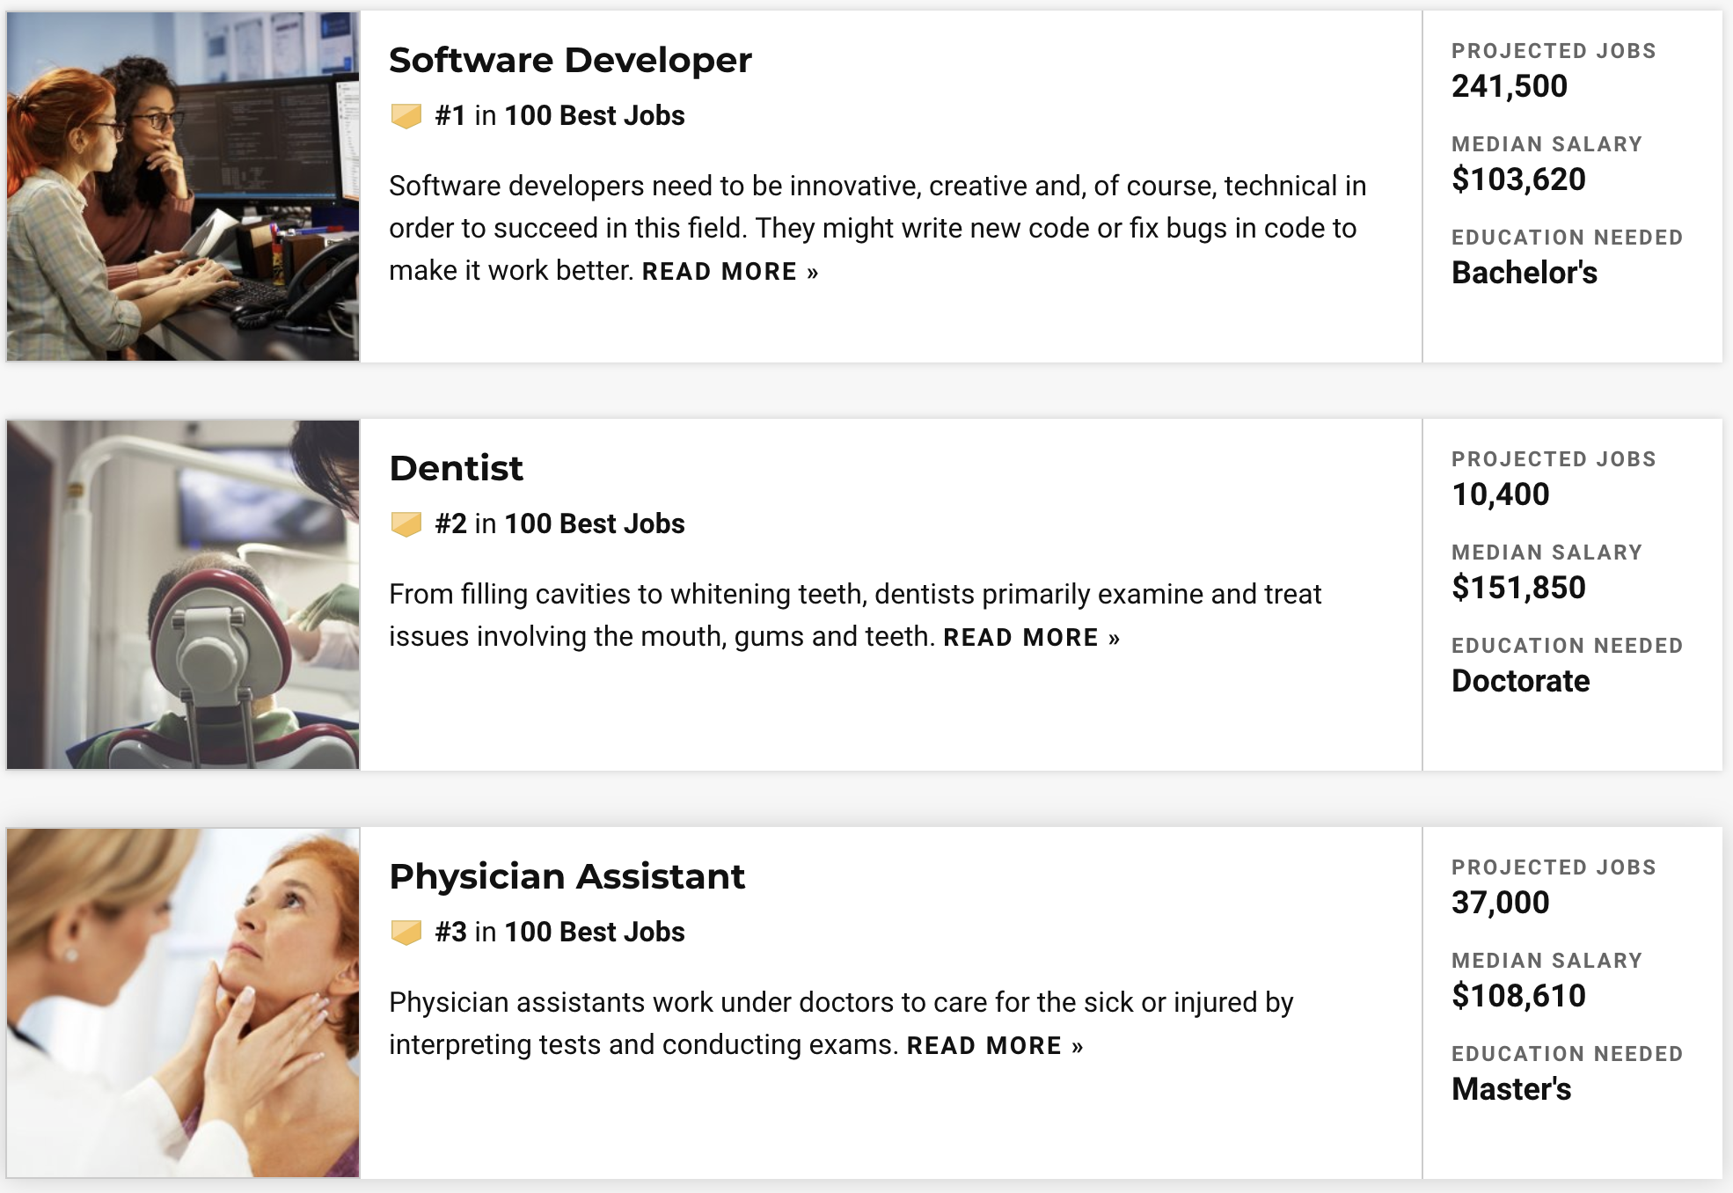
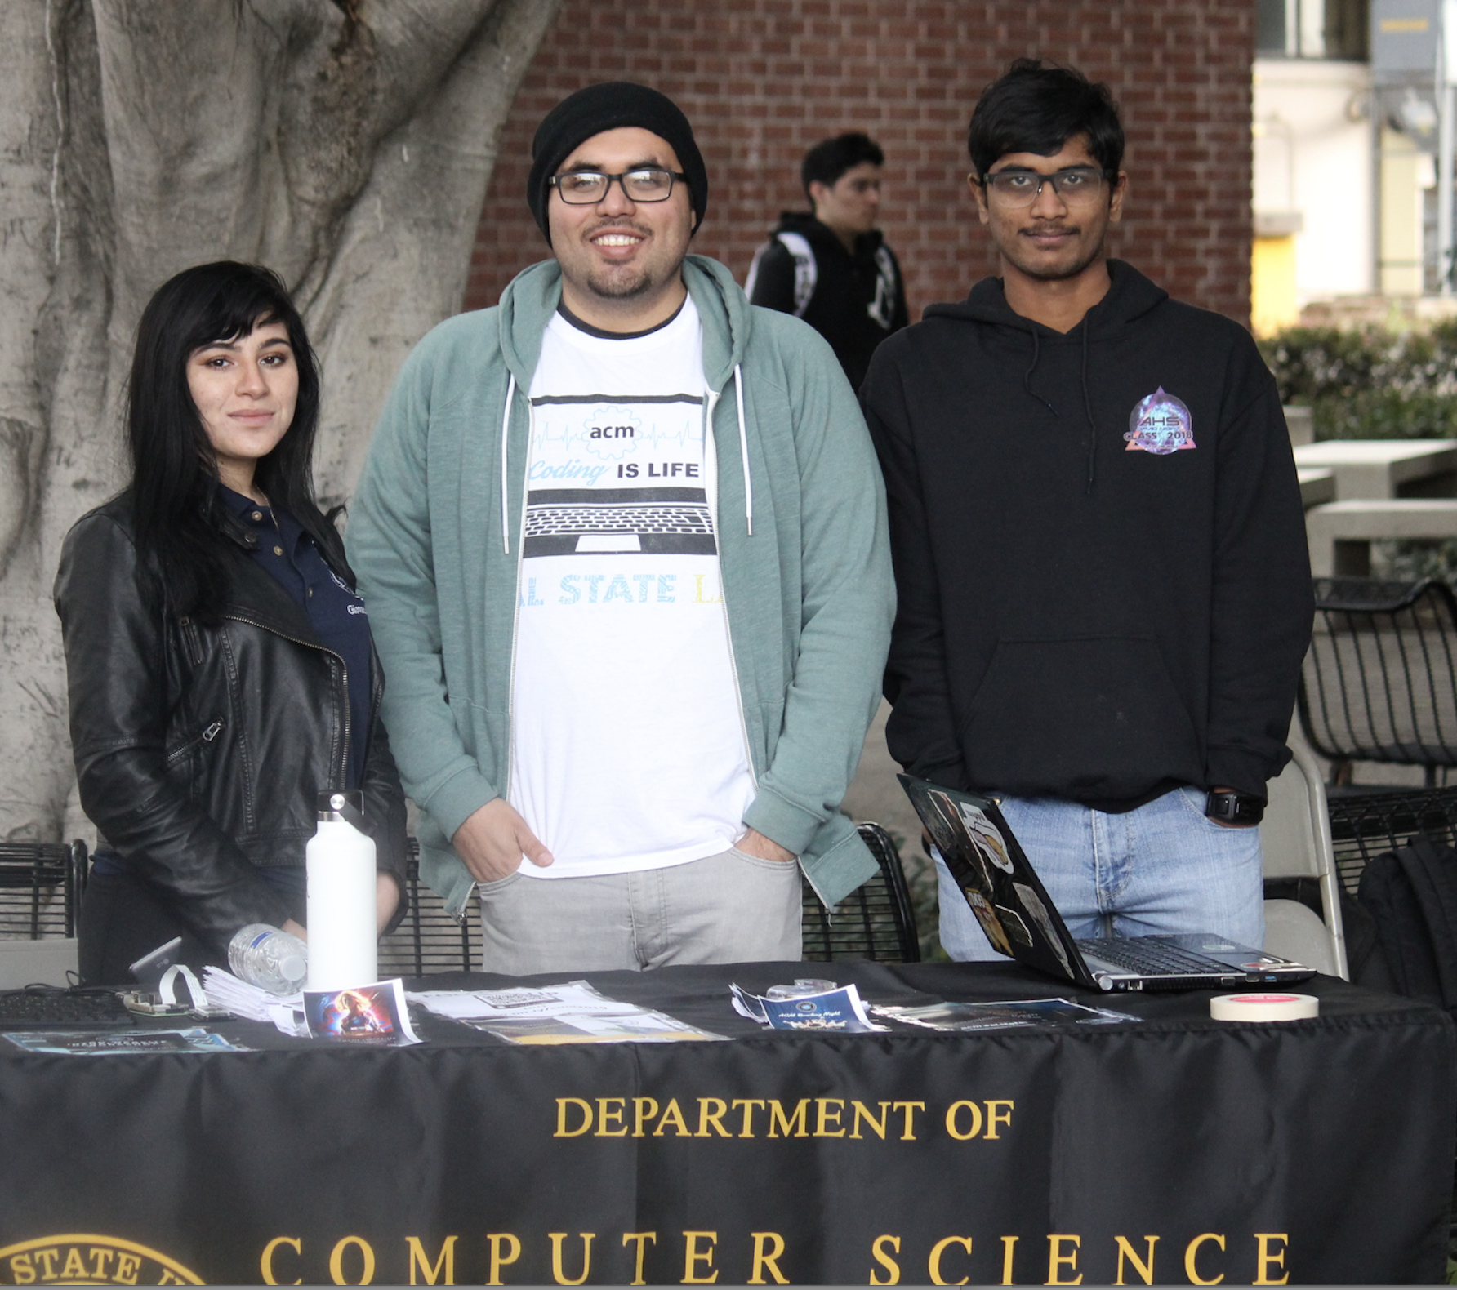
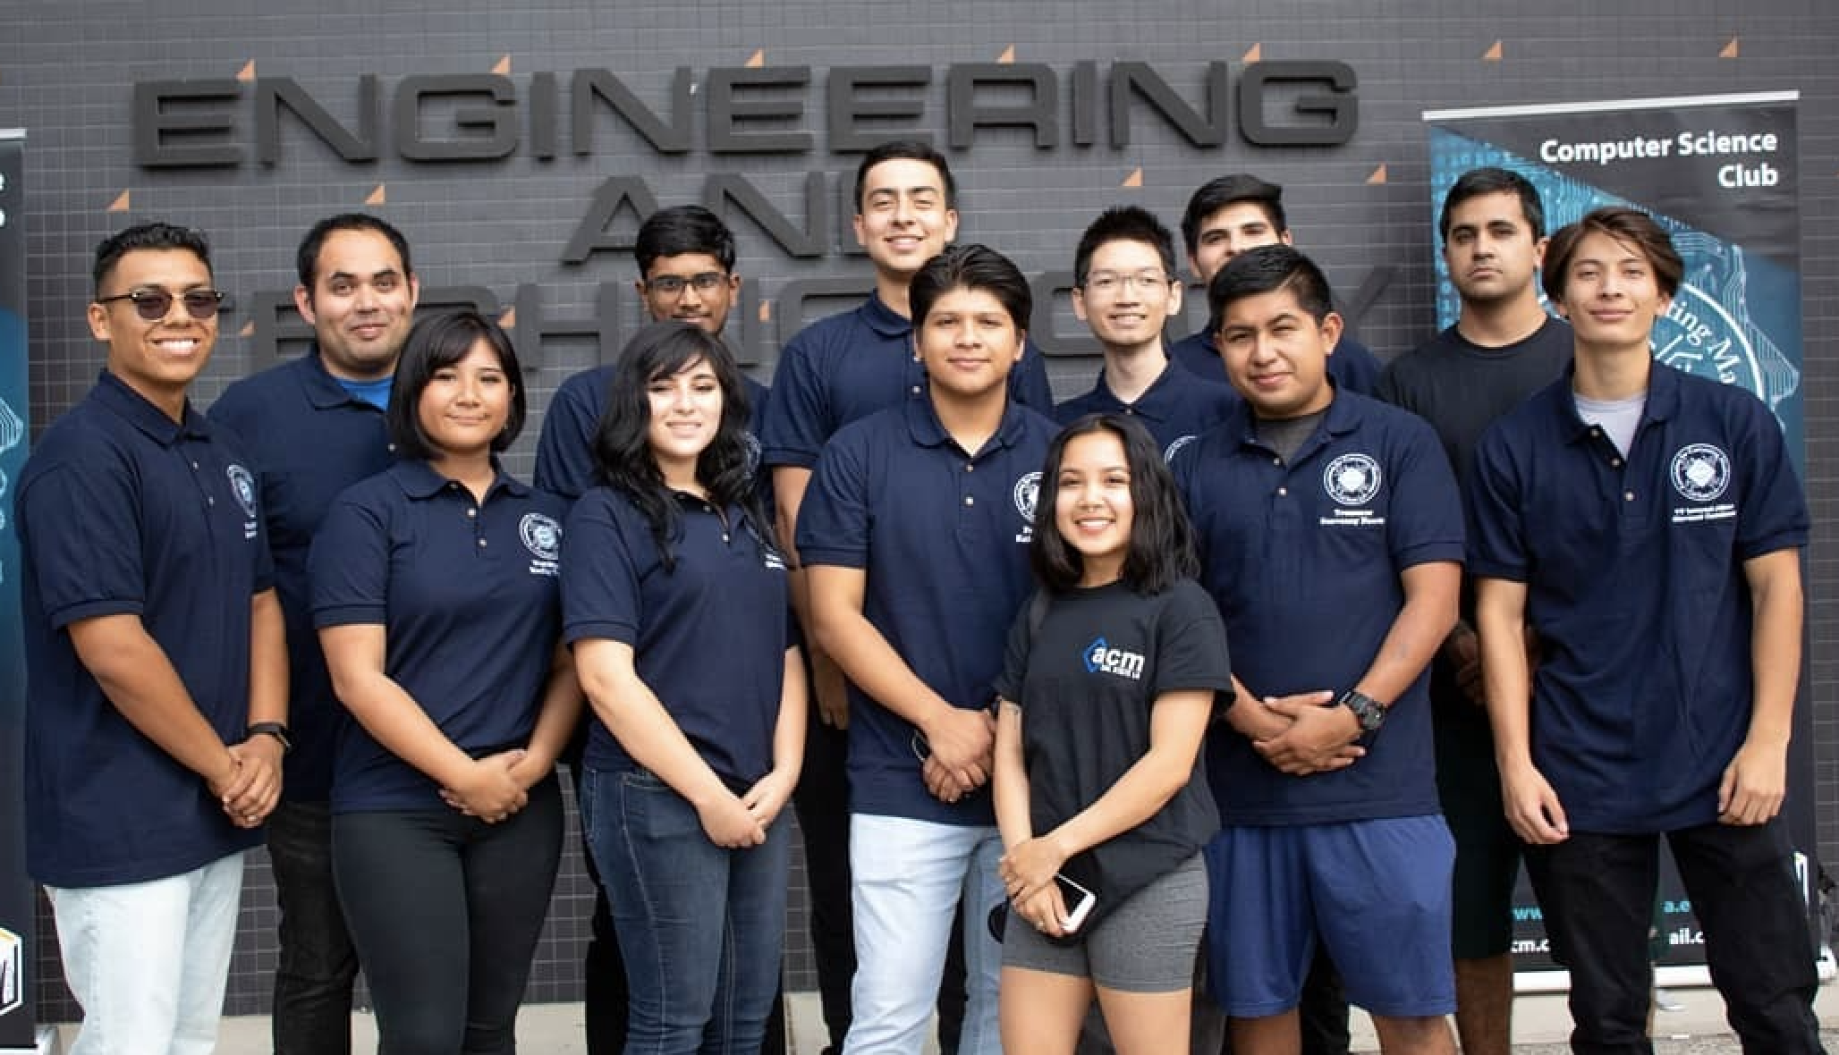
Best Jobs 2020 (Based on Prospects and Satisfaction)
#1 Software Developer
4
Notes:
A career in computer science is one of the best careers out there, according to US News and World Report.
These rankings are based on job prospects and job satisfaction. On the job satisfaction scale, being a software developer usually provides above average flexibility. Overall, there are many job opportunities in the computing profession, the jobs earn good wages, and people enjoy their jobs.

Slide 5
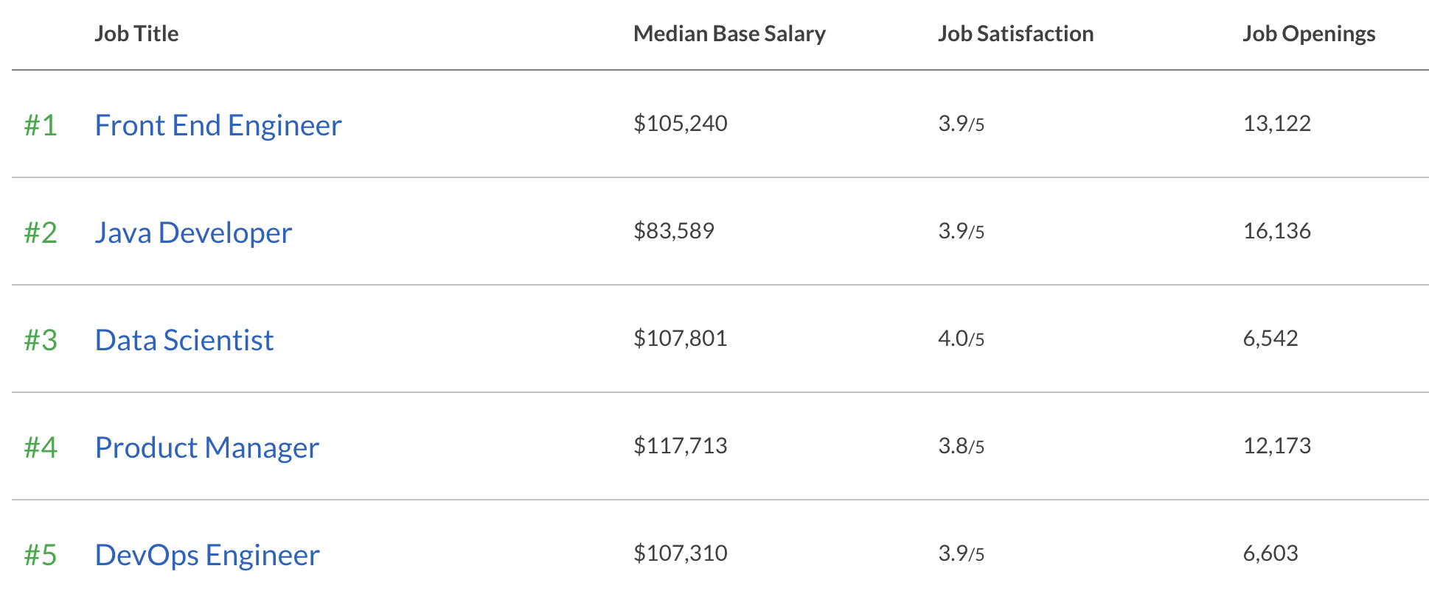
Best Jobs 2020 (Based on Salary and Satisfaction)
#1 Software Developer
5
Notes:
Glassdoor also rates computer science jobs at the top of the best jobs list.
The front-end developer focuses on the look and feel of the site, along with its functionality.
Java developer is a software developer who uses the Java programming language.
A data scientist analyzes data and helps companies make decisions. They are part mathematician and part computer scientist.
A product manager could be in any field, but there are many in computer and technology companies. They have manage the development of new product features and often need a strong background in computer science.
DevOps (development and operations) is an enterprise software development phrase used to mean a type of agile relationship between development and IT operations. The goal of DevOps is to change and improve the relationship by advocating better communication and collaboration between these two business units.
Number 6 is Data Engineer. (Work with data scientists)
Number 7 is Software Engineer. (general title for someone who develops software.)
Number 8 is speech pathologist.

Slide 6
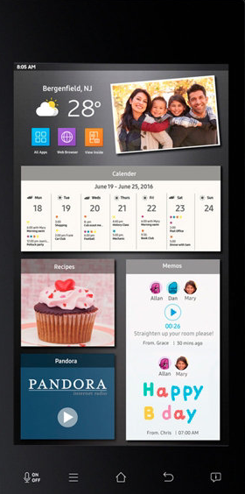
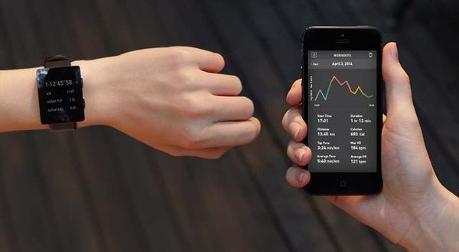
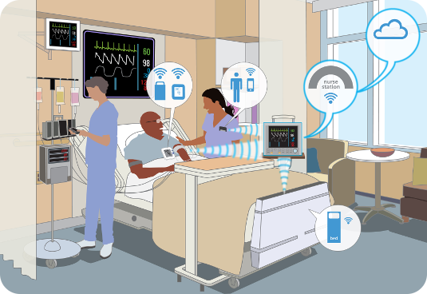
Computers Are Everywhere
Smart Appliances
Wearable Tech
Entertainment
Google Glass Enterprise
Healthcare
Automotive and Transportation
6
Notes:
Computing is such a fundamental part of our society. It is the engine on which the world runs.
Computer science is deeply embedded in healthcare, entertainment, automotive design, appliances and homes, and even worn on our wrists and in our pockets.

Slide 7
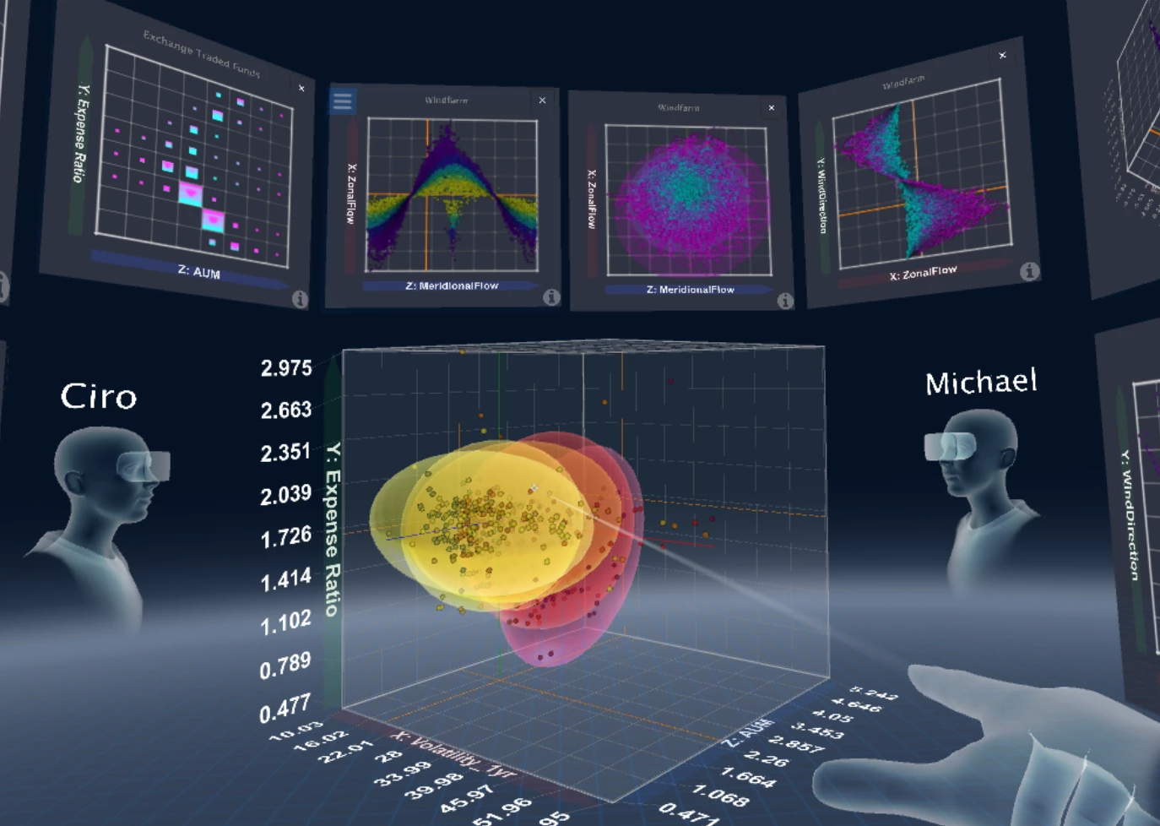
Solving Complex Problems to Make a Positive Difference
Computer Scientists build the tools that make the future possible
Discovering new drugs
Optimizing logistics and the supply chain
Organizing the world’s information
Supporting worldwide communication and collaboration
Exploring other planets
And more...
Notes:
Computer scientists build the tools that make the future possible.
Without computation, we would not be able to develop new drugs as quickly.
In fact, we would all problably starve. The world’s food distribution, the logistics and the supply chain are optimized by computers.
We all use the web and search engines to learn.
We also rely on computing to communicate at work and at home.
Many of our graduates have gone to work for NASA’s Jet Propulsion Laboratory. Computing helps us explore the universe.

Slide 8
Job Satisfaction of our Alumni
8
Notes:
Our alumni are very satisfied with their careers. You can see that over 80% are satisfied or very satisfied.
I think that a computer science education at Cal State LA and the opportunities in the computer science field can put you in a very good place.

Slide 9
Alumni Profiles
Phu Kieu (Class of 2012)
Senior Software Engineer
Google
Vignesh Saravanan (Class of 2018)
Software Engineer
Comcast
Mark Sargent (Class of 2015)
Software Engineer
Google
Mohammed Al Rawi (Class of 2018)
Chief Information Officer
LA County Public Defender
Sweta Shinde (Class of 2010)
Lead Engineer (Mobile App Dev.)
AutoGravity
Stacey O'Malley (Class of 2008)
Lead Engineer
Honeywell
9
Notes:
Here are some of our alumni and some of the different organizations they have joined. Some are tech companies that you have hear of, like Google and Comcast. Honeywell is a large industrial comglomerate. But you can see that we also have an alum working as a CIO in the LA County Public Defender’s office and another working for on mobile app development for a startup that is a few years old.
Job satisfaction. Giving back to the department and college.
Many of our alumni give back to the department and college by providing gifts or financial support, recruiting our students as interns or new employees, and also by sponsoring senior projects.

Slide 10
Senior Design Capstone Project
Projects sponsored by
Businesses: large and small, local and global
Government: city, county, state, federal (e.g., Govt. printing office, DoD)
The university: other departments, colleges, etc.
Public-service organizations: Engagement, Service, and the Public good (e.g., hospitals, libraries)
Year long group projects: typically, five students and one or two faculty advisors.
https://csns.cysun.org/department/cs/projects
10
Notes:
Capstone projects are sponsored by a variety of organizations.
https://csns.cysun.org/department/cs/projects

Slide 11
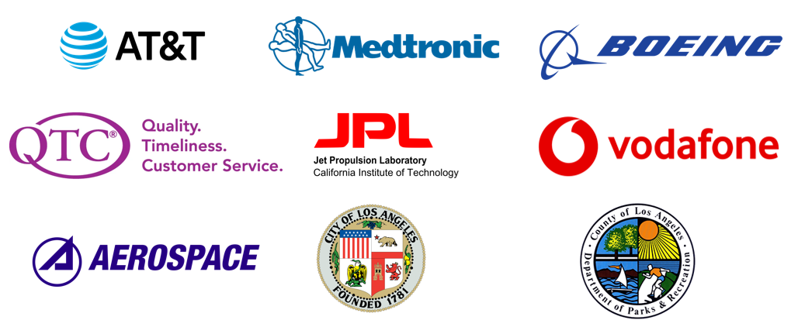
Senior Design Capstone Project
Provide students with a capstone experience in which they apply their theoretical knowledge to real-world applications.
Get to know potential employees over an extended period—like a hassle-free year-long internship
Improve students’ resumes and job prospects
11

Slide 12
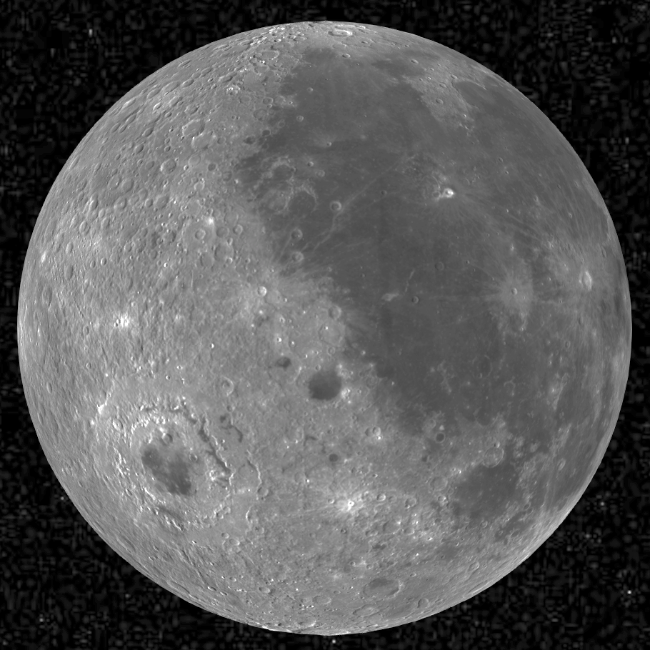
Sample Project: Collaborative Visualization for Solar System Treks
Students: Abdullah Alshebly, Stanley Do, Jose Garcia, Zipeng Guo, Johnny Lee, Montague La France, Miguel Sanchez, Christopher Smallwood, Odasys Soberanes, David Tang
Advisor: David Krum
Liaison: Emily Law https://trek.nasa.gov
Notes:
https://trek.nasa.gov

Slide 13
Background
Solar System Treks is a web-based tool for scientists and the public, to view and analyze 3D terrain data for other moons, asteroids and planets.
It is Google Earth (and more) for other worlds!
Planets: Mars and Mercury.
Moons: Icy Moons, Luna, and Titan.
Asteroids: Ennu, Ceres, Ryugu, and Vesta.

Slide 14
Design Process: Human Centered Approach
Persona – John is an ex-military, 35-year-old Mission Planner who works for NASA. John is an expert at coordinating hands-on research on the Moon for possible colonization. John does not like to wait around for people to do things and gets straight to the point with what he wants. He is extremely knowledgeable on the needs and resources required for human life on the Moon and is familiar with the process of getting an astronaut there.
Persona – Tom is a 40-year-old high school teacher who is currently teaching a science class. He is currently teaching a chapter about space and assigns group projects to his students.
Wants to – He wants them to use the Solar System Treks Portal and create a research presentation on one of the datasets that they found particularly interesting.

Slide 15
Development Process
Working with JPL to understand the current Trek system.
Creating new features and data structures to support collaboration.

Slide 16
Collaboration through Rooms and Markup Tools

Slide 17
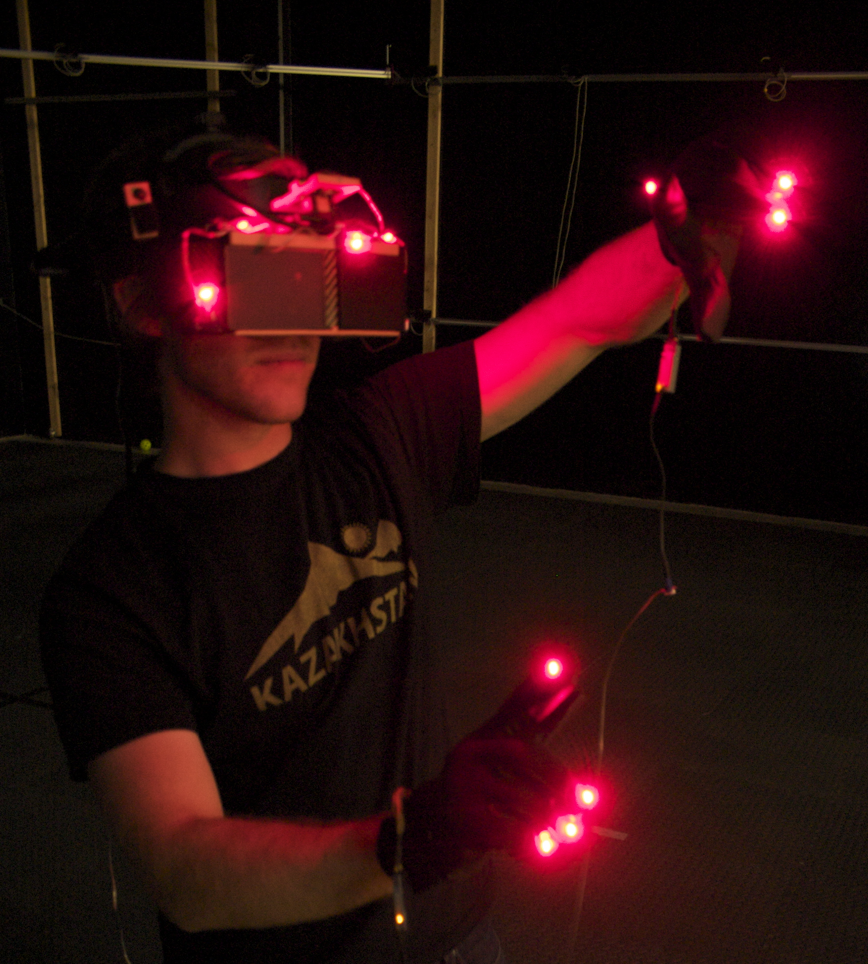
Future
Development in progress
More markup tools
Paths (lines, curves)
Shapes (rectangles, circles, other polygons)
States to save collections of markings
Testing and Debugging
Transfer of code to JPL
Further in the future
Immersive Virtual Reality?

Slide 18
Sample Project: Video Analysis Using Cloud Services
Students: Aschelle Thomas, Conan Yee, Danny Tran, Miguel Castillo, Samuel Moon
Advisor: Chengyu Sun
Liaison: Mohammed Al Rawi

Slide 19
Project Background
Largest Public Defender's Office in the country: 700 attorney's handling 500,000 cases annually
Problems of using surveillance/bodycam video evidences
Footage are often several hours long
Most of the video is downtime (immaterial or blank footage without audio)
Transcribing and captioning video are expensive
The goal of the project is to use Artificial Intelligence and Machine Learning technologies to automatically transcribe videos

Slide 20
System Architecture
AWS
Lambda
User
Box Skill App.
2. Send Event
3. Make Call
1. Upload
6. Write Metadata
5. Retrieve Analysis
box.com
MS Azure Cloud
AI/ML Service
4. Download File

Slide 21
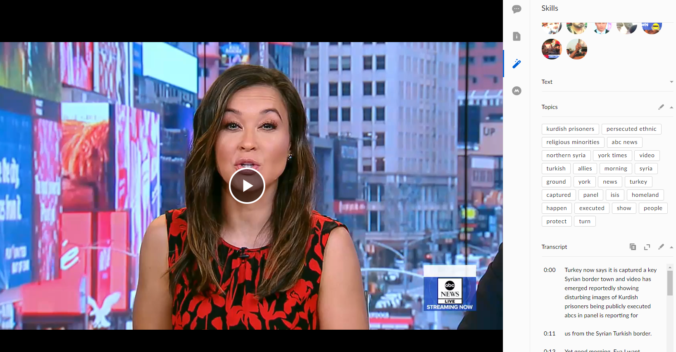
Sample Video

Slide 22
Student panel
Discussions

Slide 23
THANK YOU!

