Slide 1
Computer Science Program Modifications
Notes:
Navid

Slide 2
BS Program (Current)
Notes:
Elaine & Raj

Slide 3
BS Program Modification
Delete 11 units (ABET reprieve)
PHYS 2200 (5 units)
MATH lower division elective (3 units)
One CS upper division elective (3 units)
Add 11 units
CS2000 - Networking/Security (3 units)
CS2000 - Data Science/Python (3 units)
Increase CS2148 to 4 units (Add 1 unit)
Meets the overall Math unit requirement of 15 units
This replaces our earlier 2 unit Math course proposal
Increase CS2011, CS2012, CS2013, CS3220 to 4 units for students (4 units added)
Currently 2 unit lecture + 1 unit lab; Converted to 3 unit lecture + 1 unit lab/workshop
Replace EE3445 with CS2445 (No change in units)
Notes:
Elaine & Raj

Slide 4
MS Curriculum (Current)
(I) Breadth Requirement (9 units) Select one course each from three of the following five areas of study.
Algorithms
Network Systems
Web Systems
Advanced Programming
Software Engineering
(II) Chose Electives (18 units)
CS4000/CS5000 level courses
Wide range of areas
Suits individual student career interests
Notes:
Behzad

Slide 5
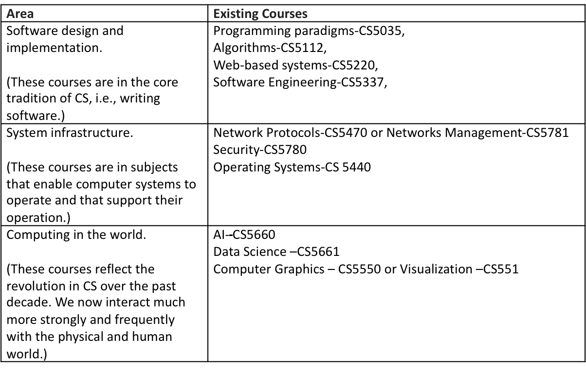
MS Curriculum (Modified Core)
Notes:
Russ

Slide 6
MS Program Modification
Required Core (18 units)
Two courses from each of the three areas
Thesis Option (12 units)
3 additional electives (CS4000/CS5000) – 9 units Internal/External
CS5990 - 3 units over 2 semesters.
Comp. Exam Option (12 units)
Take 4 additional electives (CS4000/CS5000)
Ensure that CS5035 or CS5337 is completed in either the core or elective classes.
Take CS5960 (0 units)
Notes:
Behzad

Slide 7
MS Curriculum Modification
Required Core (18 units)
Two courses from each of the three areas
Thesis Option (12 units)
3 additional electives (CS4000/CS5000) – 9 units
CS5990 - 3 units over 2 semesters.
Comp. Exam Option (12 units)
Take 4 additional electives (CS4000/CS5000)
Ensure that CS5035 or CS5337 is completed in either the core or elective classes.
CS5960 (0 units)
Notes:
Behzad

