Slide 1
Computer Science Groups Advisement for CS Seniors
Department Chair: Dr. Eun-Young (Elaine) Kang
Faculty Advisors: Dr. Raj S. Pamula & Dr. Zilong Ye
Department Coordinator: Valentina Ovasapyan

Slide 2
AGENDA
Review Academic Requirements
Graduation Application
Blended BS/MS Application
Senior Design Capstone Project (CS4961-CS4962)

Slide 3
Computer Science Requirements
General Education
Lower Division – Reduced number for CS
A Block – Written, Oral – 2 courses
AM Block: US History, US Constitution/State/Local Govt. – 2 courses
B Block: Biological Sciences – 1 course
C: Block: Arts – 1 course
D Block: Social Science – 2 courses
E Block: Lifelong Understanding – 1 course (CS1010?)
d/re requirements – To be covered by the above courses.
Upper Division – Covered by CS 3112, CS4961, CS4962
Math/Physics
MATH 2110, MATH 2120, MATH 2550, MATH Elective
PHYS 2100, PHYS 2200

Slide 4
Computer Science Requirements
Remaining Requirements – Verify on GET
CS3186 (Exception this year as a senior)
MATH2550, PHYS2200, EE3445, CS4440
GE lower division including “d/re” requirements
6 upper division CS electives
Base planner – Graduate in S21, X21 or F21
Fall 2020 | Spring 2021 | Summer 2021 | Fall 2021
CS 4961 | CS 4962
 | CS 4963
Graduation Check in Fall 2020

Slide 5
Advising Guide
Better time management – Work From Home
CS4961-CS4962 is the big elephant in the room
Each course by itself is a lab course and requires a minimum of twice the commitment of a regular course
Treat it each as two courses
The planner has 5 rows including the CS4961 for Fall and CS4962 for Spring.
In today’s environment, I would even recommend 4 courses each in Fall/Spring

Slide 6
Fall 2020 Registration Issues
Registered in the courses?
Project Advisor could recommend changing electives.
GET Degree Planner
Populate courses (including electives) as per your plan
Can modify later if needed
Planned Advising Report
Verify the report for all the requirements (GE and major)
Green (completed), Yellow (registered), Blue (planned), Red (missing) indicators
Any red indicators?

Slide 7
Blended BS/MS
To provide an accelerated route to a graduate degree, with simultaneous awarding of both bachelor’s and master’s degrees.
BS and MS coursework can be taken concurrently.
Maximum of 9 shared elective units between BS and MS programs.
Eligibility
Students must have a minimum GPA of 3.0 (>3.5)
“B” grade or better in CS 3000-level courses in the BS degree program with an average of 3.0 in these courses. (A- or better)
Apply in Fall 2020 for Spring 2021

Slide 8
CS4961 - CS4962 Software Design Laboratory
(Senior Design Capstone Group Project)

Slide 9
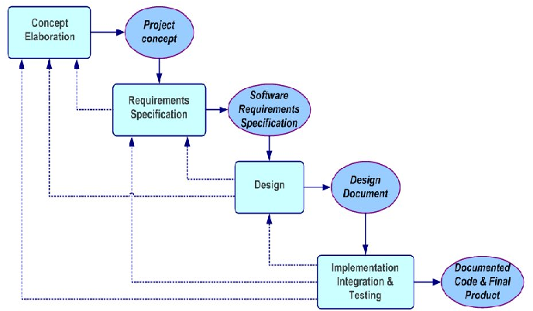

Slide 11
Projects Sponsored
Industry, County/City, CSULA, Competition
All Projects
Software engineering projects (R, D, I) …
Web, App, AI, ML, IoT, Game, Graphics,…
Learning process – New terminologies/technologies
Outside Liaison (client)
Faculty advisor(s)
Students work in groups
Contracted as problem solvers

Slide 12
Today’s Activities
Project preference survey
Q/A

Slide 13
CS4961-CS4962 Mandatory meetings
Events
College wide Kick off day (?)
Fall Midway presentation (?)
Spring Expo day (?)
Class meetings
Speakers
Workshops

Slide 14
CS4961 on CSNS
Course page
Syllabus
Announcements
Assignments – Mandatory Individual
Projects page - Group
Team (leader) responsibility
Upload deliverables
See prior year projects

Slide 15
Individual/Team Responsibilities
Teams chosen – NBA draft style
Communicate with faculty advisor, team members and liaison
Don’t miss ANY meetings
Don’t get cut by the team
Observance of team rules
Participation, commitment, delivery etc.,

Slide 16
Individual/Team Responsibilities
Time commitments per week (9 hours/week)
1 to 2 hour block with customer liaison
1 to 2 hour block(s) with faculty advisor
3 to 5 hours of time for group activity
3 to 5 hours of individual
Scheduling
Fridays 8.00AM – 11.30AM
Other hours – added by the faculty advisors
Be flexible

Slide 17
Individual/Team Responsibilities
Meeting times
CS4961 – 8AM-10.30AM
Other hours: Decided as a team
Be flexible.
Use Zoom/Teams/Hangout for meetings
Consult with Faculty advisors and Liaisons

Slide 18
Individual/Team Responsibilities
Project Information (in August)
Project
What is my project? Sponsor?
Who are my group members? faculty advisor(s)?, Outside liaison?
Scheduling
Ideally 3 other courses along with CS4961
Change any electives to meet the project need (faculty input)
Exchange class Schedules
Find common meeting times
Introductions
Just worry about your own team and your own project
Meet as a team & select a team leader (faculty input)
Reach out to any group member who was absent today

Slide 19
August – Kick off day with liaisons
Discuss project details (problem, objectives, key requirements, outcomes)
Come prepared with questions, clarifications, suggestions,…
Discuss deliverables
Finalize weekly meeting days and times
Liaison, Faculty, Group
Share emails, Skype/Google video conferencing ids
Discuss any scheduling of site visits
Address any questions regarding project strategy or approach

Slide 20
Q&A
www.calstatela.edu/cs

