Slide 1
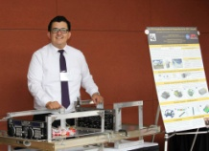
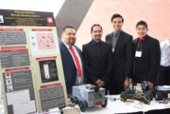
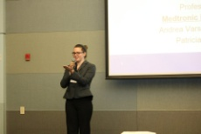
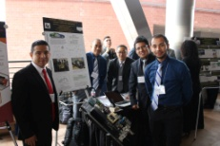
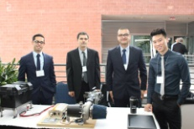
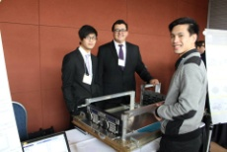
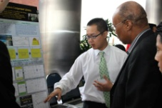
CALIFORNIA STATE UNIVERSITY, LOS ANGELES – COLLEGE OF ECST
2018 COMPUTER SCIENCE SENIOR DESIGN EXPO
What: Capstone symposia for our CSULA Electrical and Mechanical Engineering Senior Design projects
When: Friday, May 4, 2018 | Registration: 8:00 AM–9.00 AM, Welcome: 9.00 AM-9.20 AM
Presentations: 9.30AM-12.00PM, Lunch and Displays 12:00-1:00 PM
Where: CSULA Eagle Ballrooms A, B, C and Foyer
Registration & Map: http://bit.ly/CalStateLAExpo2018
Highlights
20 minute student presentations and project demonstrations
Opportunity to selectively recruit (interview) students and evaluate novel ideas
Free lunch and parking for all attendees
2018 Project Titles and Sponsors
Computer Science Expo Presentations University Student Union
Session | Project | Sponsor | Session | Project | Sponsor
1 (Alhambra) | A Location-based Intelligent Forwarding Strategy for NDNWiFi | Fujitsu | 3 (Los Angeles B) | Diabetic Patients Monitoring | Medtronic
 | A Network Simulator for Evaluating Resource Allocation Strategies | Faculty |  | Capital Project Development Map | LA City Data Science
 | Improve the WiFi Coverage and Quality in Cal State LA | ITS |  | County Library Automated Registration | LA County
 | Program Review Information System Management (PRISM) | Office of Grad. Studies |  | Smart Board | LA County Hall of Admin.
 | Aquila: Process Management System for Univesity Auxiliary Services | UAS |  | Visualization Tool for Composition of Cloud Computing Services | NASA Project
 | Swarmathon Competition | NASA
2 (Los Angeles A) | Augmented Reality for Hydrology (JPL Project) | JPL | 4 (Los Angeles C) | Closed Captioning QA | AT&T
 | First Generation (Game Development) | College of A&L |  | Smart Remote-Control Vehicle | The Aerospace Corp
 | Layer Analyzing | JPL |  | Landfill e-Forms Application | LA City,Dept. of Sanitation
 | Referral ERRA Trending Analysis Tool (RE-TAT) | QTC |  | Kastle 2.0 | Kipp LA
 | Computer Science Scheduler | CS Department |  | Fleet Management System | LA County
 | RoboSub Competition | RoboSub |  | Sidewalk Repair Photo Archive | LA City BoE

