Slide 1
Computer Science Department Industry Advisory Board
October 23rd, 2020
https://csns.calstatela.edu/wiki/content/department/cs/assessment/iab/
Notes:
Navid

Slide 2
Agenda
9.00AM – 09.30AM : Welcome and Program Overview
Undergraduate Curriculum
Graduate Curriculum
9.30AM – 10.30AM : IAB Input for Department Goals
Discussion
Feedback about our programs
Internship/full-time opportunities for our BS and MS students
Future collaboration opportunities
10:30AM: Adjourn
Notes:
Navid

Slide 3
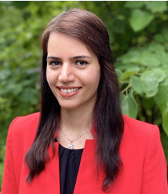
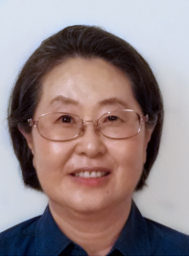
New Tenure-track Faculty
Negin Forouzesh
Computational Biology, Optimization, Computational Geometry
David Krum
Human-computer interaction, 3D interaction, virtual and augmented reality
Jungsoo Lim
IoT, Cyber-Physical System, Wireless Networking, Wireless Sensor Network
Notes:
Elaine

Slide 4
BS CS Overview
ABET accreditation
Notes:
Chengyu

Slide 5
ABET
Program Educational Objectives
are long term goal statements that will describe what graduates are expected to attain within 3-5 years of graduation.
Gainfully employed
Attained advanced studies
Adapted to lifelong learning
Student Outcomes
are specific skills that the students will possess at the end of the degree program.
Notes:
Chengyu

Slide 6
Student Outcomes (new)
Analyze a complex computing problem and to apply principles of computing and other relevant disciplines to identify solutions.
Design, implement, and evaluate a computing-based solution to meet a given set of computing requirements in the context of the program’s discipline.
Communicate effectively in a variety of professional contexts.
Recognize professional responsibilities and make informed judgments in computing practice based on legal and ethical principles.
Function effectively as a member or leader of a team engaged in activities appropriate to the program’s discipline.
Apply computer science theory and software development fundamentals to produce computing-based solutions.
Notes:
Chengyu

Slide 7
ABET Changes
From "program characteristics" to required outcomes
Reduce minimum Math and Science units to 21
Coverage of principles and practice of secure computing
Exposure to computer architecture and organization, information management, networking and communication, operating systems, and parallel and distributed computing
Notes:
Elaine & Raj

Slide 8
BS CS Curriculum
General Education
CS (Core and Electives)
120 units
(39+9) + 72 = 120 units (Univ.)
(24+0) + 96 = 120 units (CS)
Notes:
Elaine

Slide 9
BS Curriculum (current)
Lower Division Required Courses
CS 1222 - Introduction to Relational Databases
CS 2011 - Introduction to Programming I
CS 2012 - Introduction to Programming II
CS 2013 - Programming with Data Structures
CS 2148 - Discrete Structures
ENGL 2030 - Introduction to Technical Writing
MATH 2110 - Calculus I
MATH 2120 - Calculus II
MATH 2550 - Introduction to Linear Algebra
PHYS 2100 - General Physics I: Mechanics
PHYS 2200 - General Physics II: Electromagnetism and Circuits
Upper Division Required Courses
CS 3035 - Programming Language Paradigms
CS 3112 - Analysis of Algorithms
CS 3186 - Introduction to Automata Theory
CS 3220 - Web and Internet Programming
CS 3337 - Software Engineering
CS 3801 - Societal and Ethical Issues in Computing
CS 4440 - Introduction to Operating Systems
CS 4961 - Software Design Laboratory I
CS 4962 - Software Design Laboratory II
CS 4963 - Computer Science Recapitulation
EE 3445 - Computer Organization
CS Electives (18 units)
Math Elective (3 units)
Notes:
Elaine

Slide 10
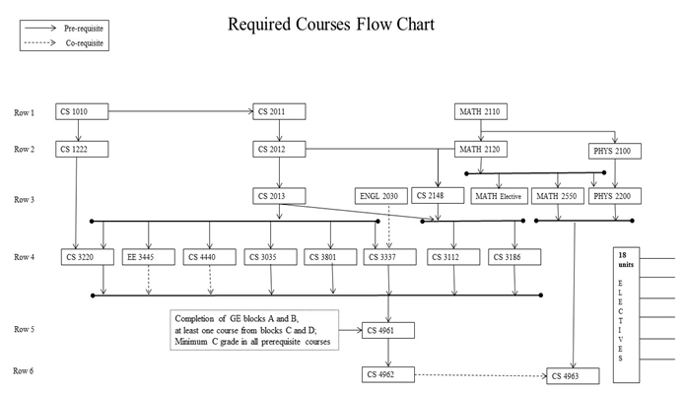
BS CS Curriculum (current)
Notes:
Elaine

Slide 11
CS Electives - Wide range of courses
CS 3034 - Widely-used Programming Languages
CS 3660 - Complex Social and Economic Systems
CS 4075 - Concurrent and Distributed Programming
CS 4112 - Competitive Programming
CS 4188 - Compilers
CS 4220 - Current Trends in Web Design and Development
CS 4222 - Principles of Data Base Systems
CS 4470 - Computer Networking Protocols
CS 4471 - Computer Networks Configuration and Management
CS 4540 - Topics in Advanced Computer Science (Data Visualization, Mobile Computing, Cybersecurity, Robotics, Human Centered Computing)
CS 4550 - Computer Graphics
CS 4551 - Multimedia Software Systems
CS 4555 - Introduction to 3D Computer Game Programming
CS 4556 - Multiplayer Online Game Design and Development
CS 4635 - Modeling and Simulation
CS 4660 - Artificial Intelligence
CS 4661 - Introduction to Data Science
CS 4662 - Advanced Machine Learning
CS 4780 - Cryptography and Information Security
Notes:
Elaine

Slide 12
Curriculum Changes by New ABET Guidelines
Effective Fall 2021
Adding Cybersecurity
Increasing units for CS 2011~CS2013, CS 2148
Deleting Physics II (Not required by ABET) and Math elective
Notes:
Elaine

Slide 13
BS Curriculum (new) – effective Fall 2021
Lower Division Required Courses
CS 1222 Introduction to Relational Databases
CS 2011 Introduction to Programming I
CS 2012 Introduction to Programming II
CS 2013 Programming with Data Structures
CS 2148 Discrete Structures
CS 2445 Introduction to Computer Systems
CS 2470 Fundamentals of Network Systems and Cybersecurity
ENGL 2030 Introduction to Technical Writing
MATH 2110 Calculus I
MATH 2120 Calculus II
MATH 2550 Introduction to Linear Algebra
PHYS 2100 General Physics I: Mechanics
Upper Division Required Courses
CS 3035 Programming Language Paradigms
CS 3112 Analysis of Algorithms
CS 3186 Introduction to Automata Theory
CS 3220 Web and Internet Programming
CS 3337 Software Engineering
CS 3801 Societal and Ethical Issues in Computing
CS 4440 Introduction to Operating Systems
CS 4961 Software Design Laboratory I
CS 4962 Software Design Laboratory II
CS 4963 Computer Science Recapitulation
Electives (18 units)
Notes:
Elaine

Slide 14
BS CS Curriculum : CS4961-CS4962 Senior Design
Projects sponsored by
Businesses: large and small, local and global
Government: city, county, state, federal (e.g., Govt. printing office, DoD)
The university: other departments, colleges, etc.
Public-service organizations: Engagement, Service, and the Public good (e.g., hospitals, libraries)
Year long group projects: a group of students working together under the supervision of a faculty advisor and industry liaisons
Notes:
Elaine

Slide 15
BS CS Curriculum : CS4961-CS4962 Senior Design
Generate and strengthen connections between sponsors and faculty
Get to know potential employees over an extended period—like a hassle-free year-long internship
Enhance students’ appreciation of life-long learning by challenging them to become productive using unfamiliar technologies and areas of specialization
Improve students’ resumes and job prospects
https://csns.calstatela.edu/department/cs/projects
Notes:
Elaine

Slide 16
MS CS Overview
Being reviewed in 2019-2020

Slide 17
MS CS Curriculum (Current)
Breadth Requirement (9 units)
Select one course each from three of the following five areas of study: Algorithms, Network Systems, Web Systems, Advanced Programming and Software Engineering
Thesis option (18 units)
Choose 18 units of 4000/5000 level courses with a minimum of 9 units from 5000 level courses
CS 5990 - 3 units over 2 semesters
Comp Exam Option (24 units)
Choose 24 units of 4000/5000 level courses with a minimum of 12 units from 5000 level courses
CS 5960 (0 unit)
Notes:
Raj (and Behzad?)

Slide 18
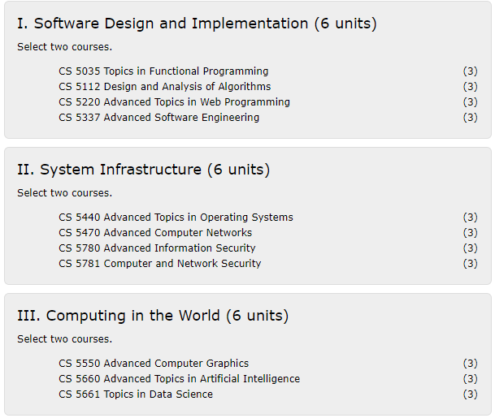
MS CS Curriculum (New)
Three Areas (Fall 2021):
Required Core (18 units)
Two courses from each of the three areas
Thesis Option (12 units)
2 additional electives (CS4000/CS5000)
CS5990 - 6 units over 2 semesters
Comp. Exam Option (12 units)
Take 4 additional electives (CS4000/CS5000)
Take CS5960 (0 units)
Notes:
Raj (and Behzad?)

Slide 19
CS MS Program
Student Outcomes
ability to write and analyze sophisticated algorithms.
ability to design, develop, and analyze software systems.
acquired advanced knowledge and skills
communicate effectively both orally and in writing.
Assessment Process
Assessment in various CS5000 level courses
Data is represented on a 5 point scale that signifies various levels of attainment. (1. Unsatisfactory 2. Poor 3. Satisfactory 4. Good 5. Excellent.)
Notes:
Raj (and Behzad?)

Slide 20
Department Highlights
Department growth in size (faculty and undergrad program)
Increased 4-6 year graduation rates (aligned with Graduation Initiative 2025)
All faculty are involved in curriculum development.
Many faculty have received external or internal grants
Dr. Abbott, Dr. Amini, Dr. H. Guo, Dr. J. Guo, Dr. Kang, Dr. Krum, Dr. Pourhomayoun, Dr. Sun, Dr. Ye, and Dr. Zhu
Many faculty are involved in student capstone projects both at the undergraduate (senior design team projects)
Many faculty are supervising graduate (individual) thesis.
60 thesis completions in the last five years.
Notes:
Raj

Slide 21
Impact of COVID-19
Notes:
Elaine

Slide 22
Adjustments due to COVID-19
Most Computer Science instructors are very familiar with online teaching tools and quickly adapt to new technology.
Spring 2020 - A couple of faculty needed extra help to get familiar with Canvas and Zoom and they were provided additional resources.
Summer 2020 - Most faculty attended CETL Alt Instruction Summer Institute to learn more about remote teaching.
For remote teaching, instructors have been utilizing Canvas, CSNS (in-house Course Management System), Zoom, YouTube, and Camtasia highly. Some instructors also use Discord to facilitate communications among students.
The majority of instructors mainly started with synchronous remote teaching but now instructors are using both synchronous and asynchronous remote teaching.
Notes:
Elaine

Slide 23
Adjustments due to COVID-19 (cont’d)
Traditional high-stakes face-to-face exams have been converted to more frequent low-stakes quizzes, programming projects and take-home exams.
Instruction-related surveys were conducted more frequently to assess students' online readiness for different situations such as lectures, exams, presentations, and group projects.
Instruction-related equipment or services (laptop, camera, mic, Hotspot, remote desktop, and whiteboard) have been provided for instructors and students.
Online advisement (more frequent group advisement and individual zoom advisement)
Notes:
Elaine

Slide 24
IAB Feedback
Discussion and feedback
Increased need in data science
Attention to detail. Need to incorporate unit-test into courses
Community outreach
Notes:
Navid

Slide 25
IAB Feedback
Surveys - IAB
https://csns.calstatela.edu/department/cs/survey/current
Notes:
Navid

Slide 26
IAB Support and collaborations
Notes:
Navid

Slide 27
IAB
Curricular feedback/guidance
Industry sponsorships
Undergraduate & Graduate projects
Student internships
Industry experts as part-time faculty
Outreach
To elementary and middle school students
To high school students
To college students
Notes:
Navid

Slide 28
Senior Design Capstone Project
Provide students with a capstone experience in which they apply their theoretical knowledge to real-world applications.
Get to know potential employees over an extended period—like a hassle-free year-long internship
Improve students’ soft skills
Presentation skills
Technical writing
Time management, teamwork, and leadership skills
Improve students’ resumes and job prospects
28
Notes:
Navid

Slide 29
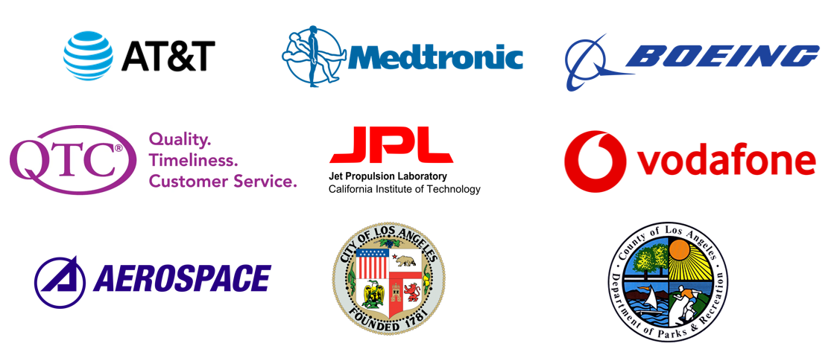
Senior Design Sponsors
29
Notes:
Navid

Slide 30
Thank you
Notes:
Navid

