Slide 1
Computer Science Groups Advisement for Sophomores
Department Chair: Dr. Eun-Young (Elaine) Kang
Faculty Advisors: Dr. Raj S. Pamula & Dr. Zilong Ye
ECST Academic Advisor: Evelyn Crosby
Department Coordinator: Valentina Ovasapyan

Slide 2
Year 2020- Life lessons
Physical Well-being
Eat, Sleep, Exercise
Virtually Connect with Family and Friends
Maintain a healthy life style with a good routine
Emotional Well-being
Reduce Stress and Anxiety
Increase Faith and Patience
Mind Matters Resources (https://www.calstatela.edu/mindmatters)
Social Well-being
Stronger together in diversity
Take action against injustices and Inequalities in our daily lives
Positive influence on social media

Slide 3
Work From Home - Life lessons
Technology
Laptop, webcam, head phones
Internet and WiFi - Unlimited, Stable, High speed, High Bandwidth
Software –Free. Set up the working environment on laptops
Space
Secluded environment - space
Working environment - desk
Even a corner of a room
Plan
Strategize - Effective self‐learning strategies
Prioritize – Scheduling, Time management - Day/Time/Hours
Communicate - Talk to Faculty, other students, Advisors

Slide 4
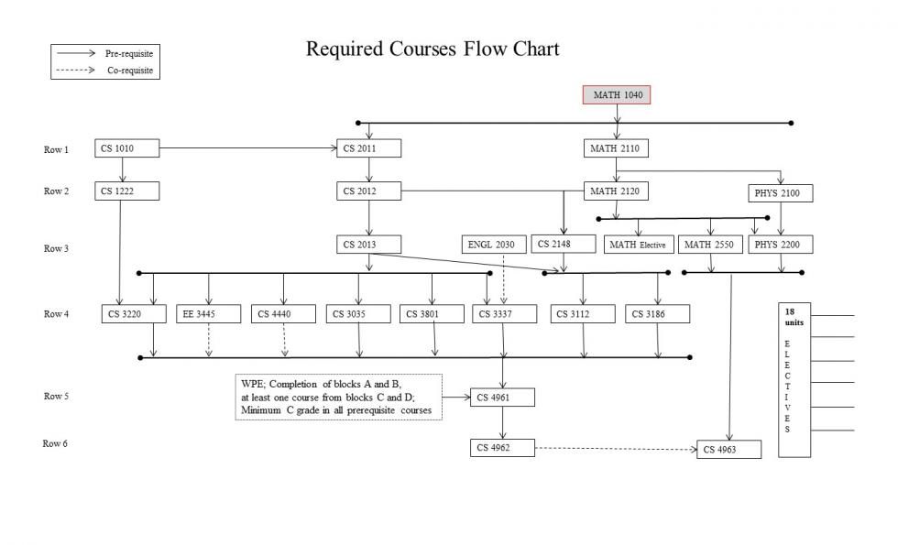

Slide 5
Critical Course Sequences
CS2011-CS2012-CS2013
Come up with a logic to solve a problem
Programming – step by step logical instructions (code) in a language.
This is the foundation of everything CS
Bread and Butter
CS4961-CS4962 (Fall-Spring)
Big projects
Icing on the Cake
Individual vs Group
Be able to do it yourself (lower division + many upper division)
Interact, learn, adapt to a group (few upper division)

Slide 6
Critical Course Sequences
CS2011-CS2012-CS2013
5 hours in class time (lecture/lab)
Textbook exercises
Homework exercises
ABC/NC grading
NC = graceful “F”
Cannot repeat course more than once!
CS2011 to CS4962
Journey through CS
The first steps are the most important
How to succeed? What are to Do’s and Don’ts?

Slide 7
Don’ts
Cheating
Copy from other students
Googling (cheating)
Copy from solutions found online
Cut and paste from other sources and tweak it, get help to make it correct
Consequences
You are cheating yourself
You are setting yourself up for failure
You are dropping out
You are wasting time and money
Remember – A Typical job interview
Explain on a White board
Logic – step by step
Programming code
What happened?

Slide 8
Faculty#1 – Do’s:
Read the textbook - Go over all check point questions
The textbook has “plenty” of exercises
How many should you do? (ALL)
White paper approach (thinking) – Hand trace your logic.
Implement on computer
Learn to debug your own code
Discuss with instructors if you have any difficulty
Need to work on assignments right away
Spend as much time as necessary outside of classroom

Slide 9
Faculty #2– Do’s:
The key is to become comfortable with programming
Do as many exercises as possible in the textbook
Planning your logic (on paper)
Implementing your logic (on computer)
Debugging and Testing.
7 to 8 chapters each for CS2011 & CS2012
16 weeks (+ weekends!) to master the material
Form study groups and challenge each other
Breaks in between semesters should not be wasted
Practice programming over summer break

Slide 10
Faculty #3– Do’s:
Complete all the assigned exercises in the labs, and more!
Redo the exercises to improve them
Start from scratch and redo
Go beyond -Make the code more efficient/concise/readable
For example
Simplify code (e.g. complex if-elseif-else ➔ switch)
No loop ➔ loop
Loop ➔ a different loop
Eliminate unnecessary code
Use naming conventions
Use better formatting

Slide 11
Faculty #4– Do’s:
Discuss implementation strategies with instructors, TAs, and fellow students
Talk implementation strategy (i.e. the way to think), not actual code
The internet is your reference, not your brain
Think before you search
There is no need to Google solutions in these classes
Practice, practice & more practice
You should be able to explain your logic and code

Slide 12
Faculty #5– Do’s:
Treat each programming exercise/assignment as an interview
Start with a clean white paper
Work on logic and in pseudo code
Implement, debug and test
You cannot “cram” in CS
Don’t procrastinate

Slide 13
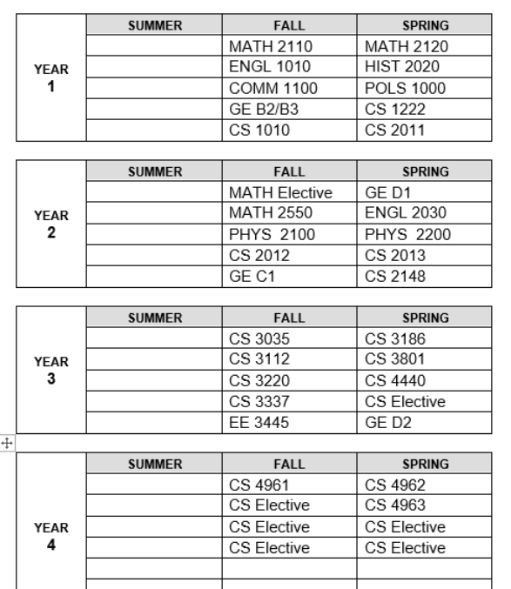
Ideal Planner

Slide 14
Course Planning and Time Management
Full time student = Full time job
15 units (5 courses) = 40 hours (or more)/week
Minimum course commitment = 40/5 = 8 hours/week
Each course scheduled time:
Lecture only – Scheduled for 3 hours/week
Lecture/Lab – Scheduled for 5 hours/week
Each course extra study time
5 hours/week
Fall 2020 Registration
Registered in the courses?
Any issues?

Slide 15
Individual Planner (Fall 20 and beyond)
Fall 20 | Spring 21 | Summer 21
Fall 21 | Spring 22 | Summer 22

Slide 16
Q&A
www.calstatela.edu/cs

