Slide 1
ways to contact US
URGENT SUPPORT CALL for Faculty and Staff ONLY: (323) 507-3060
8 AM to 6 PM (last question to be received by 5:45 PM) on Monday thru Friday (except for holidays)
Non-Urgent Requests still made via Service Now Tickets: https://www.calstatela.edu/ecst/itsupport OR Email ecstitc@calstatela.edu
For more info: https://www.calstatela.edu/ecst/ecst-it-support

Slide 2
Reminder Password Rules
Password expiration now in 365 days rather than 180
Password lock out after 9 attempts rather than 3
Password lock out for 5 minutes rather than 20
For More Info: https://www.calstatela.edu/its/lockout
Note: Instructions on how to reset your password yourself in above link

Slide 3
ICT Pre-Approved Items
Lenovo ThinkCentre or HP Elite or Z-series desktop computers running Windows 10 or above with a minimum three-year manufacturer warranty
Lenovo ThinkPad or HP Elite series laptop computers running Windows 10 or above with a minimum three-year manufacturer warranty
Mac laptops or desktops with a three-year AppleCare warranty
Tablets running Android, Chrome OS, or iOS
Personal non-network Printers
NOTE: Microsoft Surface, HP non-elite models, Dell, and other computer brands still require an ICT
For More Info: https://www.calstatela.edu/accessibility/pre-approved-ict

Slide 4
Deloitte Refresh
3rd party company Deloitte is working with ITS baseline to distribute new laptops
You receive an email from Deloitte it is not spam
If you have concerns, feel free to CC ecstitc@calstatela.edu

Slide 5
New Enhanced Tech classrooms
TIPS
ALT+P to Turn-on/Wake-up Computer
HDMI connector with adaptors available
Some Laptop audio does not work with the HDMI connector. Use the Computer available if you need to use the audio
For More Info: https://www.calstatela.edu/its/classroom-technology-guides

Slide 6
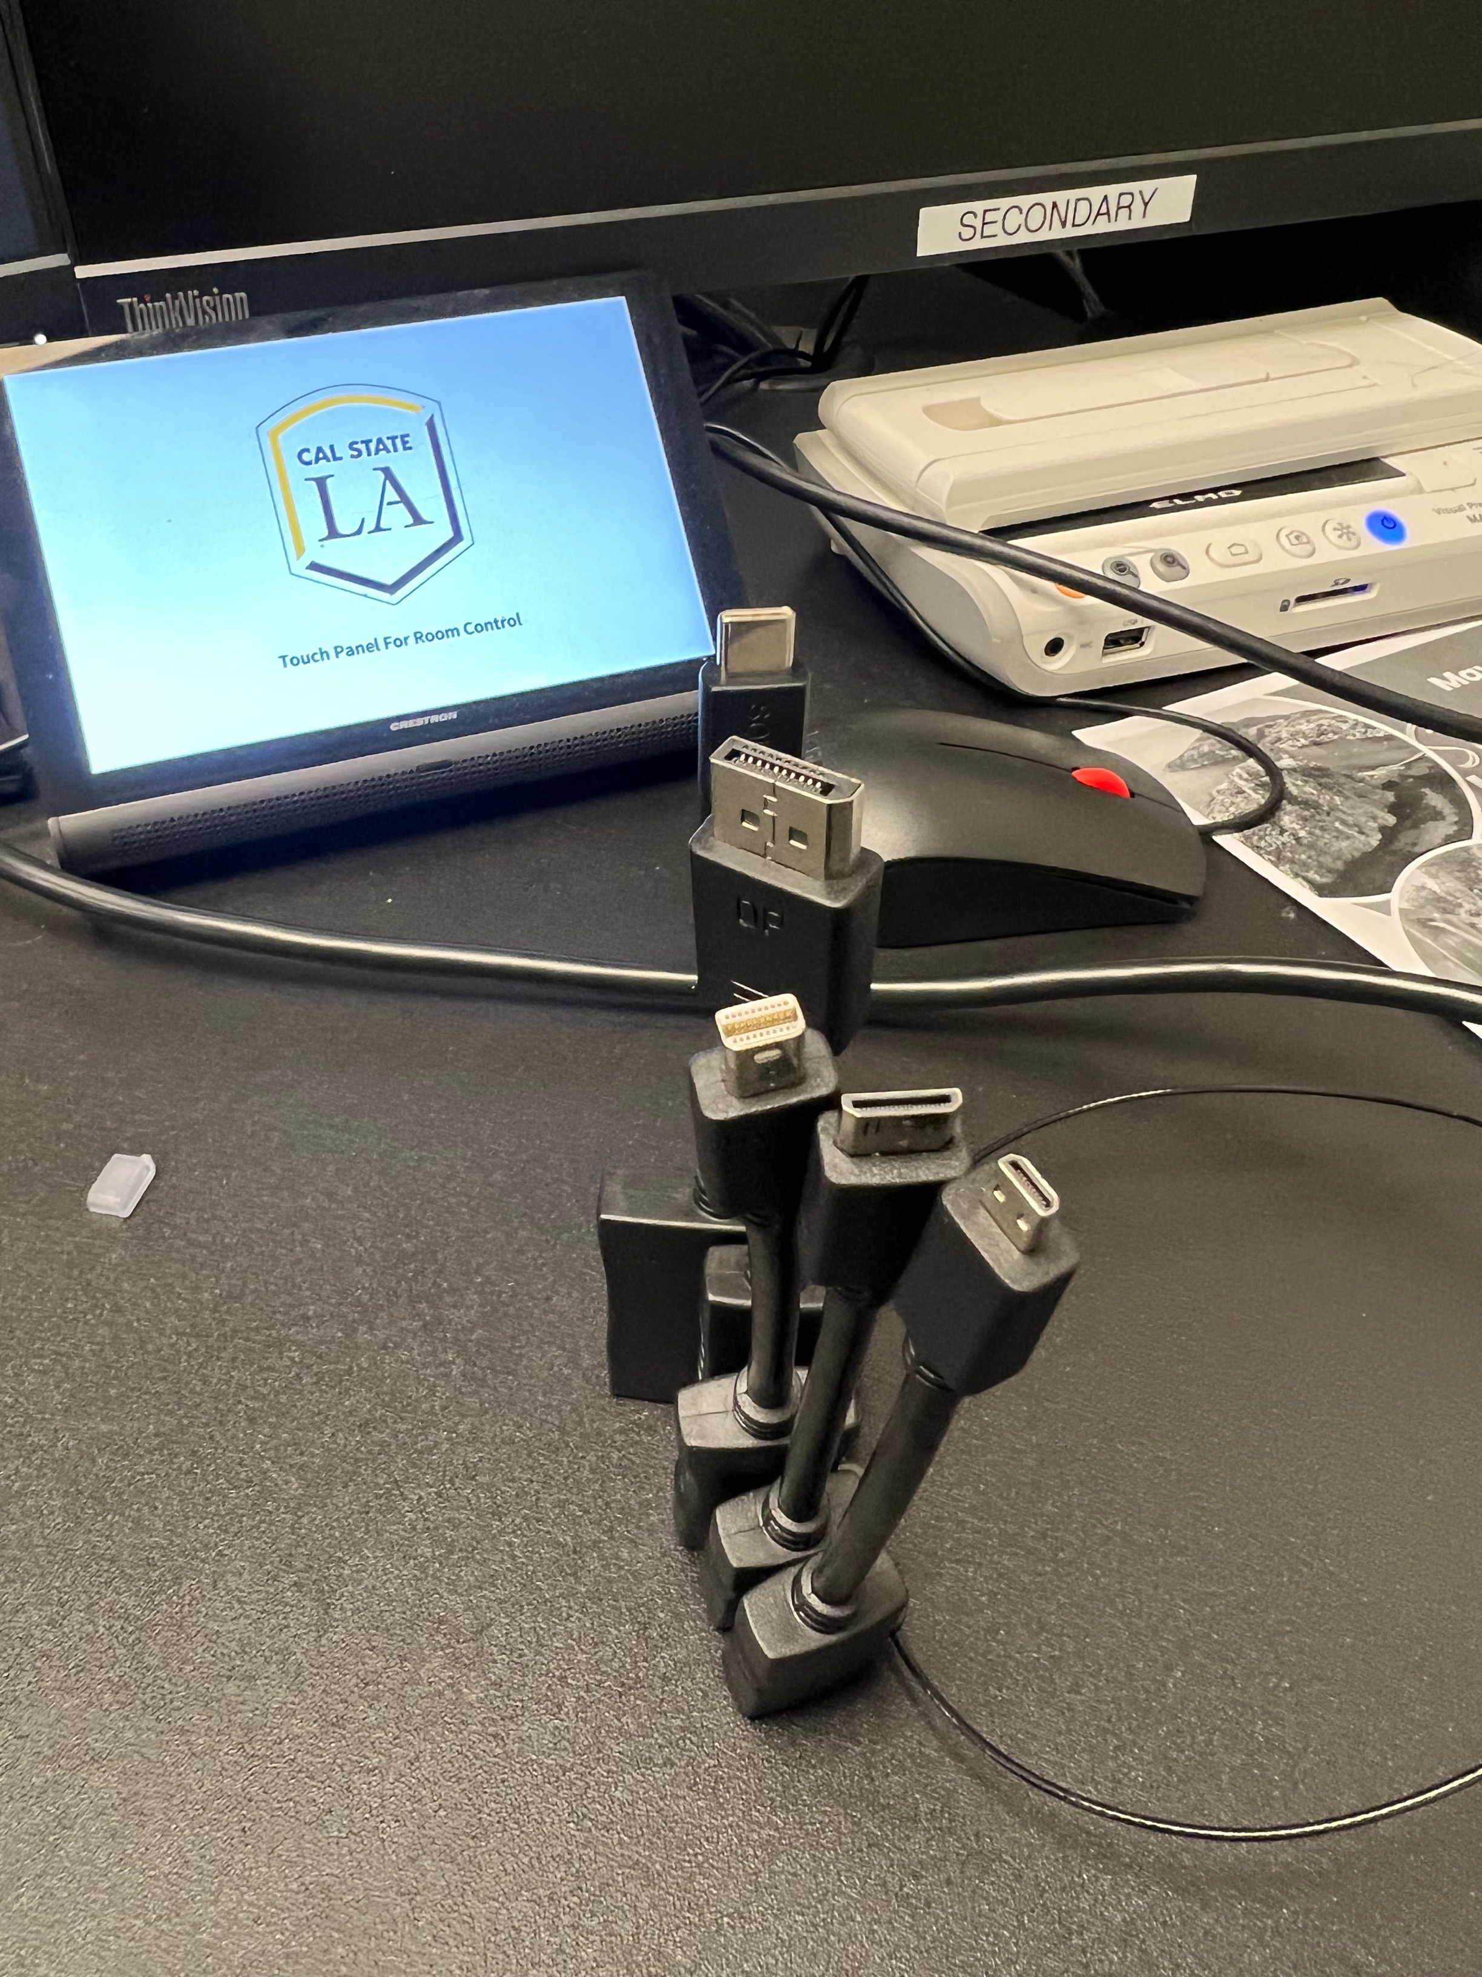
USB TYPE C
DISPLAYPORT
USB TYPE B
MINI HDMI
MICRO HDMI
HDMI

