Slide 1
Department Meeting
Friday, August 20th, 2021

Slide 2
Agenda
Part 1: 1-1:50 PM
Announcements
Department data for Fall 2021
Readiness check for Fall 2021
ITS Presentation
Part 2: 1:50-2:30 PM
Senior Design Class (senior design faculty advisors only)
Committees (tenure-line/FERP faculty only)

Slide 3
Announcements
Retirement/FERP starting from Fall 2021
Russ Abbott (Retirement)
Raj Pamula (FERP)
Promotions!
Mohammad Pourhomayoun (early promotion to associate)
Zilong Ye (promotion to associate)
New hiring (tenure-track faculty)
2 positions approved
New adjunct faculty : https://www.calstatela.edu/ecst/cs/faculty
In-person department gathering (Off-campus) ?

Slide 4
Department Data
As of August 16, 2021

Slide 5
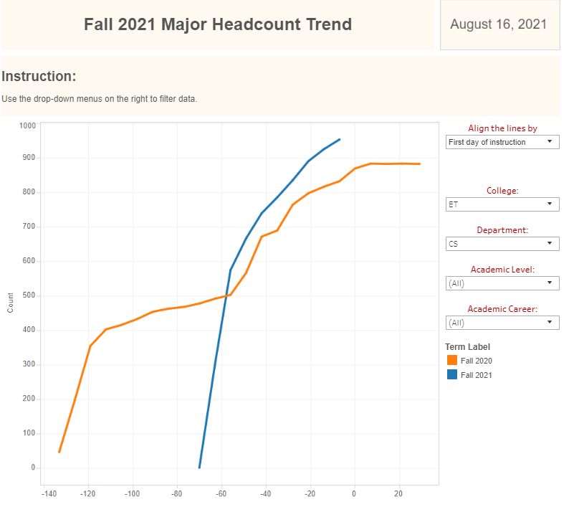
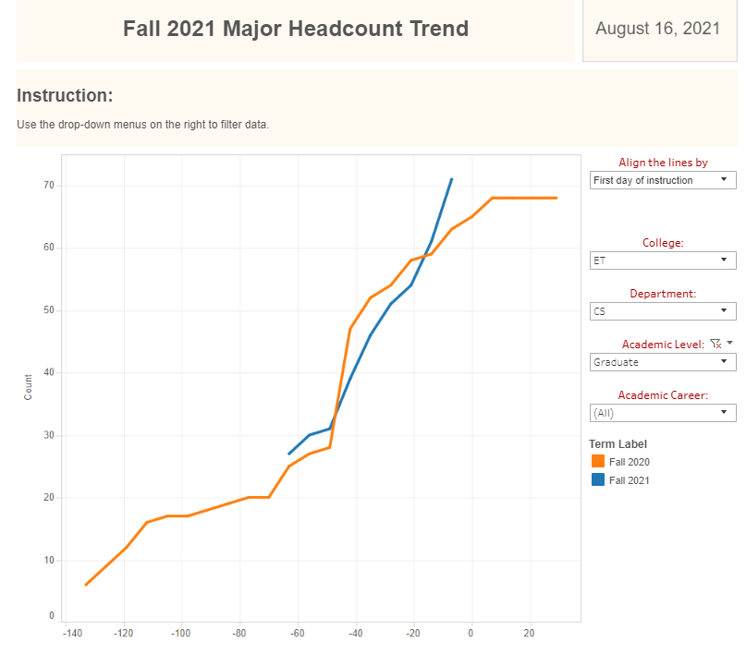

Slide 6
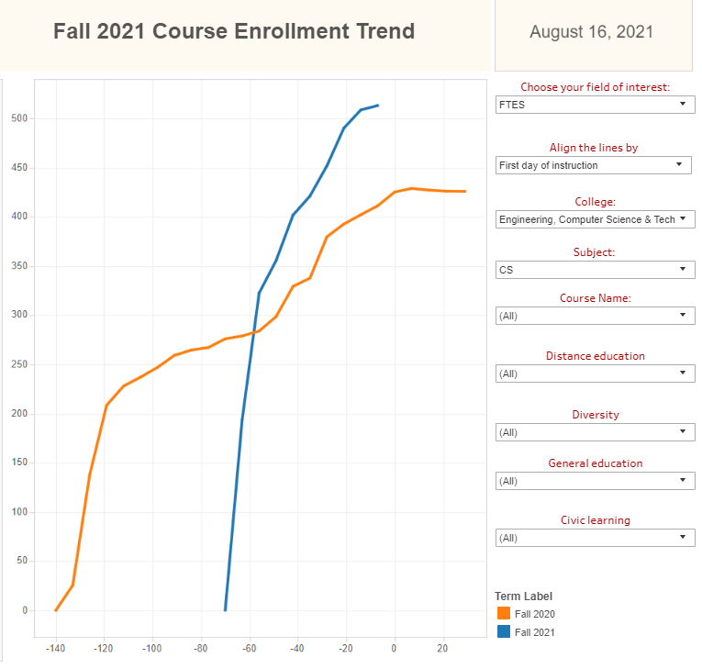

Slide 7
Readiness check for Fall 2021
Canvas
Have a contingency plan: recommend to add a backup faculty to your Canvas shell
Syllabus
In-person meeting schedule
Mask requirement and student support
IT support contacts
Students help
Instructional policy related to excused absence

Slide 8
Instructional policy related to excused absence
“Students may have a valid reason to miss a class. When any of the following reasons directly conflict with class meeting times, faculty shall consider an excused absence and no penalty shall be accrued. Students are responsible for informing faculty members of the reason for the absence and for arranging to make up missed assignments, tests, quizzes, and class work insofar as this is possible.”

Slide 9
Mask requirement (Sample)
Returning to campus and in-person instruction will be a transition for all of us, but we will navigate it together. Please know that your safety and your learning are a priority.
As a reminder, the CSU requires all faculty, staff and students who are accessing University facilities to be fully vaccinated against COVID-19 by September 30, 2021, unless you have an approved exemption. Face coverings are required at Cal State LA while indoors. Accordingly, all students are required to wear an appropriate face covering that covers the nose and mouth in order to participate in this course. Wearing a face covering outdoors when in a group or populated area is also recommended.
Find more details about campus COVID-19 protocols and answers to frequently asked questions on Health Watch. Policies and requirements regarding COVID-19 may change based on campus, local, state and/or federal guidelines; the Health Watch page is the best resource for current Cal State LA information.

Slide 10
Readiness check for Fall 2021
Students on waitlist
Let waitlisted students know a zoom link
Sep 7 (Tuesday): Add deadline and no-record drop deadline
Classroom cleaning for in-person meetings
No cleaning in-between classes
Hand sanitizer and wipes placed

Slide 11
IT Support in Fall
ECST IT Helpdesk
Phone number (1-669-900-6833)
Meeting ID (3233434500)
Please call the helpdesk first when encountering computer issues, and the ITC will help to identify what the best way to resolve the problem

Slide 12
ITS Presentation

Slide 13
Senior Design Projects

Slide 14
College Committee – Department Rep to ECST
Committee/Taskforce Name | 2021-2022
 | Dept Rep | Alternate
FAC (Faculty Affairs Committee) | J. Guo | R. Pamula
RTP Committee (elected) | R. Pamula | R. Abbott (need an update)
IAC (Instructional Affairs Committee) | M. Pourhomayoun
SAC (Student Affairs Committee) | N. Amini | D. Krum
Assessment | C. Sun
Budget | B. Parviz
Grad Studies | H. Guo
Research | N. Forouzesh
Safety | Y. Zhu
Senior Design | J. Lim
IRA Proposal Review | Z. Ye
Advisory council EDI | D. Krum

Slide 15
Department Committees
Committee/Taskforce Name | 2021-2022
 | Committee Member (Chair*) | Alternate
RTP & PTR Committee (elected) | H. Guo, Z. Ye, Y. Zhu* | B. Parviz
Faculty Search (elected) | B. Parviz, H. Guo*, N. Amini | XXX
Lecturer Review (elected) | M. Pourhomayoun, C. Sun*, Z. Ye | Y. Zhu
Lecturer Eval Taskforce (class visitations) | Amini, Krum*, Forouzesh, Lim
IAC (syllabi, course proposals, course redesign, program mods, certificate programs, textbook selection) | Pourhomayoun*, C. Sun, R. Pamula, N. Amini, J. Lim
SAC (scholarship, events) | Amini, Forouzesh*, Krum
Senior Design | J. Lim, C. Sun*
Graduate Program (orientations, admission, Comp. Exam, Thesis scheduling, academic standing) | B. Parviz*, R. Pamula
IAB (IAB meetings, internships, professional development) | Krum*, Pourhomayoun, Forouzesh, J. Guo, N. Amini
Research (program promotion, grants, …) | Pourhomayoun, J. Guo*, Y. Zhu
Assessment | C. Sun*, R. Pamula

