Slide 1
International Students Experience
International Students' Orientation

Slide 2
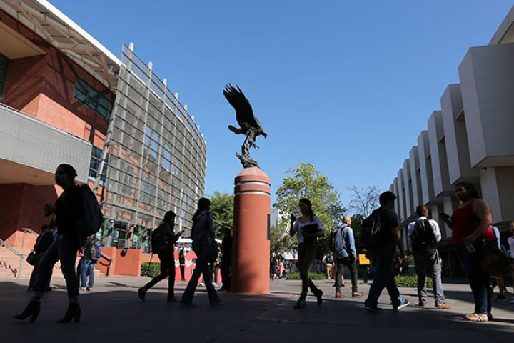
Campus

Slide 3
Learning Experience
Professors
01
Knowledge, Hands-on Learning Tools
02
Instructors
Industry Exposure, Practical Learning
Clubs & Organizations
03
Many Opportunities: ACM, SWE etc. (CSI)
04
Fellow Classmates
Hard-work and Dedication

Slide 4
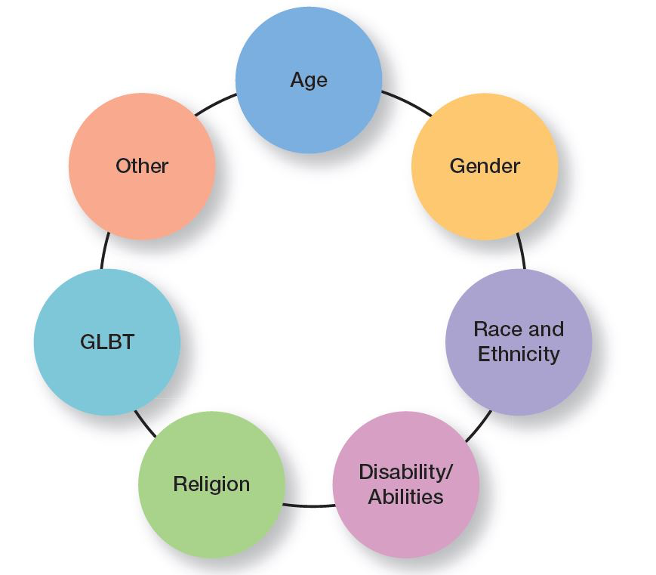
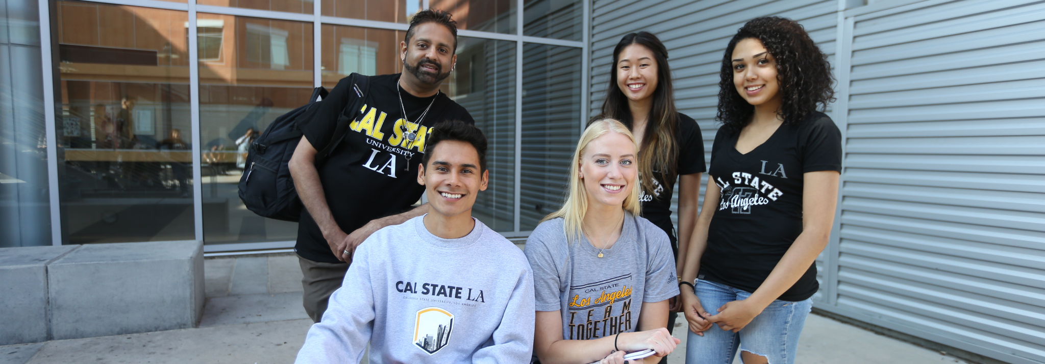
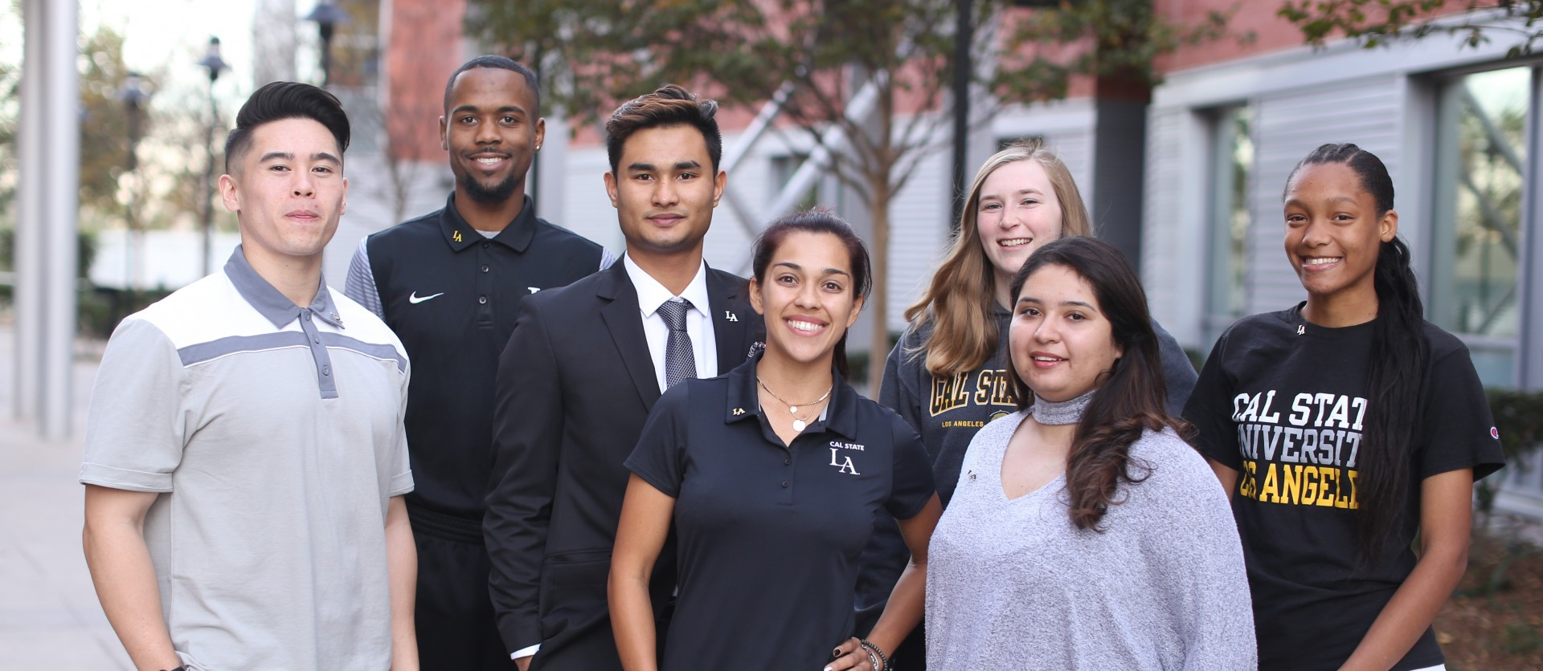
Diversity
Really Diverse and Inclusive, making everyone feel welcomed!

Slide 5
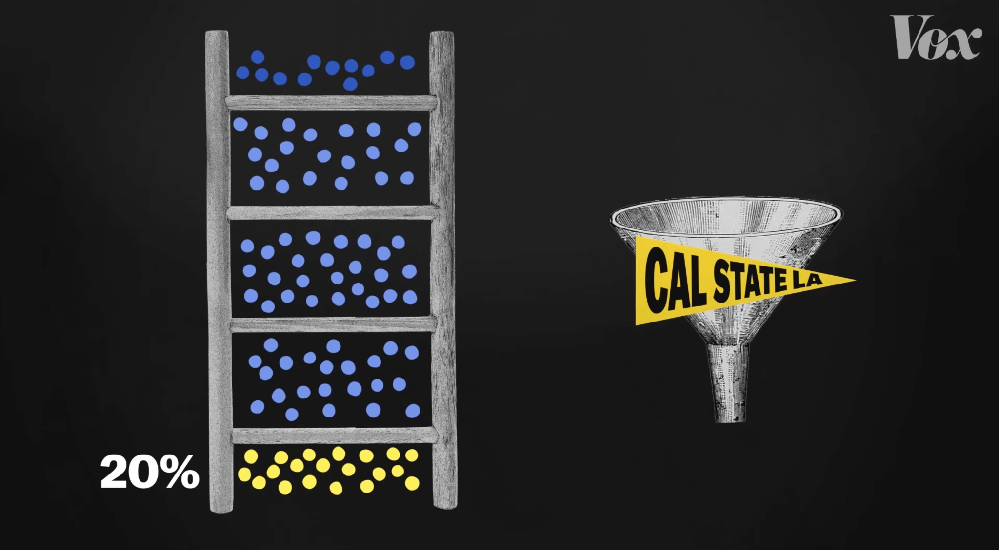
#1 in Upward Mobility in the US
A group of economists compared Elite Universities to Cal State LA in regards to Upward Mobility and found Shocking Results. When comparing students who come from families in the bottom 20% income scale, CSULA was far better in moving them to the top-most income status on the ladder. As this video mentions, they’re not the ones talked about in movies, but they’re doing the work!
https://www.youtube.com/watch?v=QhN4wBfQ9yI

Slide 6
Tuition Fee Calculation
International Students' Orientation

Slide 7
CASHNET PORTAL - International Student Fee
01
PICK SEM
03
NON-RES
05
Choose the semester for fee payment
Add the non- residential fee
LOGIN PAGE
02
ADD TUITION
04
PAY
Login with your CIN & Date of Birth
Choose the number of credits and add fee
Credit card, International Flywire

Slide 8
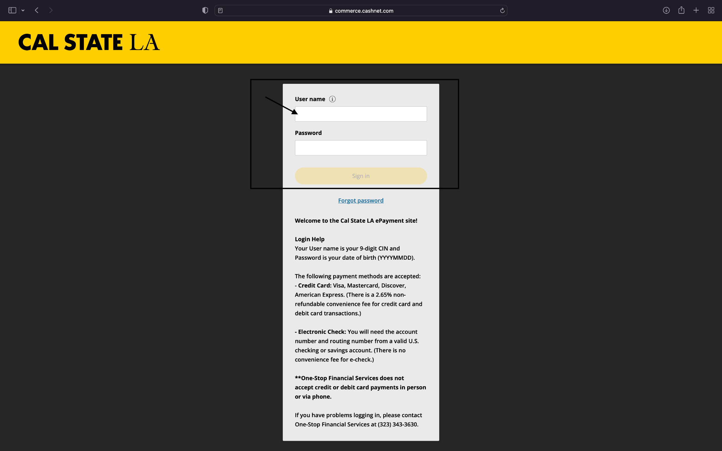

Slide 9
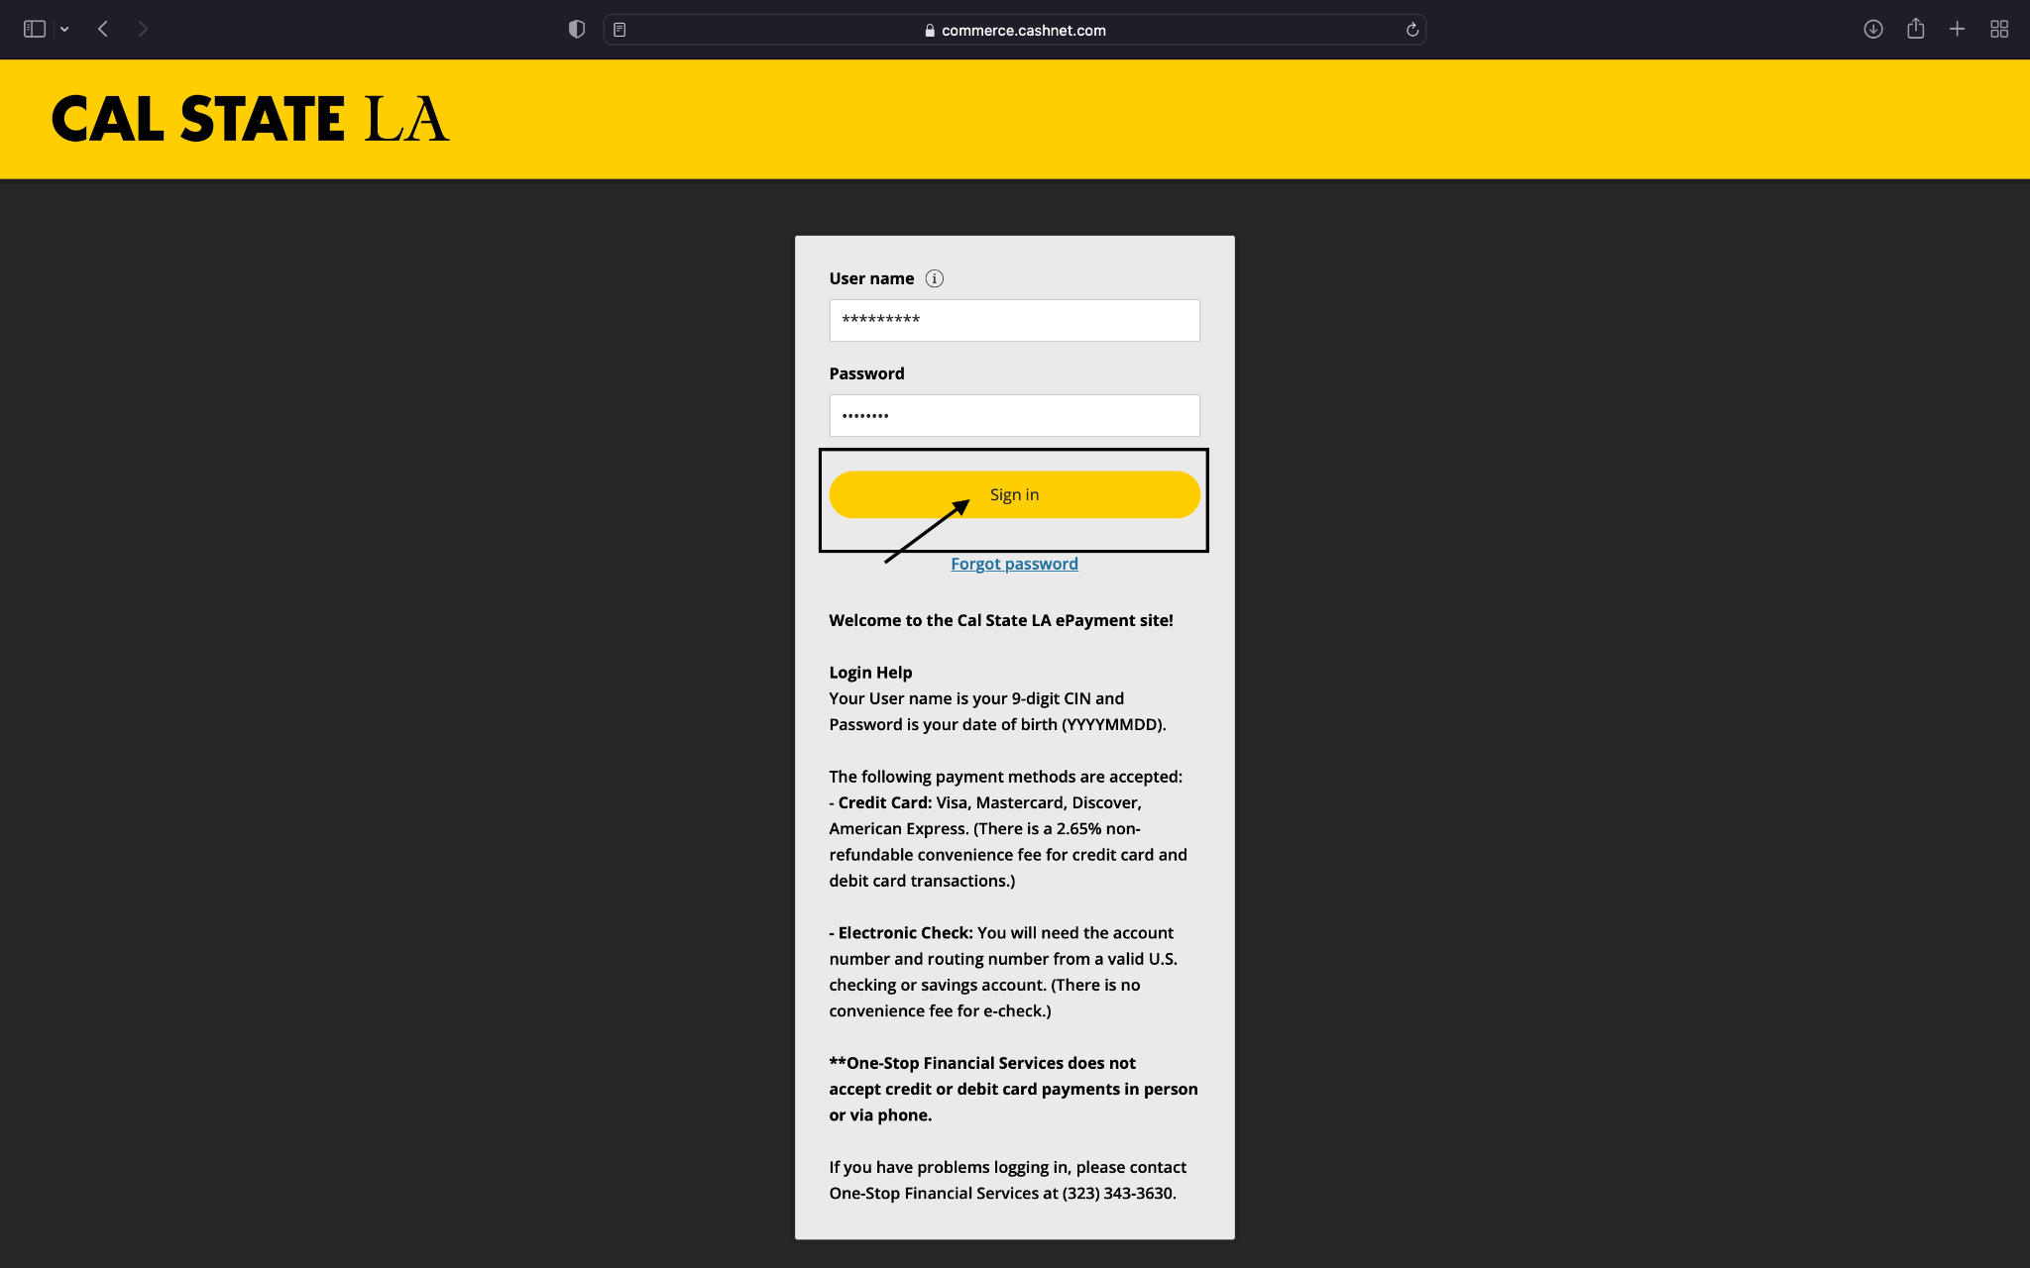

Slide 10
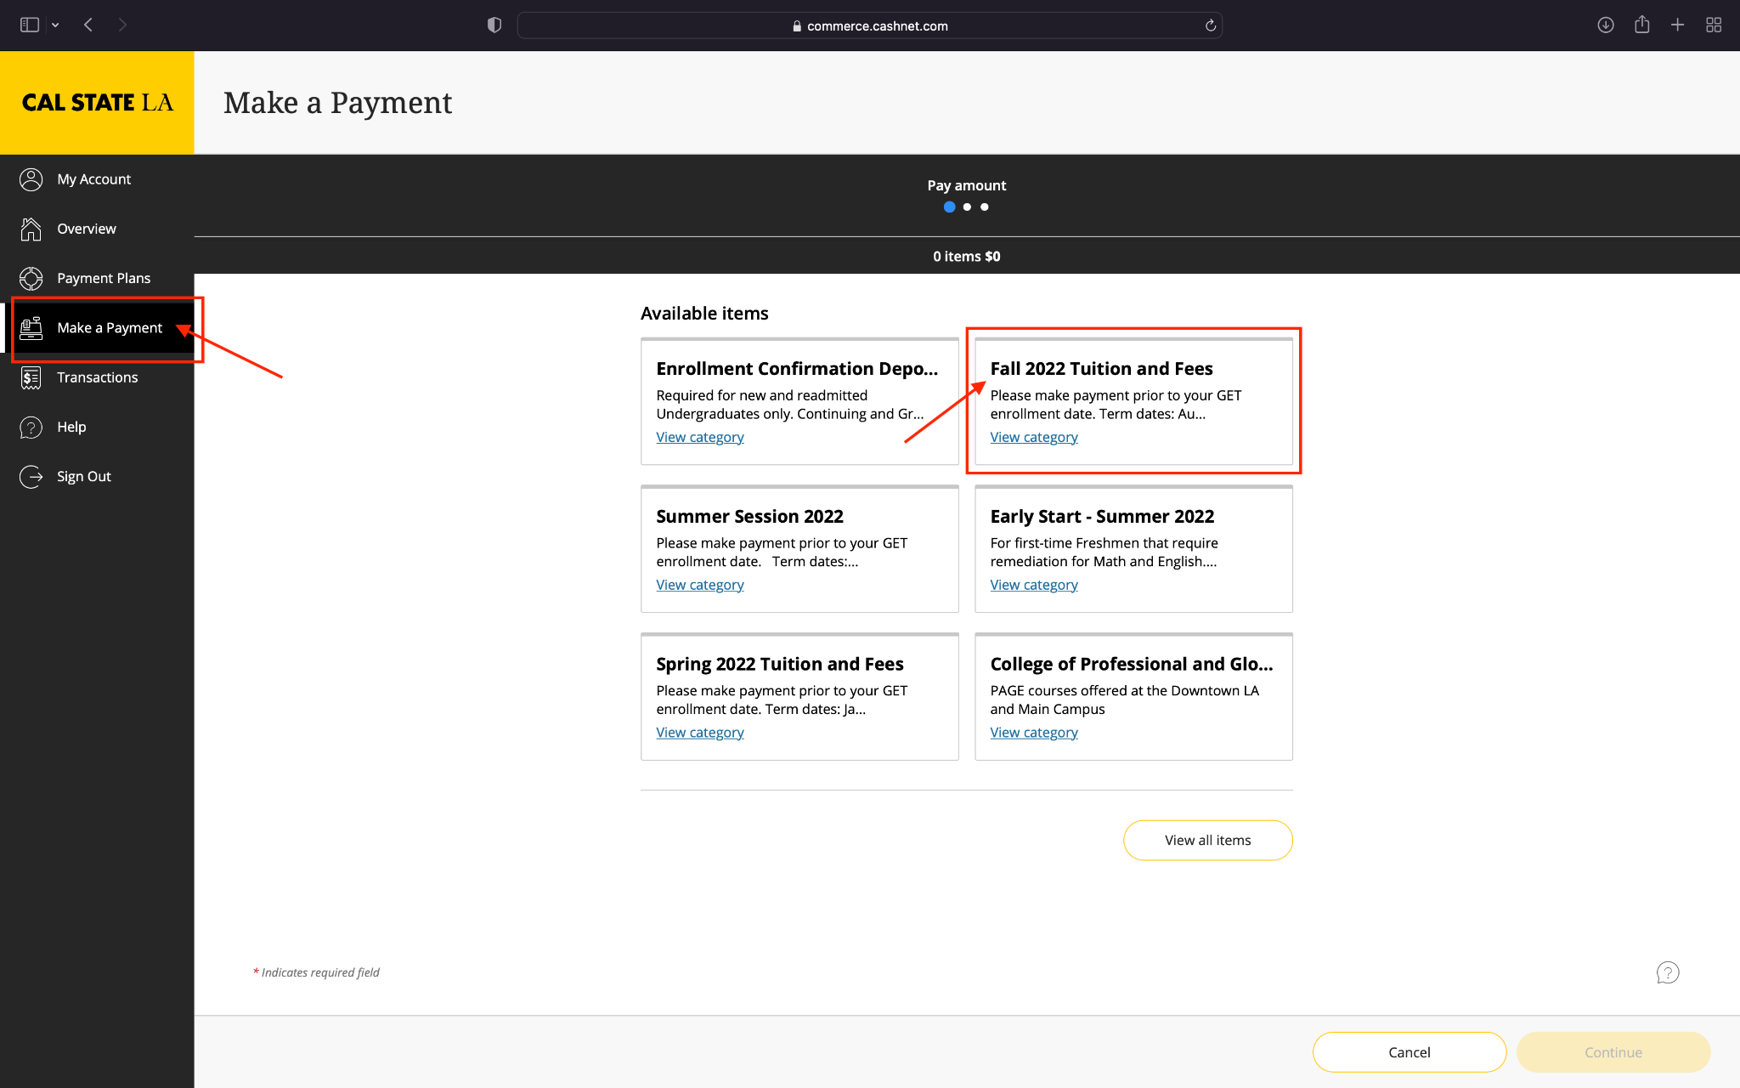

Slide 11
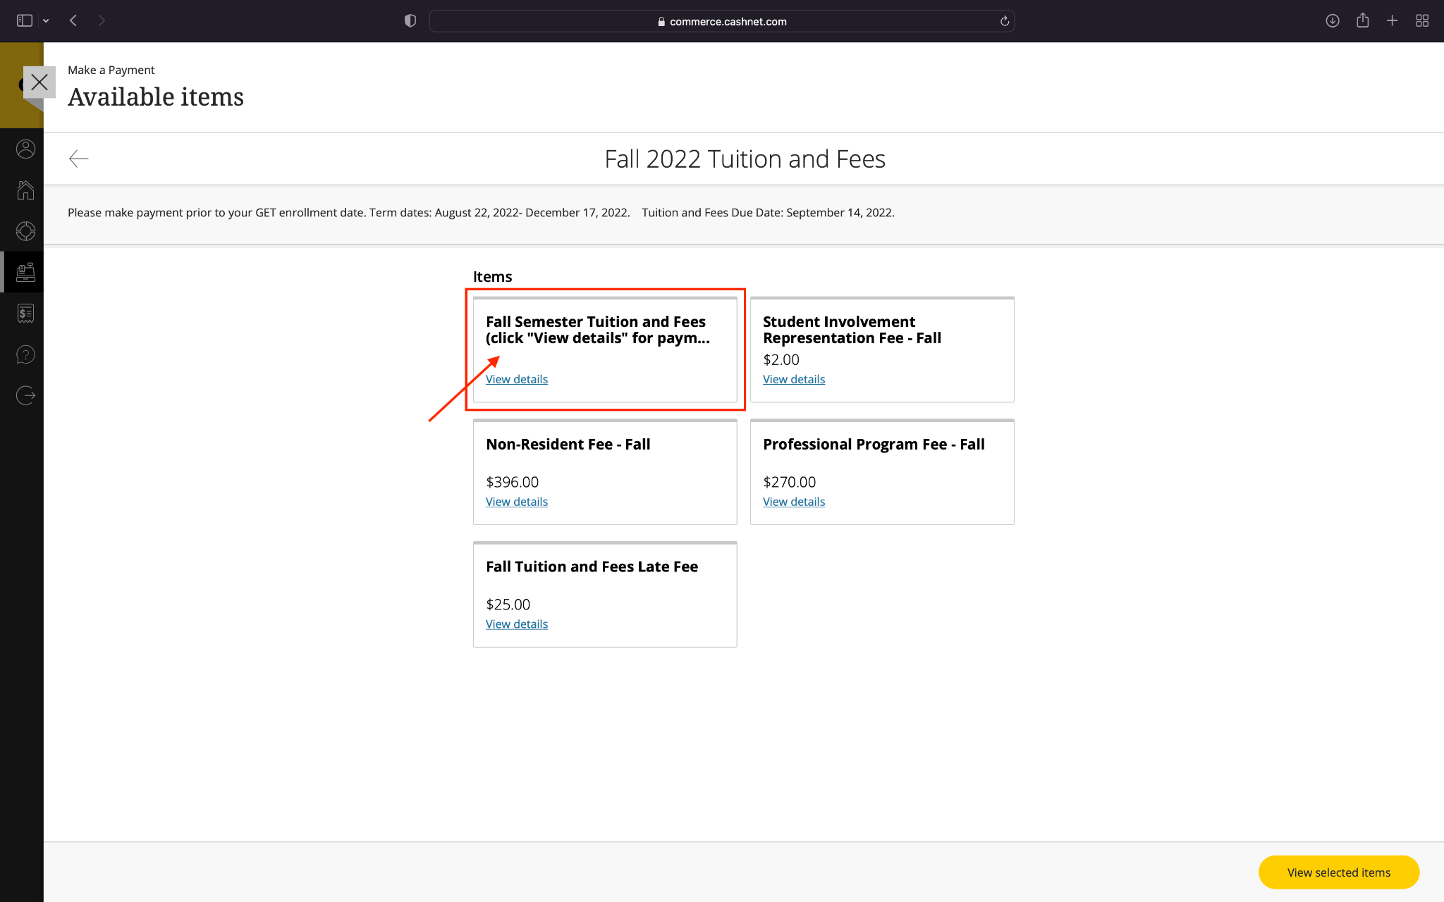

Slide 12
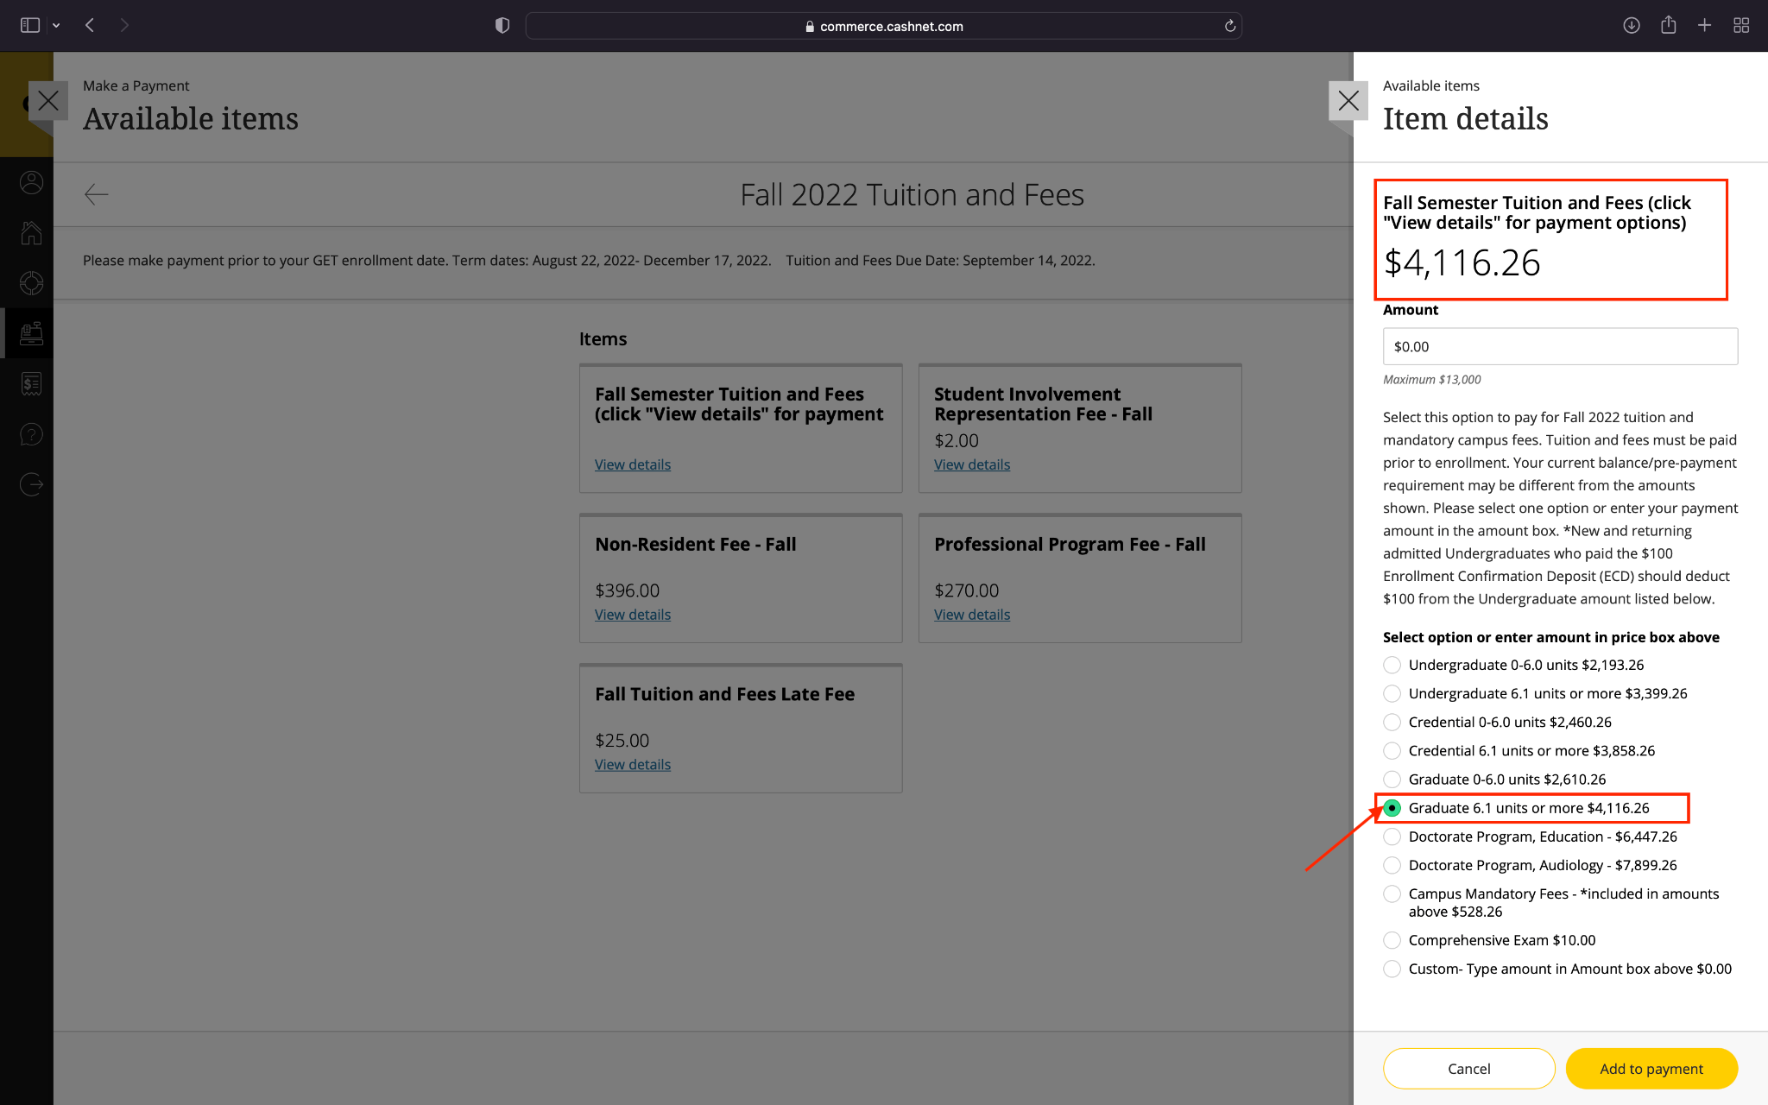

Slide 13
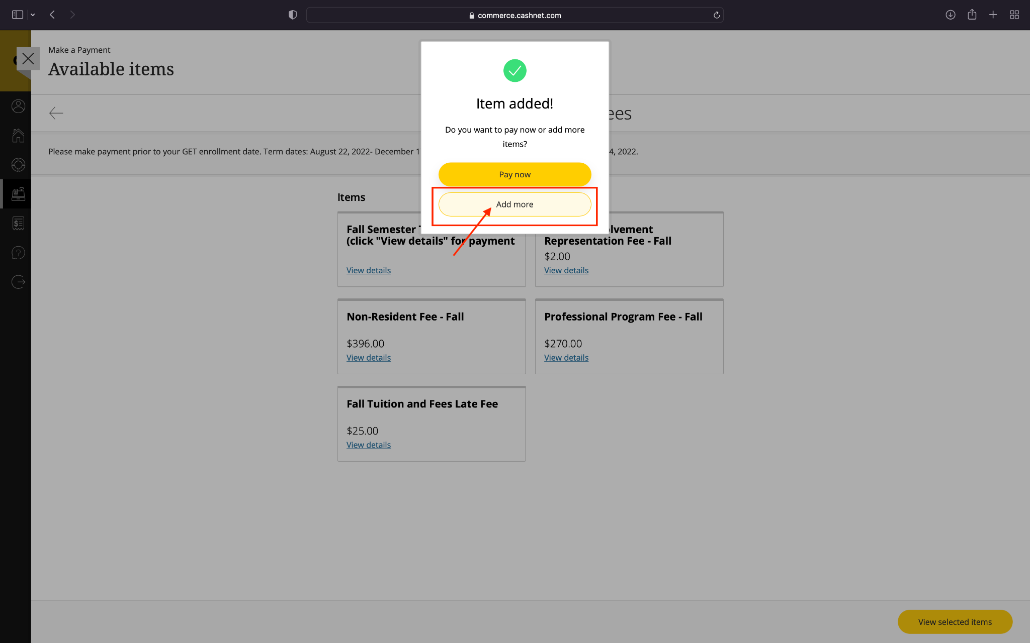

Slide 14
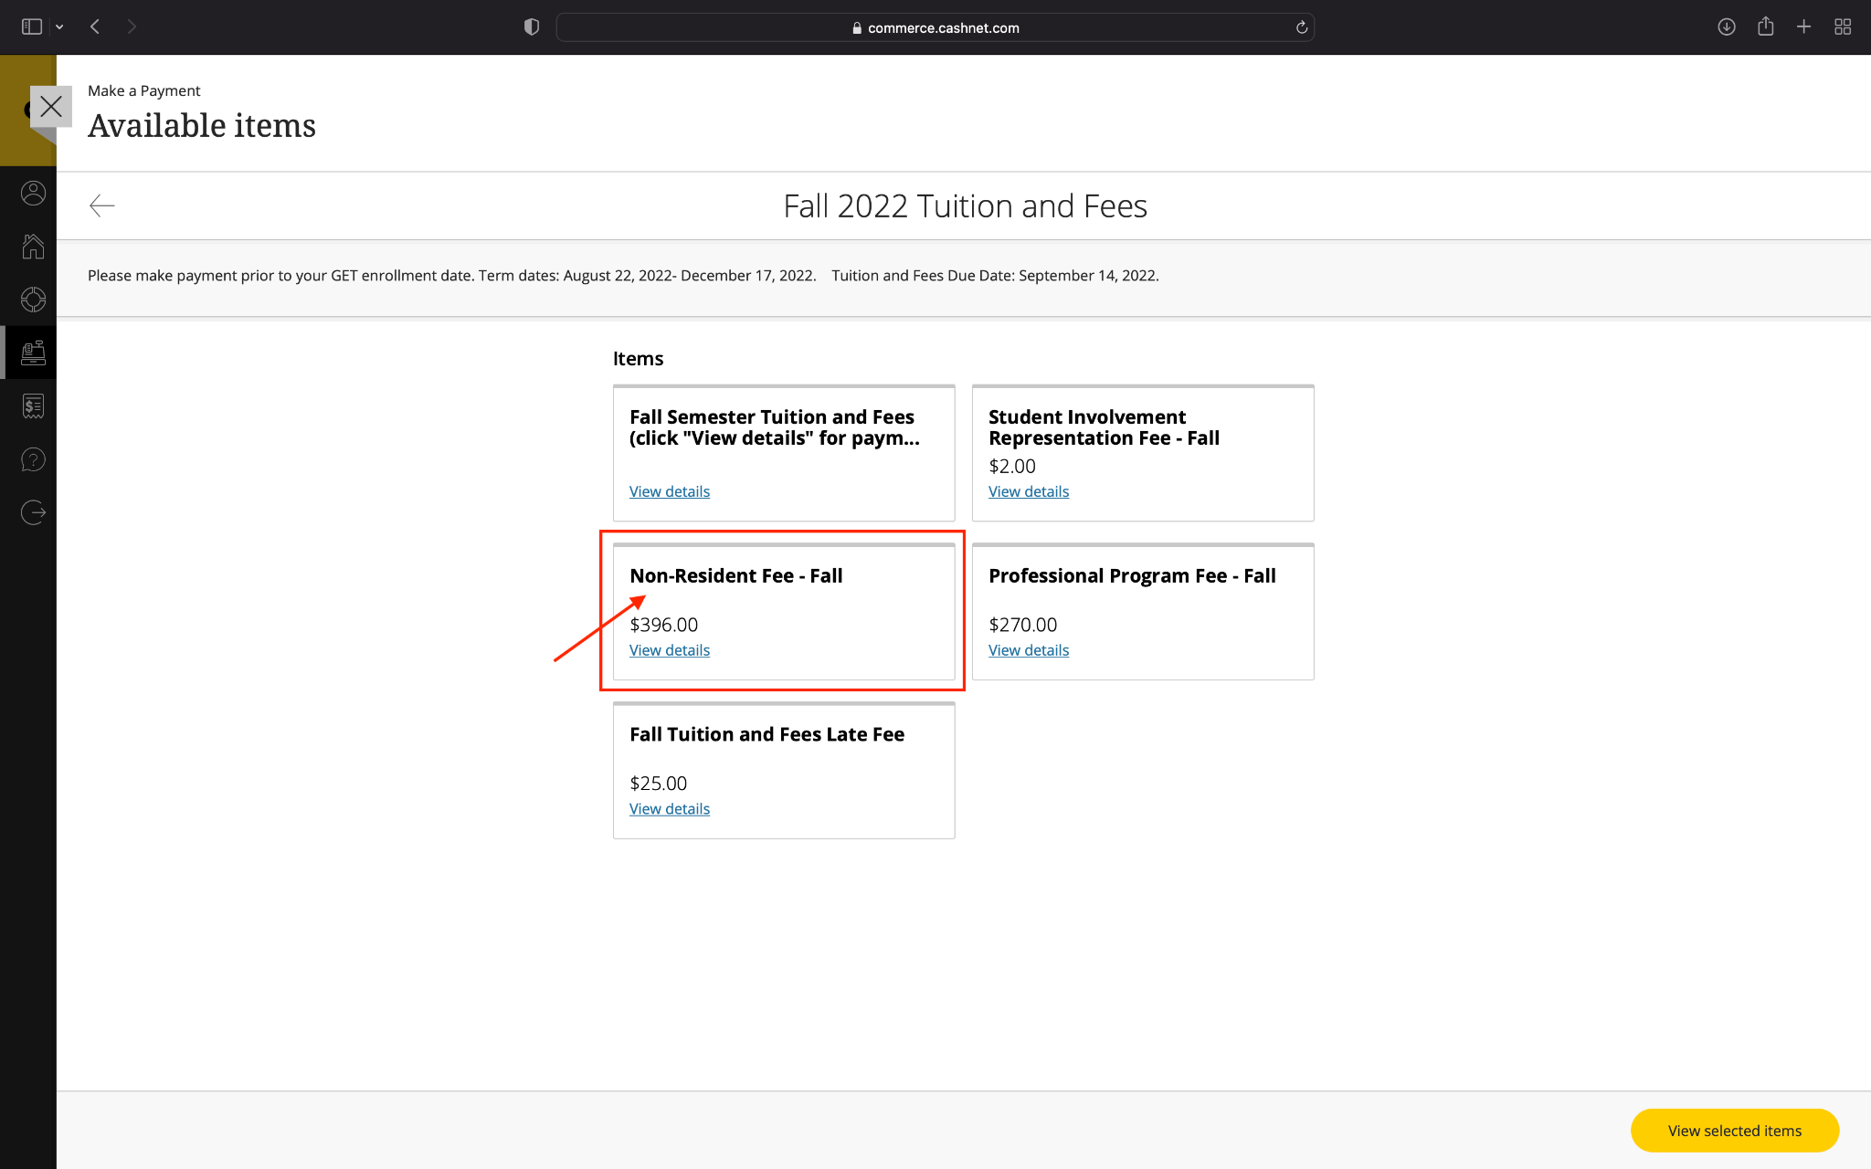

Slide 15
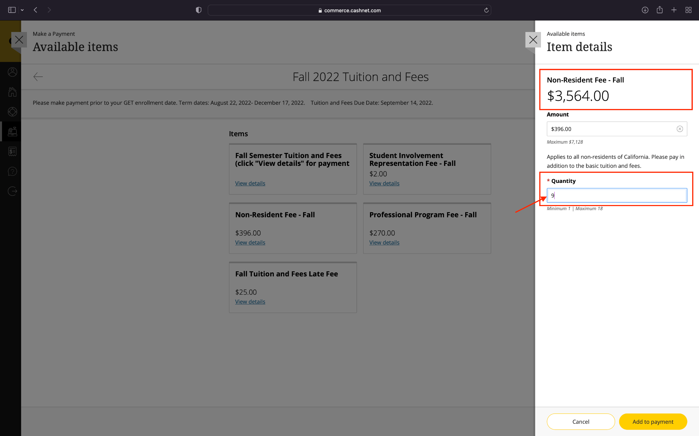

Slide 16
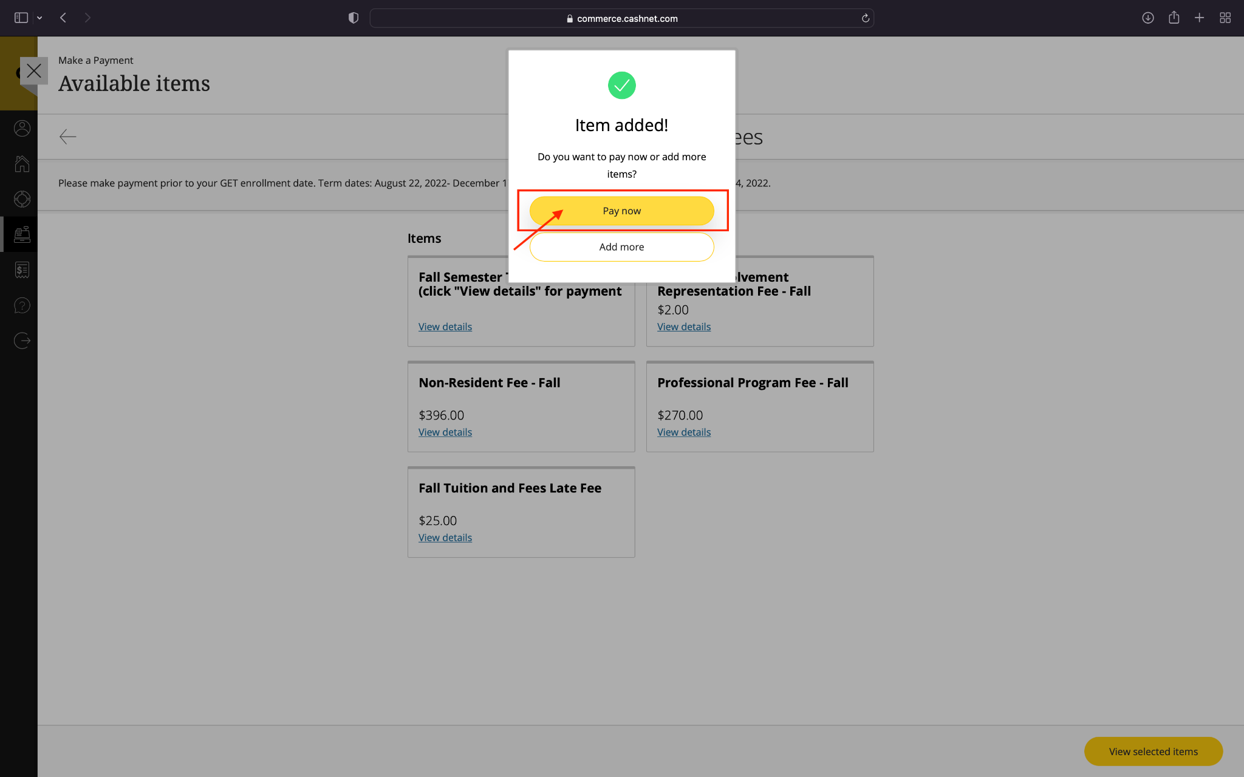

Slide 17
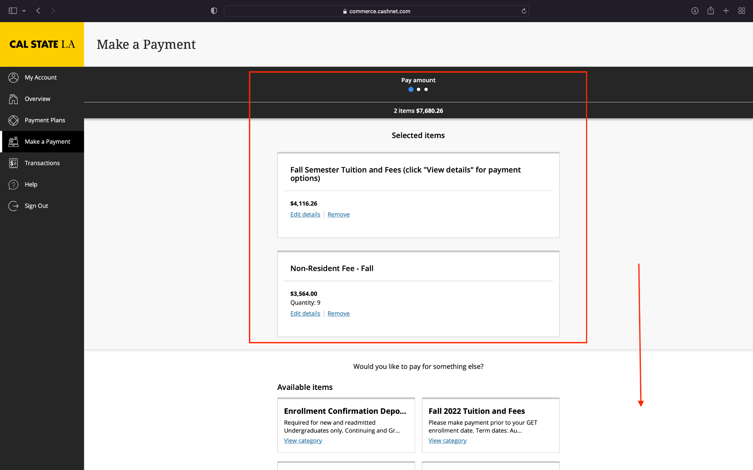

Slide 18
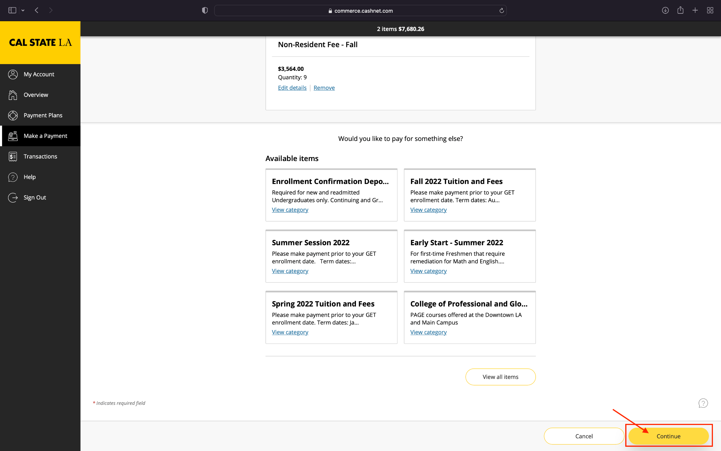

Slide 19
Thank you!

