Slide 1
Department Meeting
Friday, March 12th, 2021

Slide 2
Agenda
F2F planning for International undergraduate students
Hiring
Upcoming Events
ECST Preview day – 3/24 and 3/26
Honors Convocation – 4/9
Student feedback on senior design project (midterm-survey)
Scheduling: Comprehensive exam, Thesis, and Senior design expo
Committee elections
Q&A

Slide 3
Fall 2021 – F2F Planning
International Undergraduate Students
Must take at least one hybrid or in-person class for the Univ. International Program to issue I-20
Pre-CS (freshman)
CS 1010 – 1 lab section (in-person)
BS CS (transfer)
Any idea? (CS 1222 or CS 2012)

Slide 4
Hiring Request
1 tenure-track position (assistant-level) beginning Fall 2022
Justifications
Faculty retirements
Enrollment
Major to TT faculty ratios
Tenure Density (the ratio of full-time faculty to part-time faculty)
Needs for the program
Areas : cybersecurity, robotics, software engineering, CS Education, Programming Paradigm and Advanced Programming(?), Symbolic AI and Constraint Programming, Cloud computing and IoT

Slide 5
ECST Preview Day
3/24, 3:30-5PM
04:10 - 04:30 : Faculty advisors (Zilong, Raj, Elaine)
04:30 - 05:00 : Zilong and Negin
3/26, 9-10:30AM
09:40 - 10:00 : Faculty advisors (Zilong, Raj, Elaine)
10:00 - 10:30 : David and Chengyu

Slide 6
Honors Convocation
April 9, 2021, 6-7:30PM (A Calendar invite with a zoom link was sent.)
6-6:30: College part
Invited Speaker: Arthur Amador, Mission Systems Manager, JPL (1986 graduate of Cal State LA with a degree in Computer Science)
6:30-7:00: Dept part
MCs – David and Navid
Name readers – Negin and Soo
HC Student Speaker Candidates
1 undergrad
1 grad/BXG

Slide 7
Honors Convocation & Honors Eligibility
To recognize students who received the following honors during the calendar year 2019 and/or 2020.
Named on the Dean’s List for two consecutive terms in the same Calendar Year
Received Special Recognition as a Graduate Student
​Honors College Recognition
Initiated into an Honor Society including Tau Beta Pi, Eta Kappa Nu, Chi Epsilon, , Epsilon Pi Tau, Pi Tau Sigma
Honors Eligibility
Dean’s List Eligibility: Undergraduate students who earn a GPA average of 3.5 or higher in 12 or more graded course work in one term
Honors College Eligibility: Students who earn a GPA average of 3.5 or higher in 12 or more graded course work in one semester and who ranks in the upper 5% of students in academic achievement
Graduate Recognition Eligibility: Students who have maintained a GPA of 3.8 or higher in 80% or more of their required program
Honor Societies Eligibility: New inductees to the honor societies

Slide 8
Student feedback on senior design project
Midterm-survey

Slide 9
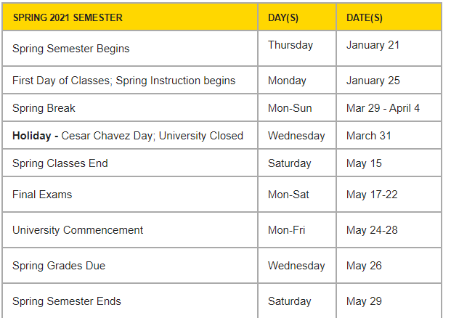
Scheduling
All dates are tentative.
Comprehensive exam : May 13th Thursday
Thesis Presentations : May 14th Friday
Senior Design Expo : May 3-7th week
Department Recognition - Class of 2021: May 24-28th

Slide 10
Committee Elections
Personnel committees :
RTP/PTR (tenured faculty)
Lecturer Evaluation (all tenure-line faculty)
Search (2 tenured + 1 assistant)
Other committees:
IAC, SAC, Graduate Program Committee, Research Committee, etc.

