Slide 1
Computer Science Groups Advisement for CS Juniors
Department Chair: Dr. Eun-Young (Elaine) Kang
Faculty Advisors: Dr. Raj S. Pamula & Dr. Zilong Ye
ECST Academic Advisor: Evelyn Crosby
Department Coordinator: Valentina Ovasapyan

Slide 2
Year 2020- Life lessons
Physical Well-being
Eat, Sleep, Exercise
Virtually Connect with Family and Friends
Maintain a healthy life style with a good routine
Emotional Well-being
Reduce Stress and Anxiety
Increase Faith and Patience
Mind Matters Resources (https://www.calstatela.edu/mindmatters)
Social Well-being
Stronger together in diversity
Take action against injustices and Inequalities in our daily lives
Positive influence on social media

Slide 3
Work From Home - Life lessons
Technology
Laptop, webcam, head phones
Internet and WiFi - Unlimited, Stable, High speed, High Bandwidth
Software –Free. Set up the working environment on laptops
Space
Secluded environment - space
Working environment - desk
Even a corner of a room
Plan
Strategize - Effective self‐learning strategies
Prioritize – Scheduling, Time management - Day/Time/Hours
Communicate - Talk to Faculty, other students, Advisors

Slide 4
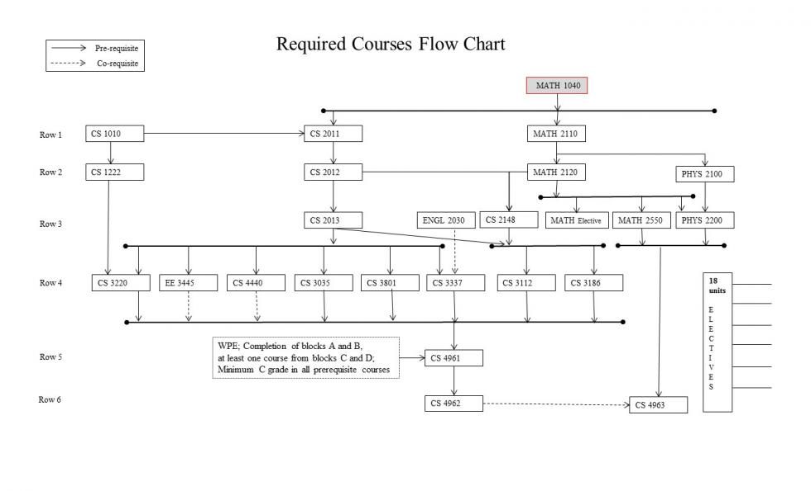

Slide 5
Course Planning and Time Management
Full time student = Full time job
15 units (5 courses) = 40 hours (or more)/week
Minimum course commitment = 40/5 = 8 hours/week
Each course scheduled time:
Lecture only – Scheduled for 3 hours/week
Lecture/Lab – Scheduled for 5 hours/week
Each course extra study time
5 hours/week

Slide 6
Ideal Planner for Juniors
Ideal planner for Juniors
GET Degree Planner
Populate courses (including electives) as per your plan
Can modify later if needed
Planned Advising Report
Verify the report for all the requirements (GE and major)
Green (completed), Yellow (registered), Blue (planned), Red (missing) indicators
Any red indicators?
summer | fall | spring
? | CS 3035 | CS 3186
 | CS 3112 | CS 3801
 | CS 3220 | CS 4440
 | CS 3337 | CS Elective
 | EE 3445 | GE ?
summer | fall | spring
? | CS 4961 | CS 4962
 | CS Elective | CS 4963
 | CS Elective | CS Elective
 | CS Elective | CS Elective

Slide 7
Advising Guide
The planner has 5 rows for each of the semesters
In today’s environment, we would recommend 4 courses each in Fall/Spring
Take advantage of Summer to reduce the burden in the Fall/Spring semesters
Don’t count on CS3000 level courses being offered in Summer sessions.
Plan properly so as not to miss out senior design next year
Any mistake ADDS ONE YEAR to your graduation plan.
EE3445 and CS4440 are the only two courses that can be taken in the senior year.
Fall 2020 Registration
Registered in the courses?
Any issues?

Slide 8
Individual Planner for Juniors
Work on Creating your Degree Planner to graduate in Spring 22 or Summer 22. (Fall 22 if needed for some electives)
Fall 20 | Spring 21 | Summer 21
Fall 21 | Spring 22 | Summer 22
CS 4961 | CS 4962
 | CS 4963

Slide 9
Q&A
www.calstatela.edu/cs

