Slide 1
Computer Science
M.S. Program Information Session & Orientation
Department Chair: Dr. Eun-Young (Elaine) Kang
Faculty Advisors: Dr. Raj S. Pamula & Dr. Behzad Parviz
Graduate Coordinator: Lupe Martinez
Department Coordinator: Valentina Ovasapyan
Notes:
Welcome and introduce ourselves

Slide 2
MS CS Program
http://www.calstatela.edu/ecst/cs

Slide 3
Agenda
Computer Science CS MS
Discipline
Job growth
Alumni CS MS
Why CSULA?
Faculty expertise
Admission to CS MS
Standing
Curriculum CS MS
New
Roadmap
Spring 2021 Registration Information
Q&A
Notes:
The agenda for this information session will be as follows:

Slide 4
4

Slide 5
5

Slide 6
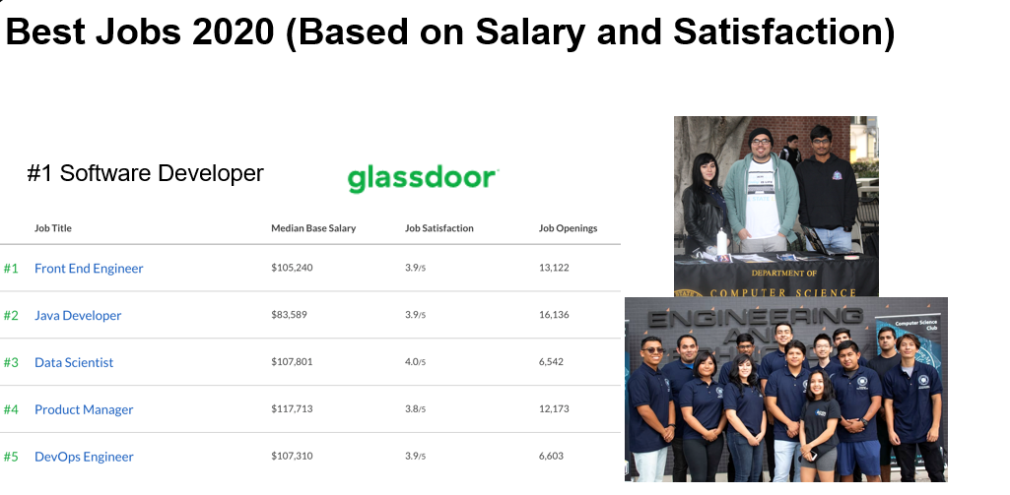
6

Slide 7
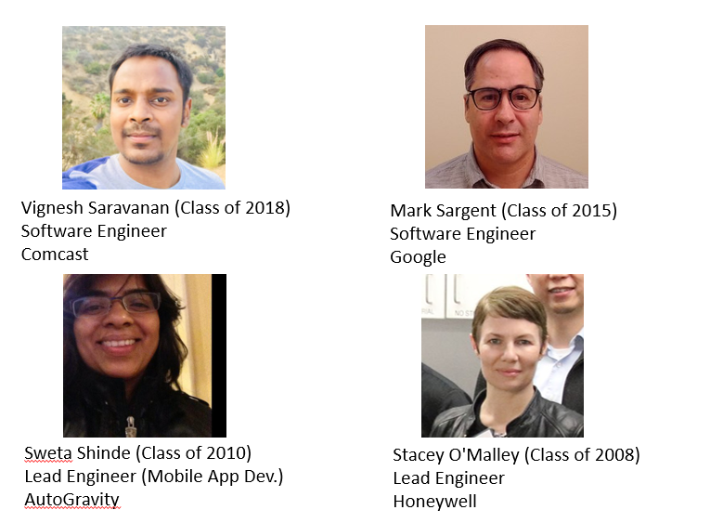
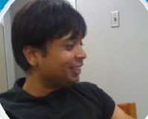
CS MS Alumni
Phu Kieu (Class of 2012)
Senior Software Engineer
Google
Ankur Bansal (Class of 2010)
Senior SW Engr II, Team Lead Manager at Uber
7

Slide 8
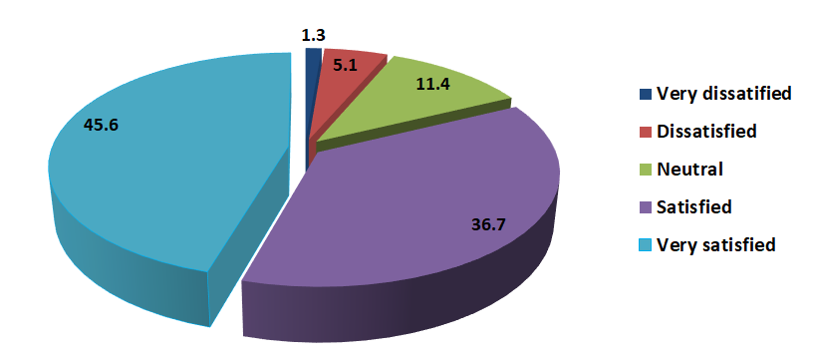
Job Satisfaction of our Alumni
8

Slide 9
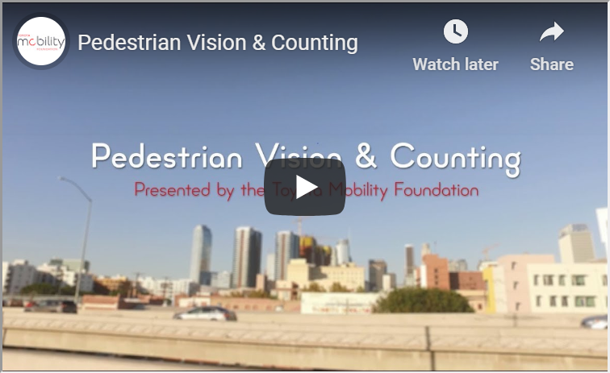
Faculty Expertise
http://www.calstatela.edu/ecst/cs/faculty
Research labs:
http://www.calstatela.edu/ecst/research
https://youtu.be/oEBVoQT2Qkw
9
Notes:
Faculty cover all the areas of Computer Science.

Slide 10
CS MS Admission & Graduate Standing
Conditional Admission (G1 standing)
(Admission with a few prerequisite conditions)
Programming (CS 3035)
Algorithms (CS 3112)
Web (CS 3220)
Must complete these prerequisites in the first semester
Classified Admission (G2 standing)
CS4000/5000 courses
Advanced to Candidacy (G3 standing)
Electives, Thesis, Comprehensive Exam
10

Slide 11
MS CS Curriculum (Current)
Breadth Requirement (9 units)
Select one course each from three of the following five areas of study: Algorithms (CS 5112), Network Systems (CS 5780), Web Systems (CS 5220) , Advanced Programming (CS 5035) and Software Engineering (CS 5337)
Thesis option (18 units)
Choose 18 units of 4000/5000 level courses with a minimum of 9 units from 5000 level courses
CS 5990 - 3 units over 2 semesters
Comp Exam Option (24 units)
Choose 24 units of 4000/5000 level courses with a minimum of 12 units from 5000 level courses
CS 5960 (0 unit)

Slide 12
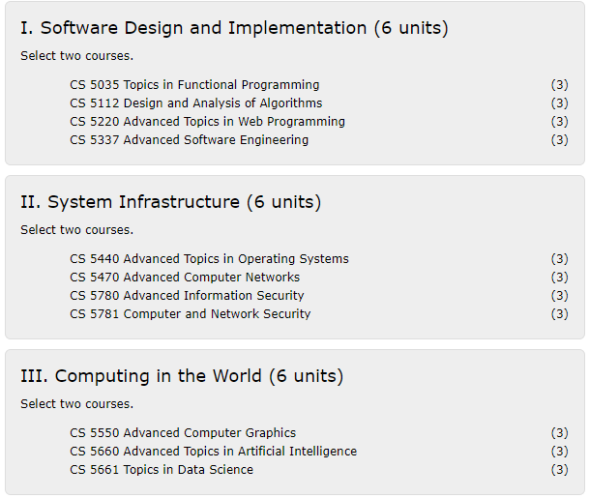
MS CS Curriculum (New) Effective Fall 2021 semester term
Three Thematic Areas (Fall 2021):
Required Core (18 units)
Two courses from each of the three areas
Thesis Option (12 units)
2 additional electives (CS4000/CS5000)
CS 5990 Thesis (3 units) - 6 units over 2 semesters
Comp. Exam Option (12 units)
Take 4 additional electives (CS4000/CS5000)
Take CS5960 Comp Exam (0 units)

Slide 13
Research Opportunities
Faculty research projects
Many faculty have external or internal grants. Many faculty are supervising graduate (individual) thesis.
60 thesis completions in the last five years.
All students under the thesis option register for a two semester course sequence (CS5990). Students usually start working on their thesis (prior to registering for CS5990) early in their graduate program.
Many faculty are involved in student capstone projects (senior design team projects). This often involve grad students as mentors.

Slide 14
Roadmap (New curriculum) :
14

Slide 15
Roadmap (New curriculum) :
15

Slide 16
Spring 2021 Registration
Survey : https://csns.calstatela.edu/department/cs/survey/response/edit?surveyId=7830847
To complete the survey, see
Spring 2021 classes via Class Search or in pdf
Course descriptions: Undergrad courses ; Grad courses
Things to remember
CS 3112 is a prerequisite to all the CS 4000 level courses.
CS 5000 levels for G2 students.

Slide 17
Questions?

