Slide 1
Computer Science Transfer Student Information Session
July 2nd 2020
Department Chair: Dr. Eun-Young (Elaine) Kang
Faculty Advisors: Dr. Raj S. Pamula & Dr. Zilong Ye
ECST Academic Advisor: Evelyn Crosby
Department Coordinator: Valentina Ovasapyan

Slide 2
Year 2020 - Life lessons
Physical Well-being
Eat, Sleep, Exercise
Virtually Connect with Family and Friends
Maintain a healthy life style with a good routine
Emotional Well-being
Reduce Stress and Anxiety
Increase Faith and Patience
Mind Matters Resources (https://www.calstatela.edu/mindmatters)
Social Well-being
Stronger together in diversity
Take action against injustices and Inequalities in our daily lives
Positive influence on social media

Slide 3
Work From Home - Life lessons
Technology
Laptop, webcam, head phones
Internet and WiFi - Unlimited, Stable, High speed, High Bandwidth
Software –Free. Set up the working environment on laptops
Space
Secluded environment - space
Working environment - desk
Even a corner of a room
Plan
Strategize - Effective self‐learning strategies
Prioritize – Scheduling, Time management (Day/Time/Hours)
Communicate - Talk to Faculty, other students, Advisors

Slide 4
Cal State LA is “doing the work”
https://www.youtube.com/watch?v=QhN4wBfQ9yI
4

Slide 5
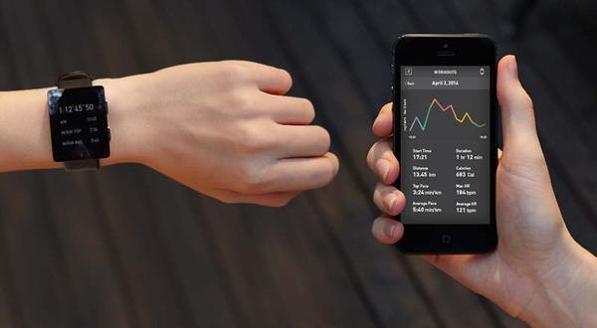
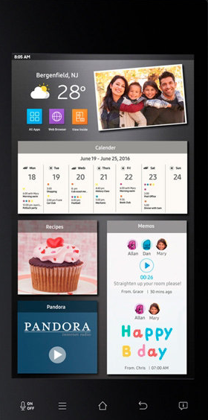
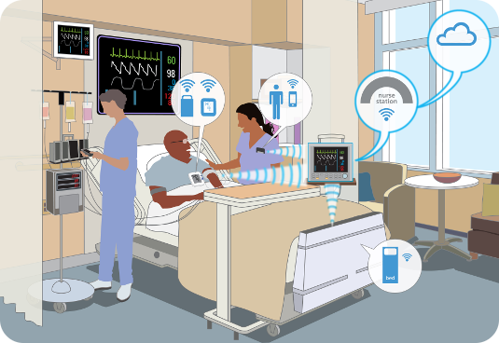
Computers Are Everywhere
Wearable Tech
Smart Appliances
Google Glass Enterprise
Entertainment
Healthcare
Automotive and Transportation
5

Slide 6
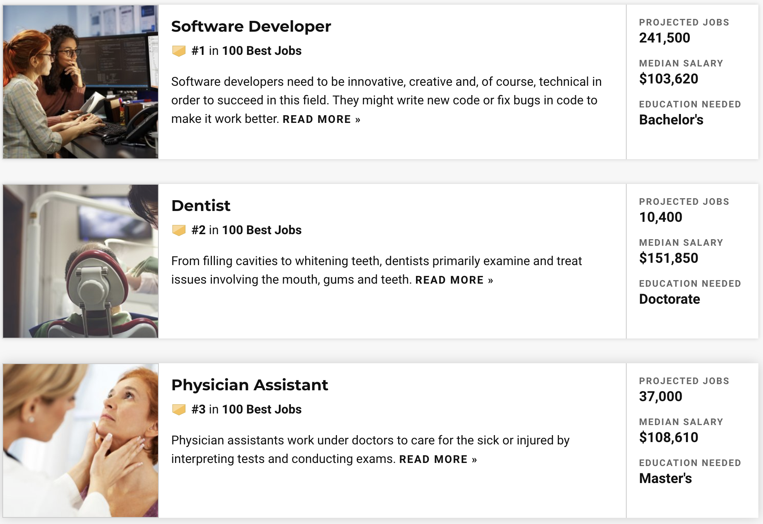
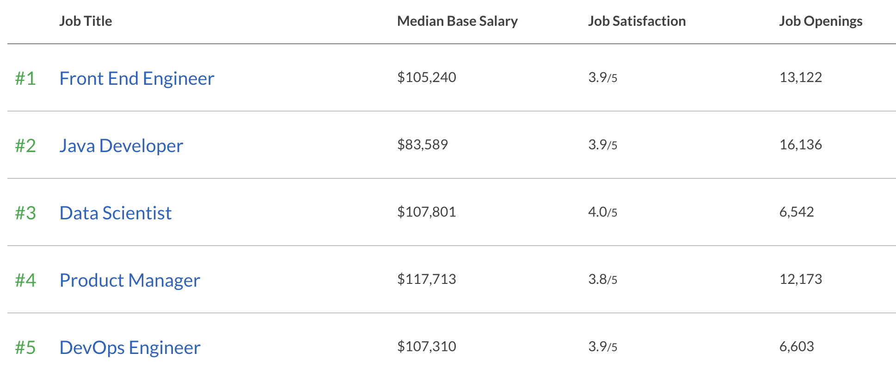
Best Jobs 2020
#1 Software Developer
#1 Software Developer
Based on Prospects and Satisfaction
Based on Salary and Satisfaction
6

Slide 7
Computer Science : BS Curriculum
General Education (GE)
CS (Math/Physics + CS courses)
120 units
24 + 96 = 120 units
GE (24 units)
CS (96 units)
7

Slide 8
Computer Science Requirements
General Education
Lower Division – Reduced number for CS
Upper Division – Met by CS courses
Math/Physics
Lower Division
Computer Science
Lower Division
Upper Division
All Lower Division Courses are Transferable

Slide 9
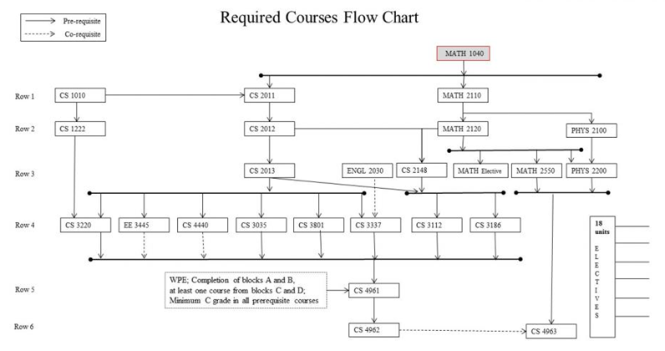

Slide 10
Transfer Roadmap
If all lower division requirements are completed, ideal 2 year planner for Juniors
summer | fall | spring
 | CS 3035 | CS 3186
 | CS 3112 | CS 3801
 | CS 3220 | CS 4440
 | CS 3337 | CS Elective
 | EE 3445
summer | fall | spring
? | CS 4961 | CS 4962
 | CS Elective | CS 4963
 | CS Elective | CS Elective
 | CS Elective | CS Elective

Slide 11
Course Planning and Time Management
Full time student = Full time job
15 units (5 courses) = 40 hours (or more)/week
Minimum course commitment = 40/5 = 8 hours/week
Each course scheduled time:
Lecture only – Scheduled for 3 hours/week
Lecture/Lab – Scheduled for 5 hours/week
Each course extra study time
5 hours/week

Slide 12
Registering for Fall 2020
Today | Discuss the survey
July 2nd – July 5th | Complete the survey Students suggest a plan for courses/sections The planner has 5 rows(15 units) for each of the semesters In today’s environment, you can decide to take less units if needed.
July 15th (or before) | We send you a plan of courses/sections
July 16th July 17th July 24th | One on one orientations to discuss/clarify/change the suggested plan (if possible)
July 20th July 23rd July 29th | University Orientation sessions followed by registration for classes.
Future Advising Sessions | A complete roadmap

Slide 13
Q&A
www.calstatela.edu/cs

