Slide 1
Computer Science
https://www.calstatela.edu/cs

Slide 2
Agenda
Introduction to Computer Science
Why choose Cal State LA Computer Science
Project Showcase
Q & A

Slide 3
Cal State LA: One of “America’s great working-class colleges”
“The colleges where the American dream is still alive”
https://www.youtube.com/watch?v=QhN4wBfQ9yI
Notes:
Congratulations on your acceptance to Cal State LA!
The New York Times called Cal State LA one of “America’s great working-class colleges”.
We’re not as famous as some other schools. But we work hard to provide a great experience for students.
Our focus is on educating students. We help you build skills, find opportunities, and embark on great careers.
Cal State LA is the best place to go if you want upward mobility. We help students move up the economic ladder better than any other American college.
Here is a YouTube link to a video created by Vox. Vox is a news website, and this video highlights Cal State LA as one of the colleges where the American dream is still alive. I encourage you to take the time to view it. I’ll paste it into the chat. Bookmark it for later.
https://www.youtube.com/watch?v=QhN4wBfQ9yI

Slide 4
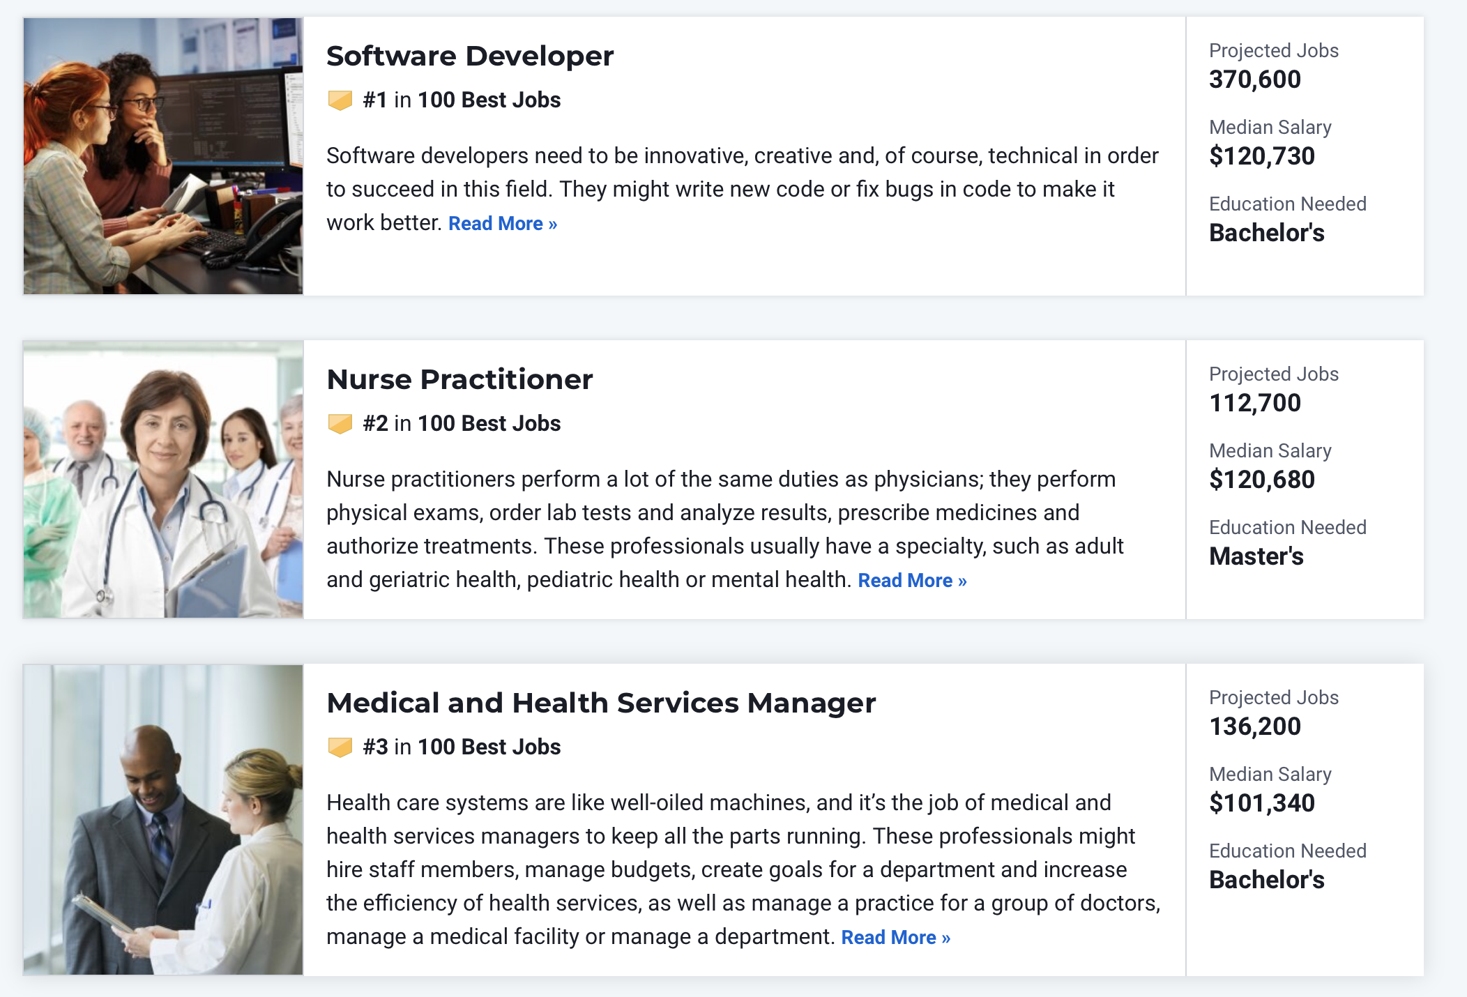
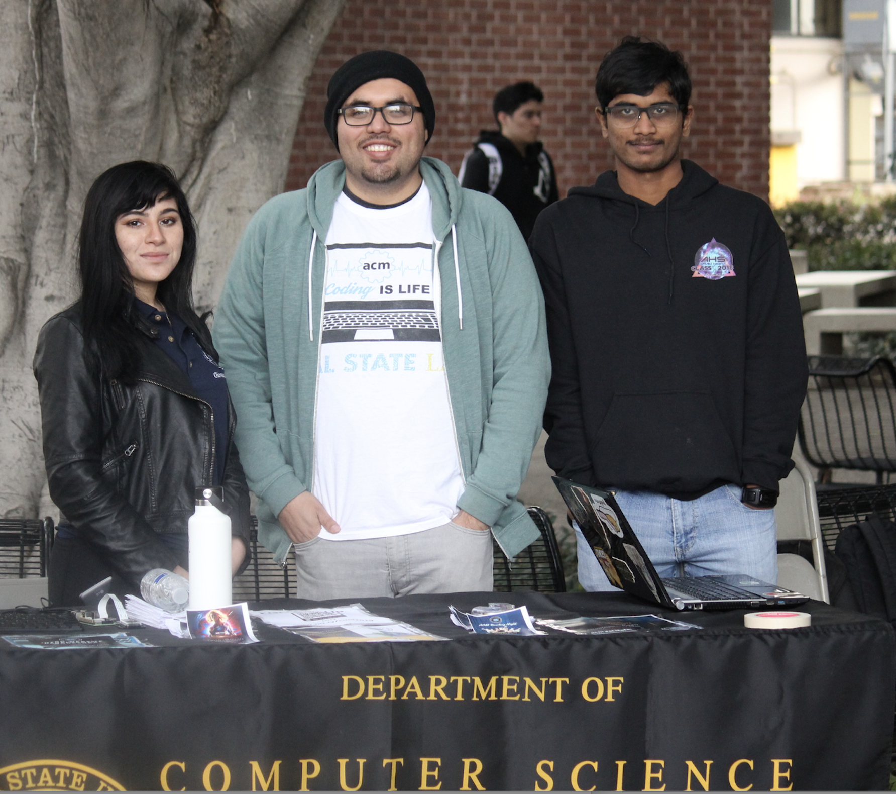
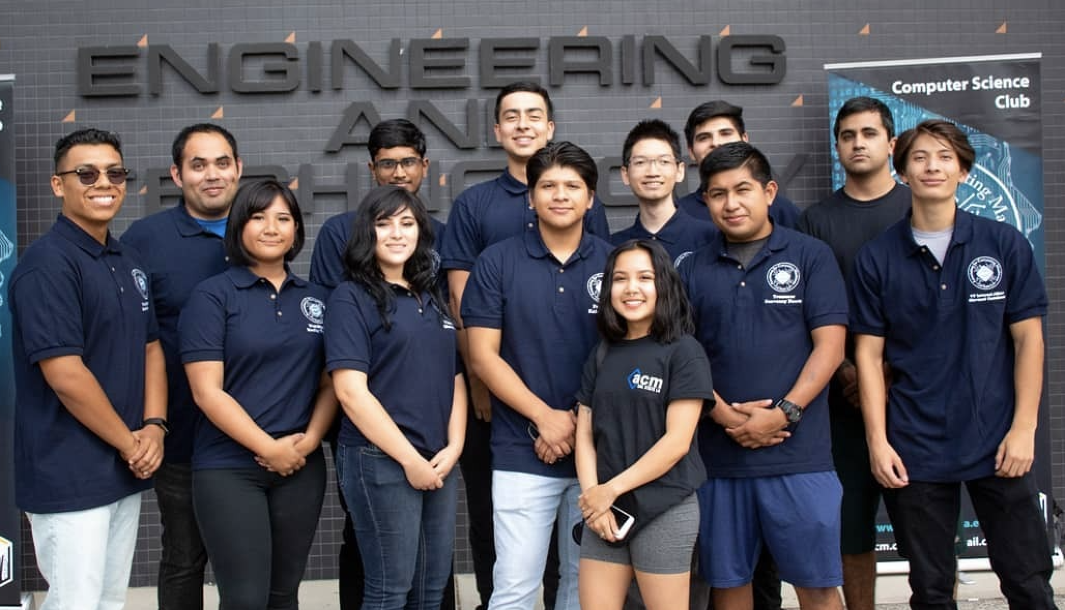
Best Jobs 2023 (Based on Prospects and Satisfaction)
#1 Information Security Analyst
Notes:
A career in computer science is one of the best careers out there, according to US News and World Report.
These rankings are based on job prospects and job satisfaction. On the job satisfaction scale, being an information security analyst usually provides above average flexibility. Overall, there are many job opportunities in the computing profession, the jobs earn good wages, and people enjoy their jobs.

Slide 5
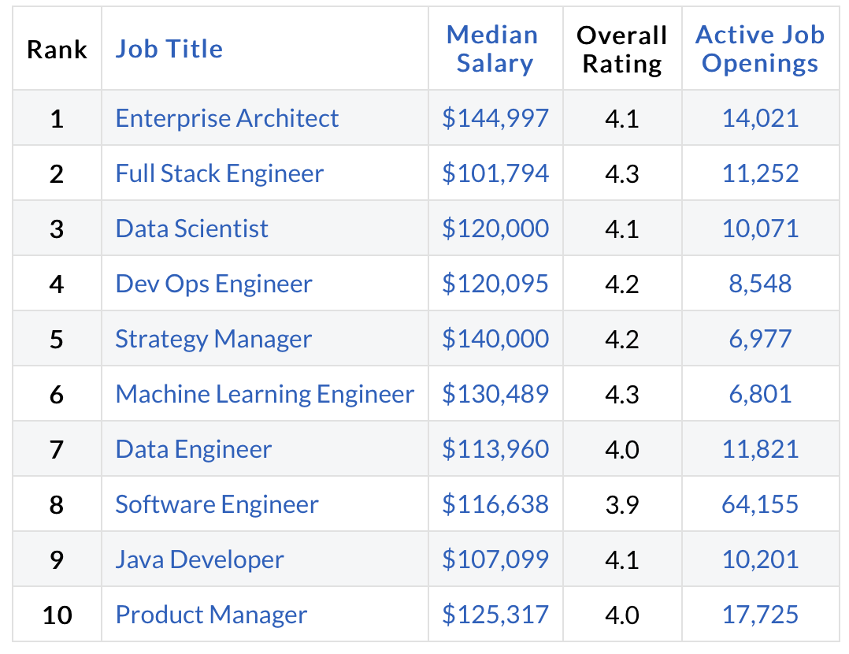
Best Jobs 2022 (Based on Salary and Satisfaction)
Notes:
Glassdoor also rates computer science jobs at the top of the best jobs list.
The enterprise architect is responsible for overseeing, improving and upgrading enterprise services, software and hardware.
Full stack engineer works on both the back-end and front-end of systems.
A data scientist analyzes data and helps companies make decisions. They are part mathematician and part computer scientist.
DevOps (development and operations) is an enterprise software development phrase used to mean a type of agile relationship between development and IT operations. The goal of DevOps is to change and improve the relationship by advocating better communication and collaboration between these two business units.
A strategy manager could be in any field, but there are many in computer and technology companies. They manage the development of new product features and often need a strong background in computer science.
Number 6 is machine learning Engineer. (Work with data scientists)
Number 7 is data Engineer.
Number 8 is software engineer. (general title for someone who develops software.)

Slide 6
Computer Science is applied in everything!
Entertainment
Notes:
Computing is such a fundamental part of our society. It is the engine on which the world runs.
Computer science is deeply embedded in healthcare, entertainment, automotive design, appliances and homes, and even worn on our wrists and in our pockets.

Slide 7
Computer Science is applied in everything!
Entertainment
Commerce
Notes:
Computing is such a fundamental part of our society. It is the engine on which the world runs.
Computer science is deeply embedded in healthcare, entertainment, automotive design, appliances and homes, and even worn on our wrists and in our pockets.

Slide 8
Computer Science is applied in everything!
Entertainment
Commerce
Homes
Notes:
Computing is such a fundamental part of our society. It is the engine on which the world runs.
Computer science is deeply embedded in healthcare, entertainment, automotive design, appliances and homes, and even worn on our wrists and in our pockets.

Slide 9
Computer Science is applied in everything!
Entertainment
Commerce
Homes
Wearables
Notes:
Computing is such a fundamental part of our society. It is the engine on which the world runs.
Computer science is deeply embedded in healthcare, entertainment, automotive design, appliances and homes, and even worn on our wrists and in our pockets.

Slide 10
Computer Science is applied in everything!
Entertainment
Commerce
Homes
Wearables
Vehicles
Notes:
Computing is such a fundamental part of our society. It is the engine on which the world runs.
Computer science is deeply embedded in healthcare, entertainment, automotive design, appliances and homes, and even worn on our wrists and in our pockets.

Slide 11
Computer Science is applied in everything!
Entertainment
Commerce
Homes
Wearables
Vehicles
Healthcare
Notes:
Computing is such a fundamental part of our society. It is the engine on which the world runs.
Computer science is deeply embedded in healthcare, entertainment, automotive design, appliances and homes, and even worn on our wrists and in our pockets.

Slide 12
Computer Science is applied in everything!
Entertainment
Commerce
Homes
Wearables
Vehicles
Healthcare
Space
Notes:
Computing is such a fundamental part of our society. It is the engine on which the world runs.
Computer science is deeply embedded in healthcare, entertainment, automotive design, appliances and homes, and even worn on our wrists and in our pockets.

Slide 13
Computer science solves important problems!
Computer scientists and engineers build the tools that make the future possible
Discovering new drugs
Optimizing logistics and the supply chain
Organizing the world’s information
Supporting worldwide communication and collaboration
Exploring other planets
And more...
Notes:
Computer scientists build the tools that make the future possible.
Without computation, we would not be able to develop new drugs as quickly.
In fact, we would all probably starve. The world’s food distribution, the logistics and the supply chain are optimized by computers.
We all use the web and search engines to learn.
We also rely on computing to communicate at work and at home.
Many of our graduates have gone to work for NASA’s Jet Propulsion Laboratory. Computing helps us explore the universe.

Slide 14
Job Satisfaction of our Alumni
Notes:
Our alumni are very satisfied with their careers. You can see that over 80% are satisfied or very satisfied.
I think that a computer science education at Cal State LA and the opportunities in the computer science field can put you in a very good place.

Slide 15
Alumni Profiles
Phu Kieu (Class of 2012)
Senior Software Engineer
Google
Vignesh Saravanan (Class of 2018)
Software Engineer
Comcast
Mark Sargent (Class of 2015)
Software Engineer
Google
Mohammed Al Rawi (Class of 2018)
Chief Information Officer
LA County Public Defender
Sweta Shinde (Class of 2010)
Lead Engineer (Mobile App Dev.)
AutoGravity
Stacey O'Malley (Class of 2008)
Lead Engineer
Honeywell
Notes:
Here are some of our alumni and some of the different organizations they have joined. Some are tech companies that you have heard of, like Google and Comcast. Honeywell is a large industrial conglomerate. But you can see that we also have an alum working as a CIO in the LA County Public Defender’s office and another working for on mobile app development for a startup that is a few years old.
Job satisfaction. Giving back to the department and college.
Many of our alumni give back to the department and college by providing gifts or financial support, recruiting our students as interns or new employees, and also by sponsoring senior projects.

Slide 16
Senior Design Capstone Project
Projects sponsored by
Businesses: large and small, local and global
Government: city, county, state, federal (e.g., DoD, DoT)
The university: other departments, colleges, etc.
Public-service organizations: Engagement, Service, and the Public good (e.g., hospitals, libraries)
Year long group projects: typically, ten students and one or two faculty advisors.
https://csns.cysun.org/department/cs/projects
Notes:
Capstone projects are sponsored by a variety of organizations.
https://csns.cysun.org/department/cs/projects

Slide 17
Senior Design Capstone Project
Provide students with a capstone experience in which they apply their theoretical knowledge to real-world applications.
Get to know potential employees over an extended period—like a hassle-free year-long internship
Improve students’ resumes and job prospects

Slide 18
Sample Project: Video Analysis Using Cloud Services
Students: Aschelle Thomas, Conan Yee, Danny Tran, Miguel Castillo, Samuel Moon
Advisor: Chengyu Sun
Liaison: Mohammed Al Rawi

Slide 19
Project Background
Largest Public Defender's Office in the country: 700 attorney's handling 500,000 cases annually
Problems of using surveillance/bodycam video evidences
Footage are often several hours long
Most of the video is downtime (immaterial or blank footage without audio)
Transcribing and captioning video are expensive
The goal of the project is to use Artificial Intelligence and Machine Learning technologies to automatically transcribe videos

Slide 20
System Architecture
AWS
Lambda
User
Box Skill App.
2. Send Event
3. Make Call
1. Upload
6. Write Metadata
5. Retrieve Analysis
MS Azure Cloud
box.com
AI/ML Service
4. Download File

Slide 21
Sample Video

Slide 22
Sample Project : Bureau of Engineering Sidewalk Assessment Rover

Slide 23
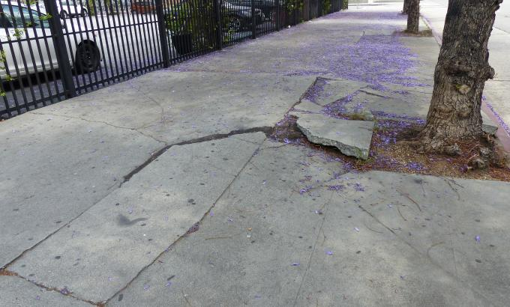
Project Background
BOE maintains approximately 11, 360 miles of sidewalks
Uneven sidewalk – did not settle evenly, tree-root growth, and decay
Pedestrian hazards
Comply with Federal American Disability Act (ADA) standards
BOE staffs measure sidewalk slope by manual level-measuring tools.

Slide 24
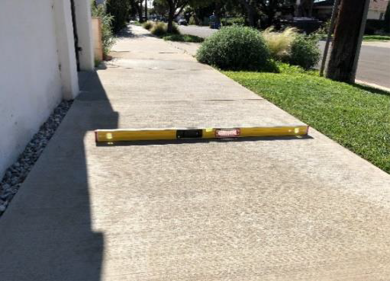
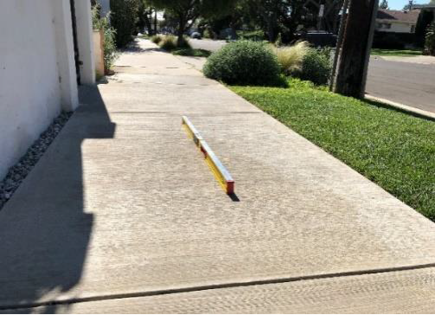
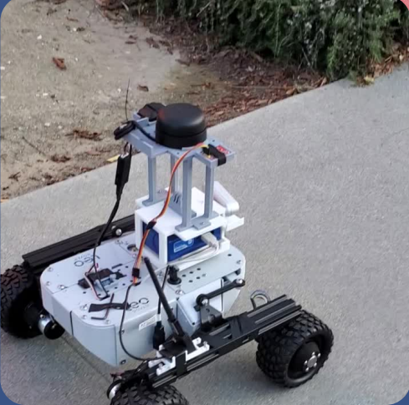
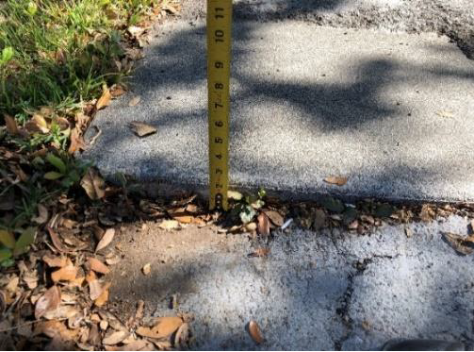
Sample Project : Bureau of Engineering Sidewalk Assessment Rover

Slide 25
Research Opportunities

Slide 26
THANK YOU!

