Slide 1
Computer Science Groups Advisement for Pre-CS and Undeclared
Department Chair: Dr. Eun-Young (Elaine) Kang
Faculty Advisors: Dr. Raj S. Pamula & Dr. Zilong Ye
ECST Academic Advisor: Evelyn Crosby
Department Coordinator: Valentina Ovasapyan
Notes:
1

Slide 2
Student Handbook
https://www.calstatela.edu/sites/default/files/groups/Department%20of%20Computer%20Science/undergraduate_student_handbook_fall2021.pdf
Curriculum requirement
Pre-requisite flowchart
Roadmap template
Spend around 20 minutes to read it, and it will be very helpful

Slide 3
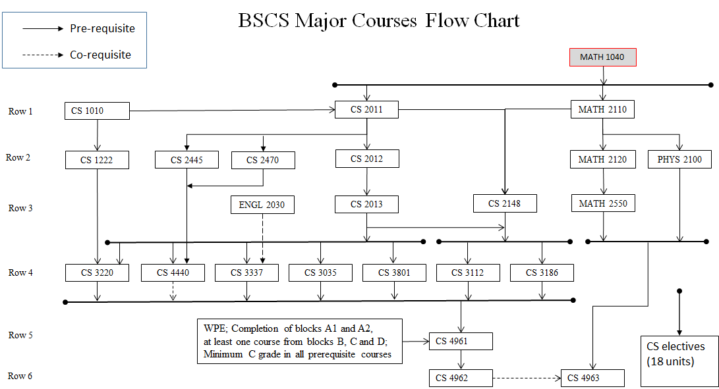

Slide 4
Academic Requirement on GET
Login to GET
Go to `academic requirement`
Green color (complete)
Yellow color (currently enrolled)
Blue color (planned)
Red color (missing)
How to fix these red blocks?
Petition or ARS for the transfer credit
Degree planner

Slide 5
Degree Planner
How to use degree planner?
https://www.youtube.com/watch?v=wt-Lqw1r6Po
Use student handbook and follow the roadmap template to plan for your future courses.
Check `advising report planned` on GET to make sure there is no red block

Slide 6
Course Planning and Time Management
Full time student = Full time job
15 units (5 courses) = 40 hours (or more)/week
Minimum course commitment = 40/5 = 8 hours/week
Each course scheduled time:
Lecture only – Scheduled for 3 hours/week
Lecture/Lab – Scheduled for 5 hours/week
Each course extra study time
5 hours/week

Slide 7
Transfer Credit, Petition Forms and Office Hours
Transfer credit
Login to MyCSULA portal
Go to GET
Check your transfer credit report
Meet an advisor to submit ARS request
Forms
CS department homepage -> advising resources -> forms https://www.calstatela.edu/ecst/cs/forms
Office hours:
https://www.calstatela.edu/ecst/cs/cs-faculty-advising-and-office-hours

Slide 8
Q&A
www.calstatela.edu/cs
8
Notes:
8

